Slide 1
LANGUAGE TRANSLATOR
Jagani Krupesh A.
It-029
Jayswal tirth B.
It-030

Slide 2
LANGUAGE DESCRIPTION
Our Language can be used for conversion of one memory storage unit to another.
To get output user needs to write “give me conversion of _____ to _____ of Number”.
For example, If user wants to find that 1024 Bytes is equal to how many Kilobytes. So the user needs to write “give me conversion of byte to kilobyte of 1024”.
The all possible inputs and their outputs are shown in next slides.

Slide 3
COMPILATION
The compilation steps are written below.
bison -d mylang.y
flex mylang.l
gcc lex.yy.c mylang.tab.c -o mylang.exe -w

Slide 4
Mylang.l
%{
#include<stdio.h>
#include "./mylang.tab.h"
%}
%%
[0-9]+ {
yylval.integer=atoi(yytext);
return NUMBER;
}
[0-9]*\.[0-9]+ {
yylval.real=(float)atof(yytext);
return FLOAT;
}
give {return give;}
me {return me;}
conversion {return conversion;}
of {return of;}
to {return to;}
megabyte {return megabyte;}
gigabyte {return gigabyte;}
byte {return byte;}
kilobyte {return kilobyte;}
[\n] {return yytext;}
[/t] ;
%%
int yywrap(){return 1;}

Slide 5
Mylang.y
%{
#include<stdio.h>
#include<math.h>
extern FILE *yyin;
#define PI 3.14
#define CONST 1.33
#define CONST1 0.33
%}
%union{
int integer;
float real;
}
%token <integer> NUMBER <real> FLOAT
%token give me conversion of to byte kilobyte megabyte gigabyte end
%type <real> S E U F X Q

Slide 6
Mylang.y
%%
//ResultExpression:S{printf("Your Answer is %f",$$);};
S:end {printf("Exit");return 0;}
|give me conversion of E{$$=$5;};
E: byte to X {$$=$3;}
|kilobyte to U {$$=$3;}
|megabyte to F {$$=$3;}
|gigabyte to Q {$$=$3;}
;
X: kilobyte of NUMBER {$$=$3/pow(2 , 10); printf("Kilobyte of %d is %f\n",$3,$$);};
|megabyte of NUMBER {$$=$3/pow(2 , 20); printf("Megabyte of %d is %f\n",$3,$$);};
|gigabyte of NUMBER {$$=$3/pow(2 , 30); printf("Gigabyte of %d is %f\n",$3,$$);};
U: byte of NUMBER {$$=$3*pow(2 , 10); printf("Byte of %d is %f\n",$3,$$);};

Slide 7
Mylang.y
|megabyte of NUMBER {$$=$3/pow(2 , 10); printf("Megabyte of %d is %f\n",$3,$$);};
|gigabyte of NUMBER {$$=$3/pow(2 , 20); printf("Gigabyte of %d is %f\n",$3,$$);};
F: byte of NUMBER {$$=$3*pow(2 , 20); printf("Byte of %d is %f\n",$3,$$);};
|kilobyte of NUMBER {$$=$3*pow(2 , 10); printf("Kilobyte of %d is %f\n",$3,$$);};
|gigabyte of NUMBER {$$=$3/pow(2 , 10); printf("Gigabyte of %d is %f\n",$3,$$);};
Q: byte of NUMBER {$$=$3/pow(2 , 30); printf("Byte of %d is %f\n",$3,$$);};
|kilobyte of NUMBER {$$=$3/pow(2 , 20); printf("Kilobyte of %d is %f\n",$3,$$);};
|megabyte of NUMBER {$$=$3/pow(2 , 10); printf("Megabyte of %d is %f\n",$3,$$);};

Slide 8
Mylang.y
%%
void yyerror(const char *s) {
}
char* main(int argc, char *argv[])
{
int i;
for(i=0;i<5;i++){
yyparse();}
return 0;
}

Slide 9
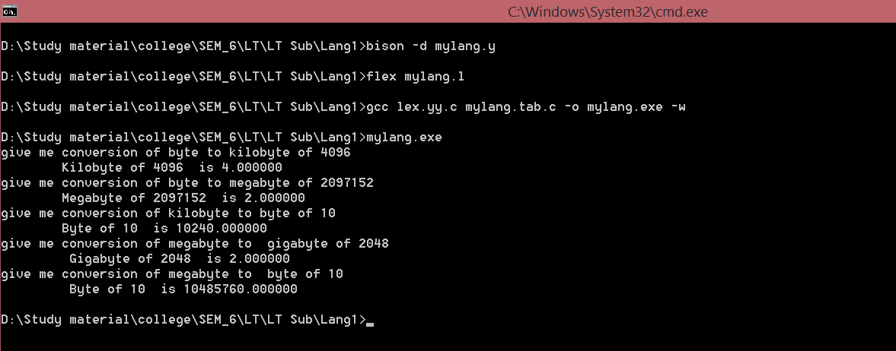
Output

