Slide 1
E-Commerce website

Slide 2
Project Aim
Our Aim is to facilitate user about detail of sales going on online stores so that they don’t goanna missed it and it also help admin to put sales at specific time on his product so that it will be easier for user and it is also available at much cheaper rate as compared to other plugin of same functionality. The user interface is also quite friendly and admin can easily understand each and every function while making changes in the product. Updates will be provided to admin in every six month and there will be no charges for updating as well as installation and 6th month free support

Slide 3
Project Objectives:
The objective of the project is to make a website which includes a web plugin from where the user will be able to install it without any problems. We are going to provide a complete as well as efficient website to users from where they will be able to get our Extension easily

Slide 4
Scope
Ecommerce website scope of work defines the project purpose, deliverables, and major known risks and constraints. It lays out the basic information to start an ecommerce business and is less detailed than a project plan.

Slide 5
Summary
Our project is basically based on Web plugin of WordPress. The main aim is to facilitate the user wherever possible. We are going to combine two different small plugin including (Product sold counter, Counter countdown) which include product sold counter and sales timer.

Slide 6
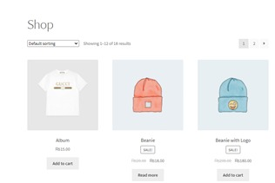

Front Layout for sale counter
Shop Page
Product Page

Slide 7
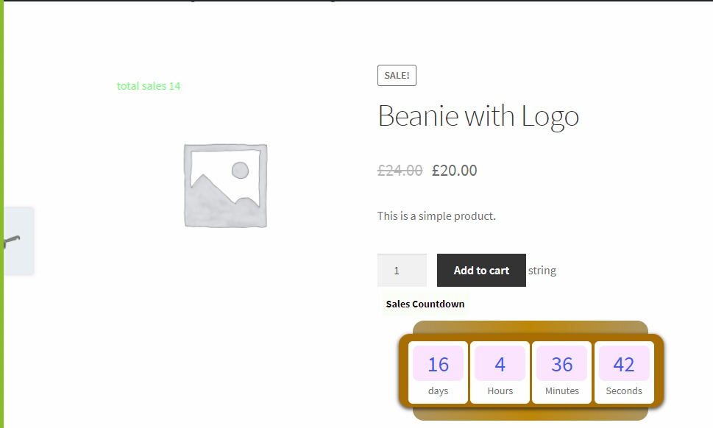
Front layout for counter countdown
Shop Page

Slide 8
Product Functionality
SALES COUNTER will be displayed on six position based on admin choice on a single product page and shop page,
1.Top left on image.
2.Top right on image.
3.Before product title
4.After product title
5.After product price
6.After add to cart button.

Slide 9
Admin can give styling to their content.
Admin can add sale count while having physical store.
There will be checkboxes for product page and shop page to show sales count.
Customized text will be shown on given position.
Admin can hide sales count for particular product.
There will be check box for admin to hide sale count of out of stock product.
Customized text which shows on out of stock product on shop page.
Short code for admin to show sale count at any position on product page.

Slide 10
For counter countdown it will perform the following task:
. The main function is to show details about sales that how much time (including the number of days) remaining of a specific product. This counter will only show on a product that is available on sales.
Admin can also change counter background color including change in design, style as well as layout.

Slide 11
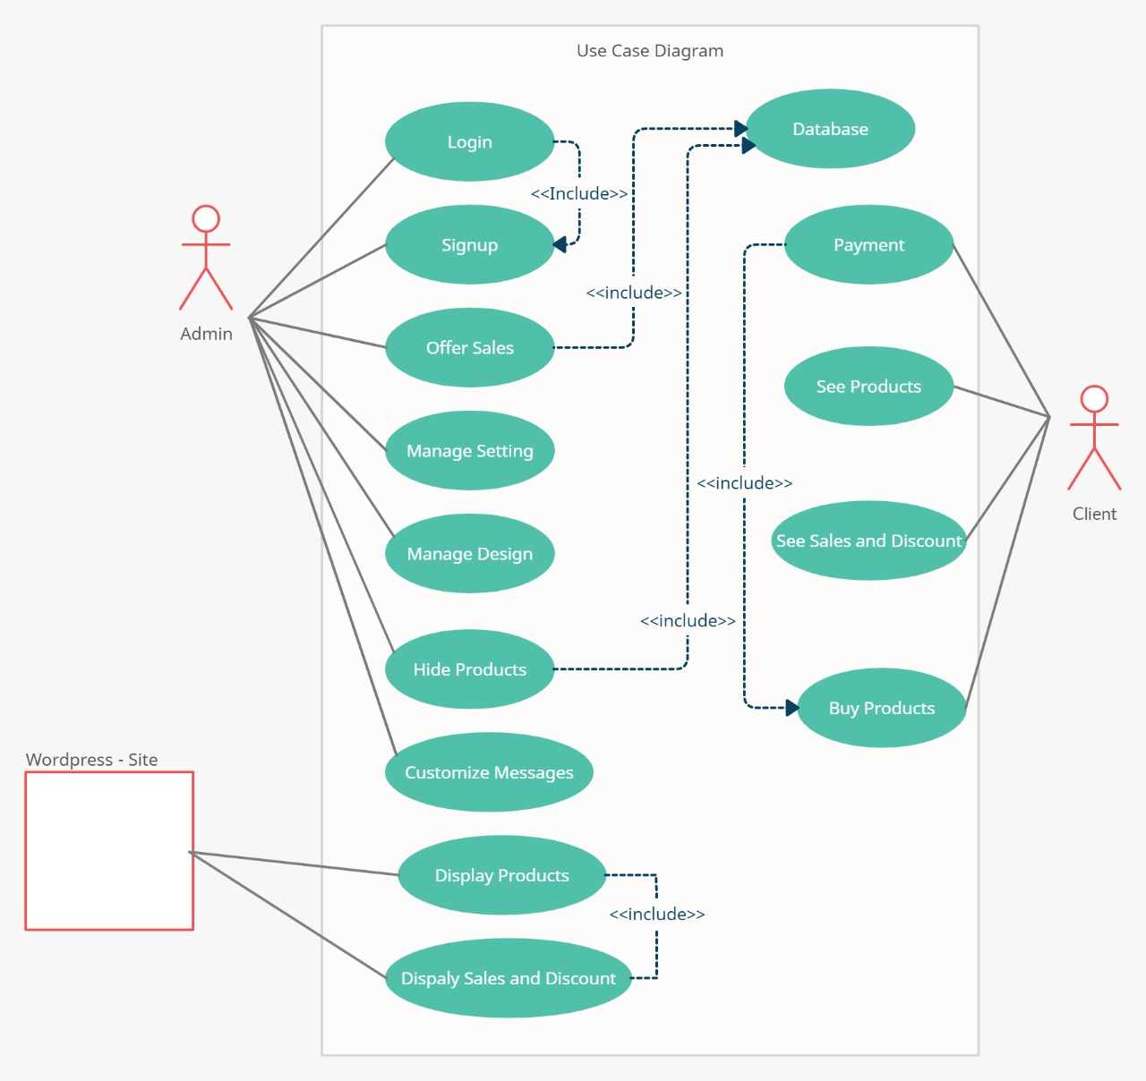
Diagram

Slide 12
Hardware Requirement
Laptop
Software/Tools Requirement
Xammp Server
Proposed Implementation Language(s)
Html
CSS
JavaScript
Database

Slide 13
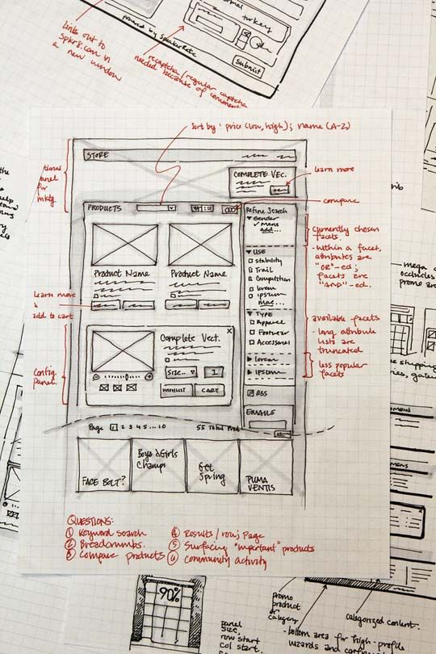

REfferences

Slide 14
Conclusion
Many of the business are converted in to online system. So these business need website that identify them. So the owner of the website need some extra functionality to enhance their business and can engage customer to their website to generate more sales.
The main issue that the website owner face is that how to manage each sales of his business product while there’s thousands of transactions are there.
Similarly, they also need some more functionality as we have provided like website owner can show sales that he want to put on specific product so that customer get the same environment while shopping from e-commerce store as he feel in the market.

