Slide 1
The Challenge & Our Answer
India's heritage is fragmented. Astrova connects the dimensions into one journey.
THE PROBLEM
ASTROVA'S SOLUTION
WHY ASTROVA IS DIFFERENT
Scattered Information
One Heritage Platform
ASTROVA CONNECTS HERITAGE DIMENSIONS
Places + History + People/Culture + Media + Sources + Relationships + Collections + Personal Exploration
• Heritage data spread across government sites, wikis, and unstructured sources
• Structured database of heritage entities with metadata, media, sources, and relationships
No Geographic Context
Map-Based Discovery
Places
History
Culture
Media
• Difficult to explore heritage locations and understand regional connections
• Interactive Leaflet/OpenStreetMap exploration with heritage markers and location context
Sources
Relations
Collections
Personal
ASTROVA
FRAGMENTED → CONNECTED
Missing Relationships
Connected Knowledge
• No way to see how places, periods, people, and traditions are interconnected
• Heritage linked to places, periods, people, media, sources — visible as relationships
Hard Discovery
Search & Filtering
• No unified search, filtering, or personalized exploration for Indian heritage
• Full-text search, suggestions, state/category filters for efficient discovery
Language Barriers
Personal Exploration
• Information mostly in English; limited multilingual access for diverse audiences
• Authenticated favorites, curated collections, timeline view for personalized journeys
ASTROVA · Smart India Hackathon 2026
1 / 6

Slide 2
Technical Architecture
Full-stack system: Next.js frontend → API proxy → Express backend → Neon PostgreSQL
USER / ADMIN
MAP / LOCATION
↓
DISCOVERY FEATURES
NEXT.JS FRONTEND
Leaflet.js
OpenStreetMap Tiles
54 Locations
• Full-text Search & Suggestions
• State/Category Filtering
• Curated Collections
• User Favorites
• Historical Timeline
• Heritage Relationships (49 connections)
↓
API PROXY / GATEWAY
↓
SECURITY
EXPRESS.JS BACKEND
AI / CHATBOT
• JWT + HttpOnly Cookie
• Role-Based Access (RBAC)
• API Key Protection
• CORS Configuration
• Rate Limiting
• Timing-Safe Comparison
↓
Multilingual AI Chatbot
Architecture preserved • 107 knowledge records
SERVICES / LOGIC
↓
UNDER CONSTRUCTION
NEON POSTGRESQL
DATA FLOW
COLLECT
→
NORMALIZE
→
VERIFY
→
STORE
→
SERVE
→
EXPLORE
TECH STACK
Next.js
React
TypeScript
Tailwind CSS
Express.js
Node.js
Neon PostgreSQL
Leaflet.js
OpenStreetMap
ASTROVA · Smart India Hackathon 2026
2 / 6

Slide 3
Feasibility & Viability
Built with proven technologies today. Designed to grow tomorrow.
FEASIBLE TODAY
VIABLE TOMORROW
✓ Open Technologies
Next.js, React, TypeScript, Express.js, PostgreSQL — mature, well-documented, free
✓ Public Data Sources
Indian Culture, Incredible India, UNESCO, National Archives — credible, accessible
✓ Working Prototype
Full-stack heritage platform with 74 entities, 54 locations, 72 media records
✓ Modular Architecture
Layered system — each module independently extensible
✓ Reasonable Deployment
Neon PostgreSQL (serverless), Vercel/Node hosting — low maintenance
→ More Heritage Data
Scale from 74 to thousands of heritage entities across India
→ More Indian Languages
Expand from current multilingual support to all 22 scheduled languages
→ Education Use
Curriculum-aligned heritage modules for schools and universities
→ Tourism Integration
Travel planning, nearby heritage discovery, guided exploration
→ Research & Institutions
Academic collaboration, data APIs, cultural research support
RISK MITIGATION
DATA ACCURACY
DIVERSE HERITAGE DATA
PERFORMANCE
AI RELIABILITY
SECURITY & MAINTENANCE
↓
↓
↓
↓
↓
Trusted sources + verification workflow
Structured schema, modular data model
Pagination, optimized queries, serverless DB
Source-grounded knowledge, human review
JWT auth, RBAC, rate limiting, monitoring
Feasible to build today. Viable to grow tomorrow.
ASTROVA · Smart India Hackathon 2026
3 / 6

Slide 4
Impact & Benefits
STUDENTS
Who benefits from Astrova — and why it matters.
IMPACT DIMENSIONS
EDUCATIONAL
ASTROVA
• Interactive learning
• Maps & timelines
• Contextual stories
RESEARCHERS
TOURISTS
CULTURAL
• Awareness building
• Visibility for traditions
• Lesser-known heritage
TOURISM
COMMUNITIES
• Discover heritage sites
• Historical context
• Nearby exploration
INSTITUTIONS
SOCIAL
• Local traditions
• Crafts & arts
• Cultural contributions
DIGITAL
5 KEY BENEFITS
• Connected knowledge base
• Structured heritage data
• Accessible discovery
1
Easy Discovery
2
Connected Knowledge
3
Geographic Exploration
4
Personalized Experience
5
Reliable Information
Search, filter, explore
Relationships between heritage
Interactive map experience
Favorites & collections
Source-aware, verified data
ASTROVA · Smart India Hackathon 2026
4 / 6

Slide 5
Research & References
Astrova is grounded in credible research and official Indian heritage sources.
RESEARCH INSIGHTS
OFFICIAL REFERENCES
1
Heritage Fragmentation
Motivates unified platform
Indian Culture
Heritage information is distributed across multiple government sources, wikis, and unstructured databases
Ministry of Culture
indianculture.gov.in
2
Structured Systems Needed
Drives Astrova's data model
There is a recognized need for structured cultural heritage information systems that connect related data
Incredible India
3
GIS for Heritage
Powers map discovery
Ministry of Tourism
Geographic Information Systems support cultural heritage exploration by linking places to context
incredibleindia.gov.in
4
Digital Discovery
Validates web-first approach
UNESCO ICH
Digital platforms can significantly improve heritage discovery and tourism engagement
Intangible Cultural Heritage
ich.unesco.org/en
5
Multilingual Access
Drives language support
Multilingual and connected digital access can improve accessibility for diverse populations
National Archives
Government of India
CURRENT DATABASE STATISTICS
nationalarchives.nic.in
74
54
9
72
49
12
Heritage Entities
Locations
Historical Periods
Media Records
Heritage Relationships
Supported States
ASTROVA · Smart India Hackathon 2026
5 / 6

Slide 6
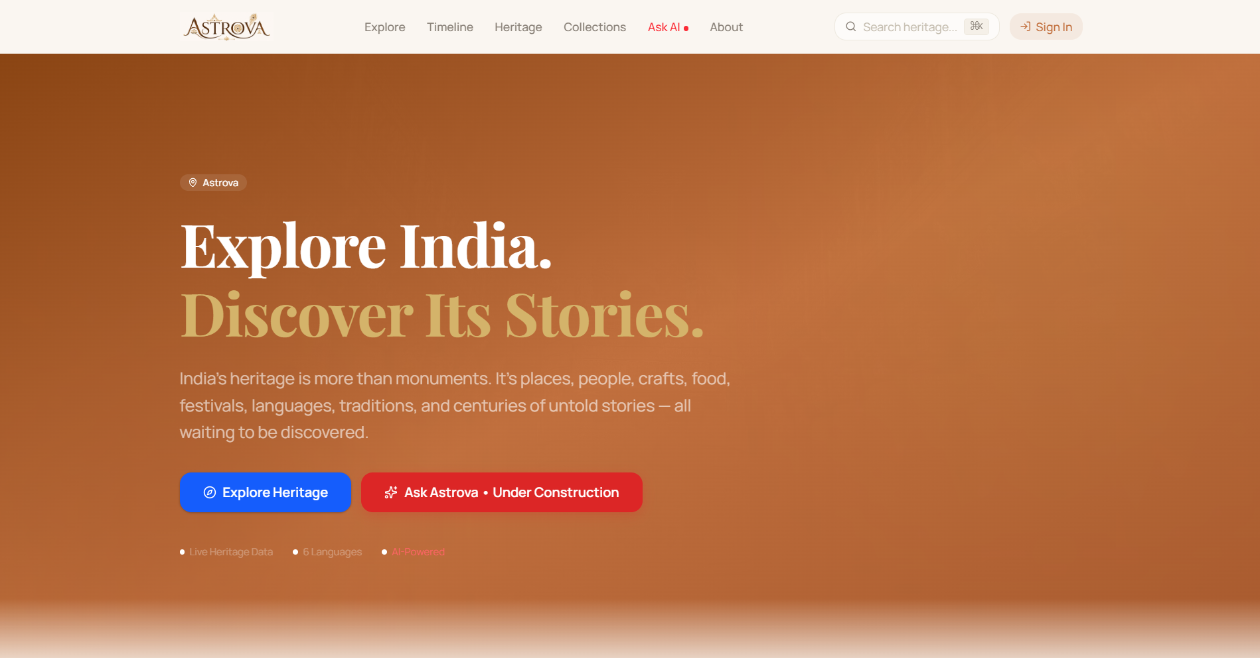
Working Prototype & Future Roadmap
A working, database-connected heritage platform — and a clear path forward.
IMPLEMENTED FEATURES
✓ Heritage discovery & details
✓ Search & filtering
✓ Interactive map (Leaflet + OSM)
✓ Connected heritage relationships
✓ Media & source management
✓ Collections & favorites
✓ Historical timeline
✓ Admin content portal
✓ Secure JWT authentication
AI / CHATBOT · UNDER CONSTRUCTION
FUTURE ROADMAP
01
02
03
04
05
06
07
Expand data coverage
More Indian languages
Community contributions
Mobile application
Educational integration
Advanced AI experiences
Global outreach
Preserve today. Inspire tomorrow.
ASTROVA · Smart India Hackathon 2026
6 / 6

