Slide 1
ASTROVA connects heritage dimensions into one exploration journey
FRAGMENTED SOURCES
CONNECTED HERITAGE
• Heritage data spread across government portals
• Structured database of heritage entities
• Difficult to explore heritage location context
• Interactive Leaflet/OpenStreetMap exploration
• No way to see how places, periods, people connect
• Connected relationships across heritage data
• No unified search, filtering, or personalization
• Full-text search, collections, and timeline
• Information mostly in English; limited accessibility
• Multilingual design toward broader support
KEY DIMENSIONS
Places
History
People & Culture
Media
Sources
Relationships
Collections
Exploration
FRAGMENTED SOURCES
→
CONNECTED HERITAGE
→
ONE EXPLORATION JOURNEY

Slide 2
TECHNICAL APPROACH
USER / ADMIN
SECURITY
NEXT.JS FRONTEND
• JWT + HttpOnly Cookie • RBAC • API Key • Rate Limiting
MAP
API PROXY / GATEWAY
Leaflet.js OpenStreetMap 54 Locations
EXPRESS.JS BACKEND
SERVICES / LOGIC
AI
DISCOVERY
Multilingual Chatbot UNDER CONSTRUCTION
NEON POSTGRESQL
Search, Filtering Timeline, Collections Favorites, Relationships
TECHNOLOGY STACK
Next.js
React
TypeScript
Tailwind
Express.js
Node.js
Neon PostgreSQL
Leaflet.js

Slide 3
FEASIBILITY & VIABILITY
FEASIBLE TODAY
VIABLE TOMORROW
✓ Existing and open technologies
→ More heritage data
✓ Trusted/public data sources
→ More states
✓ Working prototype
→ More languages
✓ Modular architecture
→ Education
→ Tourism
✓ Reasonable maintenance path
→ Research
→ Institutional collaboration
RISK → MITIGATION
DATA ACCURACY
DATA SCALE
PERFORMANCE
AI / MULTILINGUAL
SECURITY
Trusted sources + verification
Structured schema + updates
Optimized queries + pagination
Source-grounded responses
Auth + Authorization + APIs
Feasible to build today. Viable to grow tomorrow.

Slide 4
IMPACT & BENEFITS
EDUCATIONAL
CULTURAL
TOURISM
Interactive learning
Awareness + visibility
Context-rich discovery
SOCIAL
DIGITAL
LONG-TERM
Visibility for communities
Structured heritage knowledge
Preservation + scalable docs
WHO BENEFITS
Students
Researchers
Tourists
Heritage Enthusiasts
Local Communities
Govt & Institutions
KEY BENEFITS
Easy Discovery
Connected Knowledge
Geographic Exploration
Personalized Experience
Reliable Information
Search, filter, explore
Relationships, timeline
Interactive map
Favorites, collections
Trusted sources, admin review

Slide 5
RESEARCH & REFERENCES
RESEARCH INSIGHTS
OFFICIAL REFERENCES
• Heritage info is distributed across multiple sources.
Indian Culture — Ministry of Culture
https://www.indianculture.gov.in/
• Structured systems improve organization.
Incredible India — Ministry of Tourism
• GIS strengthens geographic exploration.
https://www.incredibleindia.gov.in/
• Digital platforms improve discovery and engagement.
UNESCO ICH — Intangible Cultural Heritage
• Multilingual access broadens accessibility.
https://www.ich.unesco.org/
National Archives — Govt of India
https://www.nationalarchives.nic.in/
Source: Astrova project database package, Sep 2026

Slide 6
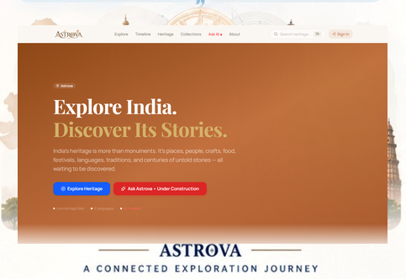
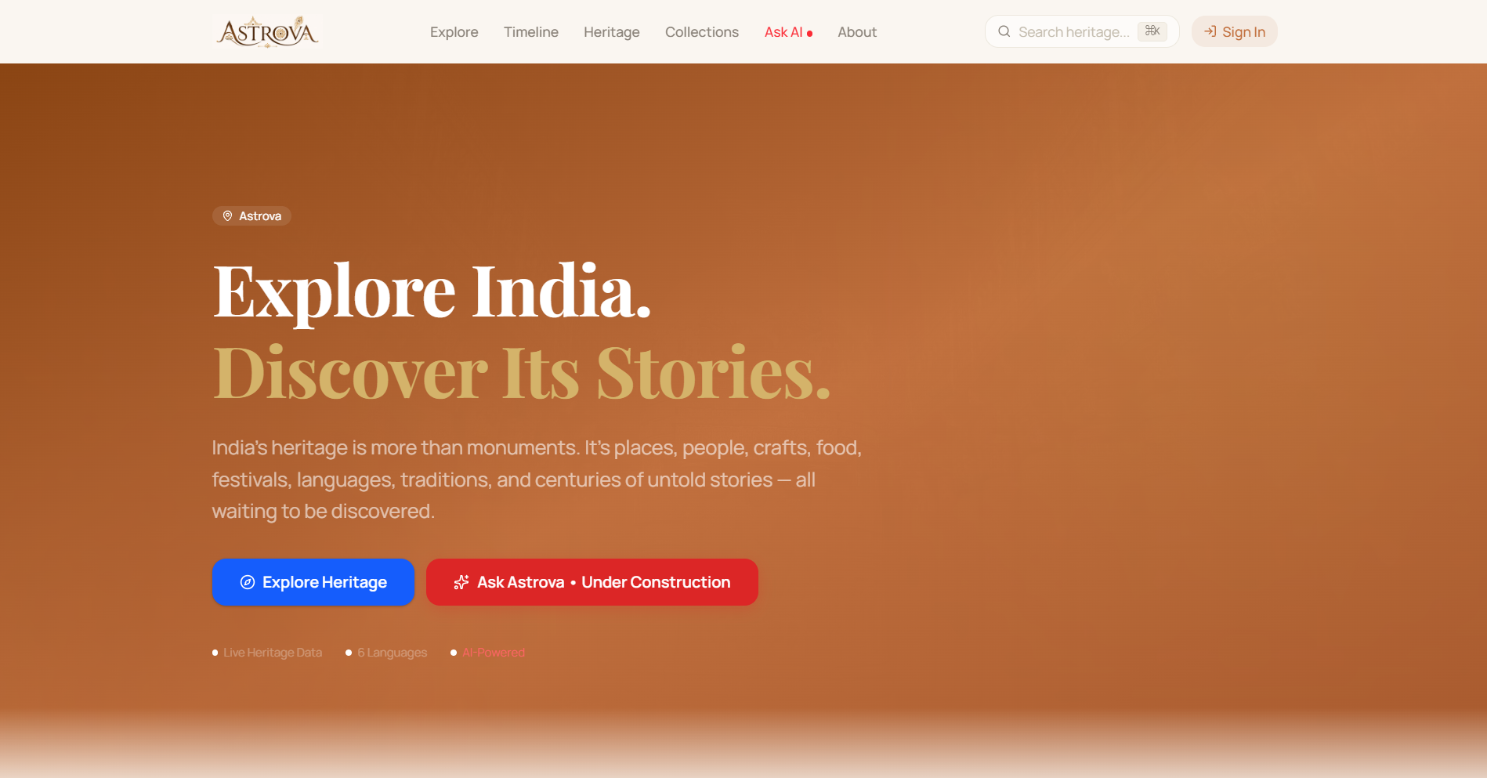
WORKING PROTOTYPE & FUTURE ROADMAP
IMPLEMENTED FEATURES
ROADMAP
✓ Heritage discovery
01 Expand data coverage
✓ Search & filtering
02 More Indian languages
✓ Interactive map
03 Community contributions
✓ Connected heritage info
04 Mobile application
✓ Media & sources
✓ Collections / favorites
05 Education integration
✓ Timeline
06 Advanced AI experiences
✓ Admin portal
07 Global outreach
✓ Secure authentication
AI / CHATBOT: UNDER CONSTRUCTION
Preserve today. Inspire tomorrow.

