Slide 1
CHANGE MANAGEMENT | ADAPTIVE LEARNING
Adaptive Learning
in Change Initiatives
Instructor: Dr. Longe
PRESENTED BY GROUP B
Basana Khadka
Harathi Katta
Sahithi Chandana Kommineni
Tirumala Raju Killamsetti
Mohammed Aaquil Khan
Raj Kiran Katru
Udayasree Kotapati
Academic • Personal • Professional

Slide 2
INTRODUCTION
1
2
What is
Adaptive
Learning?
Observe
Reflect
Notice what is
actually happening
Understand why
it happened
v
v
The ability to continuously adjust
approach based on real feedback,
new information, and changing
conditions — rather than following
a fixed plan.
3
4
Adjust
Act & Learn
Change your
strategy accordingly
Apply, measure
and repeat

Slide 3
TABLE OF CONTENTS
01
Academic Context
02
Personal Context
03
Professional Context
Narrative Game for Emotional Support
Adaptive Learning in Real Life
Cloud Adoption Challenge
Adaptive Learning Leadership
AI Scenario: Self-Driving Car
AI Scenario (ChatGPT)
Key Takeaways
Adaptive learning in action — across three real-world contexts

Slide 4
01
SECTION ONE
Academic
Context

Slide 5
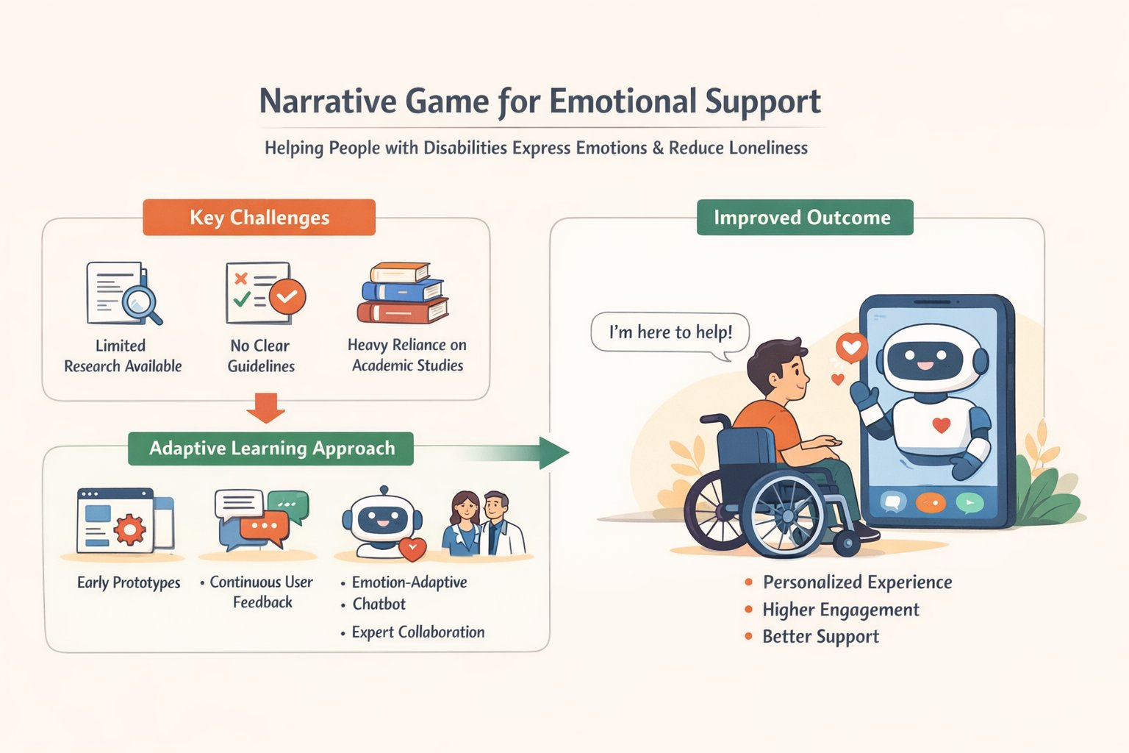
ACADEMIC > Narrative Game for Emotional Support
04
PROJECT SCENARIO
Developed a narrative-based game for people with disabilities
Focus: Help users express emotions & reduce loneliness
Designed as a chatbot-style interactive experience
KEY CHALLENGES
Limited research papers and prior work available
No clear guidelines or frameworks to follow
Heavy reliance on academic research initially
ADAPTIVE LEARNING APPROACH
Develop early prototypes
Design chatbot to adapt based on user emotions
Collaborate with experts (therapists, caregivers, support groups)

Slide 6
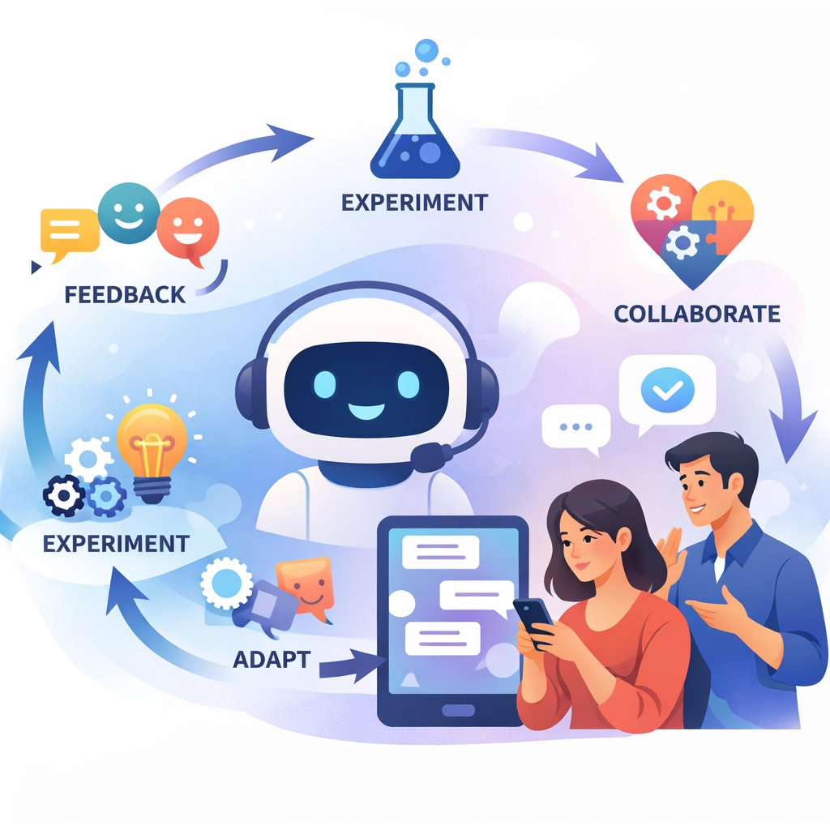
ACADEMIC > Adaptive Learning Leadership
05
AI TOOL
ChatGPT
PROBLEM
Low user engagement
ACTIONS
1
Continuous feedback
2
Experimented with conversation styles
3
Made chatbot adaptive
4
Collaborated with experts
OUTCOME
Personalized experience
Higher engagement
More flexible team

Slide 7
02
SECTION TWO
Personal
Context

Slide 8
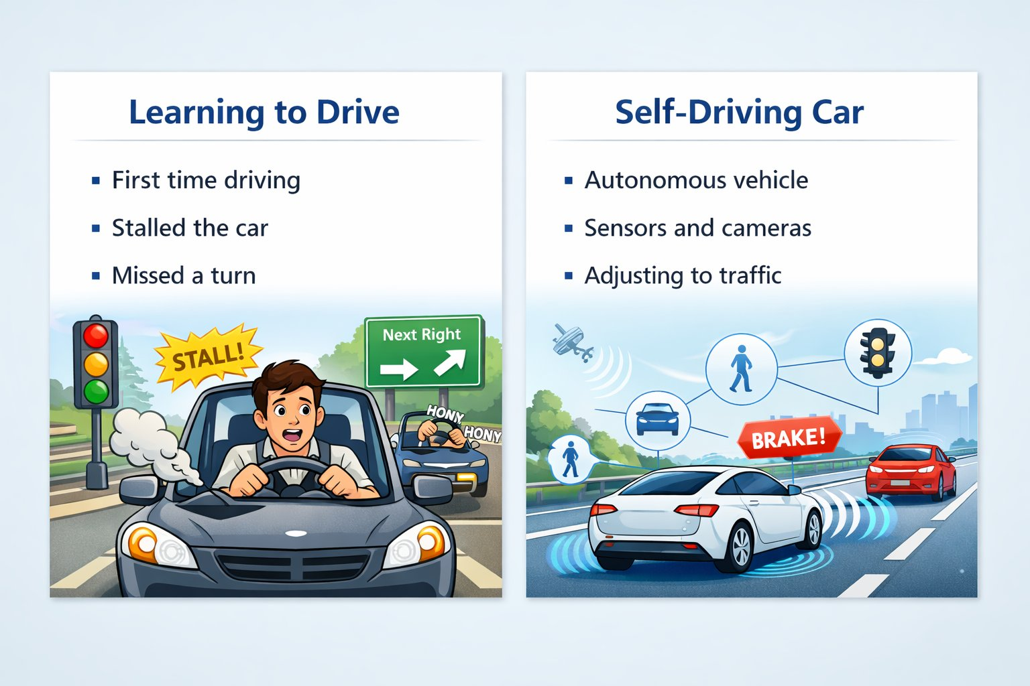
PERSONAL > Adaptive Learning in Real Life
Adaptive Learning in Real Life
Followed rules exactly at the beginning
Expected driving to be predictable
Real-world driving is unpredictable
Needed to observe and adapt
Rules
Reality
Adaptation
Confidence

Slide 9
PERSONAL > AI Scenario: Self-Driving Car
Adaptive Learning in AI Systems
Cannot rely on fixed rules
Roads and conditions constantly change
Learns from data (traffic, obstacles, behavior)
Continuously improves over time
Data
>
Learning
^
v
Feedback
<
Decision
"Whether person or AI — adapting to change leads to better results."

Slide 10
03
SECTION THREE
Professional
Context

Slide 11
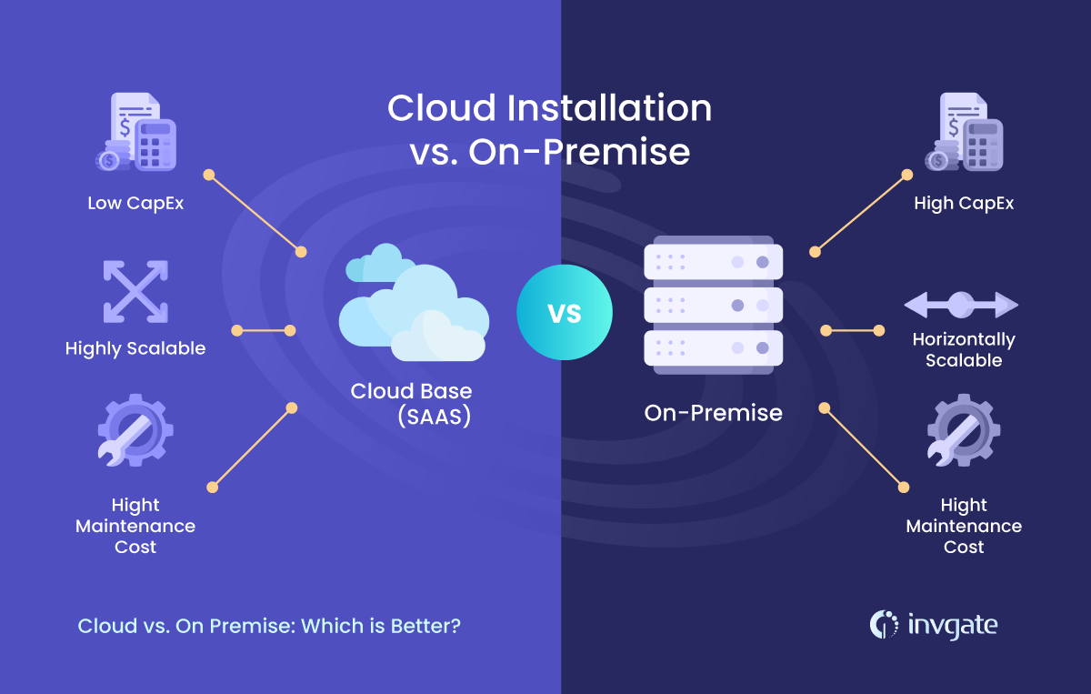
PROFESSIONAL > Cloud Adoption Challenge
SITUATION
On-prem infrastructure → delayed cloud migration
CHALLENGE
Rigid plans caused delays & resistance
ADAPTIVE
Adaptive learning: adjust strategy, train teams
RESULT
Faster adoption, better performance

Slide 12
PROFESSIONAL > AI Scenario
Fixed vs. Adaptive Training
SITUATION
AI system implementation in company
FIXED
ADAPTIVE
Same training for all
Custom per learner
CHALLENGE
Fixed training failed (skill differences)
Ignores skill gaps
Addresses skill gaps
No feedback loop
>
Continuous feedback
ADAPTIVE
Adaptive leader: feedback, custom training
Low confidence
High confidence
RESULT
Better adoption & confidence
Result: Better adoption & confidence

Slide 13
PROFESSIONAL > Key Takeaways
01
Adaptive learning = flexibility
02
Continuous feedback improves success
Adjust strategy based on real conditions, not just the original plan.
Regular check-ins and data loops allow timely course corrections.
03
Helps manage change effectively
04
Use right strategy for changing situations
Adaptive approaches reduce resistance and build team confidence.
No one-size-fits-all — match your method to the context.

Slide 14
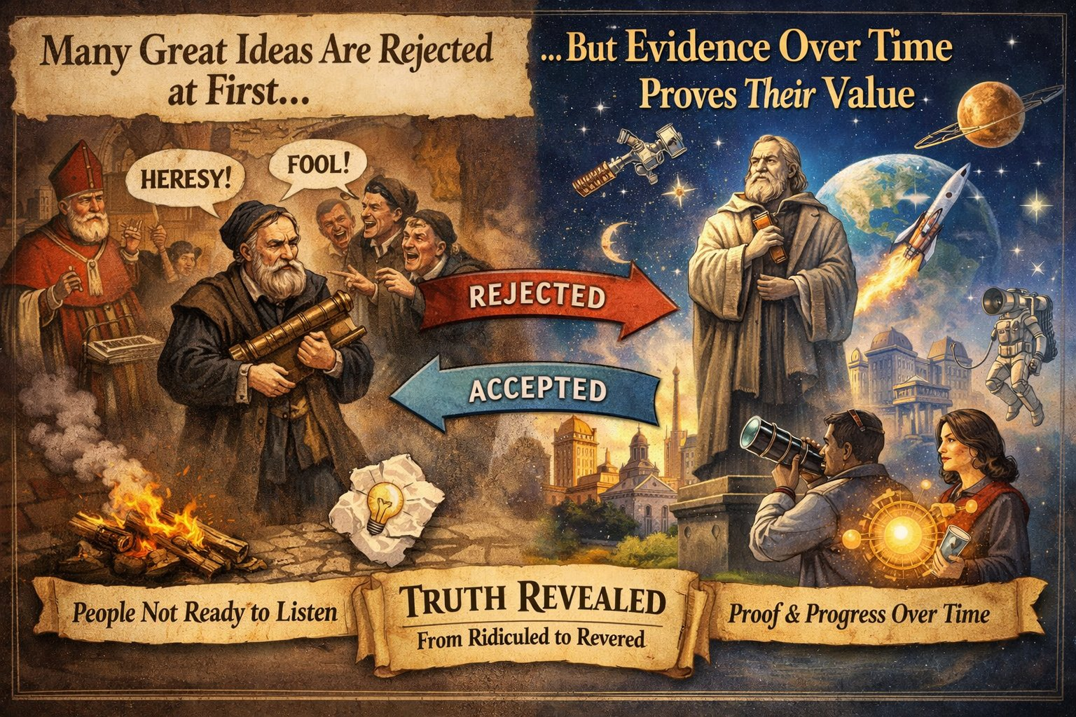
Thank You
Adaptive learning is not a methodology
— it is a mindset.
Questions & Discussion
Academic | Professional | Personal

