Slide 1
AI RESEARCH PAPER ASSISTANT
ResearchForge
BIT4543 Artificial Intelligence
AI Topic: Document Intelligence
researchforge.rukon.dev

Slide 2
Background and motivation
Researchers work with large volumes of academic literature
THE FIRST PASS
Reading and understanding papers manually is slow
For every paper a researcher must decide:
What does it claim?
What does it leave open?
How does it relate to the rest?
Key findings are hard to extract quickly
Research gaps are difficult to identify
Literature reviews require comparison across sources
AI can assist with document understanding
ResearchForge assists this first pass, so effort is spent on the papers that matter.

Slide 3
Problem statement
Slow analysis
Hard to extract
Gaps are hidden
Reading and assessing each paper
takes significant time
Key findings are buried in
long, dense documents
Identifying what a paper leaves
open requires close reading
Review effort
Duplicate AI cost
No structure
Literature reviews need
comparison across sources
Re-analysing the same paper
repeats API calls
Researchers lack a structured
assistance workflow
A general chatbot will answer about a paper it has not read - an unreliable summary is worse than none.

Slide 4
Project objectives
01
Upload research papers
06
Support cross-paper literature review
02
Extract text from PDF papers
07
Provide a usable assistant interface
03
Generate summaries and key findings
08
Secure accounts and private ownership
04
Identify research gaps
09
Reduce duplicate AI processing (cache)
05
Generate literature review content
10
Controlled AI routing and fallback
Objectives 8 to 10 are the engineering that makes the analysis trustworthy, private and affordable.

Slide 5
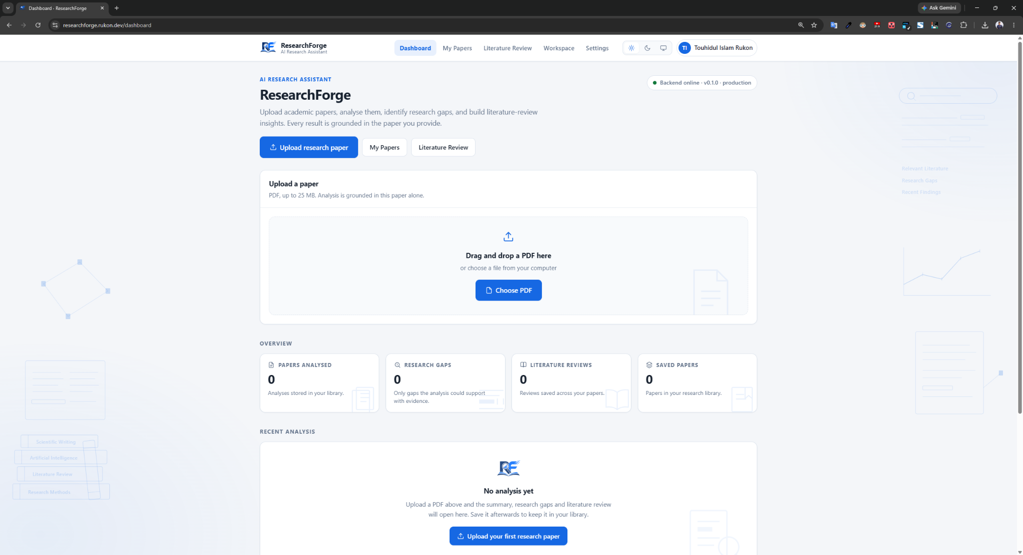
Proposed solution: ResearchForge
Academic
paper (PDF)
Upload
PDF text
extraction
AI analysis
Structured
insights
Summary and key findings
Research gaps
Literature review
Research library
Cross-paper review
Several analysed papers from the user's own library can be reviewed together. The feature requires more than one paper.
Every generated section is constrained to the uploaded document. Where the paper does not support a section, the system reports insufficient evidence.

Slide 6
Methodology
Requirements
System
design
Implementation
AI
integration
Database and
authentication
Testing
Production
verification
Incremental, milestone-based development
Thirteen milestones, each ending with a test and a review before the next began
Design decisions driven by measurement, not assumption
Retrieval was not built after measuring that whole papers fit the model context
Isolation moved into the database after a defect showed application filtering had failed silently
Six additive-only migrations: no DROP, TRUNCATE or DELETE

Slide 7
System architecture
User
Web interface
(Next.js / React)
FastAPI backend
authentication check
PDF extraction,
normalisation, SHA-256 hash
Primary: Groq
qwen/qwen3.6-27b
Analysis cache
lookup
AI provider
router
Schema
validation
Fallback: Anthropic
claude-opus-5
A cache hit returns the stored analysis with no model call. A miss goes to the primary provider, with one fallback attempt permitted for an allowed retryable failure.
Supabase PostgreSQL - Row Level Security
Results filtered by the signed-in user
Prepared scaffolding, not production: Jina embeddings, pgvector and the chunks table exist in the repository but are not called during analysis.
The pipeline is full-document grounded generation, not RAG.

Slide 8
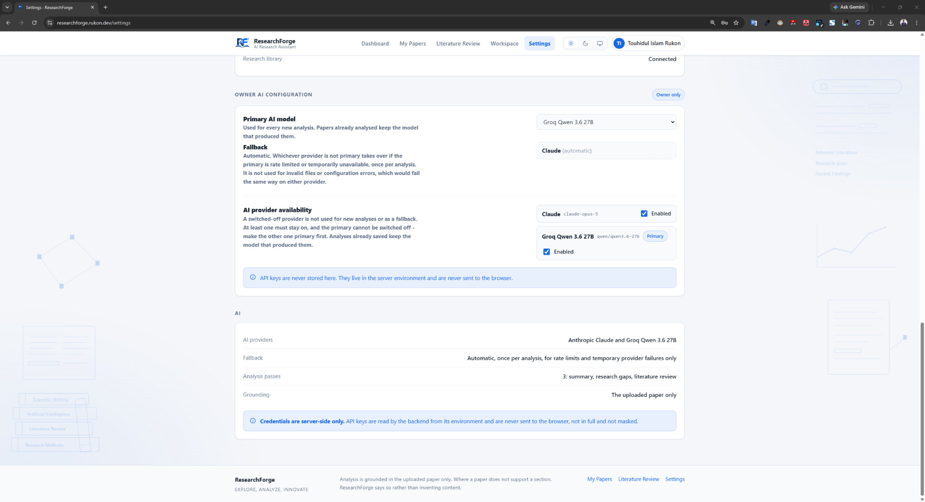
AI model implementation
INFERENCE, NOT TRAINING
CONTROLLED ROUTING
Primary: Groq qwen/qwen3.6-27b
The owner selects one global primary provider; the other enabled provider becomes the fallback.
Normal users cannot switch providers. There is no auto option.
One fallback attempt only, for allowed retryable failures.
Fallback: Anthropic claude-opus-5
Three structured passes: summary, gaps, review
Whole uploaded document supplied as grounding context
Output validated against a declared schema
Invalid output is discarded, never repaired
Provenance recorded: provider, model, fallback, cache

Slide 9
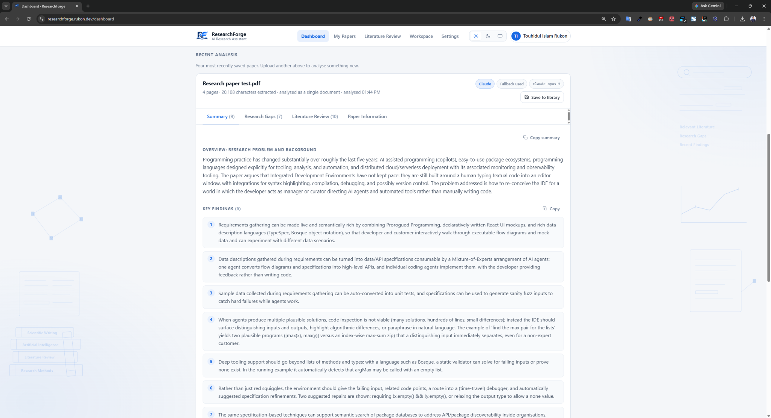
Key system features
PDF upload and text extraction
Scanned documents rejected, not analysed
Structured summary and key findings
Research gaps and stated limitations
Literature review content
Cross-paper review across saved papers
One upload produces summary, key findings, gaps and review
Private per-user research library
Each section is generated from the uploaded document only, and validated against a declared schema before it is stored.

Slide 10
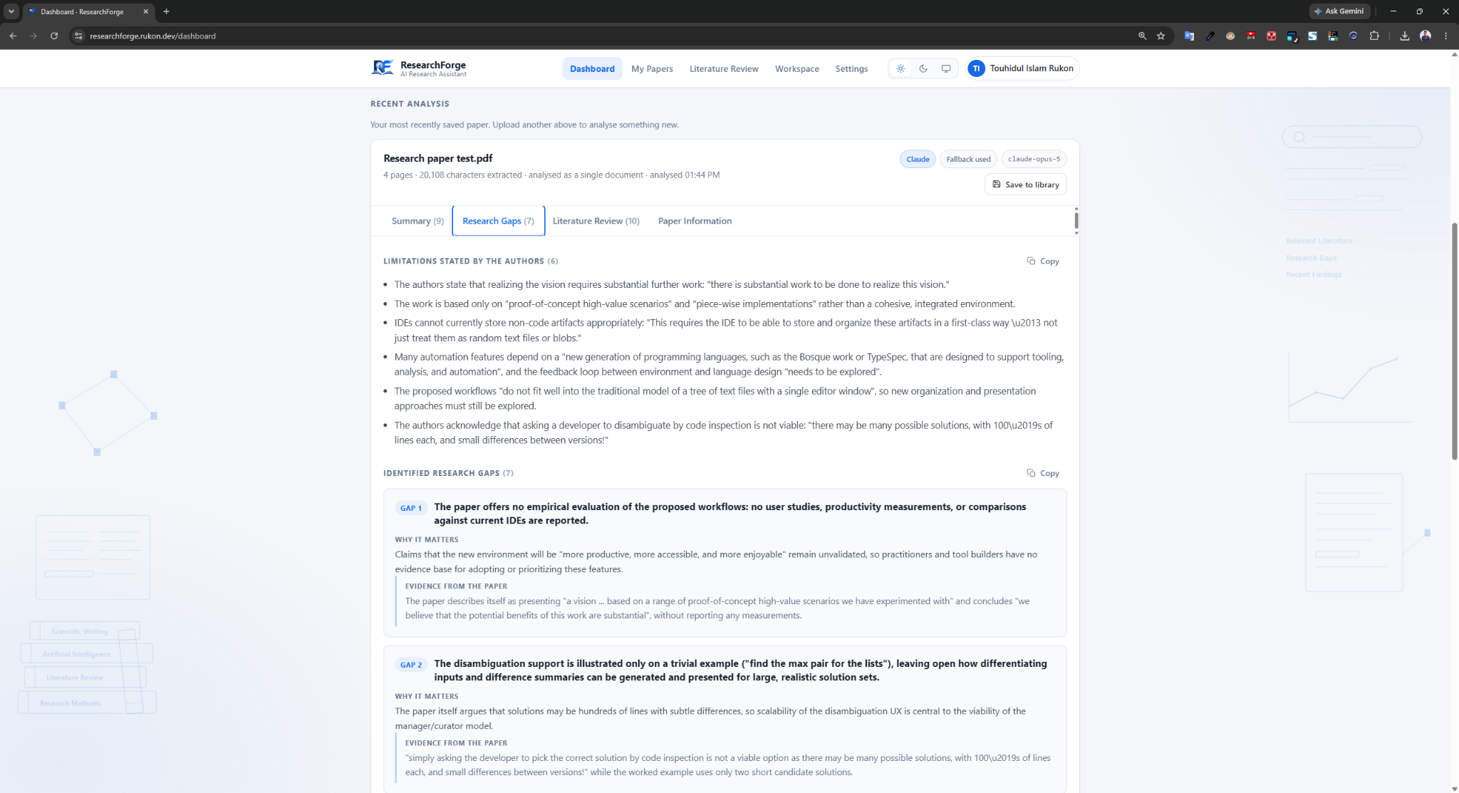
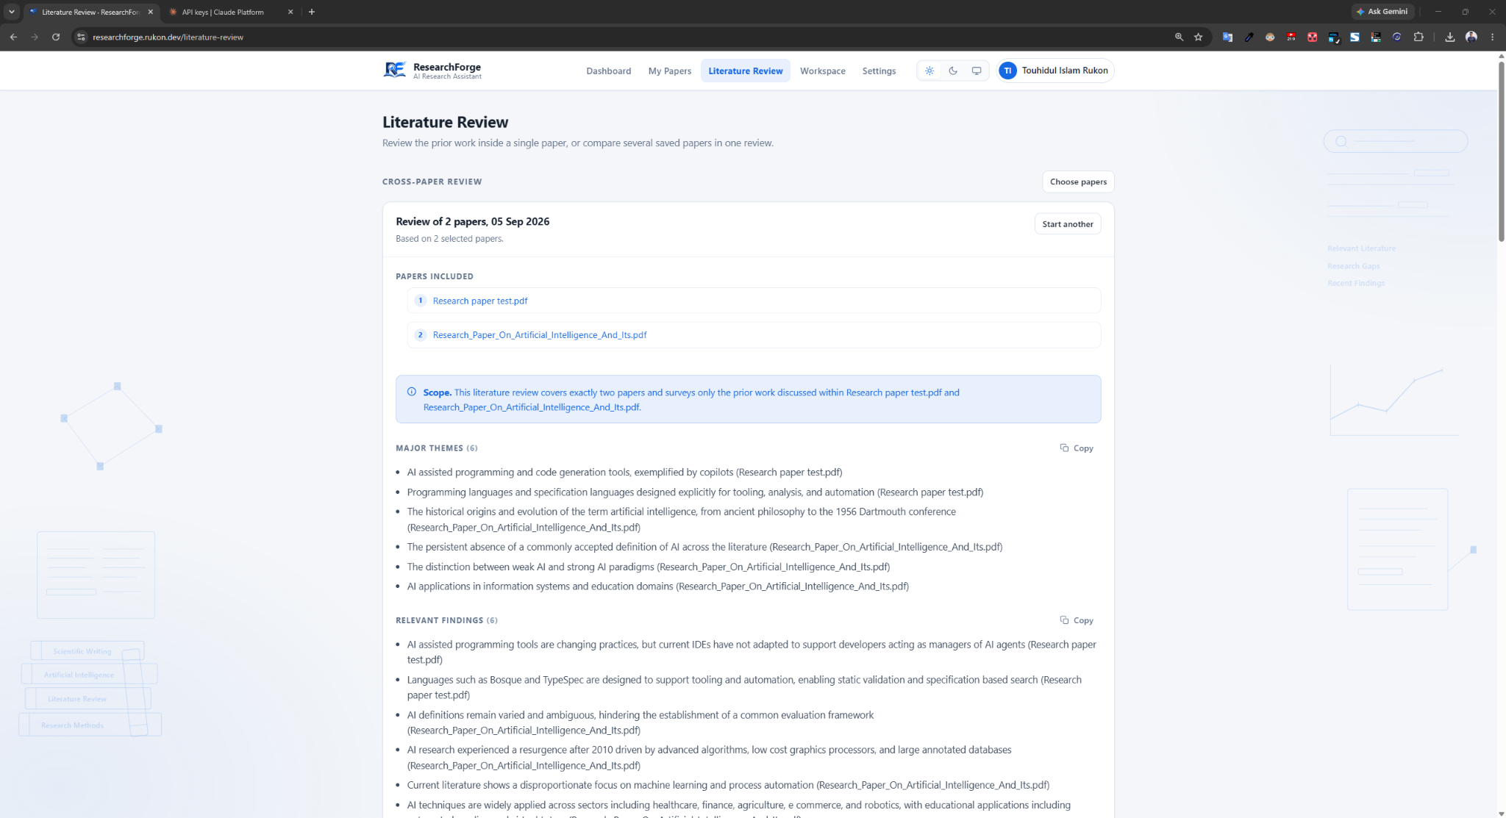
Research gaps and literature review
Research gaps and limitations
Cross-paper literature review
Gaps are drawn from the limitations the authors state and the future work they propose
Literature review content covers themes, comparisons with prior work and future directions
Cross-paper review compares several analysed papers; it requires more than one paper
Where the paper does not support a section, the system reports insufficient evidence

Slide 11
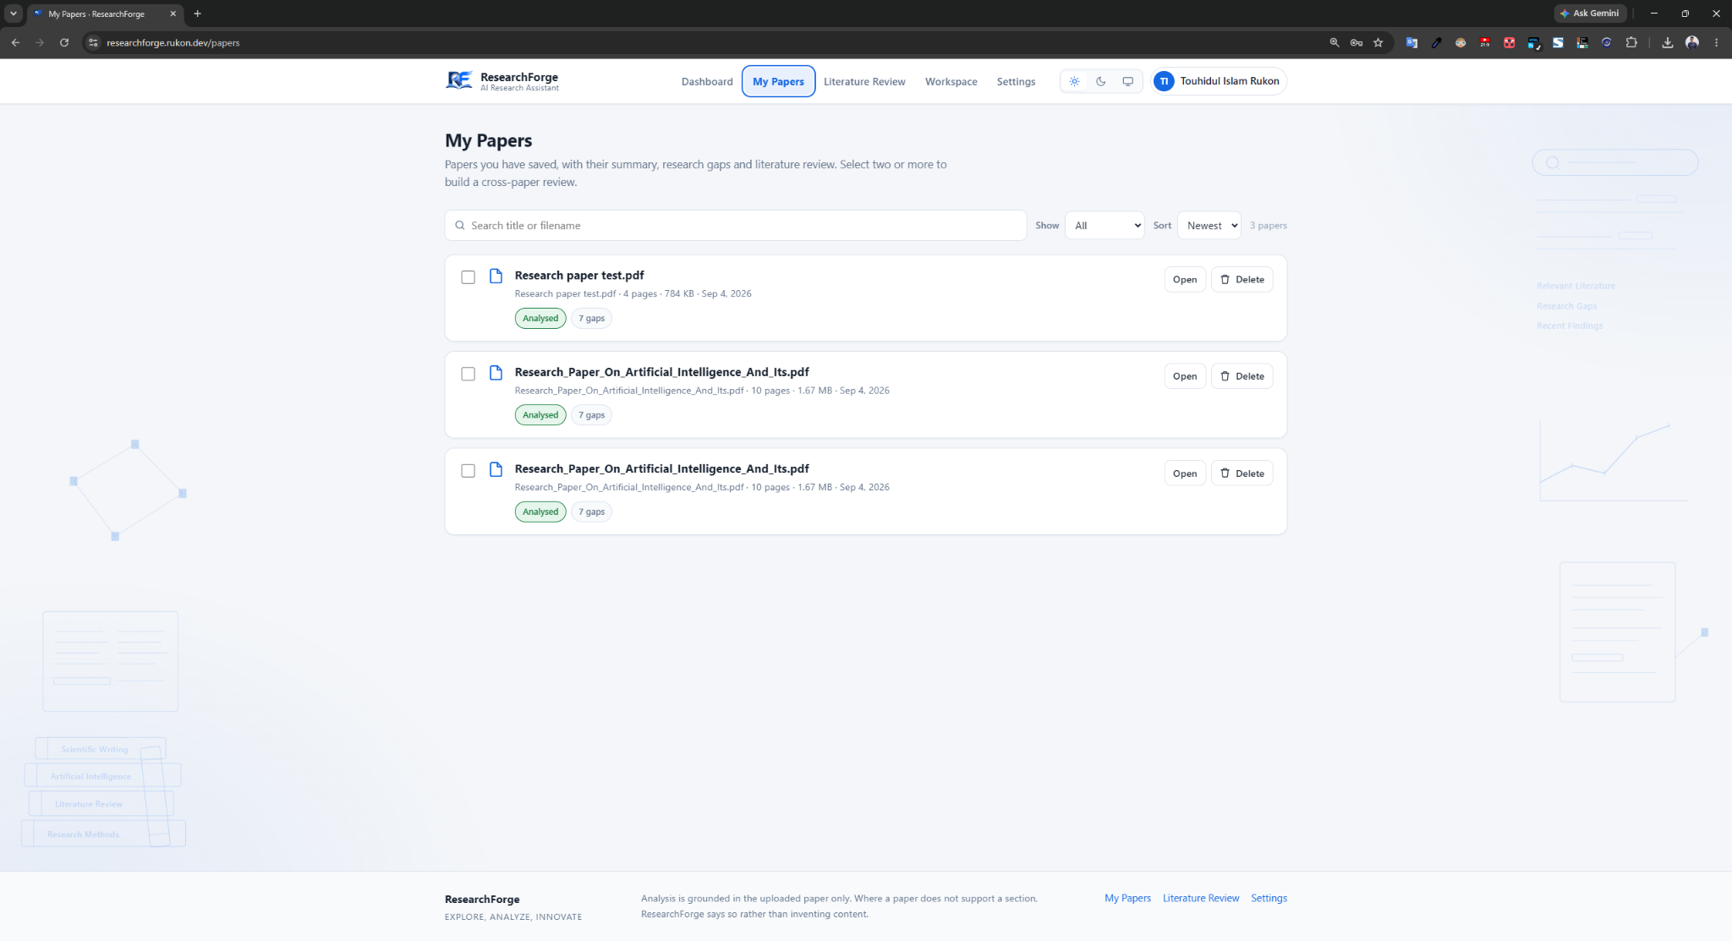
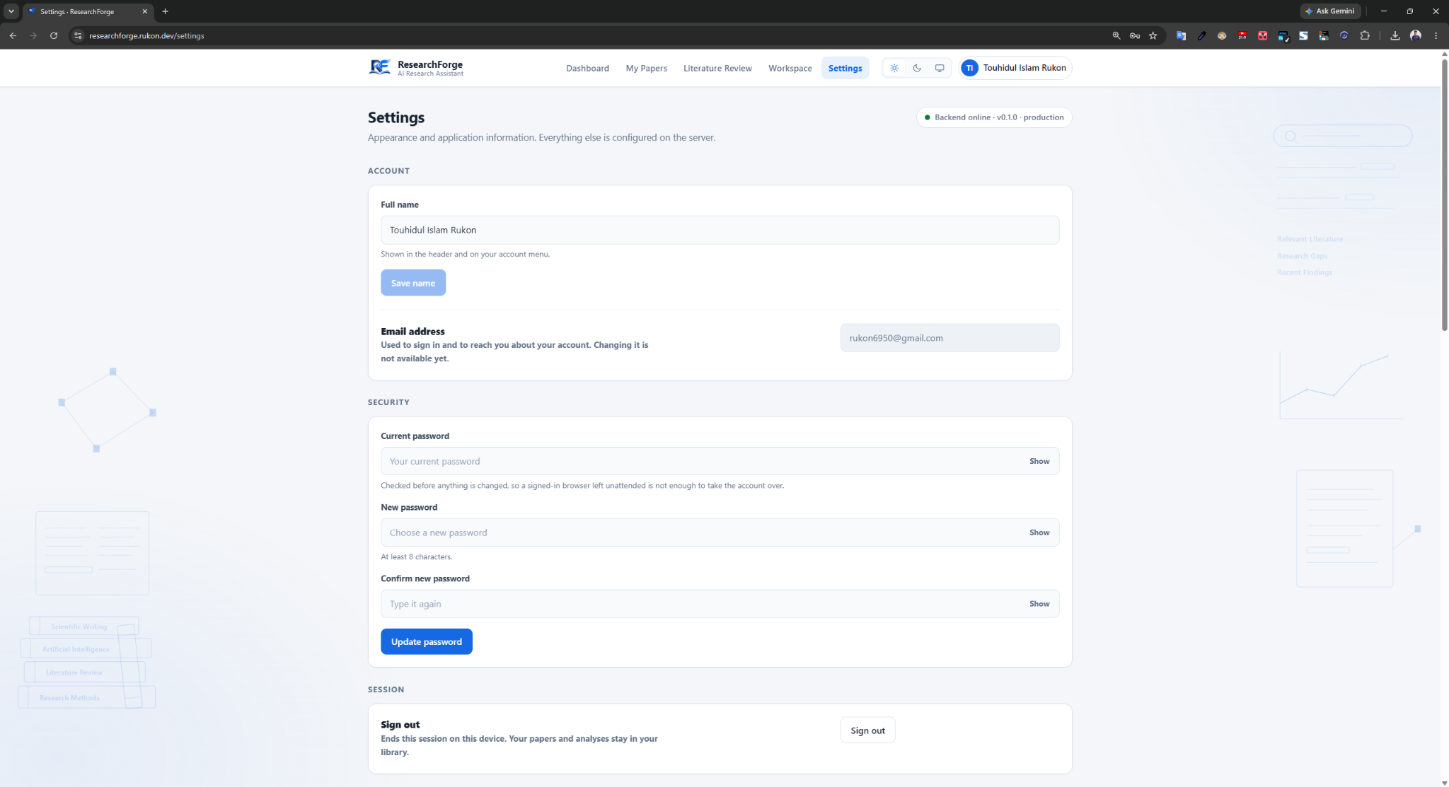
Authentication and data ownership
Email and password sign-in, plus Google sign-in
Password reset and account settings
Private per-user research library
Ownership enforced by PostgreSQL Row Level Security
Owner rights resolved server-side, not in the browser
No password is stored by this project
User A cannot access User B's private records.
Verified live: 26 isolation checks, 0 failures, including a direct database query that bypassed the application and returned zero rows.

Slide 12
Same-paper analysis cache
PDF upload
Text extraction
Normalisation
SHA-256 hash
Cache lookup
HIT - existing valid analysis
MISS - no stored analysis
Reuse the stored analysis
Create this user's own private record
Display result - 0 AI calls
Observed: 3.2 s same user, 2.7 s another user
Run AI analysis and validate the response
Store the analysis and the cache entry
Only successful analyses are cached
Observed: 32.4 s with three AI calls
The cache is global internal infrastructure, not a shared library.
Each user keeps their own private record, the original uploader is never revealed, and Row Level Security still applies.

Slide 13
Testing and evaluation
522
16
26
0
backend tests
passing
frontend tests
passing
live isolation
checks passed
failing tests
VERIFIED ON THE CURRENT REPOSITORY
Unit testing against fakes, so the suite runs offline
AI provider and fallback testing
Integration and API testing on the deployed system
Cache testing with four independent signals
Authentication and session testing
Responsive testing on a real device
User ownership and Row Level Security testing
Ruff, TypeScript and production build all clean
5 further tests call live providers and are skipped by design. No model accuracy value is claimed: there is no labelled benchmark.

Slide 14
Results and achievements
OBSERVED IN THE TESTED SCENARIOS
Cache miss
32.4 s
3 AI calls
PROVIDER FINDING
Under the owner's configuration all five evaluation papers completed, but every one was produced by the fallback provider.
At its free service tier the primary provider allows 7,000 input tokens per minute, while the papers required 7,920 to 20,362 in a single request.
The fallback worked correctly - and in doing so concealed that the primary was unusable.
Cache hit, same user
3.2 s
0 AI calls
Cache hit, different user
2.7 s
0 AI calls
A repeated analysis costs about a tenth of the time and no tokens, while each user keeps a separate private record.
Isolation verified live: 26 checks, 0 failures. Deployed and publicly reachable. No universal performance claim is made.

Slide 15
Conclusion and future work
ResearchForge provides an AI-assisted workflow for analysing academic research papers and extracting structured research insights.
DELIVERED
FUTURE WORK
Upload, extraction and AI analysis
Production vector retrieval (RAG)
Research gaps and literature review
Stronger retrieval and ranking
Cross-paper review
Citation-aware evidence linking
Authentication and per-user ownership
Larger benchmark and human evaluation
Provider routing with one fallback
Document versioning and multilingual support
Same-paper analysis cache
Richer research comparison
researchforge.rukon.dev

