Slide 1
Helius app features
Phase I – Employee offer roll out, onboarding, maintenance, exit
HR will use the app for employee offers, onboarding and exits
Existing employee data will be migrated into the new app
All the existing excel based HR processes for employee record keeping will be eliminated
Phase II – Employee selfcare
Automating processing of client’s timesheet report. Manual processing of report will be eliminated to the extent possible
Timesheet submission directly in app for employee who do manual timesheet submission
Availability of payslips for downloading
Employees can request for letters from HR
Employees can raise reimbursement claims
Employees can view their leave balance details
Audittrail
Phase III
SOW workflow automation
Invoicing workflow automation
Generation of invoice from SOW instead of current funding master

Slide 2
Helius app features (contd..)
Phase IV
Employee feedback survey – integration with survey tools like “survey monkey”
Integration with accounting systems
Integration with recruitment process system
Integration with payroll system
Change Requests (CR)
User feedback will be evaluated and incorporated into the system on an ongoing basis

Slide 4
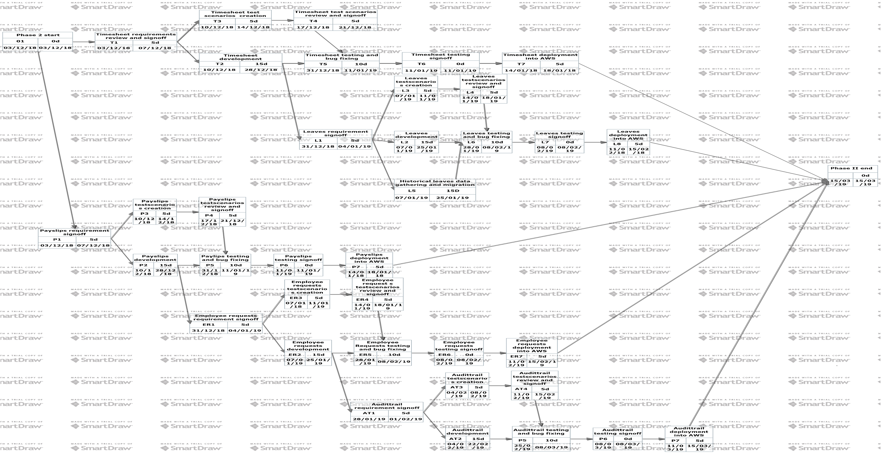
Notes:
For more clear schedule diagram, please see

Slide 6
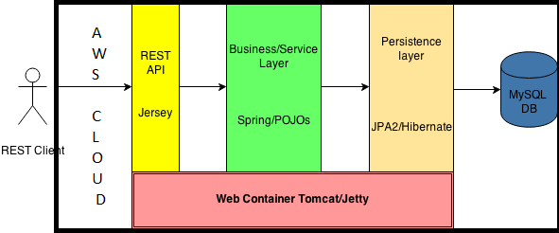
Serverside Architecture

Slide 7
Clientside Architecture
View
(HTML)
Model(Angularjs)
Controller(Angularjs)
Service request and response (Angularjs)

Slide 8
Deployment architecture
Helius HCM app server on AWS
Browser based Helius app client
(chrome)

Slide 9
Design Decisions
Flexibility
Client side code is developed using AngularJS – Popular framework for desktop web and mobile based clients. This supports MVC (Model-View-Controller). View (HTML) is independent from model which makes it flexible for modifications as long as the model does not change
JSON is used for data transfer between client and server. JSON is very popular for web and mobile based apps for data transfer. This is to use and maintain compared to xml.
REST based services at server side – Again, REST has become very popular protocol for hosting services on server

Slide 10
Design Decisions
Scalability
The app will be hosted in AWS cloud. AWS provides dynamic scalability. Depending on the load, AWS adjusts the computing resources required for our app
Maintainability
As the app is hosted in AWS cloud. There is no internal server is required for running and maintaining the app
The robustness of AWS cloud and its 24X7 availability keeps our app downtime to almost zero

Slide 11
Assumptions
The app client will work on chrome, IE, firefox.
AWS will automatically will scale the server hosting the app backend
Employees will be able to launch the app in browser either from their desktop or mobile or both from their client locations
Historical leave data atleast for the running year will be available for migration

Slide 12
Risks
Collection of existing employee and client data
As the existing data lies in different sources in different formats. Data collection and consolidation is some what problematic
Employees use different kinds of mobile devices. Cross device compatibility of the app can be cumbersome
Use of third party apps and frameworks to implement some of the features of this app can be an issue because of technology differences

Slide 13
3rd party tools
Employee surveys & User management
The first choice to evaluate out of the box tools like “survey monkey” instead of building one inhouse
For user management also, out of the box tools will be evaluated first

Slide 14
Software engineering tools
Client side – webstorm is used for developing client layer using Angularjs, HTML5, Jquery etc..
Serverside – Eclipse is used for developing server layer using java and related frameworks like spring, hibernate etc..
Database – MySQL
Application server – Wildfly 8.1
Deployment – AWS cloud
Version management – Github cloud

