Slide 1









Eazydiner Webscrapping
Analysis
Exploring Hyderabad’s Dining Scene with EazyDining

Slide 2




INTODUCTION
This dataset covers 800+ restaurants across Hyderabad with details like cuisine, price, rating, and discounts.
It helps analyze food trends, pricing strategies, and customer preferences in the city.
The data is diverse and well-structured, ideal for visualizations and insights.
It’s perfect for real-world business, marketing, and data analysis applications.

Slide 3

Business Problem
Hyderabad’s restaurant scene is highly competitive with diverse cuisines, pricing, and offers.
Restaurants struggle to attract customers while balancing cost, quality, and discounts.
Understanding what drives customer ratings and preferences is key to success.
This dataset helps analyze trends in pricing, location, cuisine, and discount strategies.
Insights can guide better marketing, menu planning, and customer targeting decisions.

Slide 4

Objective
To analyze the rating patterns of items or recipes in the dataset.
To understand user preferences based on rating distribution.
To identify the most common rating range and overall satisfaction level.
To detect any negative feedback or low-rated items for improvement.
To visualize the data using charts like histograms and heatmaps for better understanding.
To learn and apply basic data analysis steps such as cleaning, grouping, and summarizing data.
To draw meaningful insights that can help in improving item quality or user experience.
To develop beginner-level analytical and visualization skills using real-world data.

Slide 5
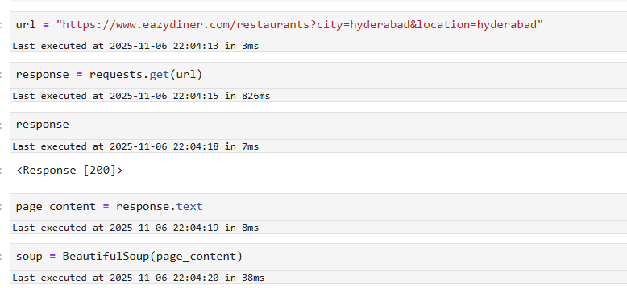

Getting Response from website
Fetched the webpage successfully using requests .
Parsed HTML content with BeautifulSoup .

Slide 6

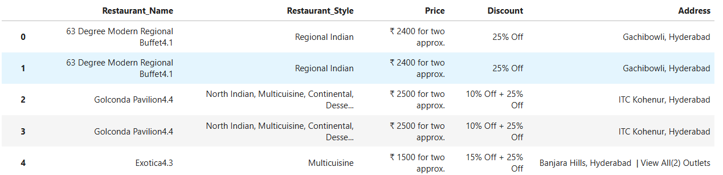
Scraping Data From website
I selected Hyderabad from the website for data scraping.
Hyderabad’s vibrant food culture and concentration of top-rated restaurants made it a strategic choice for scraping dining data.
Hyderabad (Raw data)

Slide 7









Tools Used

Slide 8
Data Cleaning
After performing web scraping, I compiled a dataset containing 887 restaurants records , each described by 9 distinct columns.
COLUMNS
Restaurant _Name - Displays the name of the restaurant .
Restaurant _Style - Indicates the cuisine or style of the restaurant .
Price_per_one - Represents the price range of the restaurant for one item.
Price_per_two - Represents price range of the of the restaurent for two items.
Discount - Shows available discounts offered by the restaurant .
Max_Discount - Represents the maximum discounts offered by the restaurents.
Rating - Reflects customer satisfaction based on food,service and overall experience.
Locality - Specifies the particular region in a city or town .
City - Indicates the specified region.

Slide 9
Data Cleaning steps
Removed empty or missing data.
Deleted repeated (duplicate) entries.
Fixed restaurant names by taking out ratings from them.
Cleaned up unnecessary characters and spaces from addresses, prices, and discounts.
Broke down the address into separate columns for area and city.
Changed price information from words to numbers.
Took out the highest discount value from offers.
Deleted columns that were no longer needed.

Slide 10
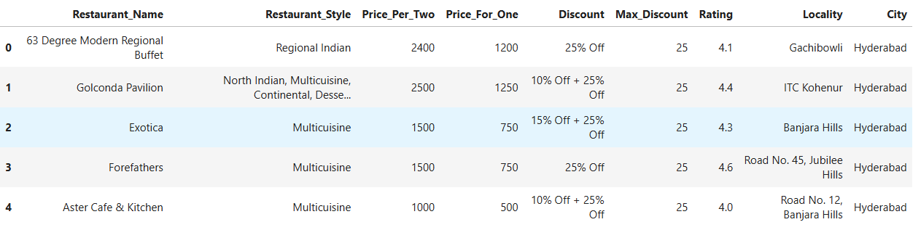
After extracting multiple columns from existing columns
Eazydiner - 887 restaurants
EASYDINER

Slide 11

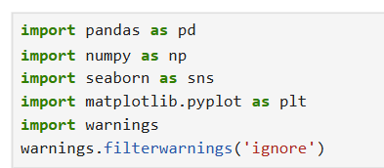

Data Visualization
“ After handling all null values in the dataset , used seaborn for data visualization.”
“ Performed Univariate, Bivariate, Multivariate by importing Seaborn and Matplotlib . ”

Slide 12
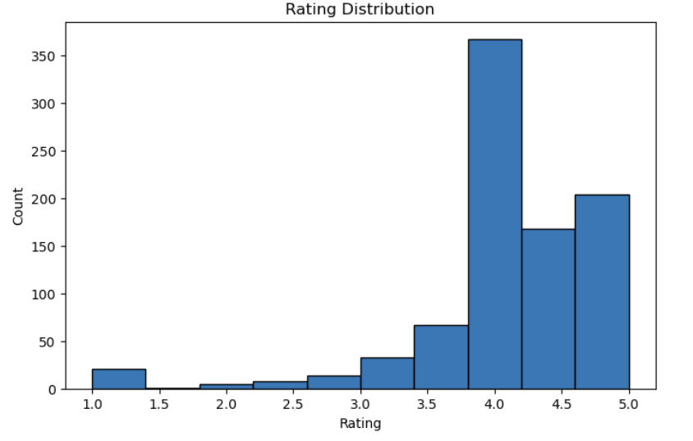
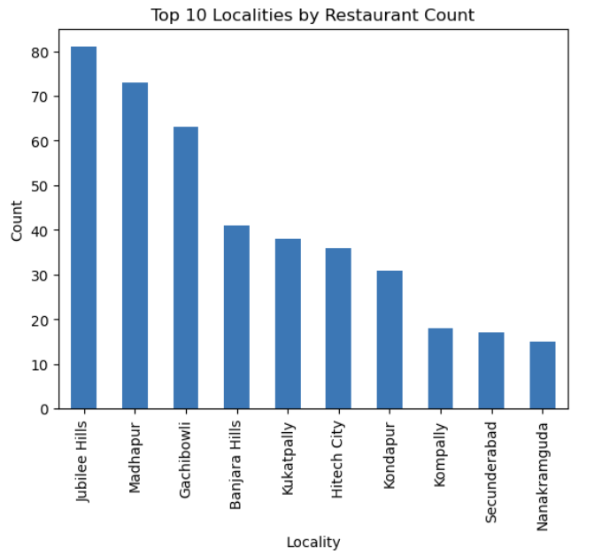
Univariate Analysis
Nanakramguda and Secunderabad have the fewest, suggesting less dining activity.
Jubilee Hills and Madhapur have the highest number of restaurants, making them prime food hubs.
Most top localities are in western Hyderabad, indicating a concentration of restaurant growth there.
This data can help food businesses choose high-traffic areas or explore underserved markets.
Most people gave high ratings between 3.5 and 5.0.
The rating 4.0 is the most common among all.
Only a few ratings are below 3.0, meaning very few bad reviews.
The chart shows that most users liked the items or recipes.
Overall, the ratings are mostly positive and encouraging.

Slide 13
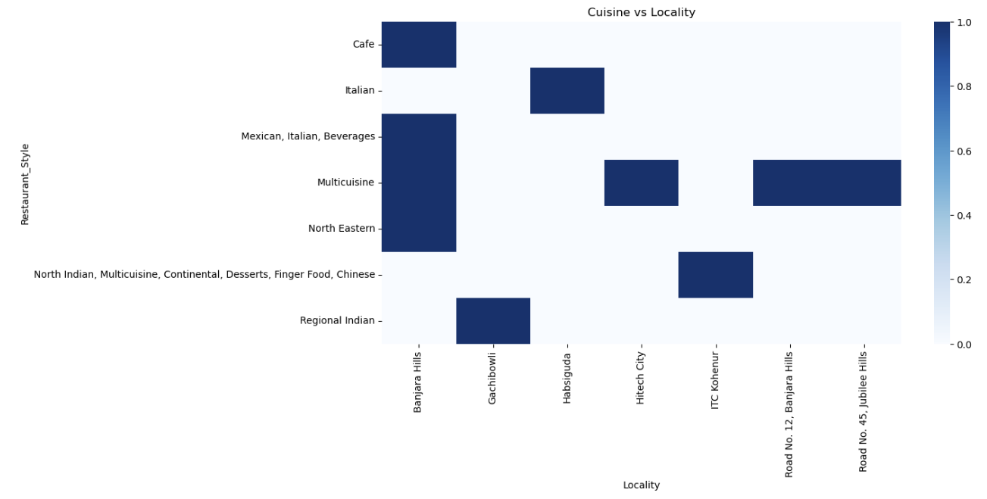
Bivariate Analysis
Darker blue shades show strong presence of certain cuisines in specific localities—like Multicuisine in Banjara Hills.
Some styles like North Indian and Chinese appear across multiple areas, showing wide popularity.
Unique cuisines like North Eastern or Regional Indian are more localized, hinting at niche markets.
This helps restaurants spot trends and choose the right cuisine for each locality.

Slide 14
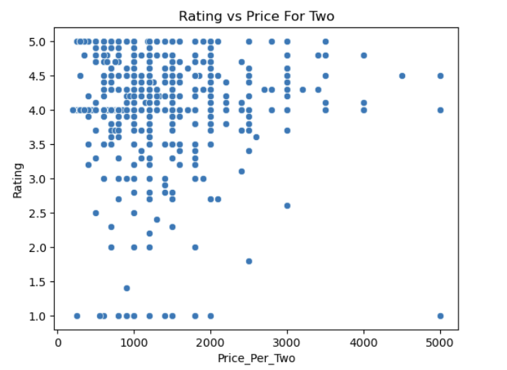
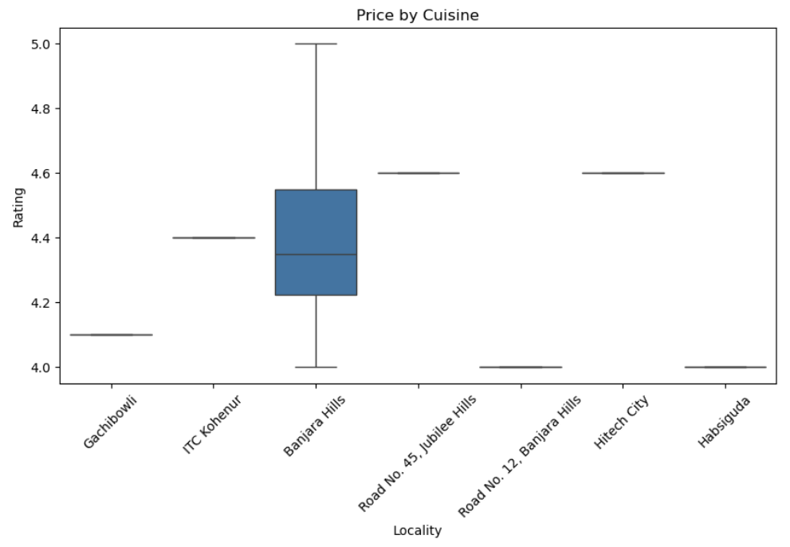
Bivariate Analysis
There's no clear link between restaurant price and rating—great food doesn't always mean high cost.
Many top-rated restaurants offer meals for under ₹1000, showing value options exist.
A few expensive places (₹3000+) have lower ratings, suggesting price alone doesn’t guarantee quality.
This helps diners find well-rated, budget-friendly spots and guides businesses on pricing strategy.
Most localities show consistent ratings around 4.5–4.7, meaning restaurants generally perform well.
Banjara Hills has more variation in ratings, suggesting a mix of both highly rated and average places.
Flat lines in other areas (like Jubilee Hills and Hitech City) indicate little or no rating variation.
This helps identify areas with stable restaurant quality vs. those with diverse experiences.

Slide 15
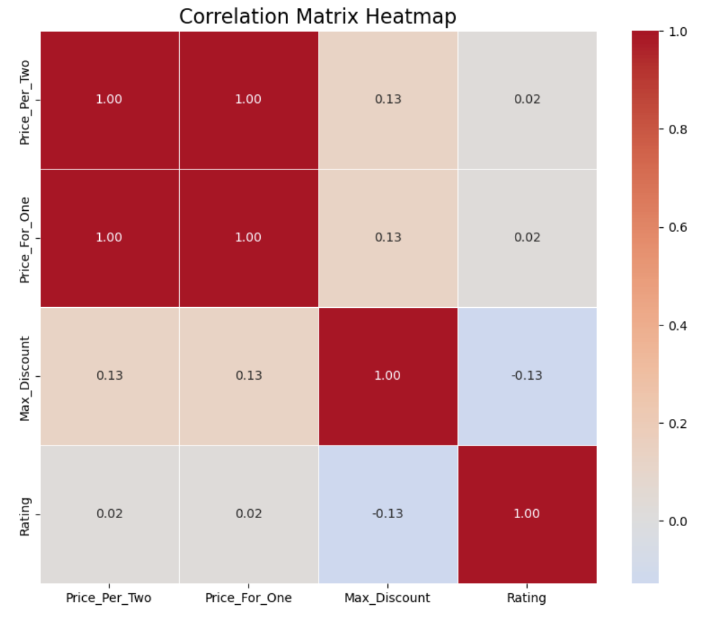
Multivariate Analysis
Price for one and price for two are perfectly correlated (1.00), meaning they rise and fall together.
Rating has almost no link to price or discount, showing that customer satisfaction isn’t driven by cost.
Max discount has a weak negative correlation with rating (-0.13), hinting that heavy discounts don’t always mean better reviews.
This helps analysts focus on other factors beyond price when predicting restaurant ratings.

Slide 16

Conclusion
The dataset mainly contains high user ratings, mostly between 3.5 and 5.0.
The most common rating is 4.0, showing strong user satisfaction.
Very few ratings are below 3.0, meaning only a small number of users were unhappy.
The distribution is skewed toward higher ratings, indicating overall positive feedback.
The analysis shows that users generally liked the items or recipes in the dataset.
Data visualization through graphs helped to understand rating patterns easily.
Cleaning and analyzing the data improved the accuracy and clarity of insights.
This project gave hands-on experience in data analysis and visualization tools.
Overall, the dataset reflects positive trends and helps identify what users prefer most.

Slide 17
Challenges - Web Scraping & Data Analysis
Missing Data – Datasets have incomplete records, making analysis less accurate.
Inconsistent Data – Variations in formats (e.g., dates, currency) can cause errors.
Duplicate Records – Multiple entries for the same data point can skew results.
Data Quality – Outliers, errors, or irrelevant information can affect insights.
Understanding the Data – Lack of domain knowledge makes interpreting patterns difficult.
Bias in Data – If the dataset isn’t representative, results may be misleading.

Slide 18

Thank You For You Attention

