Slide 1
GIT
Version Control System

Slide 2
VCS
Vcs is a process of tracking and controlling Changes In software
The Goals of VCS are generally
Team Work
Defect Tracking
Configuration Auditing
Process Management

Slide 3
What is VCS(Version control system)
The management of modifications to documents, computer programs, huge websites, and other collections of information is known as version control, sometimes known as revision control or source control. Each revision has a timestamp and the name of the person who modified it. Revisions can be compared, restored, and merged with some file formats. [1]
VCSs are most typically used as stand-alone applications, but they can also be embedded in other types of software, such as integrated development environments (IDEs).

Slide 4
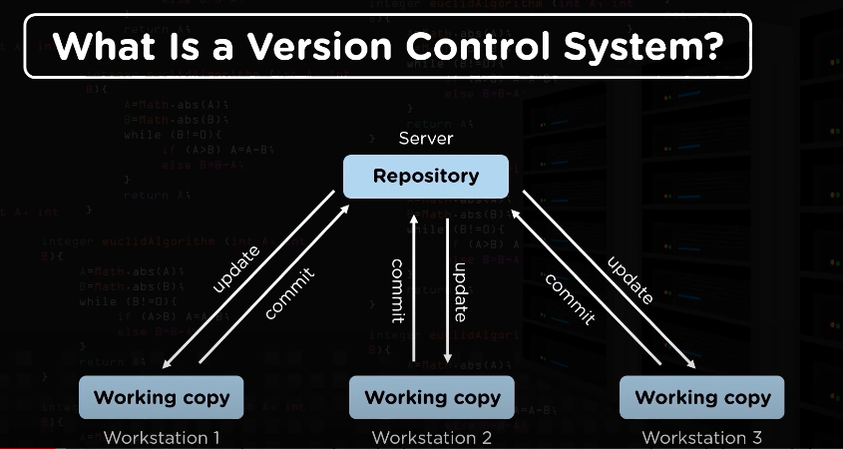

Slide 5
a version control system is used for the following.
Version control allows several people to work on the same project at the same time. Each team member modifies their copy of the files and decides when to share the changes with the rest of the group. As a result, one person’s temporary or partial alterations do not interfere with the work of another.
Version control also allows one person to work on a project from various computers, so it’s useful even if you’re working alone.
Version control brings together work done by different team members at the same time. In most circumstances, you can mix adjustments to several files or even the same file without losing any work. When two persons make contradictory updates to the same line of a file, the version control system will occasionally ask for human help in choosing what to do.
Version control allows you to see previous versions of your project. This is protection against computer failure or data loss. You can go back to a prior version if you make a mistake. A bug report from a previous version of your software can be reproduced and understood. You can also go back and undo edits without losing all of your previous work. You can find out when, why, and by whom a file was ever altered by looking at any area of it.

Slide 6
Types of Version Control system
Generally, VCS is categorized types –
Version Control Systems on a Local Level
🔎Version Control Systems that are centralized
🔎 Version Control Systems in a Distributed Environment

Slide 7
Centralized vs Distributed Version Control
The main difference between centralized and distributed version control is that, in centralized version control, the versions are saved in the remote repository, while in distributed version control, versions can be saved in the remote repository as well as in local repositories of the local machines.`

Slide 8
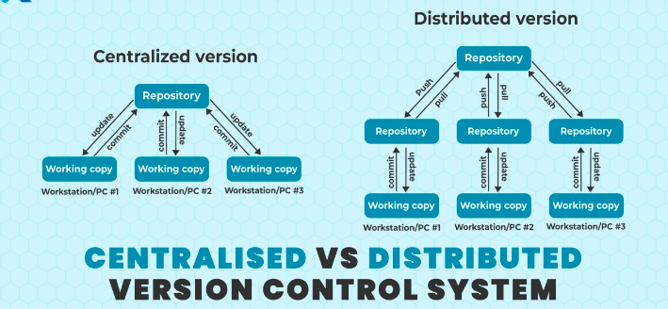
Types of Version Control Systems

Slide 9
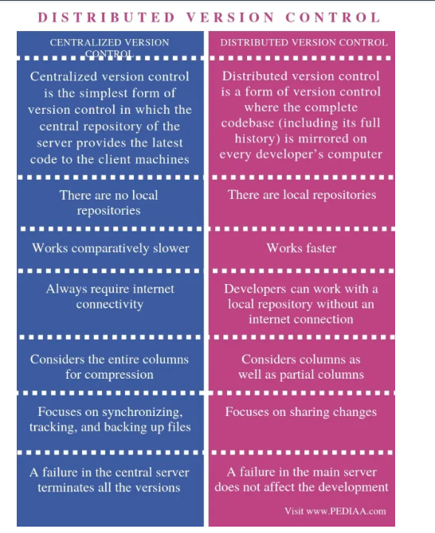
Centralized vs Distributed Version Control

Slide 10
Why Version Controlling is very important?
A version control system helps software development teams manage and communicate changes to the source code. Each developer works on their own branch, and changes are merged into the main codebase only after review. This system organizes code, tracks who made changes, and improves productivity by streamlining the development process.

Slide 11
Benefits of using Version Controlling.
Maintain abreast of developments — and ensure that everyone on your team is working on the same version.
Visibility is improved.
Assists teams from all around the world in collaborating.
Improves the speed with which products are delivered.
Easier backups and centralized source code repository.
Easy collaborative development.
Overview of changes performed to a file.
Access control.
Conflict resolvent.
It tells us Who, What, When, and Why modifications were done.
📌 Summary; 😊
“Management of multiple revisions of the same unit of information”
● Managing changes to a source.
● Changes are identified using a revision number.
● Each revision has its timestamp as well as the person who done the change.
● Revisions can be restored, compared, and merged.

Slide 12

GIT USE CASE

Slide 13
WHAT PROBLEMS CAN FACE A HUGE COMPANY
Collaboration: Many Prople and different locations
Storing version: One project has many versions
Restoring previous versions: Sometimes you need the older versions
Figuring out what happened: where exactly has the changes in a file
Backup: In case someone’s disk breaks down

Slide 14
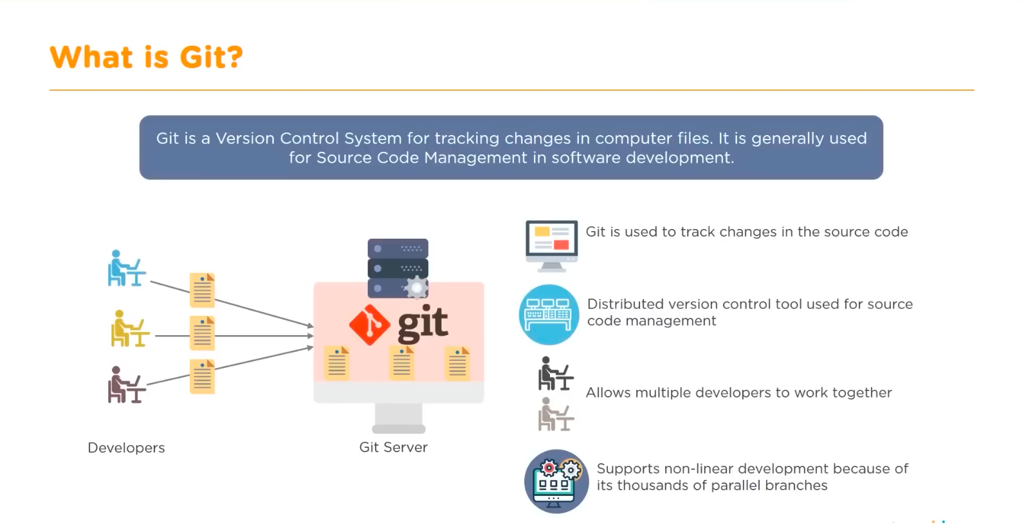
Git helps both programming professionals and non-technical users by monitoring their project files
It Helps in coordinating work among several people on a project and tracing progress over time

Slide 15

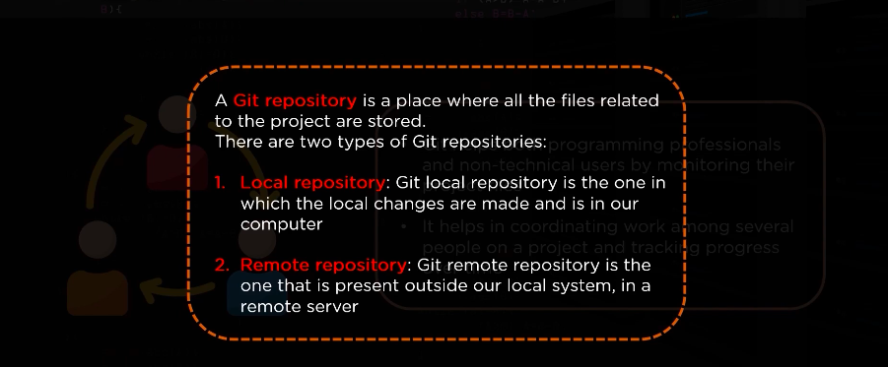

Slide 16
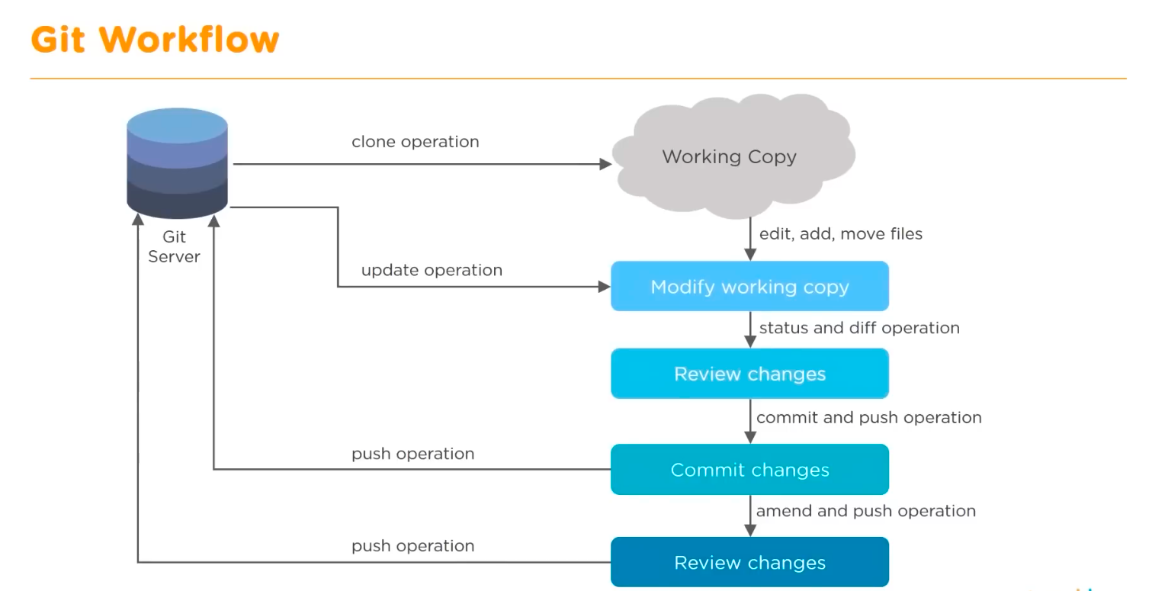
Git workflow

Slide 17
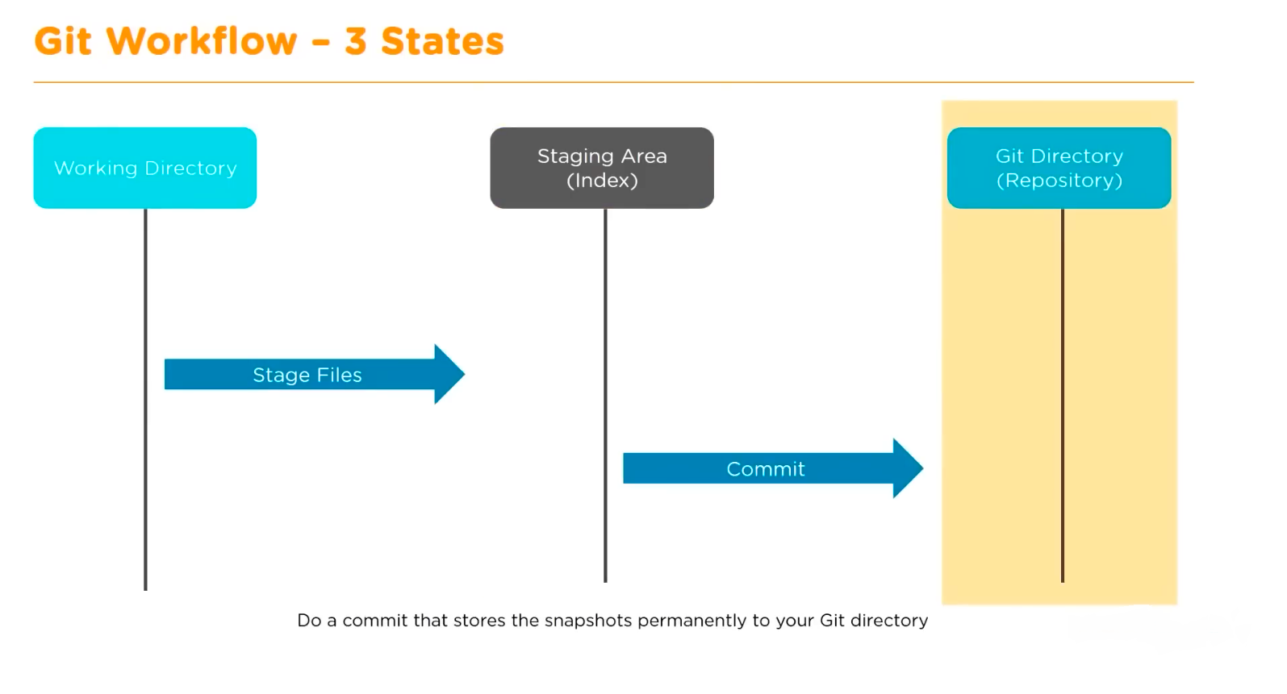

Slide 18
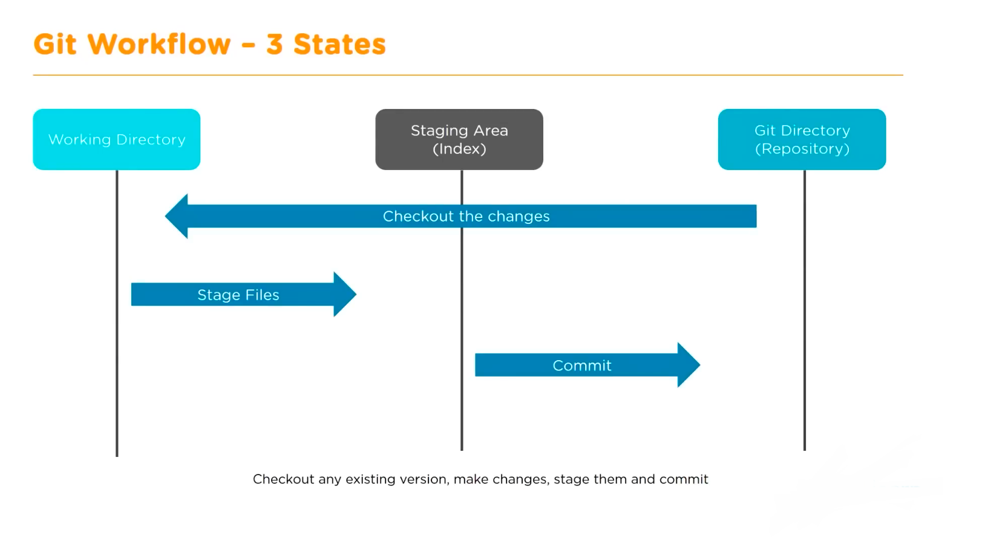

Slide 19
Git Configuaration
First install Git
Configure Git with your name and email Id using below commands
$ git config --global user.name "John Doe"
$ git config --global user.email johndoe@example.com
Then create folder and intiliaze the folder using below command
$ git init
By default Git will create a branch called master when you create a new repository with ”git init”
To set main as the default branch name do:
$ git config --global init.defaultBranch main

Slide 20
Check your settings
If you want to check your configuration settings, you can use the git config --list command to list all the settings Git can find at that point
$ git config –-list
$ git config user.name
$ git config user.email

Slide 21
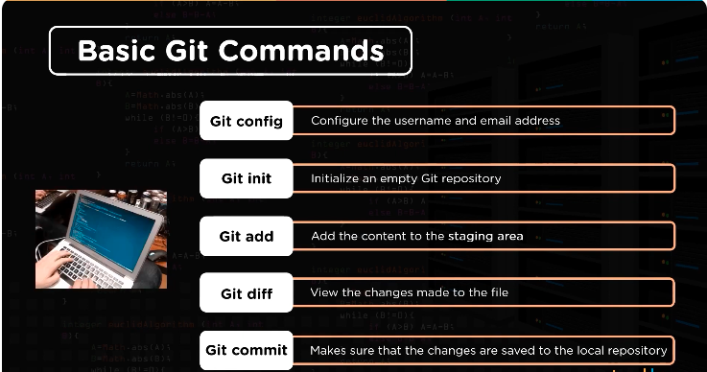
Basic git commands

Slide 22
Practical commands
mkdir chages
557 cd chages/
558 git init
559 git pull https://github.com/tiruvedi/firstrepo.git
560 ll
561 ls -la
562 vi alpha.txt
563 vi beta.txt
564 git status
565 git add .
566 git commit -m "changes made"
567 git status
568 git remove -v
569 git remote -v
570 git remote add origin https://github.com/tiruvedi/firstrepo.git
571 git remote -v
572 git push origin master

Slide 23
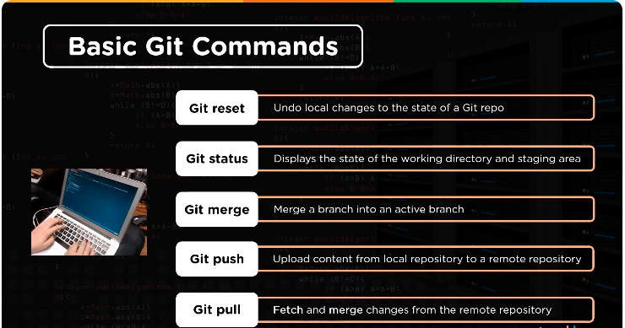
Basic git commands

Slide 24
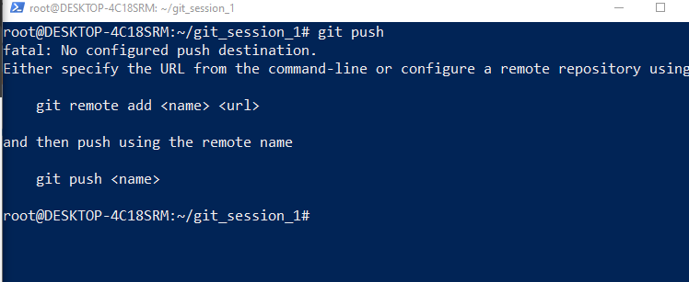
Error screenshot for git push
Solution:
https://stackoverflow.com/questions/10032964/git-push-fatal-no-configured-push-destination

Slide 25
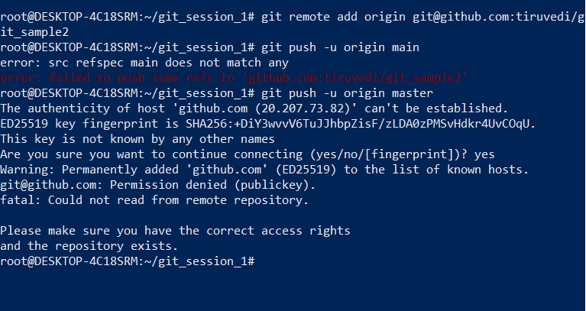
Solution:

Slide 26
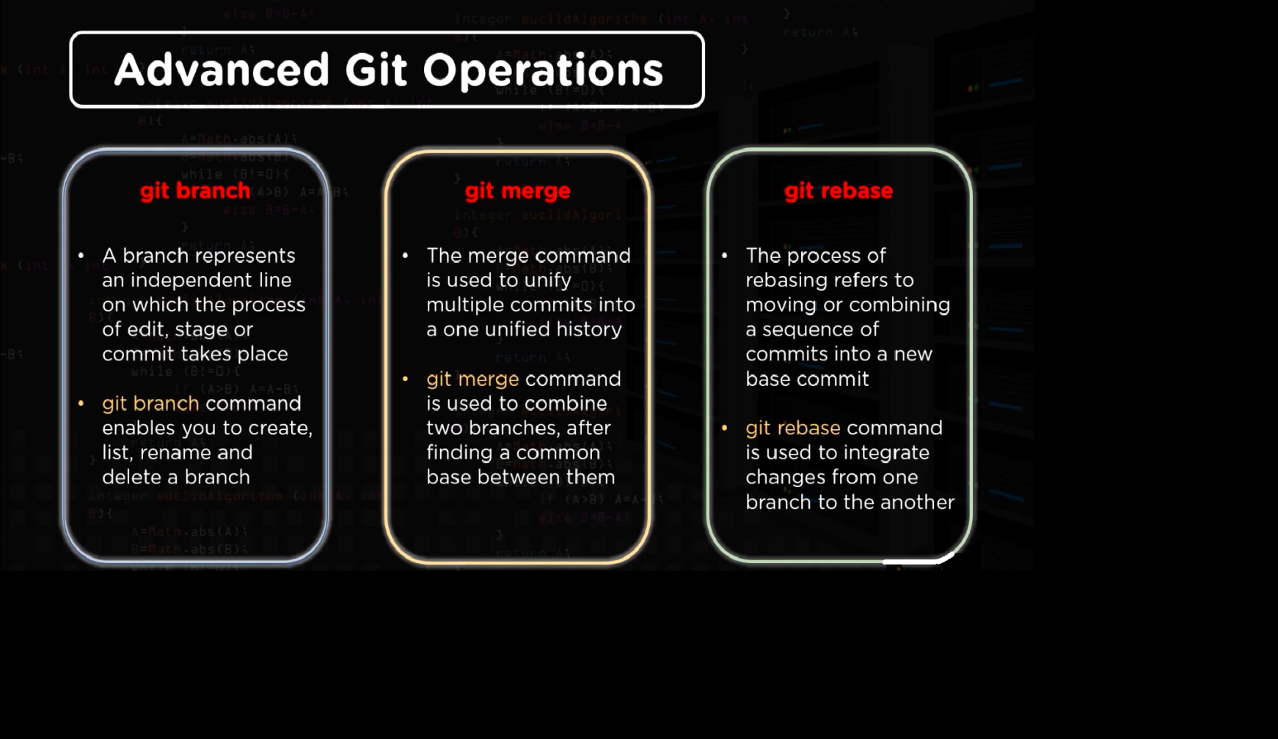

Slide 27
mkdir git_advance
577 cd git_advance/
578 git init A
579 git init B
580 cd A
581 pwd
582 git remote add origin https://github.com/tiruvedi/firstrepo.git
583 git pull origin master
584 ll
585 cd .
586 cd ..
587 cd b
588 cd ..
589 cd B
590 git remote add origin https://github.com/tiruvedi/firstrepo.git
591 git pull origin master
592 cd ..
593 cd A
594 ll
595 vi alpha.txt
596 git status
597 git add .
598 git commit -m "commit done from Repo A"
599 git push origin master
600 cd ..
601 cd B
602 ll
603 vi alpha.txt
604 vi alpha.txt
605 git add .
606 git status
607 git commit -m "commit from repo B"
608 git push origin master
609 git pull --rebase origin master
610 git mergetool
611 git rebase --continue
612 git log -n 2
613 git push origin master

