Slide 1
ReO Stats
Total class count = 3100
~ 150 reagent classes in ReO, representing ‘categories’ of reagents.
Nearly all have textual definitions, many have logical class definitions or descriptions.
All ERO reagent classes represented (although there are conflicts/questions regarding a few)
A handful of example defined classes (‘mouse cell line’) and example particular classes (‘BSA protein reagent’) have been implemented
~800 additional ‘REO_’ classes implemented that are not in scope, but modeled to support ReO reagents
e.g. techniques, qualities, objectives, cell types, chemicals, sequence regions, processes
some of this is truly exploratory and should be trimmed out of ReO
~2100 referenced classes imported for external ontologies, and incorporated into ‘referenced hierarchies (note that over half are organisms (NCBI) and cell types (CL)
171 object properties (~half imported)
Reasons well with Hermit (~12 min) (but breaks Pellet and FACT++)

Slide 2
Review Process Workflow
Use reo-dev.owl to record reviewer comments on specific classes/properties - custom annotation properties have been created for each of you (e.g. ‘MH reviewer comment’)
Use shared google spreadsheet for broader issues -
https://docs.google.com/spreadsheet/ccc?key=0AiKzIoedGeqJdGR2dFF3Sl9aYVdvVkRnSzFwUTRrdmc#gid=5
(note there are four sheets in this doc)
3. Be sure to email other reviewers when doing review to avoid conflicting copies
4. Will ultimately document development issues, design decisions, and review process on Wiki
e.g. http://code.google.com/p/reagent-ontology/wiki/Reagents, http://code.google.com/p/reagent-ontology/wiki/Antibodies

Slide 3
ReO Use Cases
Cataloging Reagents (eagle-i)
A hierarchical classification of reagent types, inferred from logical descriptions of classes asserted according to their natural type and thereby integrated into the existing ontological landscape
A rich set of relations and design patterns to describe their provenance and potential applications as reagents (to provide a standardized ‘language’ for modeling these reagent attributes)
Describing the use of reagents in experimental processes
will rely heavily on a classification of roles reagents play and processes that realize them. Unlikely to use categorical reagent classes (ie will use ‘universals’ that realize a particular reagent role).
Inference of new Knowledge
logical, integrated modeling can allow inference of expertise, research trends, scientific contributions, reagent quality, etc

Slide 4
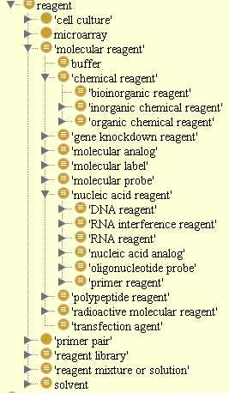
ReO Development
Early focus:
Define classes of reagent categories in such a way as to yield a suitable inferred reagent hierarchy (eagle-i UI use case)

Slide 5
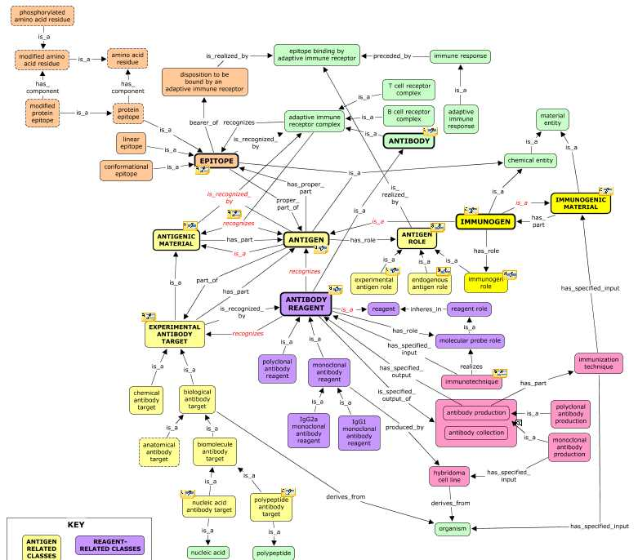
ReO Development
Present and ongoing focus:
Modeling key types of reagents . . .
Constructs
Cell lines
Antibodies
siRNA reagents
primers
. . . to enable rich OWL/RDF descriptions of reagent metadata for diverse use cases
Structuring catalog data, annotating experimental data and the literature, supporting inference of expertise/scientific contribution, etc)
For best and most mature example, see model of Antibodies and Antibody reagents
Antibody Model in ReO

Slide 6
General ReO Issues for Review
Logical Definition of ‘Reagent’
Concerns over use of ‘roles’ will limit utility and/or compromise ontological rigor
See http://code.google.com/p/reagent-ontology/wiki/Reagents
Bloating/Scope Creep - ReO became a sandbox for testing modeling outside purview of ReO
Trim out fat where modeling is not essential (but feedback to orthogonal efforts)
cells, specimens, general role classification
Work with orthogonal efforts to converge on solution where modeling is needed
techniques (OBI), sequences and genetic characteristics (SO/OBI), qualities (PATO), measured and specified values (IAO), objective specifications (OBI), biochemicals/analogs (ChEBI), pathology (OGMS, MPATH), experimental modifications (OBI), cell cultures/lines (CLO, OBI)
Baroque axiomatization
Prepping for integration into ERO, OBI

Slide 7
Issue: Genetic Entity Modeling in ReO
Note that sandbox modeling of genes and genetic elements and their linkage to reagents, organisms, etc. was based on a view of SO:regions as GDCs. It has since been clarified (by CM on LAMDHI hangout call) that the SO now views these as ICEs, such that I need to revisit all of this modeling in ReO.
Older writings about SO, such as that quoted above, had indicated that SO classes could be ‘borne’ by (aka encoded_in - a shortcut for being concretized_in some SDC that inheres in some material bearer) either sequence molecules or information artifacts. With SO classes now considered as ICEs, it would seem that they cannot be borne by/encoded in sequence molecules.
If this is the case/intent, then implications of this design choice include the fact that the relation between an SO region, gene, promoter, etc., and the corresponding biological material entity in reality, is one of ‘aboutness’ (not one of being ‘encoded_in’ – a shortcut for being concretized_in some SDC that inheres in some macromolecule). In this new view, the encoded_in relation only holds between the SO ICEs and the man-made artifacts/mediums used to physically manifest them.
For more on this topic, see wiki page here: http://code.google.com/p/reagent-ontology/wiki/GeneticSequences

Slide 8
Issue: Genetic Entity Modeling in ReO
Some examples of modeling that is now wrong :
All usage of the encoded_in_material_bearer relation to link sequence classes to material entities
e.g. axiom on sequence region: 'encoded_in_material_bearer some nucleic acid'
The sequence_derives_into/from shortcut relations needs revisiting.
e.g. axiom on gene: sequence_derives_into some(encoded_in_materrial_bearer some ('ribonucleic acid' or protein))
Modeling of genetic characteristics information
e.g. axiom on ‘genetic population background information: 'is about' some ('variant genome' and (encoded_in_material_bearer some 'material genome'))

Slide 9
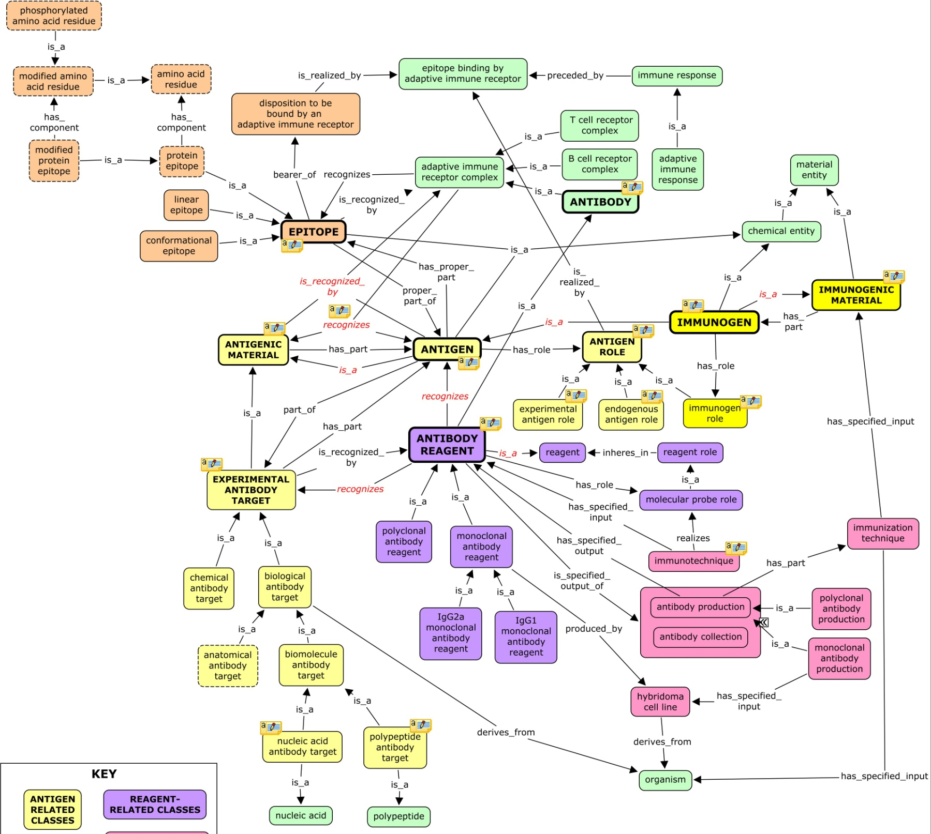

Antibody Model

Slide 11
To Do – Long Term
Expansion – in light of intended use as a flexible and extensible framework for building custom models for different use cases , I would like to expand capability to describe key features of reagents through import/creation of more relations, roles, design patterns, etc
Understand what are all the things people want to say about reagents, and what are all the entities they want to connect them to, and describe design patterns that can be implemented in ReO to do this.
In this way, ReO will become not just a source of reagent classes, but a flexible and extensible language for describing reagents , whose elements can be assembled as ‘semantic building blocks’ into rich logical descriptions that connect their data across the web through ReO’s integration into the OBO landscape
Documentation - To enable users to understand and be able to apply ReO in this way, will build an ‘attribute’ spreadsheet for each top level reagent type – listing each relevant attribute for a given reagent and showing design patterns for how this can be stated/modeled using ReO (and perhaps offering shortcut relations as well)
Integrate ReO with eagle-i. . . how will this work?
Integrate ReO with OBI . . . how will this work?
Sort out metadata standards, implement in ReO, and amend ReO to follow these
Notes:
at present, lots of ad hoc annotations used in ReO.
of particular import are how to record alternate/augmented definitions and labels

Slide 12
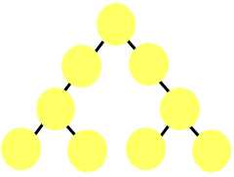
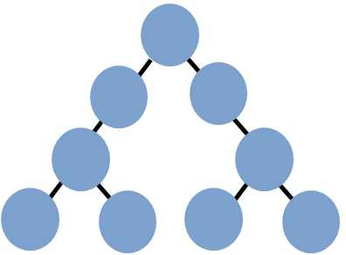

ReO Leverages Existing Ontologies
ReO
Core
Reagent
Hierarchy
C L
(cell types)
OBI
(techniques,
roles)
CLO
(cell lines)
UBERON
(anatomy)
PRO
(proteins)
VIVO
(persons,
organizations)
SO
(sequence
molecules)
ChEBI
(chemicals)
GO
(biological
processes)
NCBI
Taxon
(organisms)
IAO
(data, pubs)
PATO
(qualities)
DOID/
OGMS
(disease)
MPATH
(pathology)
R O
(relations)
‘Referenced Hierarchies’
Notes:
ReO re-uses from 15 different ontologies, by importing classes it needs to describe reagent attributes into what we call ‘referenced hierarchies’. Reagent classes in the core hierarchy are logically described through relations to classes from these referenced hierarchies. With this approach, we create semantic links across ontologies when we record, for example, that an antibody reagent recognizes a particular class of protein or was produced in a particular class of organism.

Slide 13
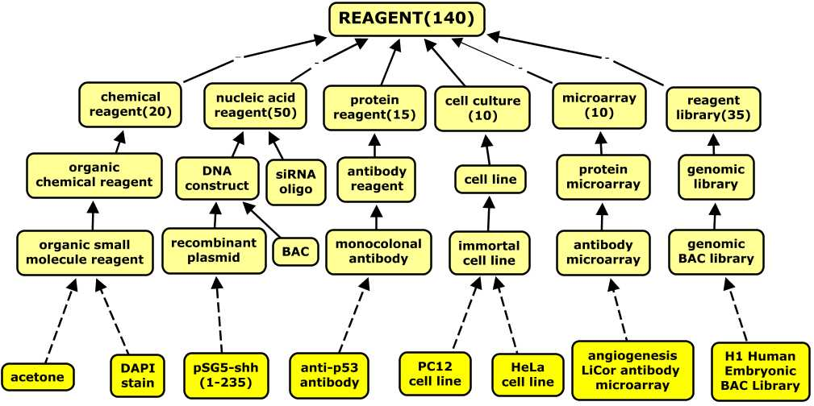
ReO as a Mid-Level Ontology
Asserted axis of classification based on ‘natural type’
ReO models categories of reagents, not specific reagent types
More granular reagent types added ‘on demand’
Notes:
too many granular types exits (millions of chemicals, antibodies, plasmids, etc) to model from the outset . . . rather, let use cases drive extension as needed, so ReO grows organically to meet community needs . . .

Slide 14
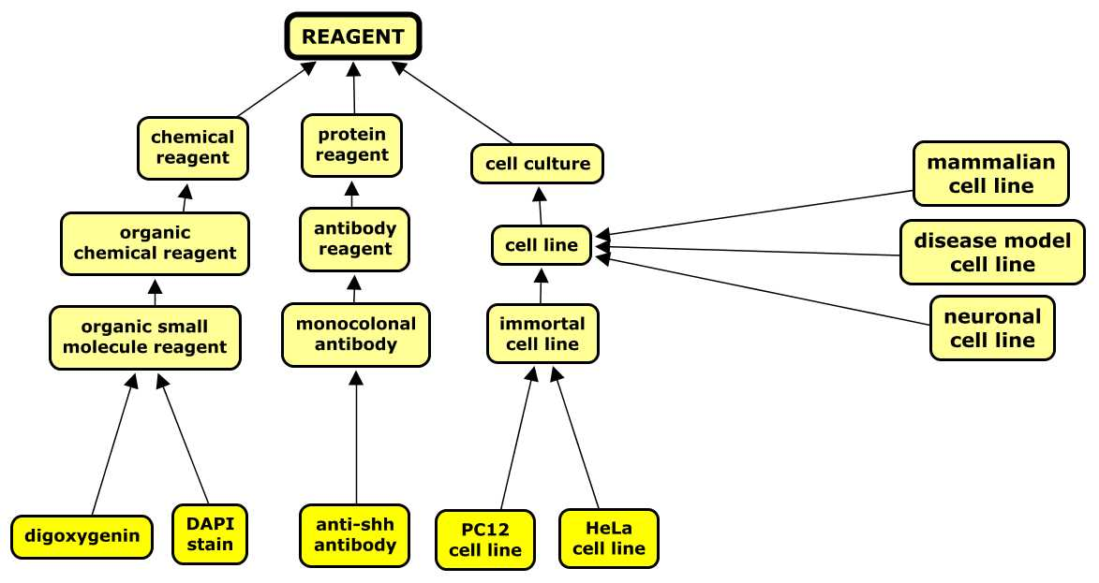
ReO Extension and Application
ReO provides a solid but flexible foundation for extensions
to meet specific and diverse application needs
‘Horizontal extension’ through creation of defined classes
‘Vertical extension’ through addition of more granular classes
Notes:
Extensions can be horizontal, to define new categories based on pertinent axes of classification . . . ReO provides framework/building blocks/ design patterns to guide such extensions
Extensions can be vertical, using ReO’s leaf nodes as anchors to implement more granular reagent types
(Notably, ReO comes standard/preloaded with many such classes representing the most common types of defined reagent classes (ie those not based on our primary
axis of natural type) that we anticipate being needed in the community. These classes also provide exemplar templates/design patterns to guide extensions to meet new community requirements. )

Slide 15
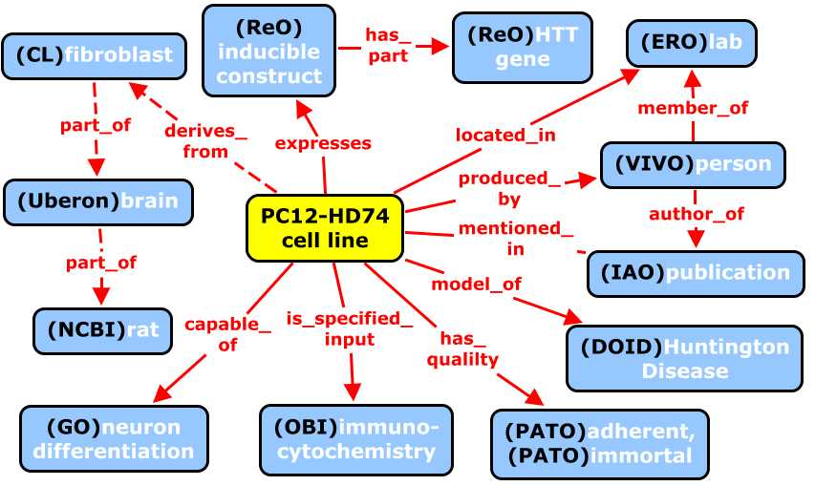
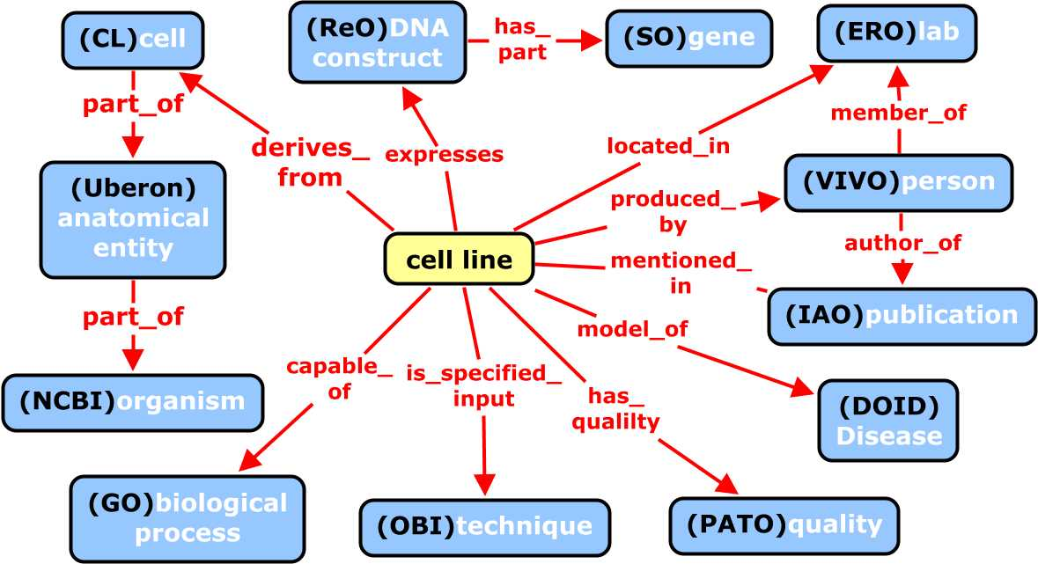
ReO Properties and Design Patterns
ReO offers more than 150 properties for describing reagent attributes and crafting defined classes . . .
. . . to provide a rich, centralized, and extensible framework that can support diverse applications and use cases
Notes:
In this way, ReO will become not just a vocabulary, but a language for describing reagents , whose elements can be assembled as ‘semantic building blocks’ into rich logical descriptions that connect their data across the web through ReO’s integration into the OBO landscape
These design patterns and relations provide a “language” (a formal and restricted set of terms and patterns with unambiguous meaning) that can be used to describe reagents in a standardized and computable way that offers semantic connections to other data in the biomedical landscape, through the integration of ReO with other biomedical ontologies.
For example, ReO provides clear and unambiguous accounts of qualities such as bioengineered and biological, and of concepts such as genetic material and experimental modification.
Because ultimately, ontologies will be used to create RDF on the semantic web that is able to express the things scientists want to say about the entities in a given domain.

Slide 16



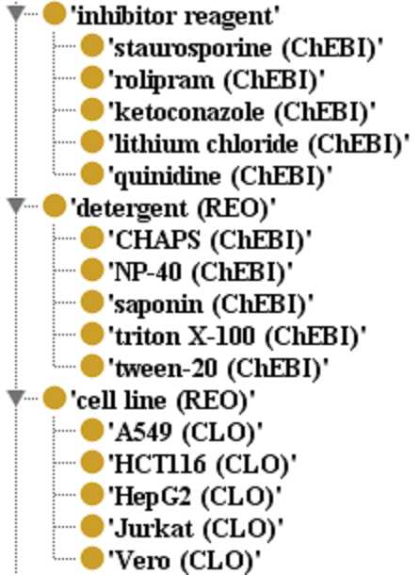
Use Case: The BioAssay Ontology
The BioAssay Ontology represents high throughput screening (HTS) assays, and is used to query and analyze data in the NCBI Pubchem database
THE BIOASSAY
ONTOLOGY
Vertical Extensions to ReO
BAO imports container classes from ReO (e.g. cell line, detergent) and extends them with specific types of these reagents relevant to the HTS domain

Slide 17
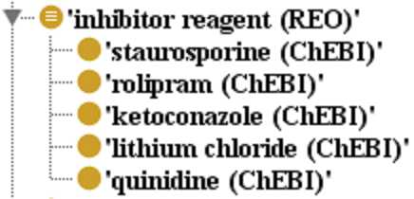
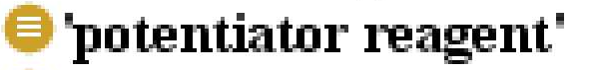
Use Case: The BioAssay Ontology
The BioAssay Ontology represents high throughput screening (HTS) assays, and is used to query and analyze data in the NCBI Pubchem database
THE BIOASSAY
ONTOLOGY
Horizontal Extensions to ReO
BAO builds defined classes using properties and design patterns from ReO to model key concepts for HTS (e.g. ‘potentiator reagent’), and also extends these with specific chemical types)
‘potentiator reagent’ = ‘molecular entity’
and has_role some ‘molecular potentiator role’

Slide 18
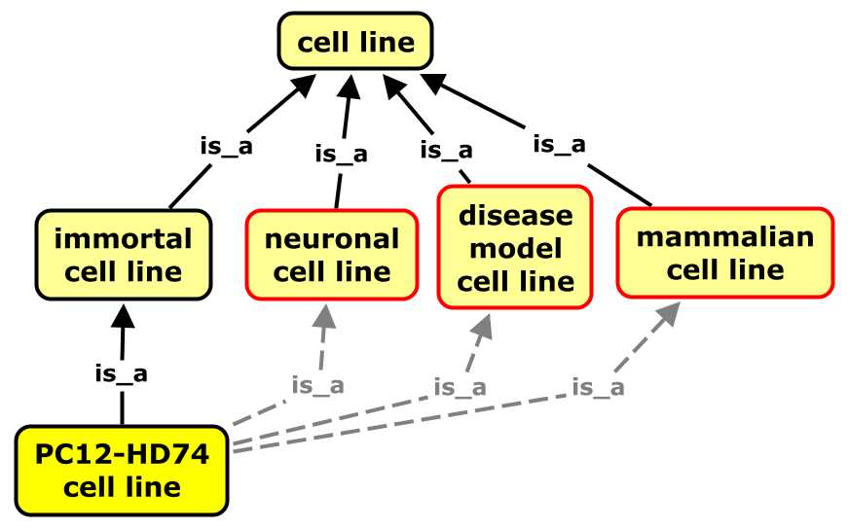
eagle-i resource discovery network
Defined cell line classes created through ‘horizontal extension of ReO allows cell lines to be classified along multiple dimensions, and returned through different queries
-
-
-
neuronal cell line
‘cell line’ and derives_from some ‘neuron’
-
-
-
disease model cell line cell line and model_of some ‘disease’
-
-
-
mammalian cell line
‘cell line’ and derives_from some (‘cell’ and (part_of some ‘mammal‘))

