Slide 1
Microcontrollers
Muahahahah

Slide 2
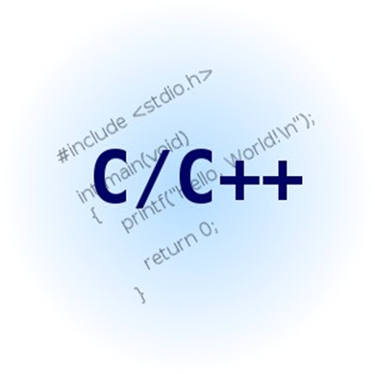
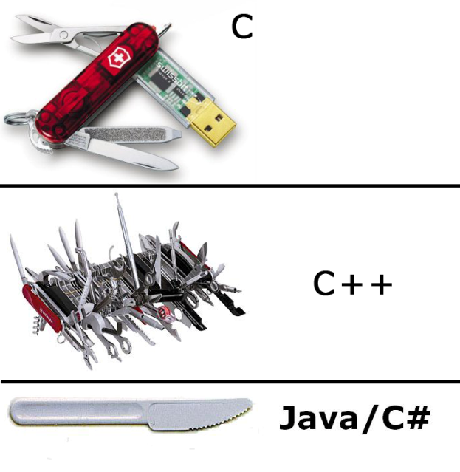

Programming
What programming language is Arduino based in?
C C++ and Java are all different
In this case Arduino is a C++ language built in a Java IDE(lol)

Slide 3

Libraries
What are libraries
What are they good for?

Slide 4
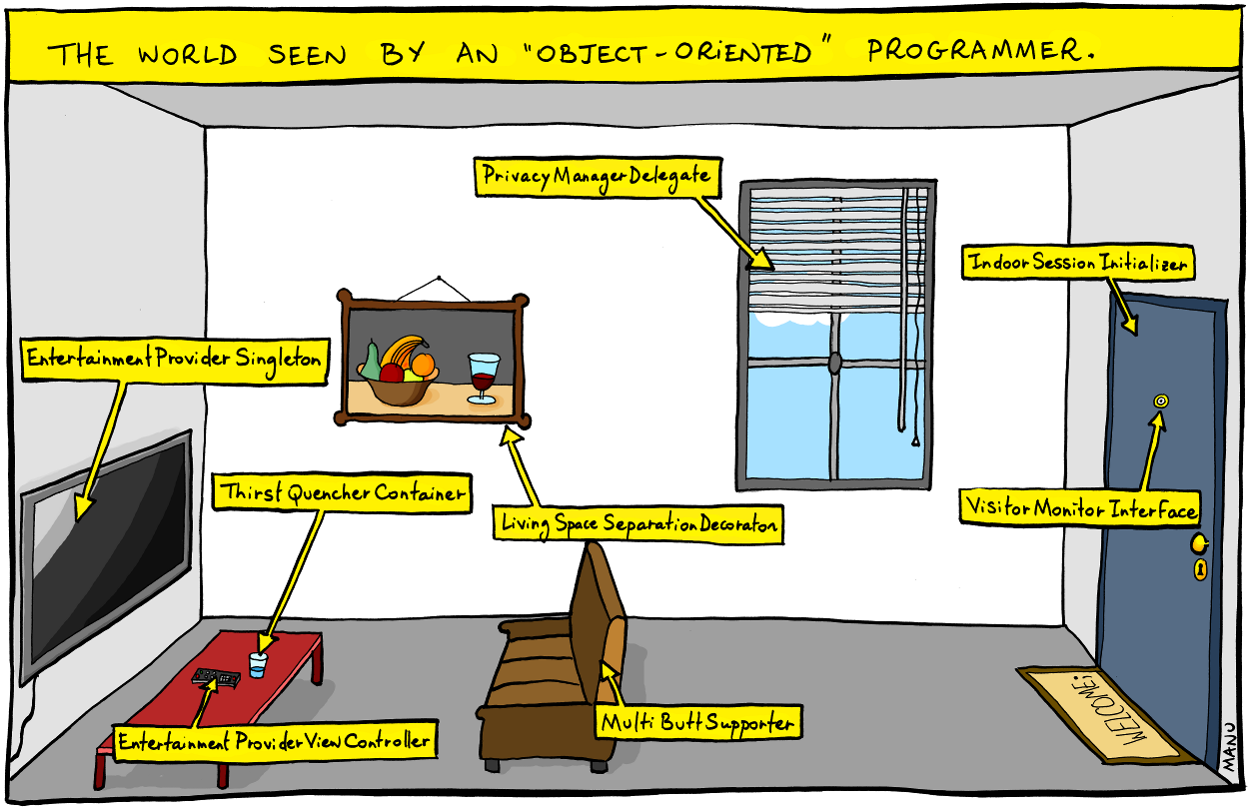
OOP’s Object oriented programming
Libraries are Object Oriented

Slide 5
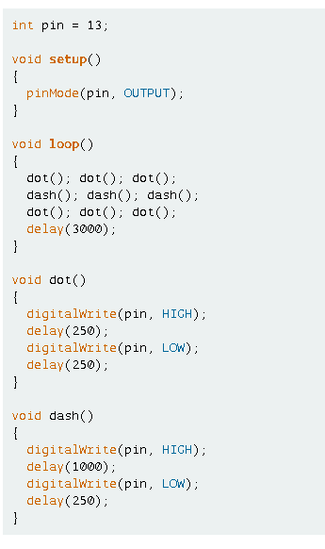
Lets get started
Setup function, why is it important?
Loop function, what does it do
Basic function
Notes:
Lets start with a basic understanding of what an Arduino program looks like!

Slide 6
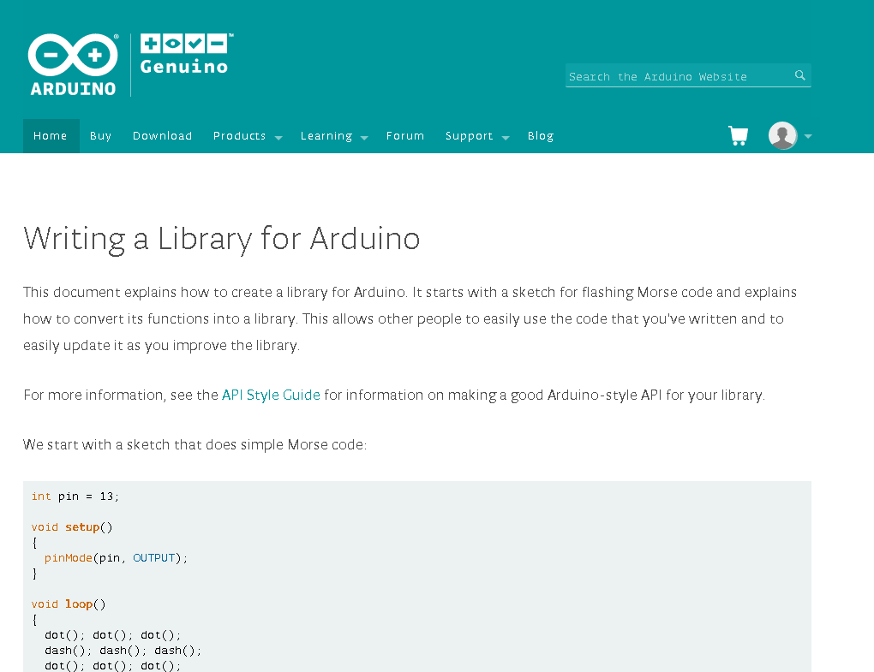
Here’s a full tutorial
Click on picture to open link

