Slide 1
Mentorship and Accessibility Challenges
Number of Mentors
Issue: Limited number of professors and TAs.
Consequence: Hinders academic growth and career advice.
Student-Specialized Mentors
Issue: Need for specialized mentors in specific cybersecurity areas.
Consequence: Gap in specialized knowledge and skills.
Flexibility
Issue: Inflexible courses and mentoring sessions.
Consequence: Missing out on learning opportunities.
Career Support and Certification Gaps
Career Support
Issue: Insufficient guidance on career paths and job market trends.
Consequence: Challenging transition from academia to professional world.
Job-Specific Certification
Issue: Need for more job-specific certification programs.
Consequence: Struggle to meet job qualifications.
Time and Resource Management Issues
Time
Issue: Limited time to acquire new knowledge.
Consequence: Hindering ability to meet industry demands.
Pain Points

Slide 2
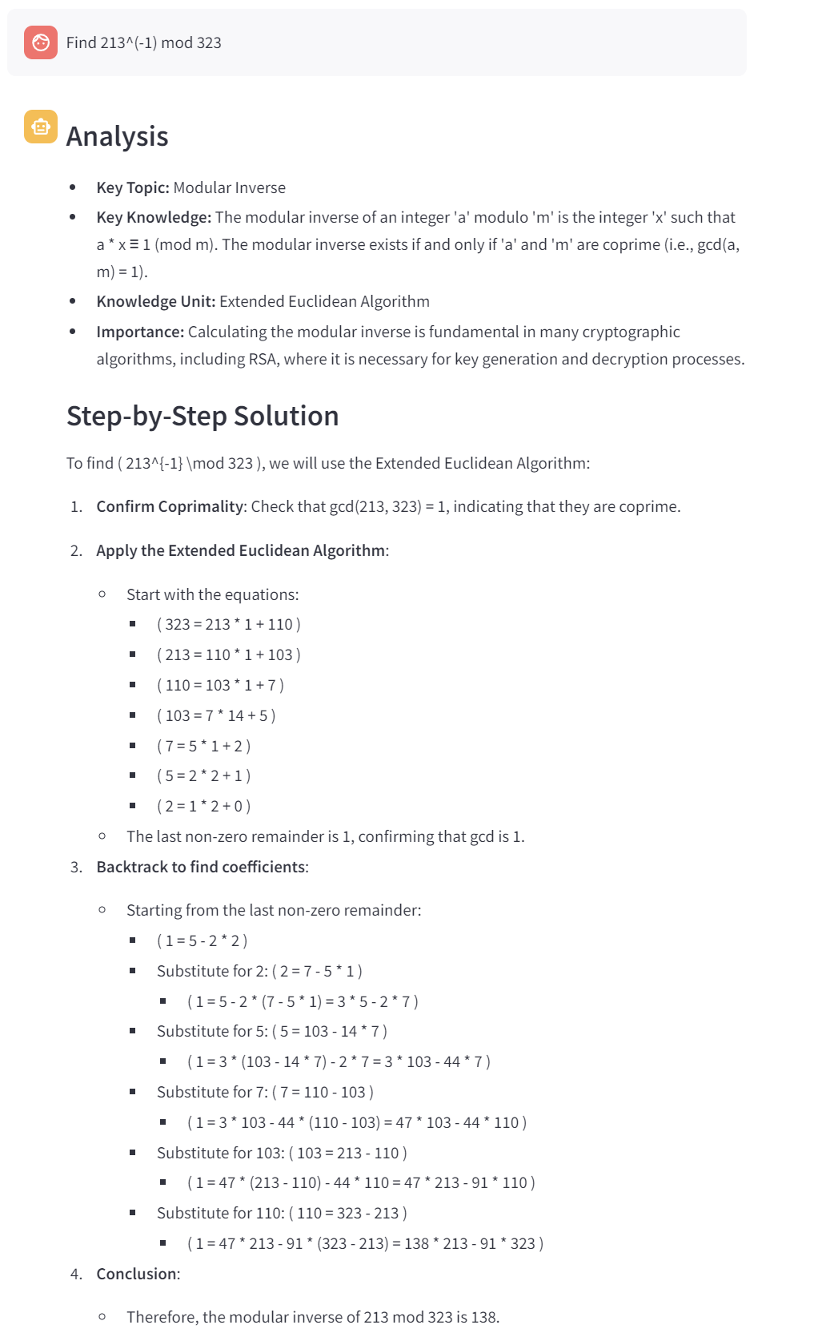
User's Query
Agent's Answer

Slide 3
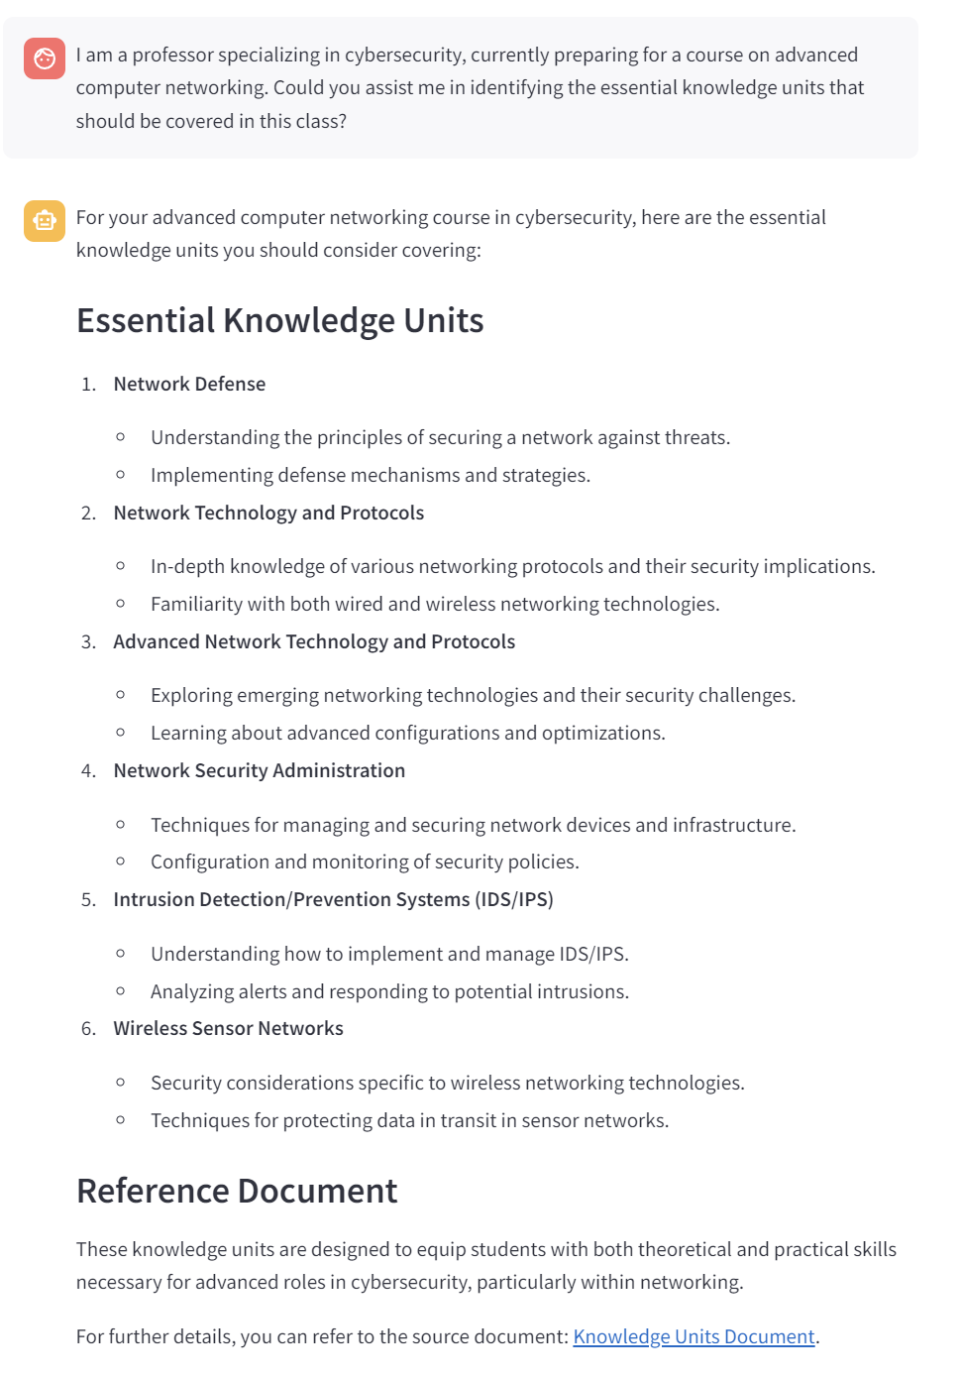
Source with URL

Slide 4
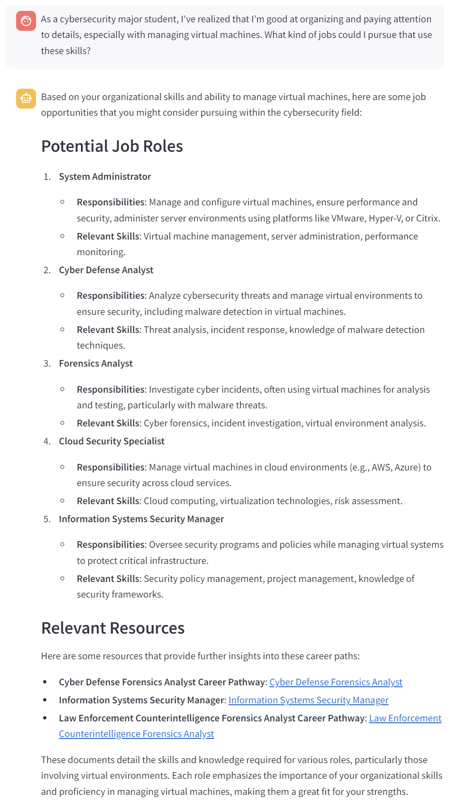
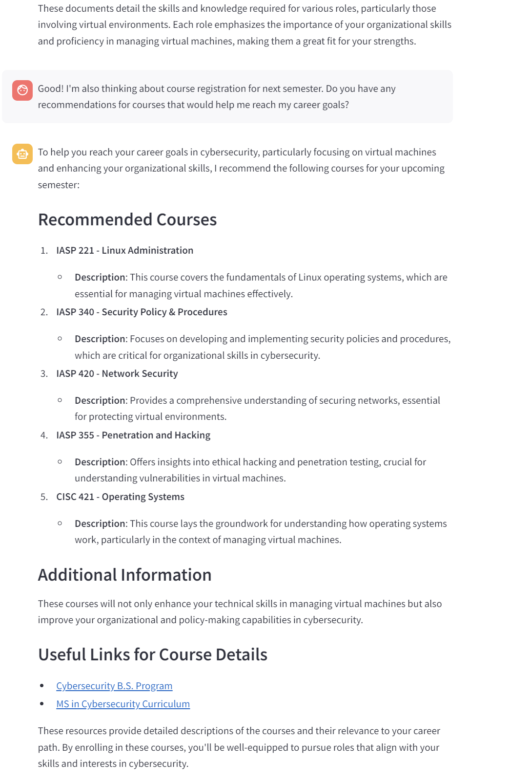
Conversational Chat
Source with URLs
Source with URLs

