Slide 1
Inspection and statistical analysis of (high-throughput) microscopy data
Christian “Tischi” Tischer
Christian.Tischer@EMBL.DE

Slide 2
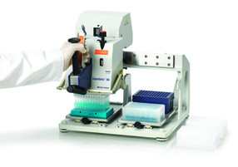

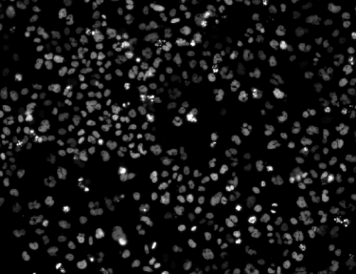
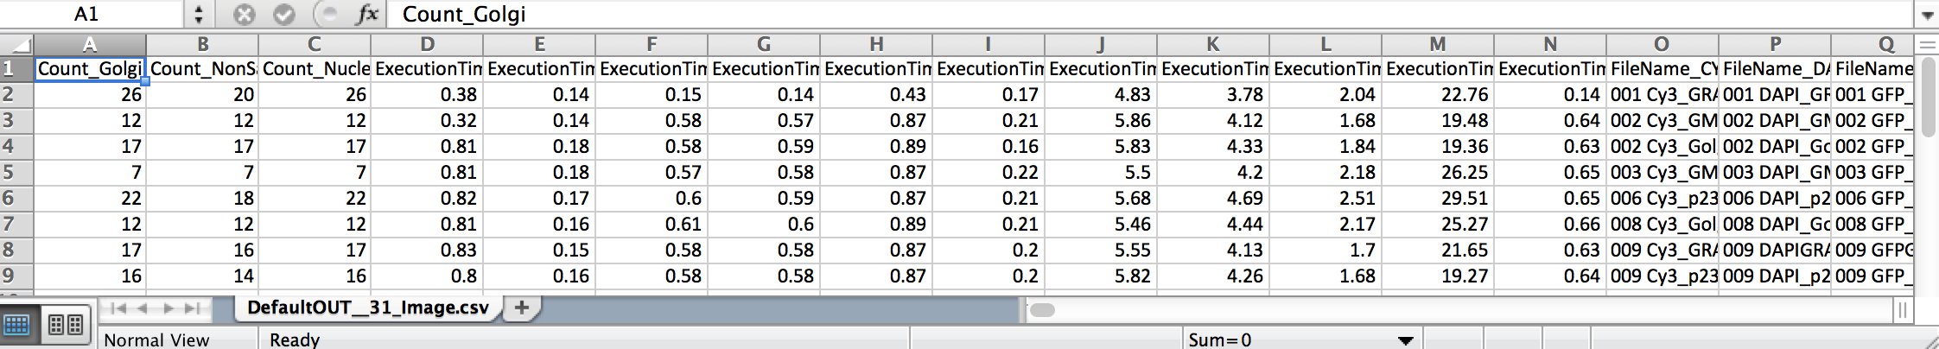
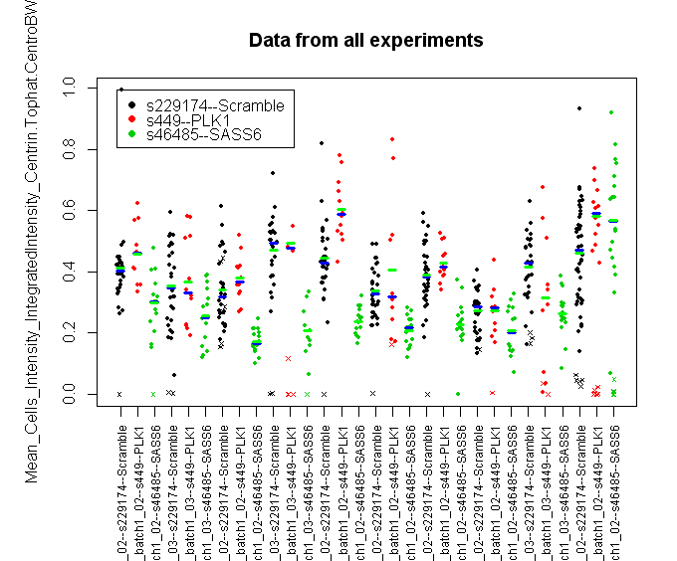
Sample Preparation
Imaging
Image analysis to calculate the readout
Visual inspection and analysis
Look at the images (don’t just believe the numbers)

Slide 3
Software for HTM data analysis
Commonly used:
Software that comes with your microscope
Pro: integrated workflow
Con: there might be some limits
Spotfire
R (cellHTS2, HTM Explorer)
Excel, MATLAB, Python, …
One feature that you should look for:
Link of the numbers back to the images (raw and segmented)
Add an example!

Slide 4
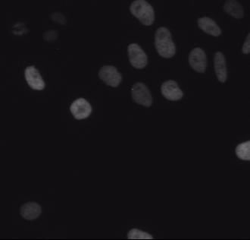
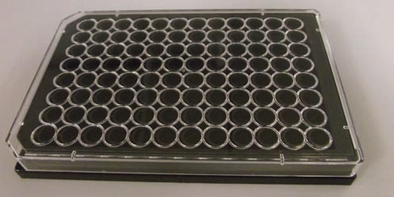
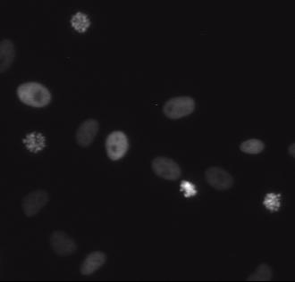
EMBO HTM course: Mitosis screen
Wide-field time-lapse for 48h (dt=30min)
of mCherry-Histone2B
Control siRNA
96-well plate
Coated with siRNAs against genes involved in mitosis
Kif11 siRNA

Slide 5

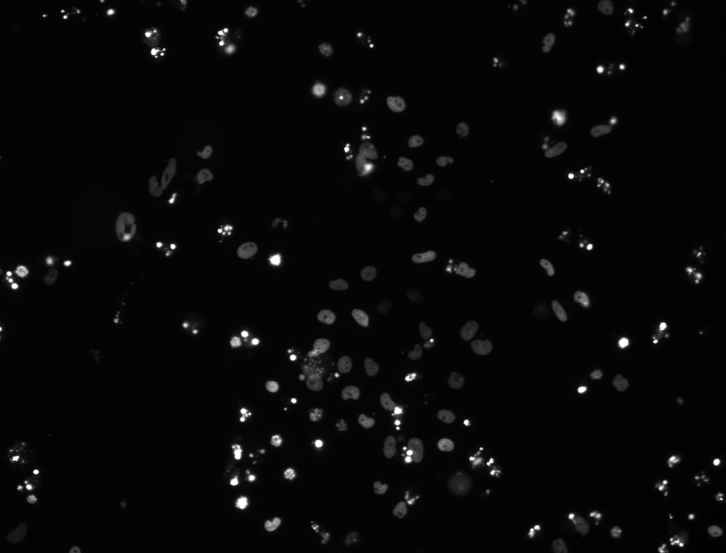
EMBO HTM course: Mitosis assay “end-point” analysis after 48h
Control siRNA
Kif11 siRNA
How would you score the difference?
Cell count
Maximal DNA intensity in each nucleus
…

Slide 6
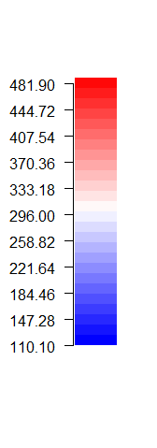
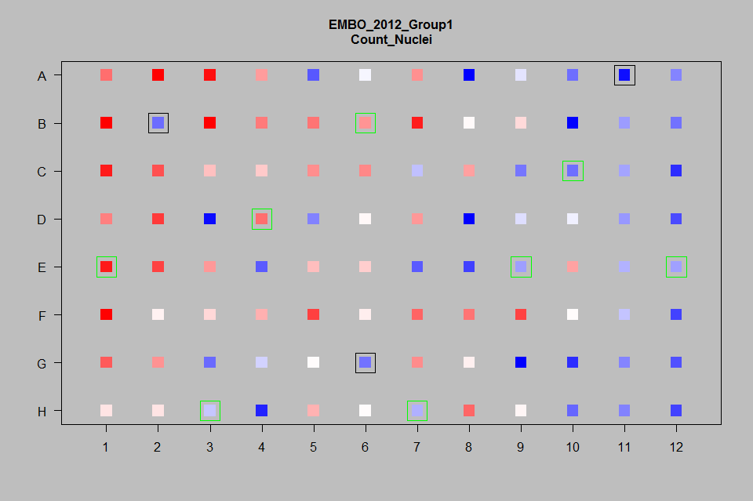
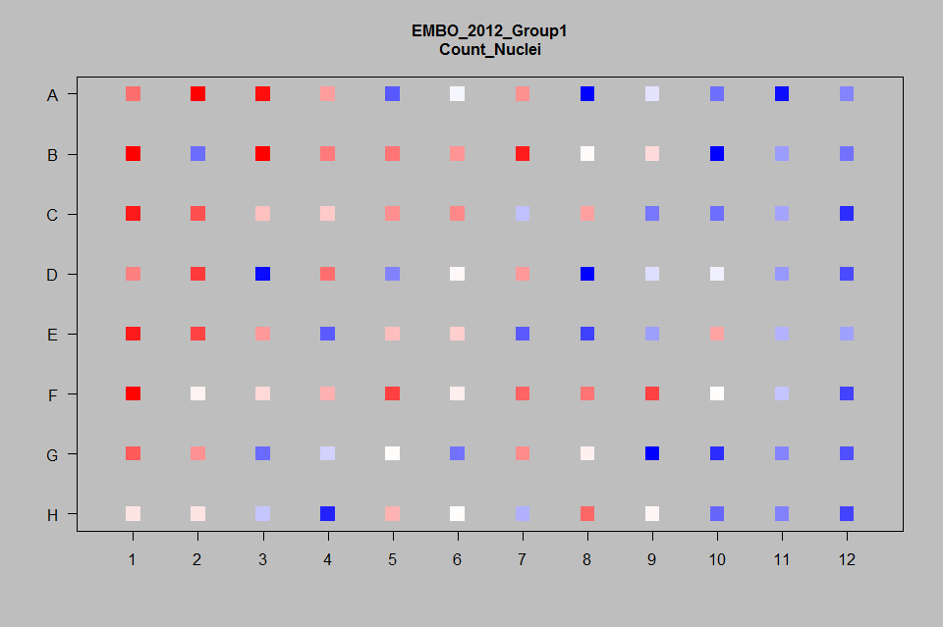
Cell count
Control siRNA Kif11 siRNA
Cell count
Gradient in cell count across the plate
Avoid cell count as a direct readout (unless you are a very good experimentalist)

Slide 7
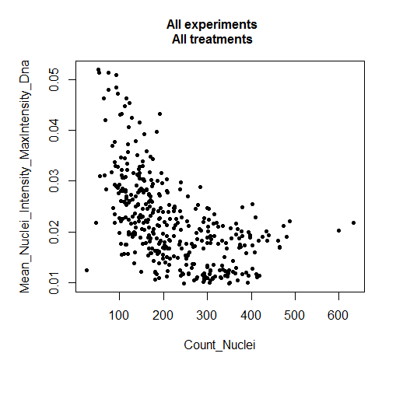
Check for cell density effects on your readout
Clear correlation between “max_DNA_intensity” and cell count; but here this is a desired feature of the assay!

Slide 8
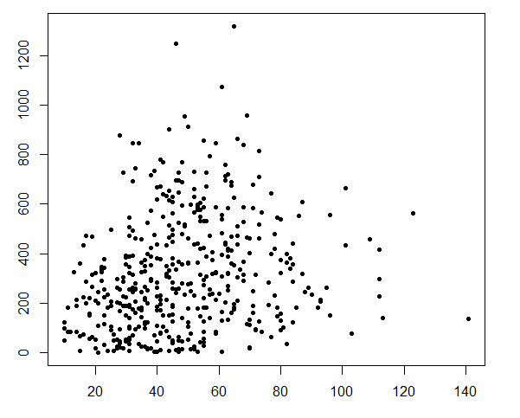
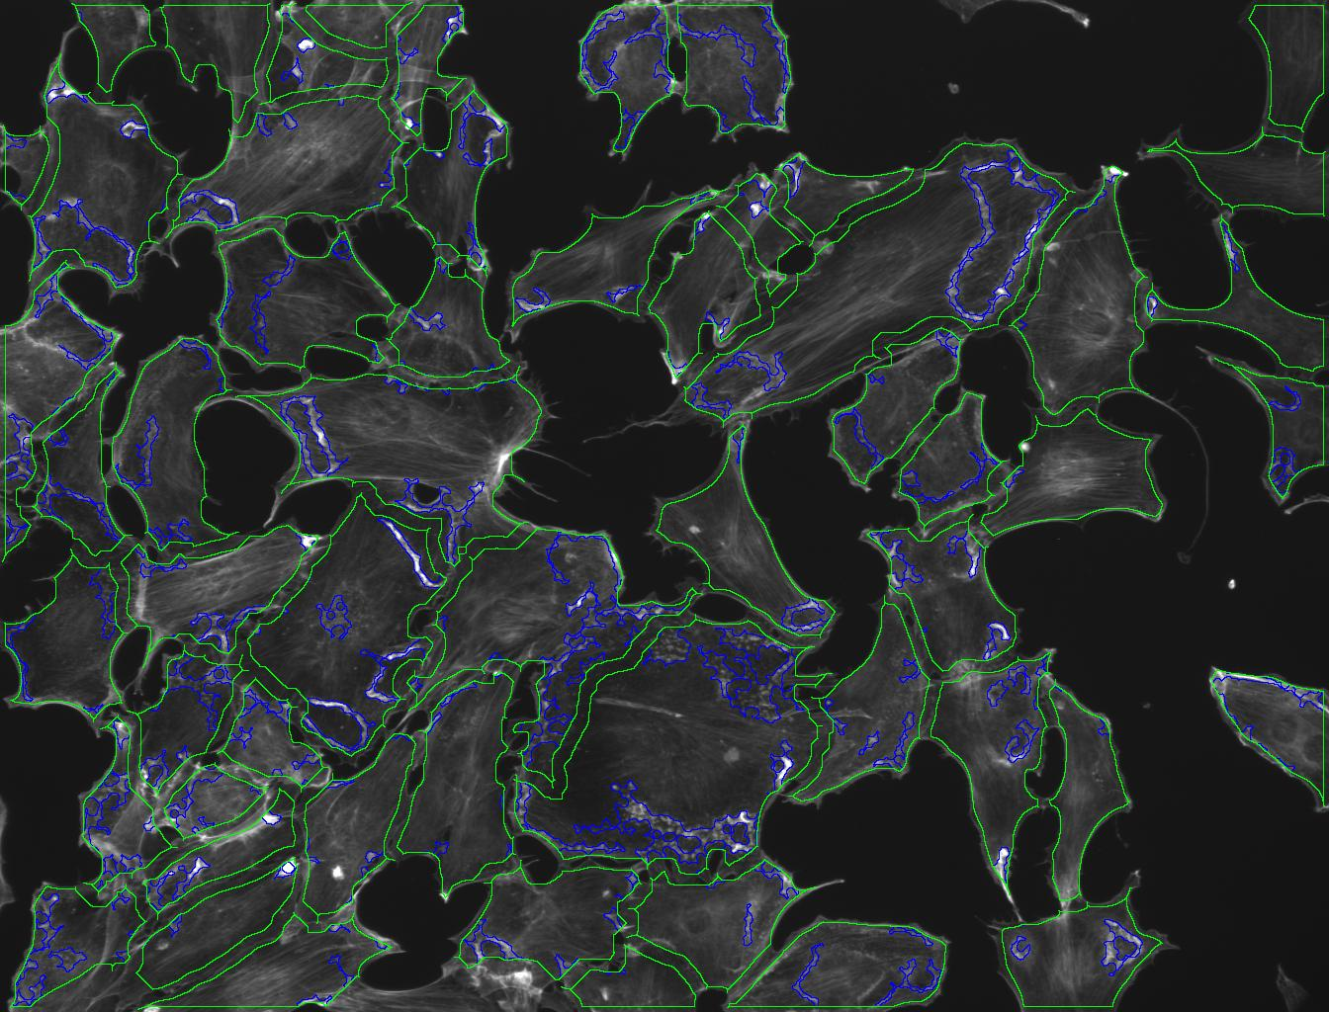
Check for cell density effects on your readout
Screen for genes involved in cell migration
Readout: Membrane ruffling (⬄ cell motility)
in response to growth factor stimulation
Only negative control siRNAs
Membrane ruffling [a.u.]
Cell count per image
Solutions: Improve cell seeding; image “gating”; modeling of the dependency in your analysis
Consider checking for cell density effects also for your non-high-throughput data
Literature: Population context determines cell-to-cell variability in endocytosis and virus infection. Nature 2009

Slide 9
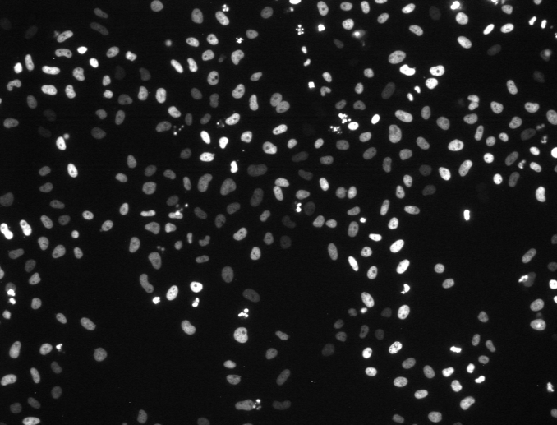
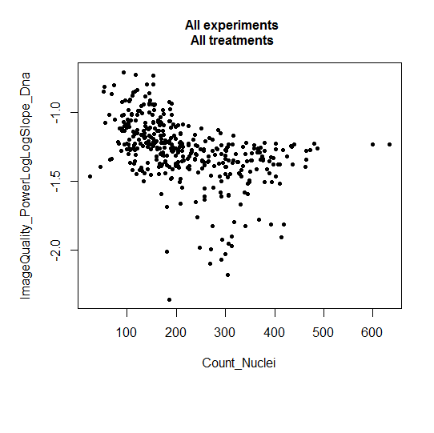
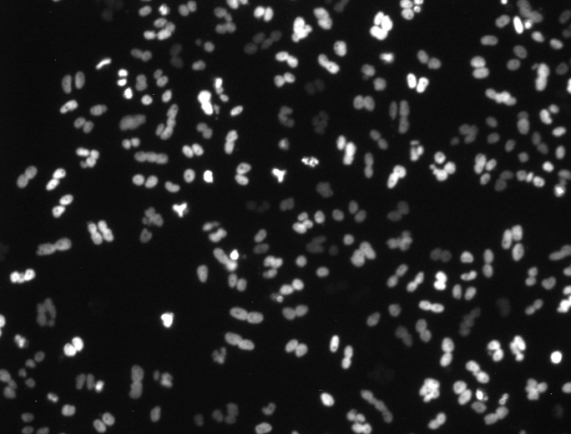
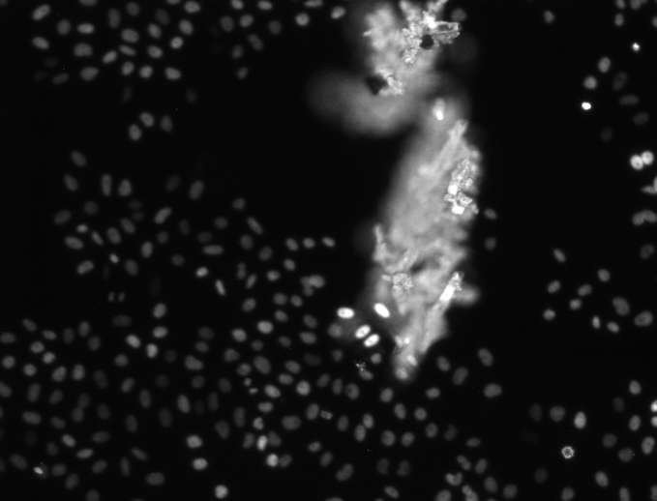
Reject “blurry” images
Nicely focussed
Blurry
Fluorescent “dirt”

Slide 10
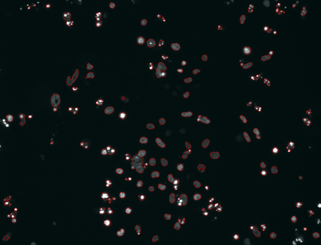
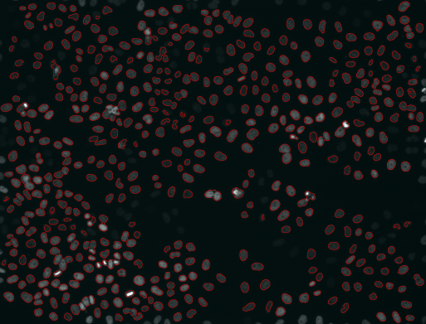
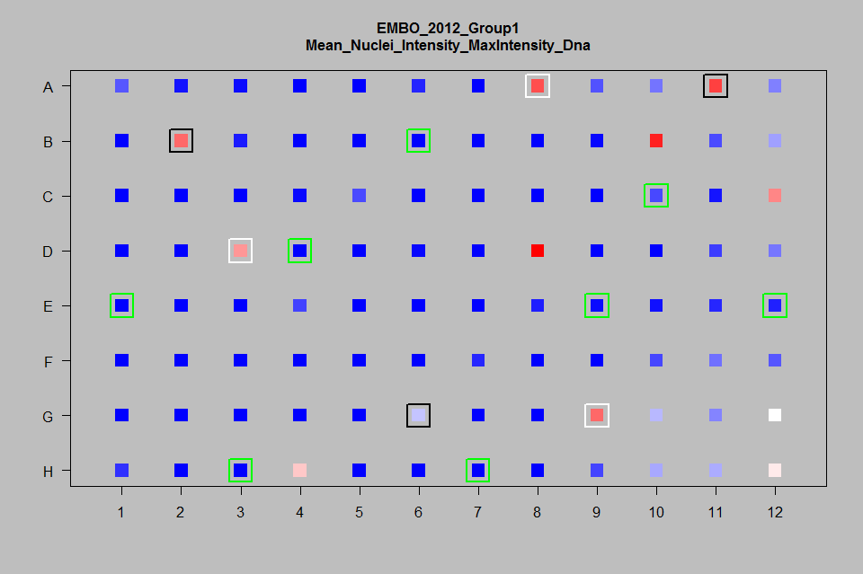
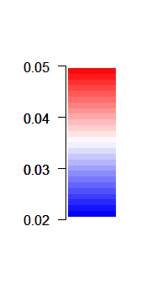
Check for intensity gradients
Kif11 Plk1 Control
Max. H2B-mCherry intensity per cell [a.u.]
Stable expression of mCherry-Histone2B: no significant intensity gradients
Phenotypes can be observed

Slide 11
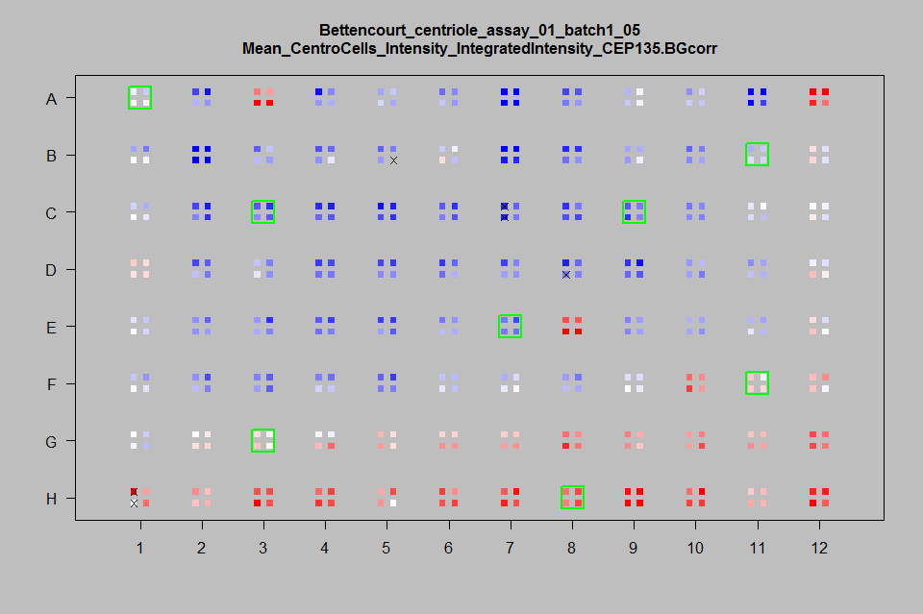
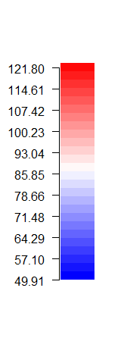
Intensity gradients in antibody staining
Control siRNA
Intensity [a.u.]
Practice the staining!
Use ratio-metric readouts!
If you can: avoid antibody staining.

Slide 12
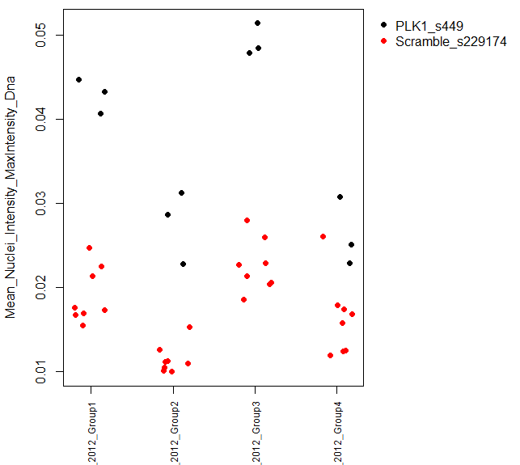
Check batch effects and effectiveness of positive controls
Controls
Many reasons for batch effects:
Cell culture…
Staining procedure
Microscope settings
…
=> Your analysis has to account for batch effects!
Readout
“Jitter plot”
Real variation of data
Artificial random “jitter”
Replicate (=“Experimental Batch”)
Also very relevant in your daily non-high-throughput experiments

Slide 13
Data transformations (for dealing with batch effects)
Typically one somehow transforms (“normalizes”) data from different experiments (“batches”) before pooling them together..
Present 3 methods (there may be more!)
Which method to chose depends on your data...

Slide 14
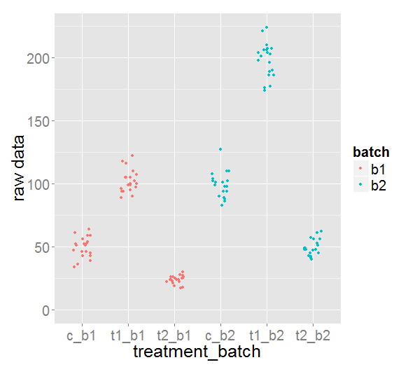
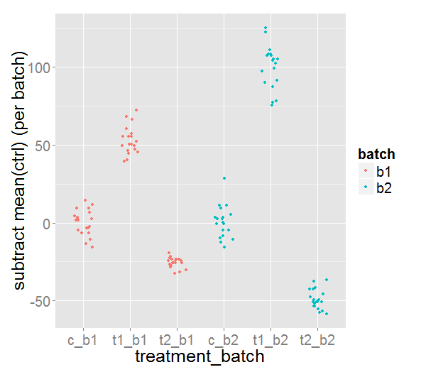
Subtracting mean of controls (per batch)
y_{i} = y_{i}-mean_{j}(c_{j})
Treatment effects were stronger in b2
Effect of t1 appears “stronger” than t2

Slide 15
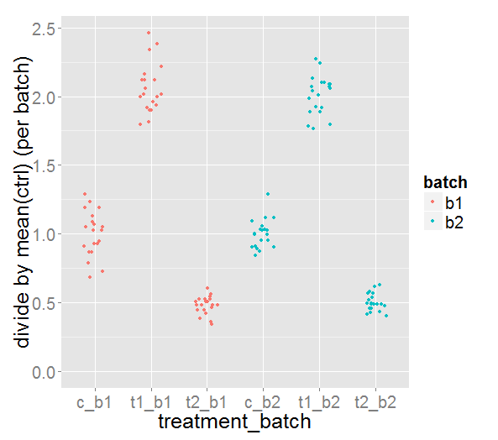
Dividing by mean of controls (per batch)
y_{i} = y_{i} /mean_{j}(c_{j})
Treatments had same effect strength in both experimental batches
Effect of t1 appears “stronger”

Slide 16
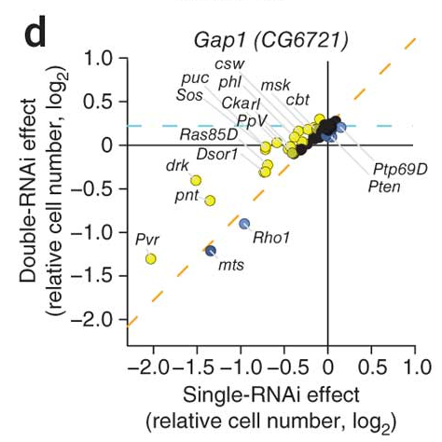
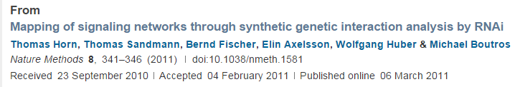
Log2 transformation

Slide 17
Log2 transformation
After transformation
Raw data
“How many factors of 2 do I need to get my measurement”

Slide 18
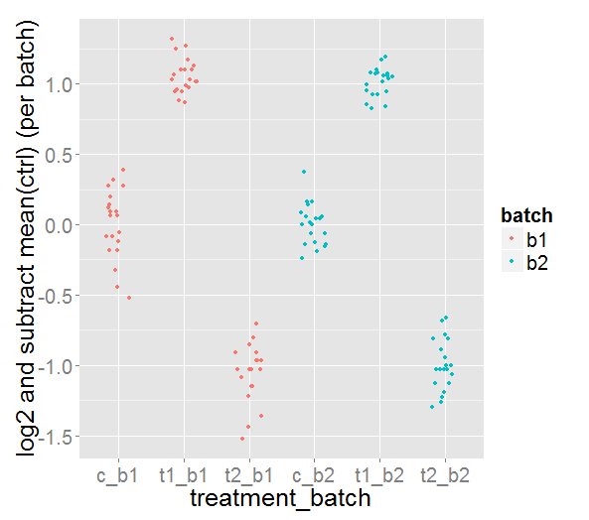
Log2 and then subtracting the mean of controls
y_{i} = log2(y_{i})-mean_{j}(log2(c_{j})) = … = mean_{j} ( log2(y_{i}/c_{j}) )
Treatments had the same effect in both experiments
t1 and t2 have same “effect strength” but in opposite directions
t1 = 2^(+1) = 2 ⬄ 2-fold increase
t2 = 2^(-1) = ½ ⬄ 2-fold decrease

Slide 19
“Statistical Analysis”

Slide 20
Literature on statistical analysis of HTM data
Bray and Carpenter. Advanced Assay Development Guidelines for Image-Based High Content Screening and Analysis. 2012.
Birmingham A, Selfors LM, Forster T, Wrobel D, Kennedy CJ, Shanks E, Santoyo-Lopez J, Dunican DJ, Long A, Kelleher D, Smith Q, Beijersbergen RL, Ghazal P, Shamu CE. Statistical methods for analysis of high-throughput RNA interference screens. Nat Methods. 2009
Many methods..no standard => you can think yourself ☹ ☺

Slide 24
Median z-score
T1, t2, ctrl; antibody staining assay
2x increase, 2x decrease
Two different days => different values (also make standard deviation of controls different)
Always: left graph: raw data; right graph: transformed data
Method 1: divide by controls
Method 2: z-score
Method 3:

Slide 25
Plate based quality control
Controls
For example:
Readout
!! Add the numbers (get from R)
Plate ID (=“Experimental Batch”)

Slide 27
Should I log-transform my data?
Additive biology:
In my treated sample I have 10 more vesicles than in my negative control
Multiplicative biology:
In my treated sample I have 2 times more vesicles than in my negative control
If you are in interested in fold-changes you should probably log-transform you data…

Slide 28
Cell density
Corallino
Strong gradient, but his readout was
not cell density => data could still be used
EMBO 2014
Gradient less severe than siRNA effect
Plate readout
Avoid cell count (proliferation) as a direct readout (unless you are a very good experimentalist)
Check that your actual readout does not depend on cell density (this typically is the case to some extend!)

Slide 29
Quality control of images
Focus quality
Cell Count

Slide 30
Check how your readout depends on cell count!
Notes:
Nature 2009
Population context determines cell-to-cell variability in endocytosis and virus infection.
Snijder B, Sacher R, Rämö P, Damm EM, Liberali P, Pelkmans L.

Slide 31
Example
Say your readout is number of cells. Your control measurement gave you
c = 20
and you have two independent measurements for your treatment, namely
m1 = 10
m2 = 40

Slide 32
Additive interpretation
In measurement one the number of cell was decreased by 10 (10-20=-10) and in measurement two the number of cells was increased by 20 (40-20=+20). Thus, on average the treatment led to an increase in the number of cells, because the mean difference of control samples and treated samples is: mean(-10, +20) = +5.
c = 20; m1 = 10; m2 = 40
d1 = m1 - c = -10
d2 = m2 - c = +20
mean(d1,d2) = +5

Slide 33
Multiplicative interpretation
In measurement one the number of cells decreased by a factor of 2 (10/20=1/2) and in measurement two the number of cells increased by factor of 2 from (40/20=2). As you got the exact opposite effect in your two measurements you would say that on average there was no effect of the treatment.
In order to get this result mathematically one needs to take the logarithm (e.g. the log2) of the data before computing the differences:
c = 20; m1 = 10; m2 = 40 log2(c) = log2(20) = 4.32 log2(m1) = log2(10) = 3.32 log2(m2) = log2(40) = 5.32 d1 = log2(m1) - log2(c) = 3.32 - 4.32 = -1 d2 = log2(m2) - log2(c) = 5.32 - 4.32 = +1 mean(d1,d2) = 0
Notes:
the -1 corresponds to a 2-fold decrease as 2^(-1)=1/2
the +1 corresponds to a 2-fold increase as 2^(+1)=2
The reason is that: log2(m1)-log2(mean(ctrls))

Slide 34
Computing the ratio to the controls…
c = 20; m1 = 10; m2 = 40 f1 = m1/c = 10/20 = 0.5 f2 = m1/c = 40/20 = 2 mean(f1,f2) = 1.25
In fact, the expected number of vesicles in the treated sample is 1.25*20=25, which is the same result as in the additive interpretation!
If, in the last step you take the geometric mean, you get the same result as with the log2….

Slide 35
Statistical Analysis:
Normalizing against controls
Taking care of batch effects
Computing statistical signifcances
There are various methods around to compute “hits” across different batches (=replicates=plates)
Here we will discuss one of the more common approaches and one of our own ideas

Slide 36
Literature on statistical analysis of HTM data
Bray and Carpenter. Advanced Assay Development Guidelines for Image-Based High Content Screening and Analysis. 2012.
Birmingham A, Selfors LM, Forster T, Wrobel D, Kennedy CJ, Shanks E, Santoyo-Lopez J, Dunican DJ, Long A, Kelleher D, Smith Q, Beijersbergen RL, Ghazal P, Shamu CE. Statistical methods for analysis of high-throughput RNA interference screens. Nat Methods. 2009
Many methods..no standards => you have to think yourself ☹☺

Slide 37
z_score and robust_z_score for one plate=experiment=batch=replicate
For each plate and treatment the z_score (or robust_z_score) is computed against the controls of the same plate as shown in below examples
Comments:
this method is not so good if there are only few control wells, because estimation of SD or MAD is noisy (see next slide)
1
3
5
4
5
z_score = (treated - mean(ctrls)) / sd(ctrls) = -3.39
mean(ctrls) = 1/4 * (3+4+5+5) = 4.25
sd(ctrls) = sqrt(1/4 * ((3- 4.25)^2+(4- 4.25)^2+(5- 4.25)^2+(5- 4.25)^2)) = 0.9574
z_score = (1 – 4.25) / 0.9574 = -3.3945
robust_z_score = (treated - median(ctrls)) / mad(ctrls) = -4.72
median(ctrls) = median(3,4,5,5) = (4+5)/2 = 4.5
mad(ctrls) = 1.4826 * median(abs(3-4.5),abs(4-4.5),abs(5-4.5),abs(5-4.5)) = 1.4826 * median(1.5,0.5,0.5,0.5) = 1.4826 * median(0.5,0.5,0.5,1.5) = 1.4826 * (0.5+0.5)/2 = 0.741
robust_z_score = (1 – 4.5) / 0.741 = -4.7212

Slide 38
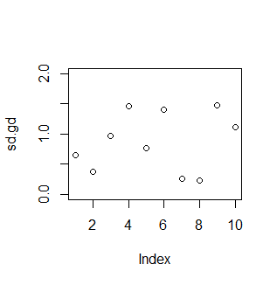
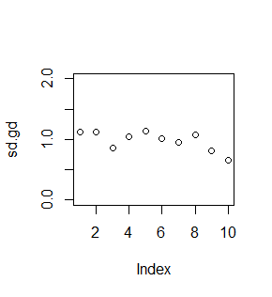
Estimation of the standard deviation is noisy if you have few negative control wells
4 negative ctrl wells
20 negative ctrl wells
Standard deviations were computed from simulated (mean=0,sd=1) Gaussian distributed numbers
z_score = (treated - mean(ctrls)) / sd(ctrls)
Thus, if you have few negative controls, just because of statistical noise, whole plates will be full of hits or non-hits…

Slide 39
z_scores for multiple batches
z_scores :
If there are multiple replicates we compute the z-score for each treatment for each plate and then the median across all replicates.
Example:
treatment T1 occurs in 3 plates (same layout, but different replicates)
We get 3 z-scores (could be the robust or the normal ones, whatever you chose)
Now we have three numbers, however for the final score of this treatment we only want one number
The HTM Explorer gives you the median of the three numbers as the final score
Comments:
The idea of taking the median is that you want to have “a hit” (i.e., abs(z_score)>2) for at least half of the plates
Not a statistical significance test.
Not a reporter of the biological effect strength
1
3
5
4
-4.72
5
3
2
4
3
0
3
2
6
5
2
-1.686
4
final score = median(0,-1.686,-4.72) = -1.686

Slide 40
Position (well)-based t-test for multiple batches
1
3
5
3
2
4
2
6
5
4
3
2
5
3
4
1
{3,4,5,5}
3
{2,4,3,3}
2
{6,5,2,4}
Raw data
Mean of controls
4.25
3
4.25
Batch-correct values
(subtract mean of controls)
-3.25
{-1.25,-0.25,0.75,0.75}
0
{-1,0,0,1}
-2.25
{-2.25,1.75,0.75,-0.25}
Pooling of batch-
corrected values
{-3.25, 0, -2.25}
{ -1.25,-0.25,0.75,0.75,-1,0,0,1,-2.25,1.75,0.75,-0.25}
Perform t-test* of the
pooled values against each other
estimate = -1.833333 (difference of treatment and controls)
p-value = 0.03870884 (statistical significance of treatment being different from controls)
* taking into account that the number of independent measurements (degrees of freedom) is diminished by the batch corection

Slide 41
Example: Spread of negative controls
Well-scores of negative controls of each plate after log2 transformation and subtraction of the mean

Slide 42
Example from a real screen
treatment | t_test__estimate | t_test__p_value |  | median__z_score | median__robust_z_score
GeneA | -1.067767813 | 0 | *** | -9.129851052 | -21.13130173
GeneB | -0.765394206 | 1.89E-11 | *** | -4.686658325 | -7.017623219
GeneC | -0.697730881 | 1.38E-13 | *** | -5.296987544 | -5.629259732
GeneD | -0.689135232 | 1.02E-14 | *** | -5.347059172 | -6.769186714
GeneE | -0.683035004 | 4.21E-12 | *** | -5.478532326 | -6.033850527
GeneD | -0.63531221 | 1.51E-12 | *** | -5.685483997 | -8.162547161
GeneE | -0.615899329 | 1.46E-12 | *** | -5.035121461 | -7.385407125
GeneF | -0.614621534 | 4.09E-13 | *** | -5.997652672 | -12.93957412
GeneG | -0.597659238 | 4.74E-13 | *** | -4.256528391 | -6.118617689
treatment | t_test__estimate | t_test__p_value |  | median__z_score | median__robust_z_score
Neg1 | NA | NA | NA | 2.22E-16 | -0.030533073
GeneH | 0.432855128 | 0.012965435 | * | 1.219720675 | 1.270834193
GeneI | 0.41240394 | 0 | *** | 3.437446649 | 4.84215126
GeneJ | 0.296609968 | 1.25E-05 | *** | 2.111099198 | 2.208698089
GeneK | 0.205647476 | 0.000492359 | *** | 1.27976947 | 1.464338023
GeneL | 0.203888283 | 0.000620351 | *** | 1.3497868 | 1.455293043
GeneM | 0.203621335 | 0.000119977 | *** | 1.603507052 | 1.52439847
GeneN | 0.195074801 | 0.000182192 | *** | 1.292321787 | 1.731353029
GeneO | 0.192554386 | 0.000200012 | *** | 1.426067453 | 1.552754476
treatment | t_test__estimate | t_test__p_value |  | median__z_score | median__robust_z_score | numPositionsOK
GeneI | 0.41240394 | 0 | *** | 3.437446649 | 4.84215126 | 179
Neg2 | -0.218463732 | 0 | *** | -1.803345254 | -2.462254826 | 224
GeneQ | -0.290877449 | 0 | *** | -2.504842724 | -3.406115025 | 90
GeneR | -0.297481536 | 0 | *** | -2.377553683 | -3.059744663 | 90
GeneA | -1.067767813 | 0 | *** | -9.129851052 | -21.13130173 | 6
GeneD | -0.689135232 | 1.02E-14 | *** | -5.347059172 | -6.769186714 | 8
GeneC | -0.697730881 | 1.38E-13 | *** | -5.296987544 | -5.629259732 | 8
GeneF | -0.614621534 | 4.09E-13 | *** | -5.997652672 | -12.93957412 | 7
Log2 transformed; negative control=Neg1

Slide 43
Statistical Analysis (Optional): Use all treatments as my negative control?
So far, we assumed that we have specific wells with negative controls
However, one needs quite many of these negative control wells on each plate in order to obtain trustworthy data …
Thus, sometimes people don’t have dedicated negative controls but use all treatments as negative controls!

Slide 44
Using all treatments as “negative controls”
1
2
1
9
5
Pro:
Good statistics
You don’t need negative control wells
Con:
Assumes that most of the wells show no effect (thus, you should not use it for preselected treatments)
4
3
5
3
2
2
3
2
5
1
robust_z_score = (treated - median(all)) / mad(all)
median(all) = 3
mad(all) = 1.4826
robust_z_score(9) = (9 – 3) / 1.4826 = 4.04
robust_z_score(2) = (2 – 3) / 1.4826 = -0.67
…

Slide 45
Statistical Analysis: Hands on

Slide 46
Statistics for Count_Nuclei
[Analysis..Statistical Analysis]
Measurement: Count_Nuclei
Method to average images: Does not matter here
Number of objects per image: Count_Nuclei
Well QC: min. num. objects: 0
Negative Control: Scramble
Data transformation: log2
[Options]
Positive Controls: PLK1
[Analyze]
Save the results table on your desktop
Open in Excel: …\embo2014\embo2014\P9_HTManalysis\data\TreatmentSummary--log2--Count_Nuclei.xlsx
Also check output in the R console
Notes:
Since replicate 4 is not convincing you may rerun the analysis without replicate 4:
[Options]
Experiments to be excluded: “EMBO_2012_Group4”

Slide 47
Checking plate quality by comparing positive and negative controls
[1] "Checking how well positive and negative controls are separated in each batch..."
[1] "Measurement: minusMeanCtrl__log2__wellscore__Count_Nuclei__weighted_mean_of_images"
[1] "Positive control: PLK1_s449"
[1] "Negative control: Scramble_s229174"
[1] ""
[1] "EMBO_2012_Group1 N_neg: 8 N_pos: 3 z-score of positive controls: -2.91 "
[1] "EMBO_2012_Group2 N_neg: 8 N_pos: 3 z-score of positive controls: -4.343 "
[1] "EMBO_2012_Group3 N_neg: 8 N_pos: 3 z-score of positive controls: -3.186 "
[1] "EMBO_2012_Group4 N_neg: 8 N_pos: 3 z-score of positive controls: -0.235 XX"
Since replicate 4 is not convincing you may rerun the analysis without replicate 4:
[Analyze..Statistical Analysis]
[Options]
Experiments to be excluded: “EMBO_2012_Group4”

Slide 48
“Hit list” for Count_Nuclei
treatment | t_test__positions__estimate | t_test__positions__p_value
PLK1_s449 | -1.131230639 | 5.53E-06 | ***
KIF11_s7903 | -0.89376534 | 0.000172683 | ***
CKAP5_s18928 | -0.851921263 | 0.000298267 | ***
AURKB_s17612 | -0.810013047 | 0.000577339 | ***
CDC20_s2748 | -0.489027968 | 0.158431571
ECT2_s4445 | -0.384445602 | 0.115076899
INCENP_s7424 | -0.316125276 | 0.137008862
XWNeg9_s444246 | -0.310462854 | 0.156312175
COPB1_s3371 | -0.17258749 | 0.44157743
CIT_s21911 | -0.147081312 | 0.460822383
CDC20_sCDC20 | -0.105638489 | 0.66812824
empty_empty | -0.086914295 | 0.392933108
XWNeg9_XWNeg9 | 0.030877695 | 0.855318244
Scramble_s229174 | NA | NA | NA

Slide 49
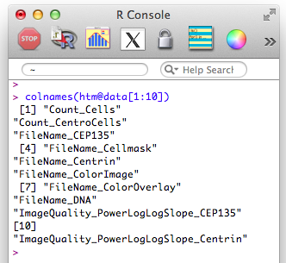

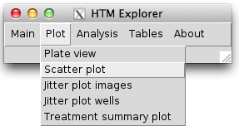
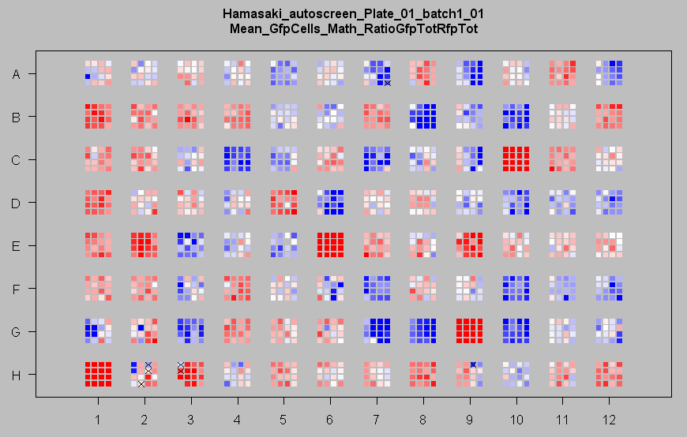
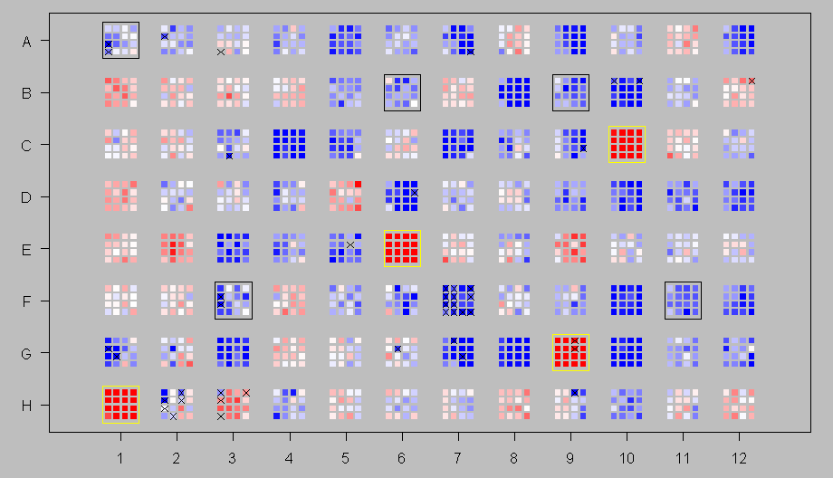

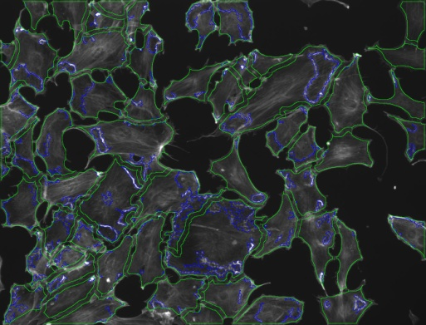
“HTM Explorer” Statistics in R linked with image viewing in ImageJ
- for free; runs on Mac, Linux and PC
- widely used (also at EMBL => help available)
- many functions for statistical analysis
good plotting tools
it is a programming language => unlimited flexibility
one can develop graphical user interfaces (GUIs) for ease of use
for free; runs on Mac, Linux and PC
the standard software for image viewing in biology
useable via GUI (=> easy to use)
varios tools for image inspection
supports basically all image formats
it also is a programming language => unlimited flexibility

