Slide 1
Abstract
High-throughput and adaptive feedback microscopy
Christian Tischer, Sabine Reither, Volker Hilsenstein, Beate Neumann, Rainer Pepperkok
Advanced Light Microscopy Facility, EMBL Heidelberg
Meyerhofstr.1, 69117 Heidelberg, Germany
High-throughput microscopy of siRNA treated cells has become a standard tool for discovering genes with roles in specific biological processes. However, conducting high-throughput microscopy experiments is still challenging as it puts high demands on sample preparation, microscopy, image and data analysis. Moreover, further characterization of the “hit genes” often requires demanding microscopic assays that are difficult to perform even in medium throughput. In this talk, I will outline the typical challenges occurring in high-throughput microscopy and discuss how dedicated microscope systems can help to tackle these challenges. In addition, I will describe how “adaptive feedback microscopy” allows scientist to perform highly complex microscopic assays in a fully automated manner, thereby enabling detailed and systematic further investigation of the identified “hit genes”.

Slide 2
To do
Name of cel

Slide 3
High-throughput and adaptive feedback microscopy
Christian Tischer, Sabine Reither, Volker Hilsenstein, Beate Neumann, Rainer Pepperkok
Advanced Light Microscopy Facility, EMBL Heidelberg
Meyerhofstr.1, 69117 Heidelberg, Germany

Slide 5
High-throughput screening microscopy
“Primary” screen
Protein knockdown by siRNA
Monitor perturbation of biological process in microscopy assay
Biological process
Protein localization dynamics
Which proteins?
Protein-protein
interaction dynamics
“Secondary” screen
“Secondary” screen
Notes:
You have an assay that tells you whether the process of interest is working and then you look in the presence of siRNAs whether the process is still working.

Slide 6
Temperature stability

Slide 7
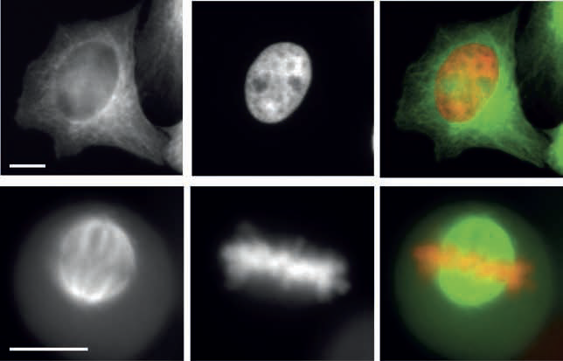
Cost efficiency
GFP-Tubulin
DNA (Hb2-mCherry)
Merge
Interphase
Mitosis
Fig. 2: Double colour imaging in plastic cell culture plates.
HeLa-Kyoto cell stably expressing H2B-mcherry and GFP-tubulin were cultured in a
plastic cell culture plate from NUNC, fixed and subsequently imaged using a 20x/0.75NA
objective with a magnification changer 2. (A,D) GFP-tubulin, (B,E) H2B-mcherry, (C,F)
overlay image (GFP-tubulin shown in green and H2B-mcherry in red). Scale bar 10 μm.

Slide 8
Edge effects

Slide 9
Autofocus CellDiscoverer 7
Find Surface
Focus Hold
Focus every time-point and position

Slide 10
Speed
Filter wheel vs. other
=>Sabine, Speed Mdev?

Slide 11
Variable NA imaging

Slide 12
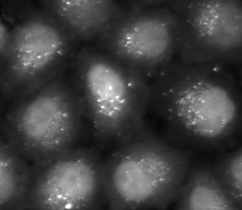
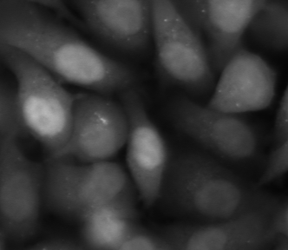
Autophagosome screen
Treatment A
Treatment B
In principle, the total intensity inside all dot-like structures
in each cell is proportional to the amount of protein recruited
to autophagosomes in this cell.

Slide 13

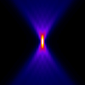
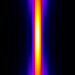
Acquisition modalities
Confocal NA1.4
Widefield NA0.9
Widefield NA0.3
z
10 micrometer
PMT
CCD
CCD

Slide 14

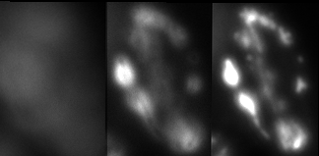

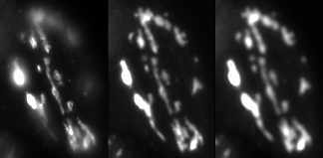
Low NA imaging of thin samples in wide-field microscopes
HeLa cell, Golgi-GFP
dz = 1 micrometer
NA 0.3
NA 0.9
z
y
x
z
NA 0.35
NA 0.26
x
NA 0.8

Slide 15
Low NA Transmission
Sebastian!

Slide 16
What to measure
Mean vs Sum
Cell cycle example

Slide 17
Secondary Screens

Slide 18
What to measure
Mean vs Sum
Cell cycle example

Slide 19



Intelligent Microscopy [Conrad et al.] Adaptive Feedback Microscopy [Tischer et al.] Smart Microscopy [Huisken et al.] Open Application Development (OAD) [Zeiss]
Sent new microscope settings
Analyze data to derive adapted microscope settings
Todo:
add references
Look for more synonyms

Slide 20
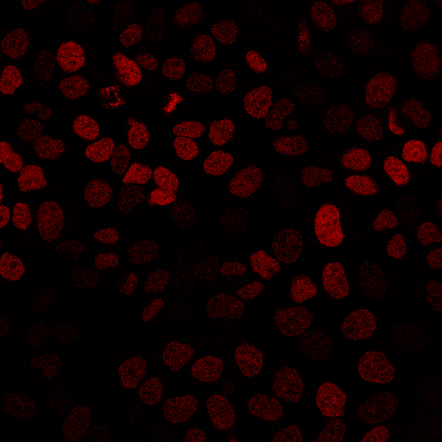
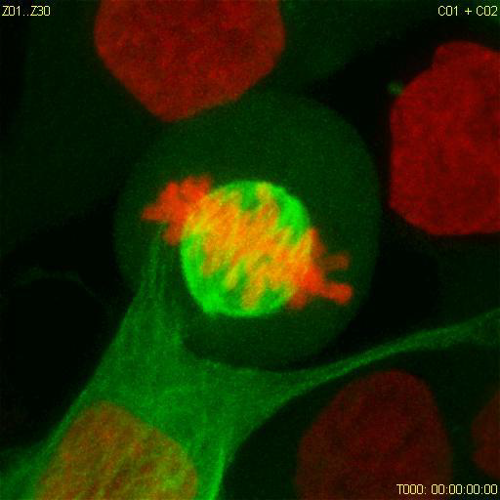
High-resolution Adaptive Feedback Time-lapse Imaging of Mitosis
- Move to next grid position. - Acquire low-zoom, single plane, single channel image
Todo:
make images gray-scale
Add microscope icon
x, y
Microscope:
- Move to x,y - Acquire high-zoom, multi plane, dual color, time lapse data
x=150 y=80
Automated analysis:
Mitotic cell coordinates

Slide 21

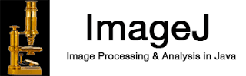
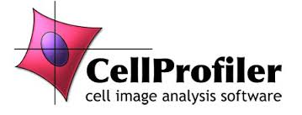
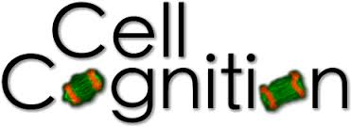
ZEN Black
Logo, LSM510 logo
Todo:
add references
Look for more synonyms
(1) Rabut and Ellenberg, Automatic real-time three-dimensional cell tracking by fluorescence microscopy. J. Microscopy, 2004

Slide 22

ZEN Blue
ZEN Blue
Todo:
add references
Look for more synonyms
(1) Rabut and Ellenberg, Automatic real-time three-dimensional cell tracking by fluorescence microscopy. J. Microscopy, 2004

Slide 23
Multi-step Adaptive FRAP Microscopy
Zeiss
LSM780
Visual Basic
ImageJ Analysis
In this way several hundreds of recovery data sets can be automatically acquired in an overnight experiment, thus drastically increasing the data significance
compared to manual data acquisition where at best several tens of useful datasets
can be acquired in the same amount of time.

Slide 24
Adaptive FCS Microscopy

Slide 28
Image analysis, quality control and statistics

Slide 29
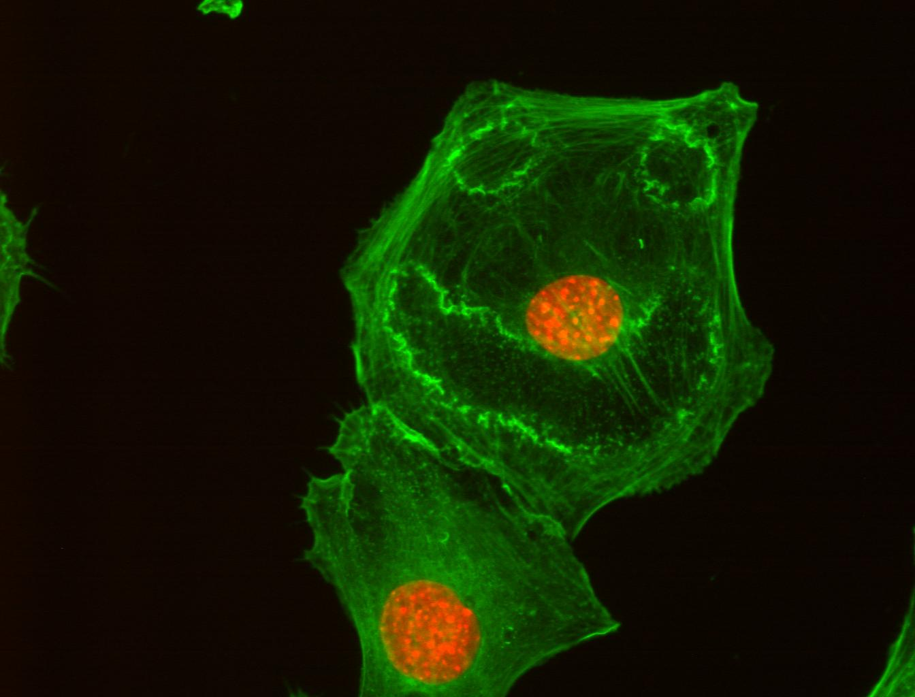
Acknowledgements
ALMF team:
Beate Neumann
Sabine Reither
Volker Hilsenstein
Yury Belyaev
Stefan Terjung
ALMF alumni
Christian Conrad
Jutta Bulkescher
FCS:
Malte Wachsmuth
Frank Sieckmann (Leica)
Zeiss LSM780 automation:
Gwen Rabut, Annelie Wuensche, Antonio Politi
Jan Ellenberg
Rainer Pepperkok
Green: actin cytoskeleton
Red: nucleus
Cells treated with PDGF

Slide 32
Adaptive Feedback Microscopy using ZEISS products
Microscope Examples | Zeiss Software | Open Application Development Modality | Image Analysis Modalities
LSM510 confocal (1) LSM780 confocal LSM880 confocal | ZEN Black | Visual Basic scripting with macro recording | Visual Basic or external software
LSM800 confocal CellDiscoverer 7 widefield | ZEN Blue | Python scripting with macro recording | ZEN Blue interal image analysis or external software
(1) Rabut and Ellenberg, Automatic real-time three-dimensional cell tracking by fluorescence microscopy. J. Microscopy, 2004

