Slide 1
Abstract
High-throughput and adaptive feedback microscopy
Christian Tischer, Sabine Reither, Volker Hilsenstein, Beate Neumann, Rainer Pepperkok
Advanced Light Microscopy Facility, EMBL Heidelberg
Meyerhofstr.1, 69117 Heidelberg, Germany
High-throughput microscopy of siRNA treated cells has become a standard tool for discovering genes with roles in specific biological processes. However, conducting high-throughput microscopy experiments is still challenging as it puts high demands on sample preparation, microscopy, image and data analysis. Moreover, further characterization of the “hit genes” often requires demanding microscopic assays that are difficult to perform even in medium throughput. In this talk, I will outline the typical challenges occurring in high-throughput microscopy and discuss how dedicated microscope systems can help to tackle these challenges. In addition, I will describe how “adaptive feedback microscopy” allows scientist to perform highly complex microscopic assays in a fully automated manner, thereby enabling detailed and systematic further investigation of the identified “hit genes”.

Slide 2
To do
Name of cel

Slide 3
High-throughput and adaptive feedback microscopy
Christian Tischer, Sabine Reither, Volker Hilsenstein, Beate Neumann, Rainer Pepperkok
Advanced Light Microscopy Facility, EMBL Heidelberg
Meyerhofstr.1, 69117 Heidelberg, Germany

Slide 5
High-throughput screening microscopy
“Primary” screen
Protein knockdown by siRNA
Monitor perturbation of biological process in microscopy assay
Biological process
Protein localization dynamics
Which proteins?
Protein-protein
interaction dynamics
“Secondary” screen
“Secondary” screen
Notes:
You have an assay that tells you whether the process of interest is working and then you look in the presence of siRNAs whether the process is still working.

Slide 6
Temperature stability

Slide 7
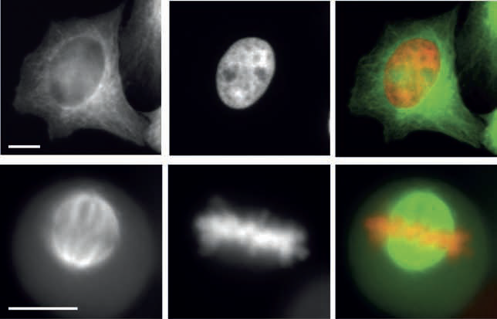
Cost efficiency
GFP-Tubulin
DNA (Hb2-mCherry)
Merge
Interphase
Mitosis
Fig. 2: Double colour imaging in plastic cell culture plates.
HeLa-Kyoto cell stably expressing H2B-mcherry and GFP-tubulin were cultured in a
plastic cell culture plate from NUNC, fixed and subsequently imaged using a 20x/0.75NA
objective with a magnification changer 2. (A,D) GFP-tubulin, (B,E) H2B-mcherry, (C,F)
overlay image (GFP-tubulin shown in green and H2B-mcherry in red). Scale bar 10 μm.

Slide 8
Edge effects

Slide 9
Autofocus CellDiscoverer 7
Find Surface
Focus Hold
Focus every time-point and position

Slide 10
Speed
Filter wheel vs. other
=>Sabine, Speed Mdev?

Slide 11
Variable NA imaging

Slide 12
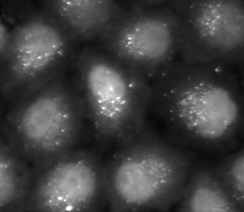
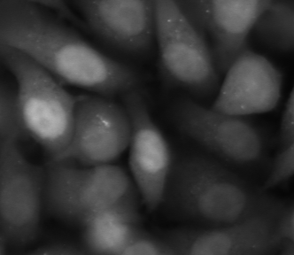
Autophagosome screen
Treatment A
Treatment B
In principle, the total intensity inside all dot-like structures
in each cell is proportional to the amount of protein recruited
to autophagosomes in this cell.

Slide 13

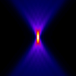
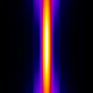
Acquisition modalities
Confocal NA1.4
Widefield NA0.9
Widefield NA0.3
z
10 micrometer
PMT
CCD
CCD

Slide 14

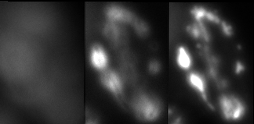

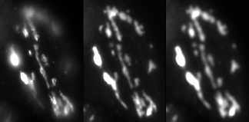
Low NA imaging of thin samples in wide-field microscopes
HeLa cell, Golgi-GFP
dz = 1 micrometer
NA 0.3
NA 0.9
z
y
x
z
NA 0.35
NA 0.26
x
NA 0.8

Slide 15
Low NA Transmission
Sebastian!

Slide 16
What to measure
Mean vs Sum
Cell cycle example

Slide 17
Secondary Screens

Slide 18
Adaptive Feedback Microscopy
Superres example
All the different names

Slide 19
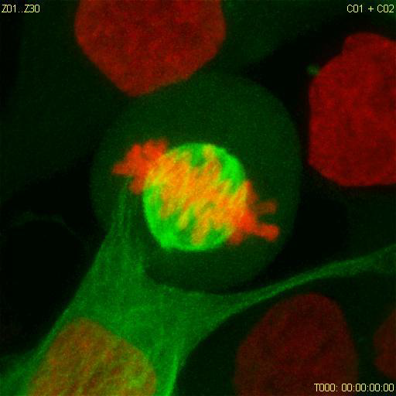
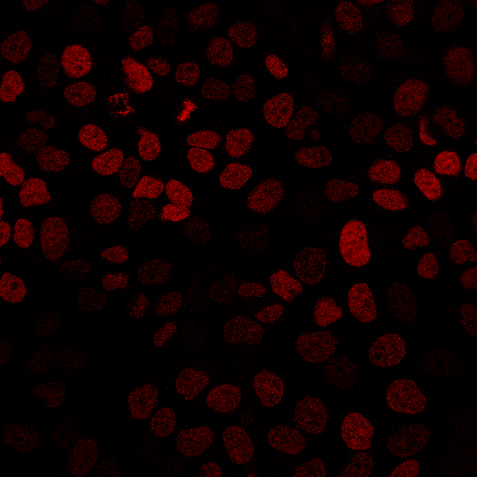
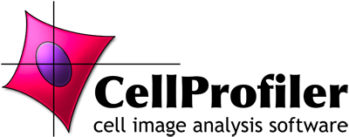

Microscopy automation for advanced imaging protocols
Online image analysis
CellProfiler, ImageJ, …
High content imaging
High-res. 3-D time-lapse, FRAP, FC(C)S
Move to next position
Image acquisition
Autofocus
Report to microscope:
- Object coordinates
- Laser intensity
- Exposure time
- …
Simple
automation
Advanced automation
H2B-mCherry
Tubulin
H2B-mCherry
Object position + additional parameters
Micropilot: Conrad et al. Nat. Meth. 2011
CellProfiler: Carpenter et al. 2006 Genome Biology ImageJ: Schneider et al. 2012 Nature Methods
Notes:
Before I go on with this I would like to put our efforts to automate FRAP on ER Exit sites in a bigger context, because we in fact invest a lot of effort into generally automating what I called here “Advanced imaging protocols”.
Initially as an analysis software we used a custom made software, called MicroPilot, which allows the user to train the detection of certain cell phenotypes, for instance, based on a nuclear staining, it would find cells entering mitosis.
However, recently we also started adding into this workflow CellProfiler, which is very convenient, if you want to find for instance simply the brightest cell or if you want to have the logic of intracellular objects. And then we also added ImageJ, which for instance allows you to do 3-D analysis.
…

Slide 20
Adaptive Feedback Microscopy
Minimal requirements

Slide 21
Adaptive Feedback Microscopy using ZEISS products
Microscope Examples | Zeiss Software | Open Application Development Modality | Image Analysis Modalities
LSM510 confocal (1) LSM780 confocal LSM880 confocal | ZEN Black | Visual Basic scripting with macro recording | Visual Basic or external software
LSM800 confocal CellDiscoverer 7 widefield | ZEN Blue | Python scripting with macro recording | ZEN Blue interal image analysis or external software
(1) Rabut and Ellenberg, Automatic real-time three-dimensional cell tracking by fluorescence microscopy. J. Microscopy, 2004

Slide 22
Multi-step Adaptive FRAP Microscopy
LSM780
Micro-
scopy
Visual Basic
ImageJ Analysis
In this way several hundreds
of recovery data sets can be automatically
acquired in an overnight experiment,
thus drastically increasing the data significance
compared to manual data acquisition
where at best several tens of useful datasets
can be acquired in the same amount
of time.

Slide 23
What to measure
Mean vs Sum
Cell cycle example

Slide 25
Image analysis, quality control and statistics

Slide 26
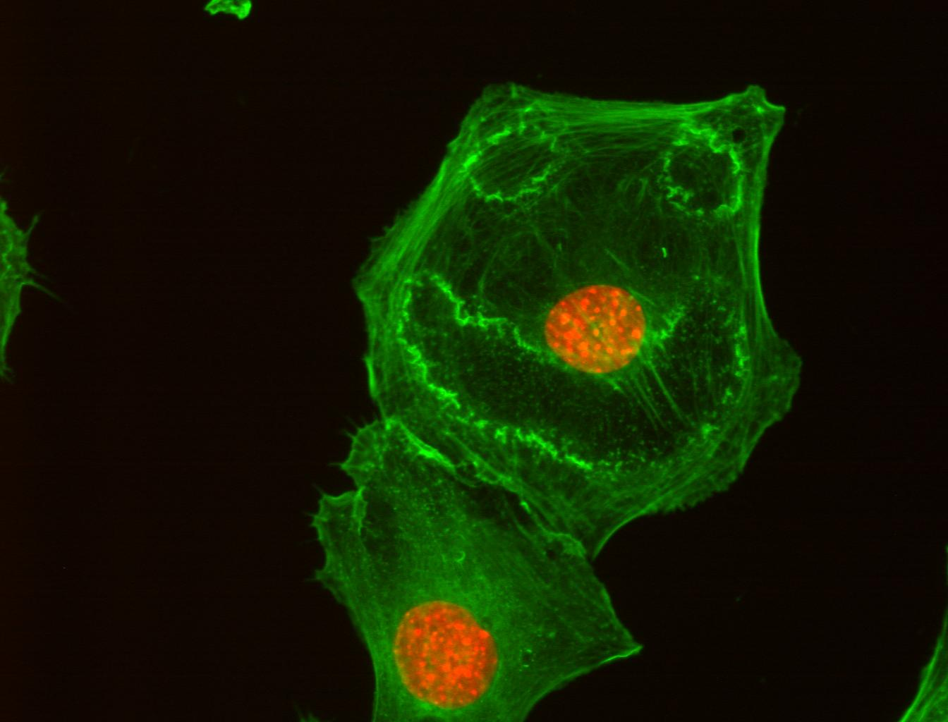
Acknowledgements
ALMF team:
Beate Neumann
Sabine Reither
Volker Hilsenstein
Yury Belyaev
Stefan Terjung
ALMF alumni
Christian Conrad
Jutta Bulkescher
FCS:
Malte Wachsmuth
Frank Sieckmann (Leica)
Zeiss LSM780 automation:
Gwen Rabut, Annelie Wuensche, Antonio Politi
Jan Ellenberg
Rainer Pepperkok
Green: actin cytoskeleton
Red: nucleus
Cells treated with PDGF

