Slide 1
Class | Student
Attributes | Name, age, ID
Methods | Initialize object, check if adult
Class | Student
Object 1:
name = Aidan
age = 19
ID = 2029912
Object 2:
name = Bella
age = 17
ID = 2028562
Object 3:
name = Charlie
age = 18
ID = 2019012

Slide 2
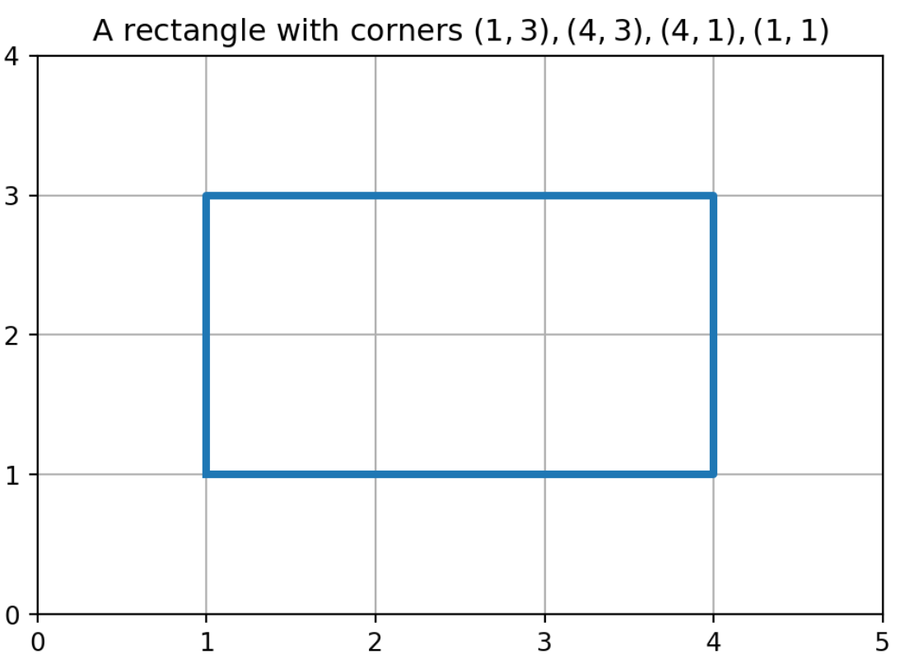
width
height

