Slide 1


Build your own indoor weather station
TIS innovation park & Transart Festival
5.-6. september 2015

Slide 2
Welcome!
W-LAN
SSID: transart
Password: in-monitor
Windows Share / SAMBA
\\192.168.1.104\inmonitor

Slide 3
Workshop Program
Day 1 – Indoor Weather Station
Design & Lasercut
Raspberry PI, Electronics, and Python
Day 2 – The Internet of Things
Connecting Things! Web Servers, Databases, …
Data Visualisation with Processing

Slide 4
DESIGN & LASERCUT
DAY 1

Slide 5
Raspberry PI, Electronics, and Python
DAY 1

Slide 6
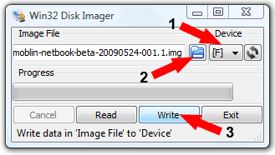
( Copy system image to SD card )
Windows: Win32DiskImager
inmonitor.img
Linux & Mac: dd, command line
“df –h”
/dev/mmcblk01p ?
“umount /dev/mmcblk0p1”
“sudo dd -bs=4M if=inmonitor.img of=/dev/mmcblk0” (no p1!)
wait…
“sync”

Slide 7
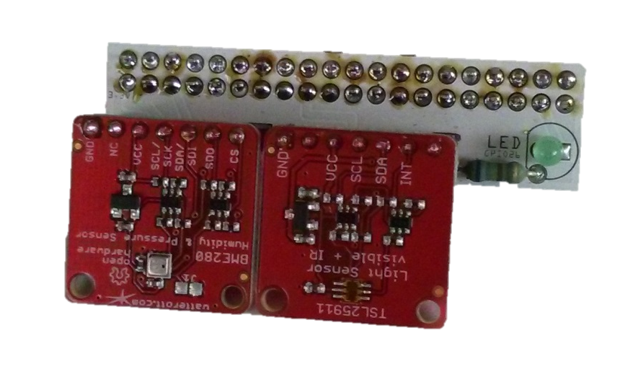
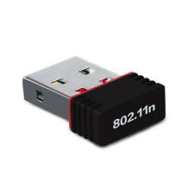
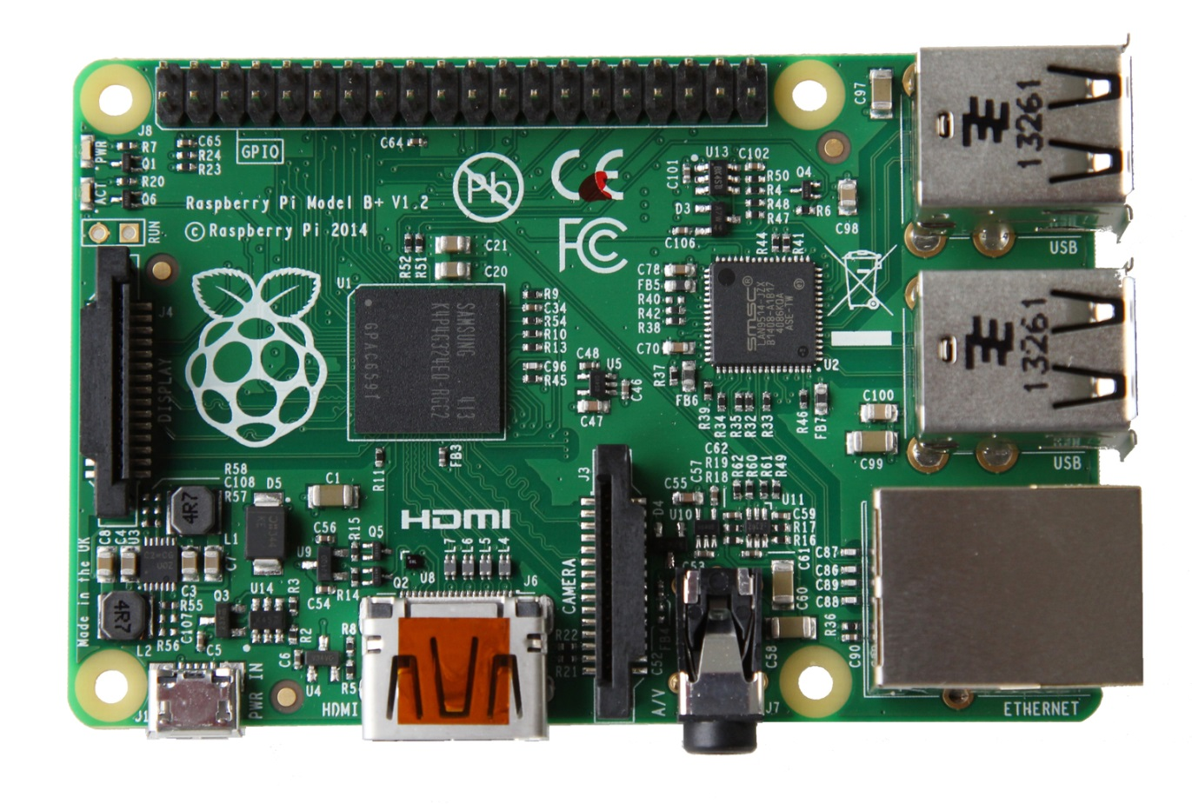

(hostname.txt?)

Slide 8
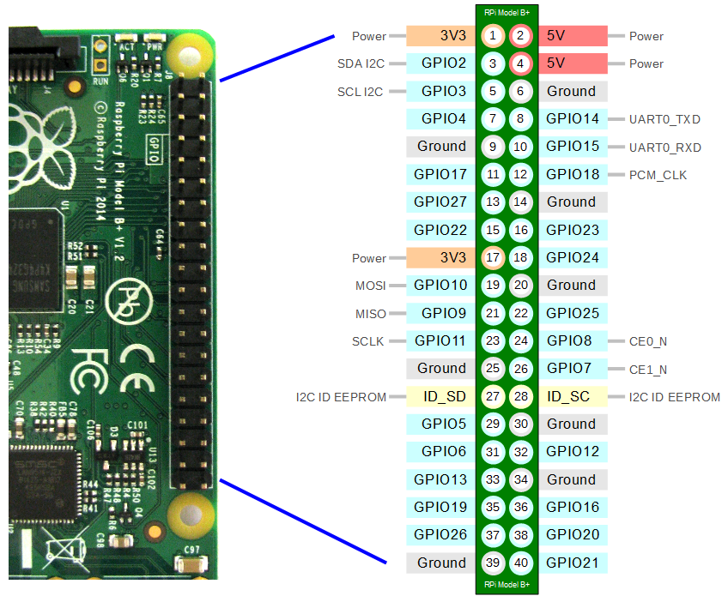

Raspberry PI GPIO Pins

Slide 9

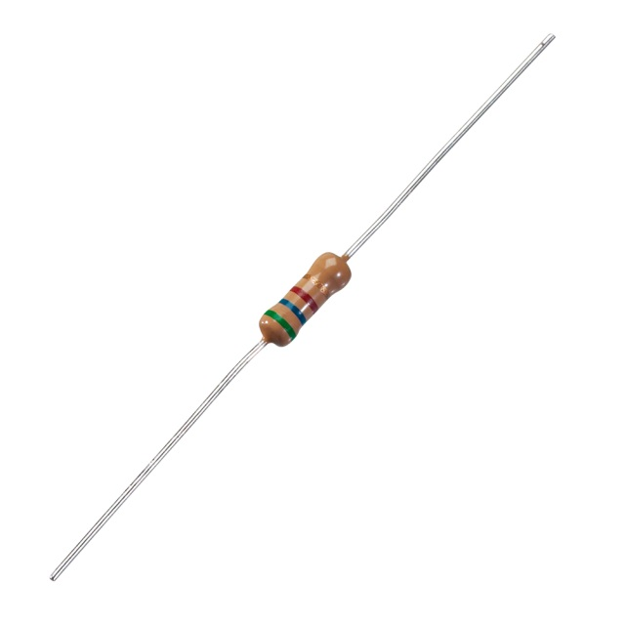





GPIO OUTPUT
$$U_{LED}=2,1V$$
$$I_{LED}=2,5mA$$
$$R=560Ω$$
$$R=\frac{U_{0}−U_{LED}}{I}$$
$$U_{0}=3,3V$$

Slide 10
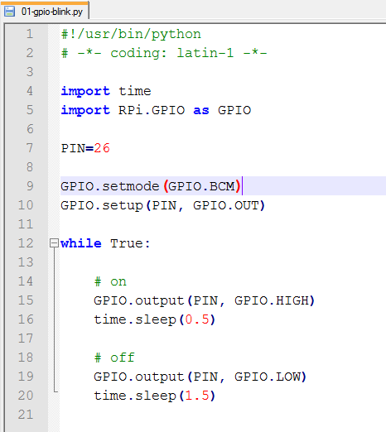
Python GPIO

Slide 11
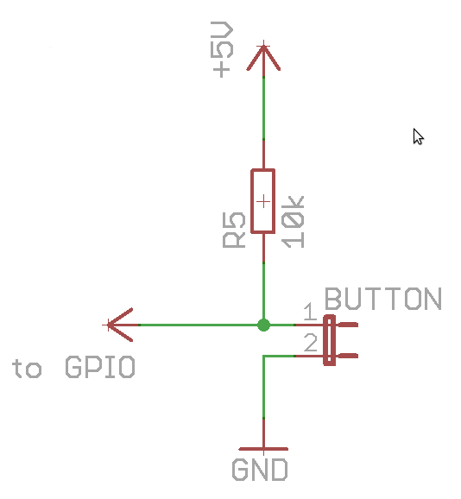
GPIO INPUT

Slide 12
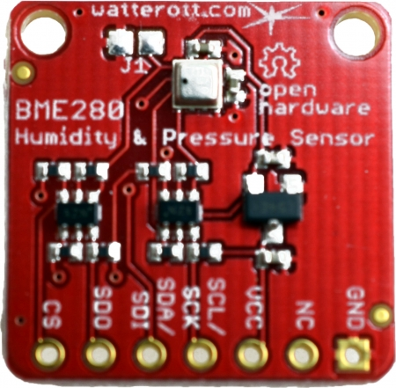
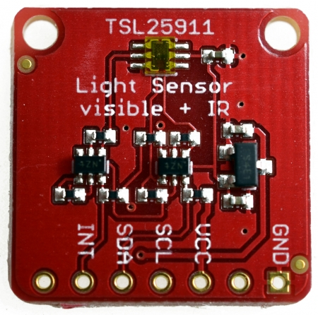
I2C Sensors
Temp., Humidity+Pressure
TSL25911 Light Sensor

Slide 13
I2C GPIO

Slide 14


Connector Board

Slide 15
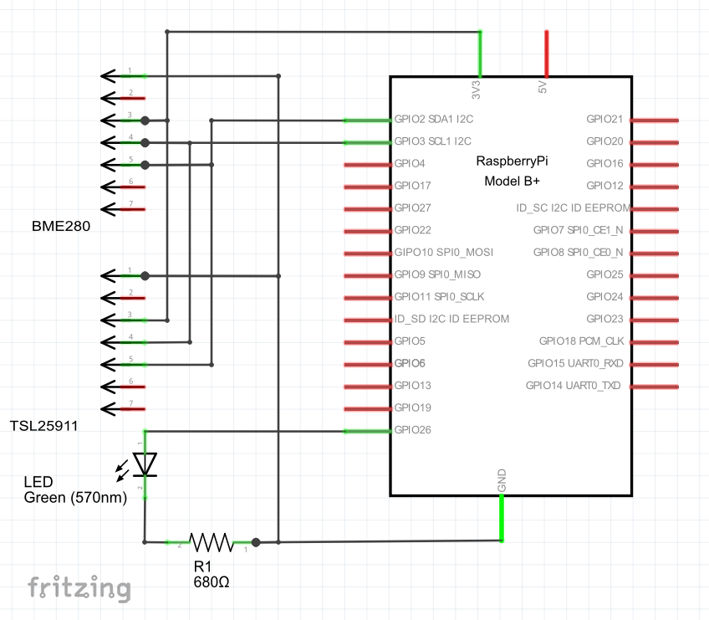
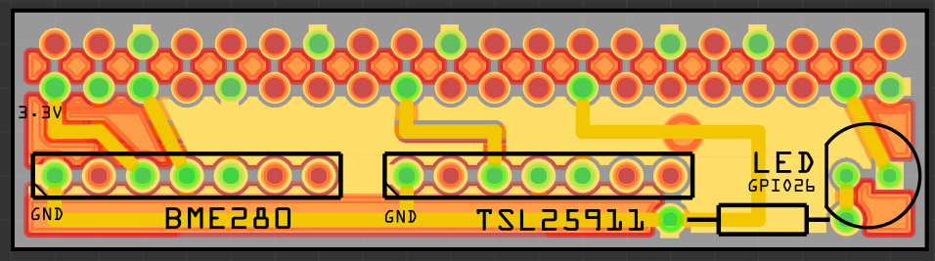
Connector Board

Slide 16
Installing INMONITOR (1)
SSH to your device and type:
cd ~
git clone https://github.com/tisfablab/inmonitor
cd ~/inmonitor/python
sudo python hwtest.py # let’s see if the hardware works!
Edit ~/inmonitor/python/inmonitor.py
set device id and password
(Edit ~/inmonitor/www/_db.php and set DB password)
Point your browser to http://<localip>/phpmyadmin
import the database dump ~/inmonitor/database.sql
add an entry to the devices table with your id and password

Slide 17
Installing INMONITOR (2)
Let’s activate the Web Service. SSH to your device and type:
sudo chmod 755 /home/pi # let apache access your home dir …
sudo chmod 755 –R /home/pi/inmonitor # … and the inmonitor files
# link the apache config file to where it belongs
sudo ln –s /home/pi/inmonitor/virtualhost.conf /etc/apache2/sites-available/inmonitor
sudo a2dissite default # disable default www
sudo a2ensite inmonitor # enable inmonitor www
sudo service apache2 restart # restart web server
Install and launch the data collector script
ln –s /home/pi/inmonitor/inmonitor.sh /etc/init.d/inmonitor # copy start file
sudo service inmonitor test # test if it works – stop by hitting ctrl-C repeatedly
sudo update-rc.d inmonitor defaults # start script at startup
sudo service inmonitor start # and start it now, in the background

Slide 18
Connecting Things! Web Servers, Databases, …
DAY 2

Slide 19


Connecting Devices
DEVICE 3
DEVICE 4
DEVICE 2
CLOUD SERVER
DEVICE 5
DEVICE 1
DEVICE 6

Slide 20
INMONITOR-X
CLOUD SERVER
Web Server (apache)
Browser
Browser
Web Server (apache)
Frontend
(HTML+Javascript)
Frontend
(HTML+Javascript)
Direct Request
HTTP, JSON
HTTP, JSON
HTTP,
JSON
HTTP,
JSON
Backend
(PHP)
Data Collector
(Python)
Backend
(PHP)
HTTP
HTTP
SQL
Visualisation Software
SQL
DB Server (mysql)
Data Storage
DB Server (mysql)
Database
Database

Slide 21
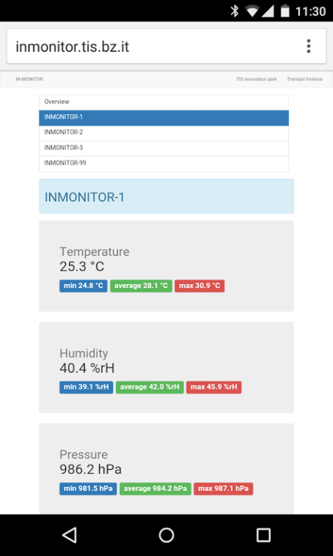
Application Program Interface
http://inmonitor.tis.bz.it/
http://inmonitor.tis.bz.it/devices.php
http://inmonitor.tis.bz.it/data.php
http://inmonitor.tis.bz.it/data.php?device=x
http://inmonitor.tis.bz.it/xml.php
http://inmonitor.tis.bz.it/store.php?device=99&password=xx&temperature=25.324&humidity=40.474&pressure=986.25&illuminance=72&ip=192.168.1.112
http://<ip>:2222

Slide 22
Data Visualisation with Processing
DAY 2

