Slide 1
Code Generation &
Code Optimization

Slide 2
Position of Code Generator
Front End
Code Optimizer
Code Generator
Source
program
Intermediate Code
Intermediate Code
Target
Program
Symbol table
Compiler Construction – CE365

Slide 3
Issues in Design of a Code Generator
Input to the code Generator
  There are several choice for the intermediate language including
  Linear representation such as postfix notation
  Three-address representation such as quadruples
  Virtual machine representation such as stack machine code
  Graphical representation such as syntax tree and DAG
Target Program
  Absolute machine language program
  Relocatable machine language program
  Assembly language program
Memory management
Compiler Construction – CE365

Slide 4
Issues in Design of a Code Generator
Instruction Selection
Register Allocation
Choice of evaluation order
Compiler Construction – CE365

Slide 5
Basic Blocks in Flow Graph
The basic block is a sequence of consecutive statements in which flow of control enters at the beginning and leaves at the end without halt or possibility of branching.
Any given program can be partitioned into basic blocks by using following algorithm.
  1. First determine the leaders by using following rules.
    First statement is a leader.
    Any target statement of conditional or unconditional goto is a leader.
    Any statement that immediately follow a goto or unconditional goto is a leader.
  2. The basic block is formed starting at the leader statement and ending just before the next leader statement appearing.
Compiler Construction – CE365

Slide 6
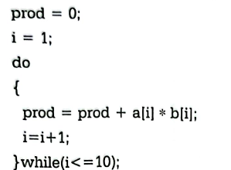
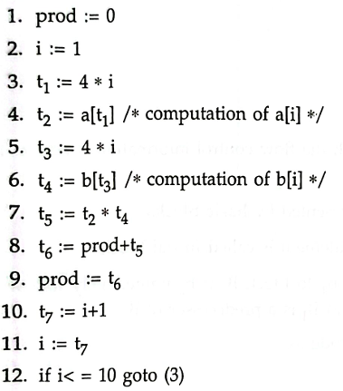
Basic Blocks in Flow Graph
As per the algorithm,
Statement 1 is leader by rule 1(a)
Statement 3 is leader by rule 1(b)
Three Address Code
Compiler Construction – CE365

Slide 7

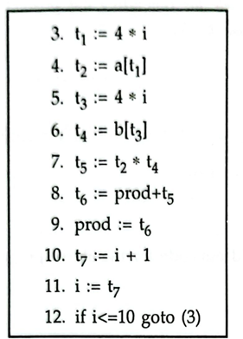
Basic Blocks in Flow Graph
Block B1
Block B2
Compiler Construction – CE365

Slide 8
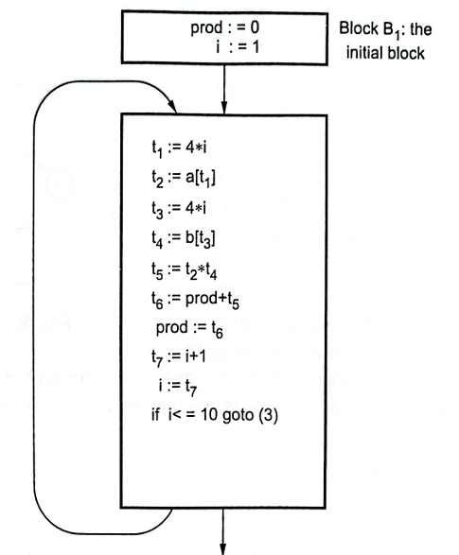
Flow Graph
Flow Graph is a directed graph in which the flow control information is added to the basic blocks.
  The Nodes to the flow graph are represented by basic blocks.
  The block whose leader is the first statement is called initial block.
Compiler Construction – CE365

Slide 9
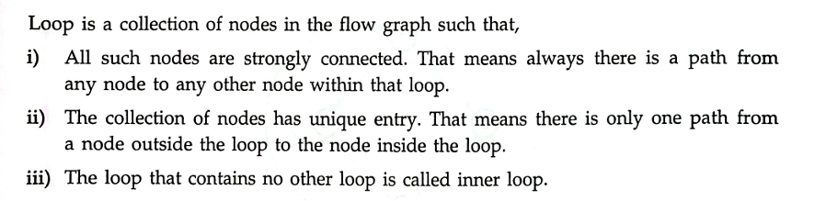
Loops in Flow Graph
Compiler Construction – CE365

Slide 10
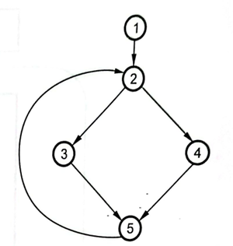
Dominator
Dominators: A node d dominated n if every path to node n from initial node goes through d only. This can be denoted as ‘ d dom n’.
Every initial node dominated all the remaining node in the flow graph.
Every node dominated itself.
Node 1 dominated every other node as it is initial node.
Node 2 dominated 3, 4 and 5.
Node 5 dominated no node.
Compiler Construction – CE365

Slide 11
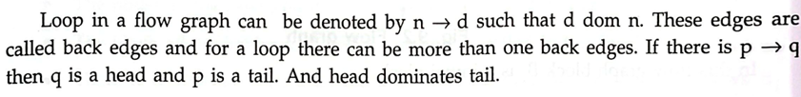
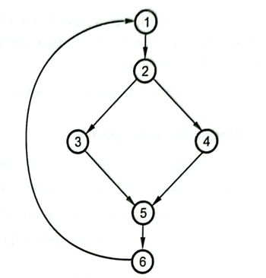
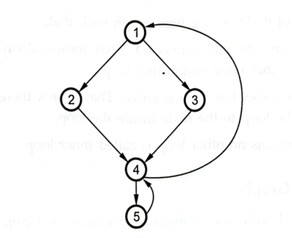
Natural Loop
The loops in the graph can be denoted by
  4 → 1 ( 1 dom 4) and 5 → 4 (4 dom 5)
Compiler Construction – CE365

Slide 12
Natural Loop
The natural loop can be defined by a back edge n→ d such that there exists a collection of all nodes that can reach to n without going through d and at the time d also can be added to this collection.
6 → 1 is natural loop because we can reach to all remaining
nodes from 6.
Compiler Construction – CE365

Slide 13
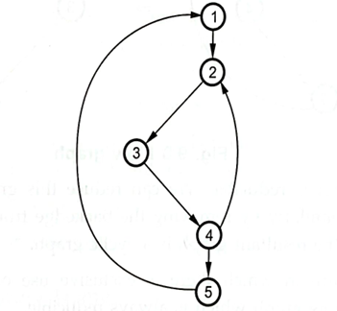
Inner Loop
The inner loop is a loop that contains no other loop.
4 → 2 is inner loop in the given graph.
Compiler Construction – CE365

Slide 14
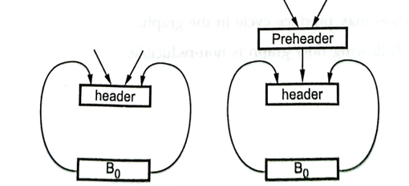
Pre Header
The pre-header is a new block created such that successor of this block is the header block. All the computations that can be made before the header block can be made before pre-header block.
Compiler Construction – CE365

Slide 15
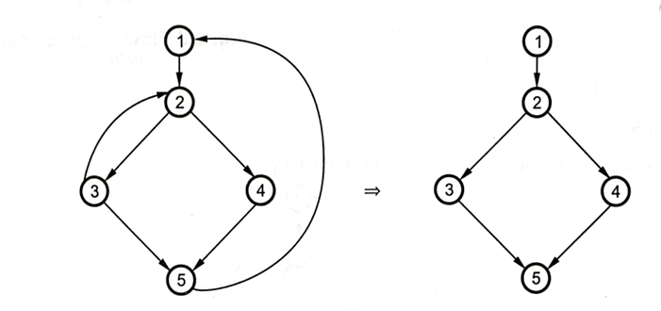
Reducible Flow Graph
The reducible graph is a flow graph in which there are two types of edges, forward edges and back edges, with following properties:
  The forward edge form an acyclic graph in which every node can be reached from an initial node
  The back edges are such edges whose head dominated their tail.
Compiler Construction – CE365

Slide 16
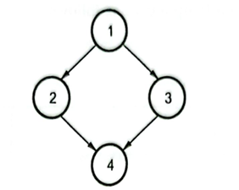
Non-reducible Flow Graph
The non-reducible flow graph is a flow graph in which
  There are no back edges
  The forward edge may contain cycle in the graph.
Compiler Construction – CE365

Slide 17
The DAG representation of basic blocks
The Directed Acyclic Graph is a directed graph which contains no cycle.
  DAG is used to optimize basic blocks
  DAG is used to eliminate common subexpression
  DAG specify how the value computed by each statement in a basic block is used in subsequent statement of the block.
  To apply transformation on basic block, a DAG is constructed from three address code.
  Algorithm for construction of DAG:
    In a DAG, leaf node represents identifiers, variable names or constants
    Interior node represents operators
    While constructing DAG, a check is made to find if there is an existing node with the same children.
Compiler Construction – CE365

Slide 18
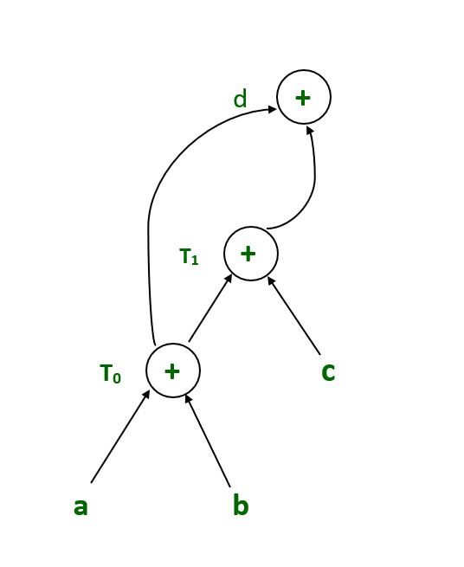
The DAG representation of basic blocks
Construct DAG for the given expression:
  (a+b)+(a+b+c)
  Three address code:
    t0 = a + b
    t1 = t0 + c
    d = t0 + t1
Compiler Construction – CE365

Slide 19
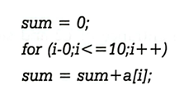
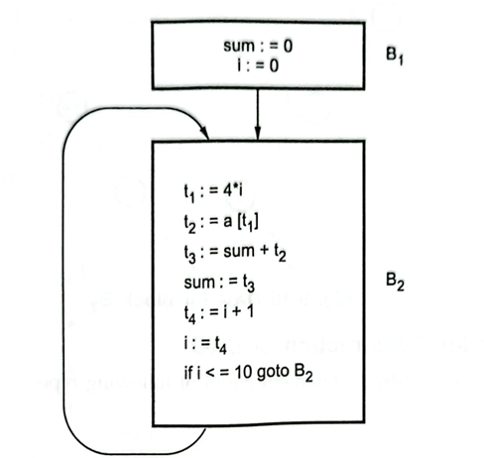
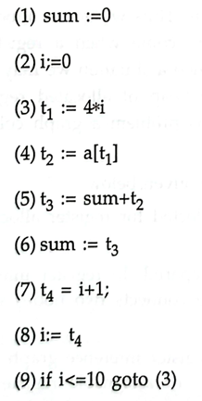
The DAG representation of basic blocks
Problem Statement
Three Address Code
Flow Graph
Compiler Construction – CE365

Slide 20
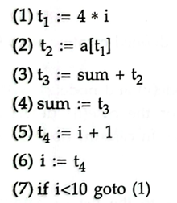
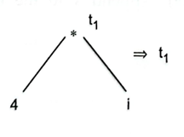
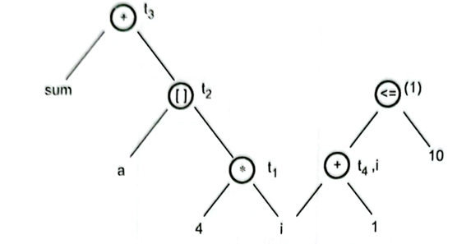
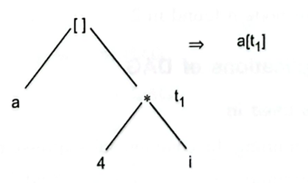
The DAG representation of basic blocks
(a)
(c)
(b)
Compiler Construction – CE365

Slide 21
Code Optimization
It mainly aims at rearranging the computation in a program so as to gain the advantage of execution speed, without changing the meaning of a program.
It is necessary as
  We want to utilize CPU efficiently
  Efficient Power Consumption
Compiler Construction – CE365

Slide 22
Code Optimization
Platform(Machine) Dependent:
  Peephole optimization,
  Instruction level parallelism,
  Data level parallelism (keep data on many resources),
  Cash optimization,
  Redundant Resource
Platform Independent:
  Loop optimization,
  Constant Folding,
  Constant Propagation,
  Common subexpression elimination,
  Code Movement,
  Dead code Elimination,
  Strength Reduction
Compiler Construction – CE365

Slide 23
Peephole Optimization
Peephole optimization is a type of code optimization performed on a small part of the code.
It is performed on a very small set of instructions in a segment of code.
It is a simple and effective technique for locally improving target code.
Characteristic of Peephole Optimization:
  Redundant Instruction Optimization
  Flow of control optimization
  Algebraic Simplification
  Use of machine idioms
Compiler Construction – CE365

Slide 24
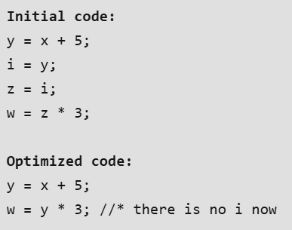
Redundant Instruction Optimization
Redundant Loads and Stores
Redundant Loads and Stores
If we see the instruction sequence
(1) MOV R0, a
(2) MOV a, R0
We can delete instruction (2) because whenever (2) is executed, (1) will ensure that the value of a is already in register R0.
Unreachable Code
sum=0;
If(sum)
printf(“%d”,sum);
Last two statement can be eliminated
Compiler Construction – CE365

Slide 25
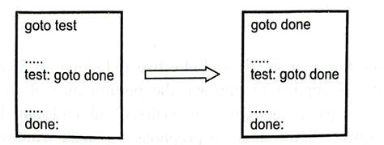
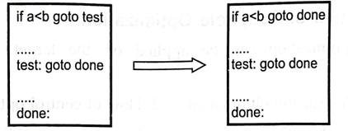
Flow-of-Control Optimization
Unnecessary jumps can be eliminated.
Compiler Construction – CE365

Slide 26
Algebraic Simplification
The statement such as
x = x + 0
or
x = x * 1
can be eliminated.
Compiler Construction – CE365

Slide 27
Use of machine idioms
The target instructions have equivalent machine instructions for performing some operations. Hence we can replace these target instructions by equivalent machine instructions in order to improve the efficiency.
For example,
  Some machines have auto-increment or auto-decrement addressing modes that are used to perform add or subtract operations.
Compiler Construction – CE365

Slide 28
Reduction in Strength
Certain machine instructions are cheaper than others. In order to improve the performance of the intermediate code, we can replace these instructions with equivalent but cheaper instructions.
For example, squaring a number is cheaper than multiplying it by itself.
Similarly, addition and subtraction are cheaper than multiplication and division. Therefore, we can effectively use equivalent addition and subtraction operations in place of multiplication and division to optimize performance.
Compiler Construction – CE365

Slide 29
Function Preserving Transformation
  Copy Propagation,
  Common subexpression elimination,
  Dead code Elimination,
  Constant Folding
Compiler Construction – CE365

Slide 30
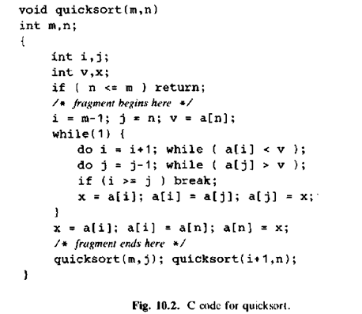
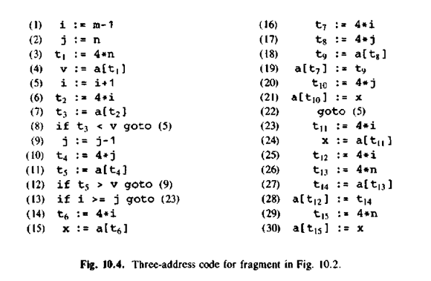
C code for Quick Sort and Three Address Code
Compiler Construction – CE365

Slide 31
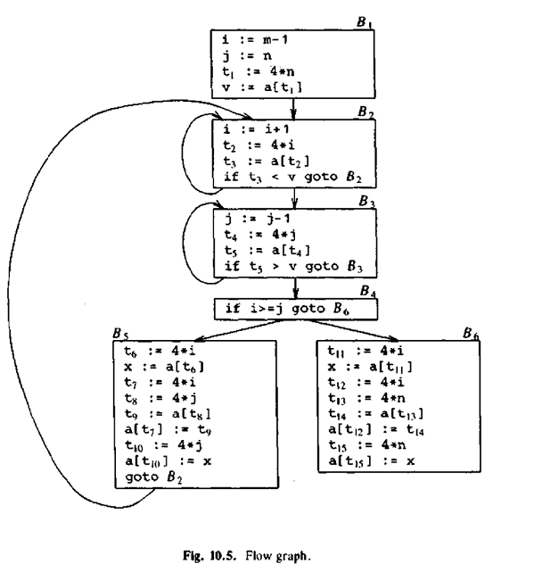
Flow Graph of Quick Sort
Compiler Construction – CE365

Slide 32
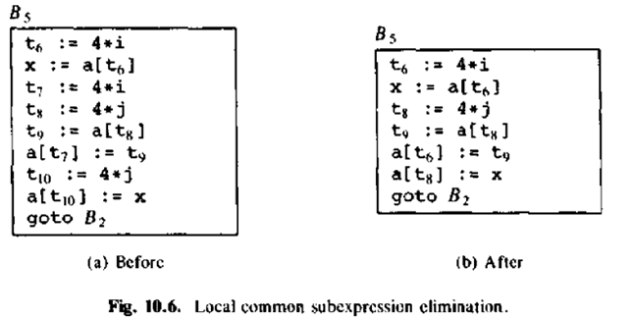
Local Sub Expression
Elimination
Compiler Construction – CE365

Slide 33
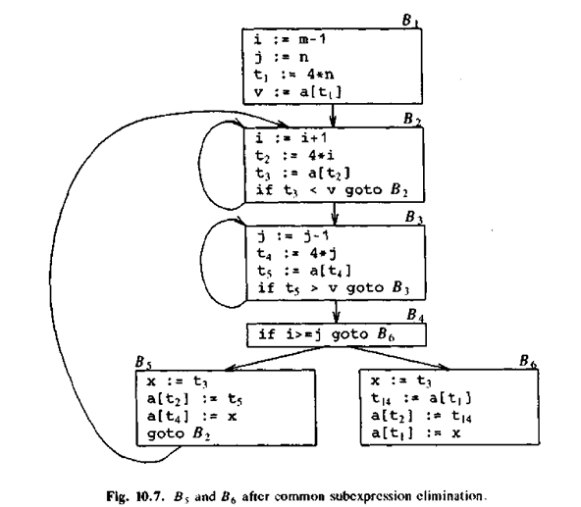
Common Sub Expression
Elimination
Compiler Construction – CE365

Slide 34


Copy Propagation
//Before Optimization
c = a * b
x = a
till
d = x * b + 4
//After Optimization
d = a * b + 4
Compiler Construction – CE365

Slide 35
Constant Folding
Consider an expression : a = b op c and the values b and c are constants, then the value of a can be computed at compile time.
#define k 5
x = 2 * k
y = k + 5
This can be computed at compile time and the values of x and y are :
x = 10
y = 10
The value of PI can be replaced with 3.14 or √2 = 1.41 at compile time
Compiler Construction – CE365

Slide 36
Constant Propagation
If the value of a variable is a constant, then replace the variable with the constant.
The variable may not always be a constant.
(i) A = 2*(22.0/7.0)*r
Performs 2*(22.0/7.0)*r at compile time.
(ii) x = 12.4
y = x/2.3
Evaluates x/2.3 as 12.4/2.3 at compile time.
(iii) int k=2;
if(k) go to L3;
It is evaluated as :
go to L3 ( Because k = 2 which implies condition is always true)
Compiler Construction – CE365

Slide 37
Loop Optimization
Code Motion
/ Frequency Reduction
a=100;
While(a>0)
{
x=y+z;
if(a%x == 0)
printf(“%d”,x);
}
Loop Fusion
/ Loop Jamming
int i, a[100], b[100];
for(i=0; i< 100; i++)
a[i]=1;
for(i=0; i< 100; i++)
b[i]=2;
Loop Unrolling
for(i=0; i< 3; i++)
{
printf(“Sarita ”);
}
Loop Unrolling
printf(“Sarita Sarita Sarita”);
Code Motion
/ Frequency Reduction
a=100;
x=y+z;
While(a>0)
{
if(a%x == 0)
printf(“%d”,x);
}
Loop Fusion
/ Loop Jamming
int i, a[100], b[100];
for(i=0; i< 100; i++)
{
a[i]=1;
b[i]=2;
}
Compiler Construction – CE365

Slide 38
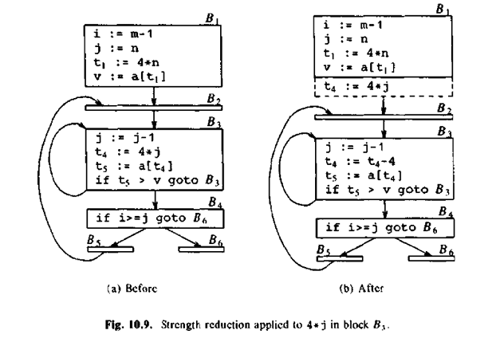
Induction Variable & Strength Reduction
An induction variable is a variable used in a loop (for, while…). It controls the iteration of the loop.
Strength reduction is one of the techniques used to optimize loop induction variables.
// before strength reduction
int main()
{
int a = 2;
int b = a * 3;
}
// after strength reduction
int main()
{
int a = 2;
int b = a + a + a; // replaced * with three + operations
}
Compiler Construction – CE365

Slide 39
Induction Variable & Strength Reduction
An induction variable is a variable used in a loop (for, while…). It controls the iteration of the loop.
Strength reduction is one of the techniques used to optimize loop induction variables.
// before strength reduction
int main()
{
int a = 2;
int b = a * 4;
}
// after strength reduction
int main()
{
int a = 2;
int b = (a << 2); // left shift by 2
}
// before strength reduction
int main()
{
int a = 8;
int b = a / 4;
}
// after strength reduction
int main()
{
int a = 8;
int b = (a >> 2); // right shift by 2
}
Compiler Construction – CE365

Slide 40
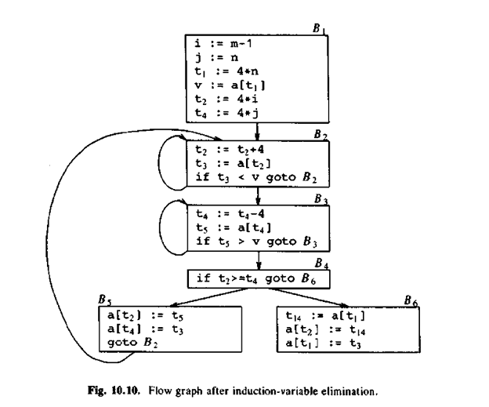
Induction Variable & Strength Reduction
Compiler Construction – CE365

Slide 41
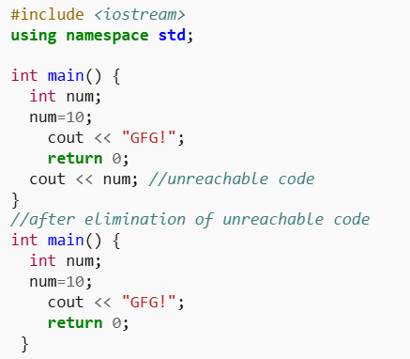
Dead code Elimination
Copy propagation often leads to making assignment statements into dead code.
A variable is said to be dead if it is never used after its last definition.
In order to find the dead variables, a data flow analysis should be done.
Compiler Construction – CE365

