Slide 1
Presentation title
Present by : Tisha Bhimani

Slide 2
Introduction

Slide 3

Asafa Powell
Confidence is like a muscles. The more you use it, the stronger it gets.

Slide 4
Agenda
Personal Information
Information Technology Project
Methods Of building Confidence
Techniques for successful impromptu speech

Slide 5

Topic one
Personal Information

Slide 6
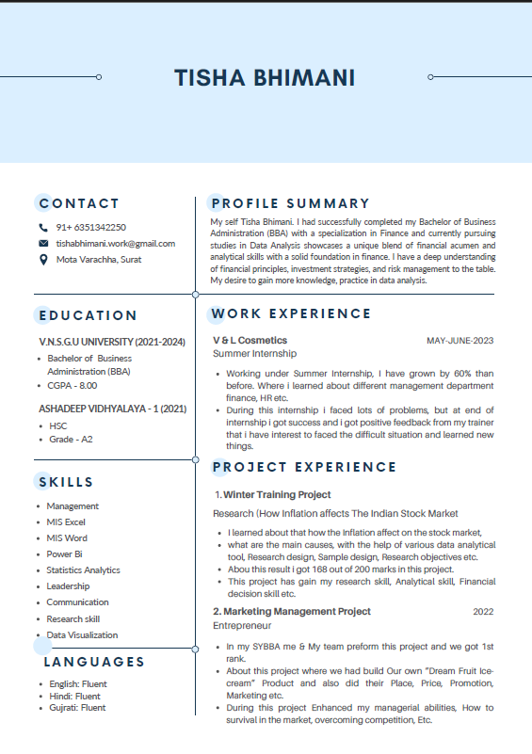

Slide 7

Topic Two
Information Technology Project

Slide 8
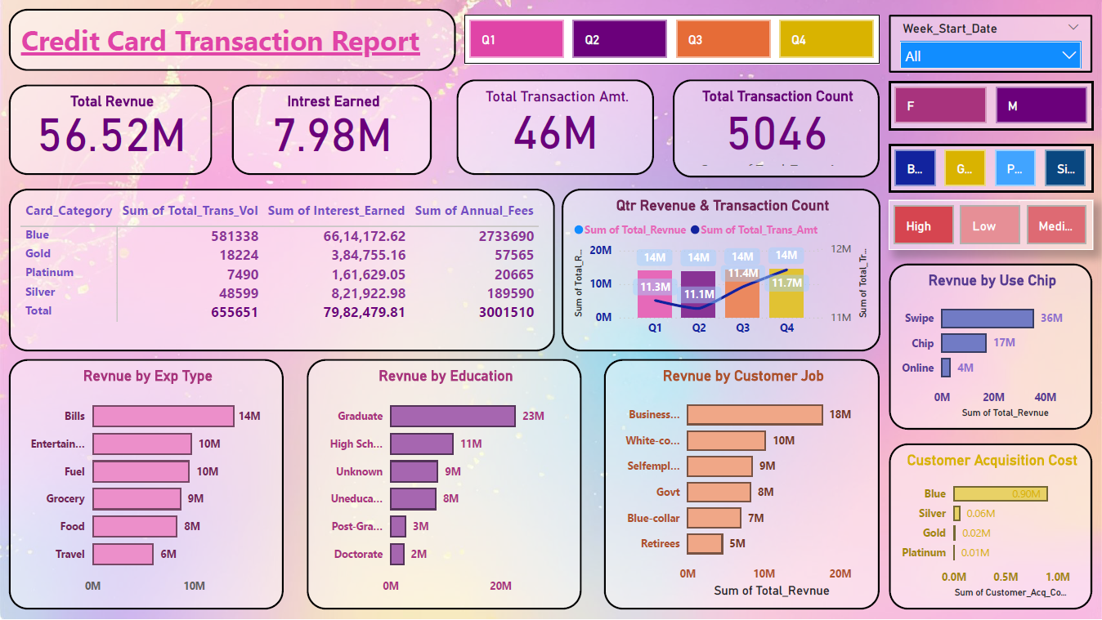

Slide 9

Topic Three
Building Confidence Toolkit

Slide 10
1. Regular Practice 2. Seek Feedback 3. Set Achievable goals 4.Positive Mindset

Slide 11
1. Regular Practice
3-4 hours Daily practice

Slide 13
Table
​ | Category 1​ | Category 2​ | Category 3​ | Category 4​
Item 1​ | 4.5​ | 2.3​ | 1.7​ | 5​.0
Item 2​ | 3.2​ | 5.1​ | 4.4​ | 3​.0
Item 3​ | 2.1​ | 1.7​ | 2.5​ | 2.8​
Item 4​ | 4.5​ | 2.2​ | 1.7​ | 7​.0

Slide 14





Team
Name
Name
Name
Name
Name
Title
Title
Title
Title
Title

Slide 15
Timeline
To start a presentation, go to the Slide Show tab, and select From Beginning.
01
To display Presenter view, in Slide Show view, on the control bar at the bottom left select the three dots, and then Show Presenter View.
02
During your presentation, the speaker notes are visible on your monitor, but aren't visible to the audience.
03
The Notes pane is a box that appears below each slide. Tap it to add notes.
04
If you don’t see the Notes pane or it is completely minimized, click Notes on the task bar across the bottom of the PowerPoint window.
05

Slide 16
Content
Subtitle
Subtitle
Add text, images, art, and videos.
Add transitions, animations, and motion.
Save to OneDrive, to get to your presentations from your computer, tablet, or phone.
Open the Design Ideas pane for instant slide makeovers.
When we have design ideas, we’ll show them to you right there.

Slide 18



Summary
With PowerPoint, you can create presentations and share your work with others, wherever they are. Type the text you want here to get started. You can also add images, art, and videos on this template. Save to OneDrive and access your presentations from your computer, tablet, or phone.

Slide 19
With PowerPoint, you can create presentations and share your work with others, wherever they are. Type the text you want here to get started. You can also add images, art, and videos on this template. Save to OneDrive and access your presentations from your computer, tablet, or phone.

Slide 20
Thank you
Tisha Bhimani
tishabhimani.work@gmail.com

