Slide 1
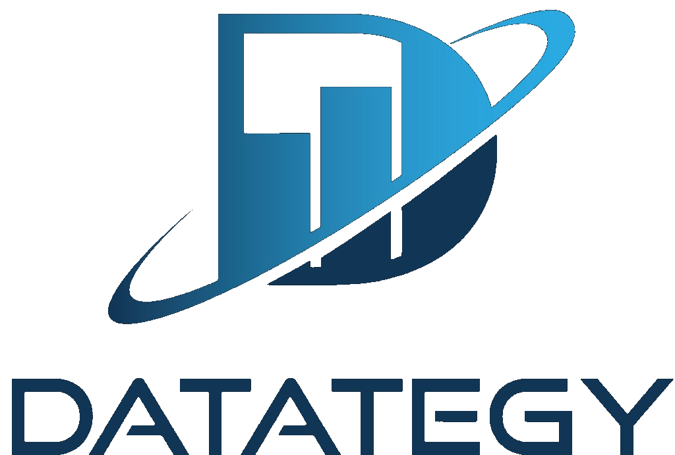
Agentium
Enterprise alignment with PIH requirements
Intro deck before live demo
Sovereignty · Robustness · Security
Observability & Scalability · Token Performance
Datategy — Confidential

Slide 2
Agenda
Agentium
What this deck covers
How Agentium's operating model maps to PIH's five enterprise pillars
1.
Agentium in one picture
An OS for intelligent systems — not a chatbot builder.
2.
PIH requirements → Agentium capabilities
Five pillars, one alignment matrix.
3.
Deep dive per pillar
Sovereignty, robustness, security, observability, token performance.
4.
Live demo
System → Run → Evaluation → Decision → Action.
Datategy — Agentium — PIH alignment intro
Page 2 / 15

Slide 3
Mental model
Agentium
Agentium — operating system for intelligent systems
Objectives in, governed and measurable outcomes out
Objective
System
Run
Impact
Optimize
Business intent
declared on System
Capability + Flow
+ Skills + Context
Stateful execution
instance with ledger
Cost · latency ·
confidence · value
Hypervisor +
Control Plane loop
Canonical chain (shipped): System → Run → Evaluation → Decision → Action. Replay, feedback, and canonical answers close the loop.
Positioning: You don't build isolated agents — you compose intelligence into systems that produce measurable, governed value.
Datategy — Agentium — PIH alignment intro
Page 3 / 15

Slide 4
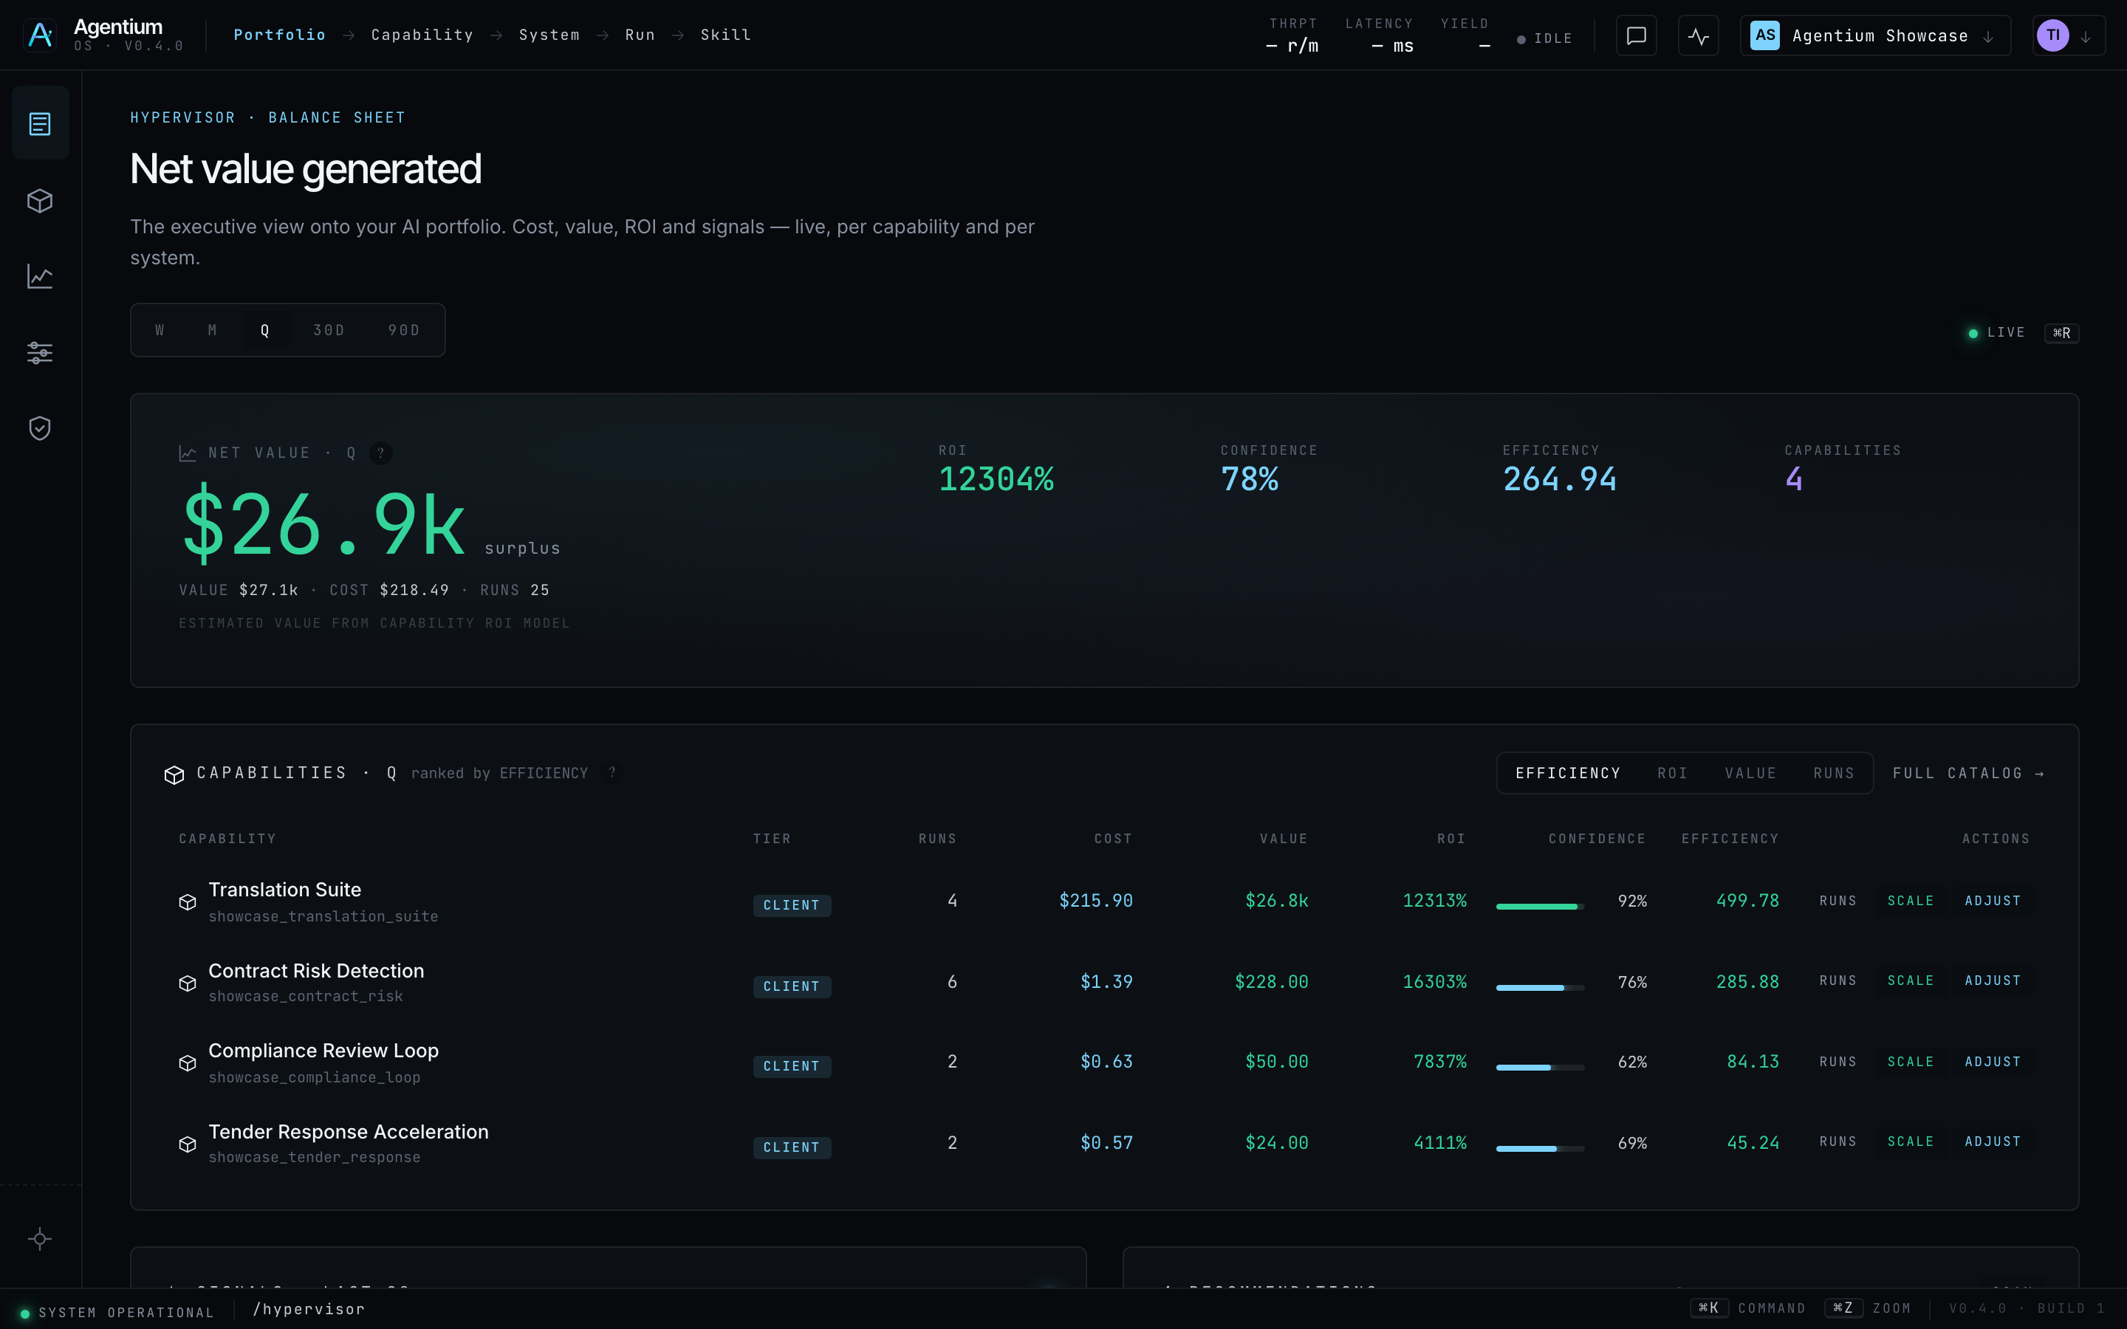
Product
Agentium
Agentium in production — agentium.papai.ai
Hypervisor cockpit: portfolio view, impact metrics, proactive recommendations
Live capture — Agentium Showcase workspace
Datategy — Agentium — PIH alignment intro
Page 4 / 15

Slide 5
PIH requirements
Agentium
PIH enterprise pillars
What regulated autonomous-agent platforms must guarantee
Sovereignty
Deploy and operate without mandatory external dependency; data and models under customer control.
Robustness
Replay, resubmission, and stateful execution — failures are recoverable, not silent.
Security
Model guardrails, distinct agent identity, strict RBAC for autonomous agents.
Observability & Scalability
Full auditability of agent tool-calling; enterprise-grade scaling.
Token Performance
Efficient, deterministic sovereign model orchestration.
Next slides: For each pillar — PIH ask → Agentium answer → what you will see in the demo.
Datategy — Agentium — PIH alignment intro
Page 5 / 15

Slide 6
Alignment matrix
Agentium
PIH requirements → Agentium capabilities
At-a-glance mapping before the live walkthrough
PIH pillar
Requirement
Agentium capability
Status
Sovereignty
On-prem / hybrid / sovereign cloud
✅ Shipped
Local & cloud providers, Qdrant, MinIO — no cloud lock-in
Robustness
Replay, resubmission, stateful runs
Run lineage, /runs/{id}/replay, skill_invocations ledger, DAG HITL resume
✅ Shipped
Security
Guardrails, agent identity, RBAC
ControlPolicy, claim_audit_v1, Keycloak workspaces, audit on every mutation
✅ Shipped
Observability
Tool-call auditability, scale
/audit, /observability, SSE stream, per-skill cost & latency
✅ Shipped
Token performance
Deterministic model orchestration
allowed_models routing, Flow/DAG engine, token_delta streaming, budget caps
✅ Shipped
Datategy — Agentium — PIH alignment intro
Page 6 / 15

Slide 7
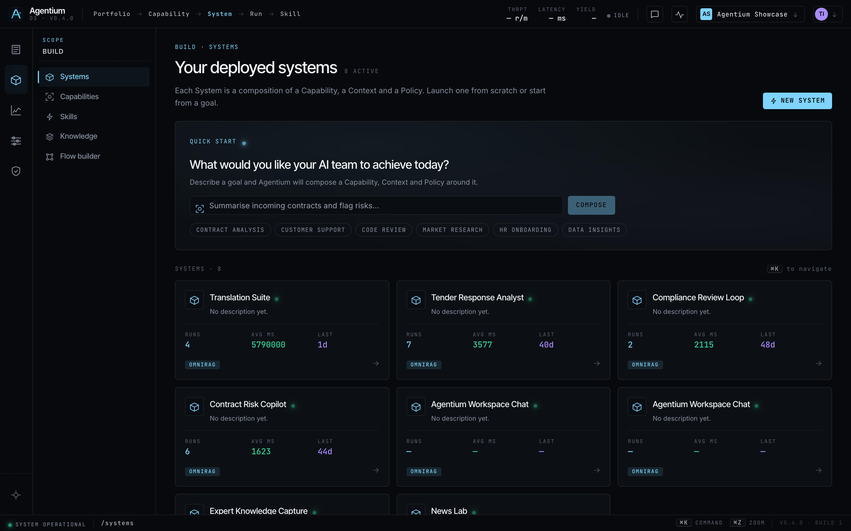
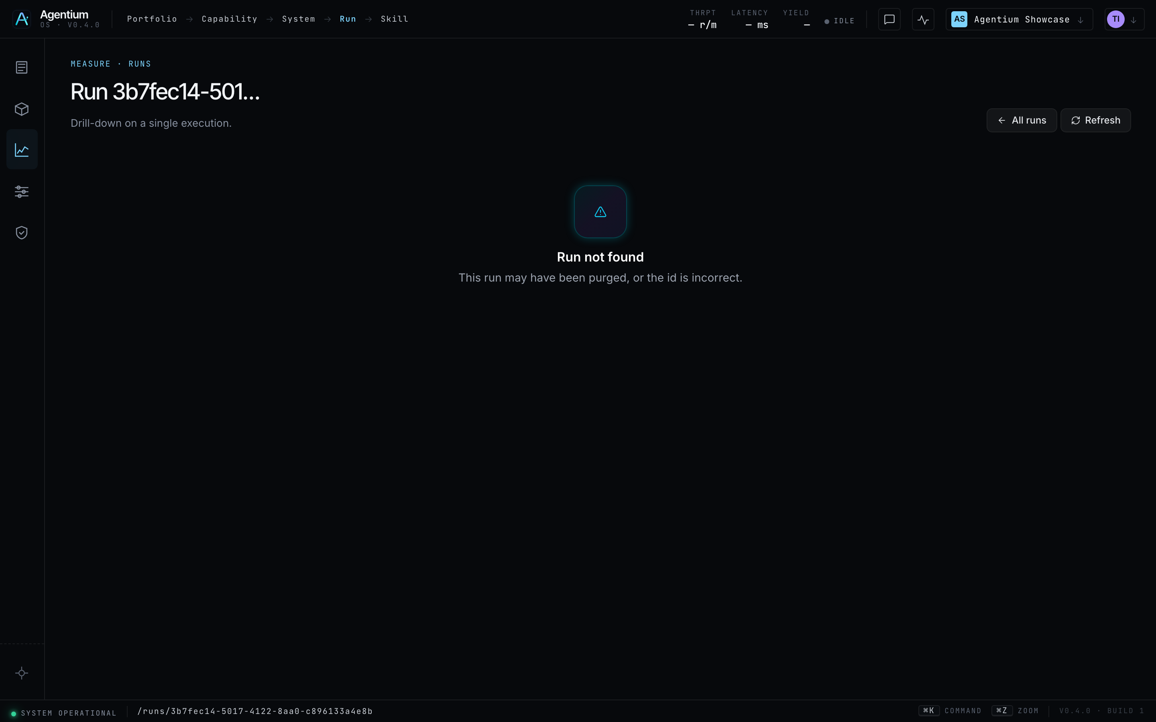
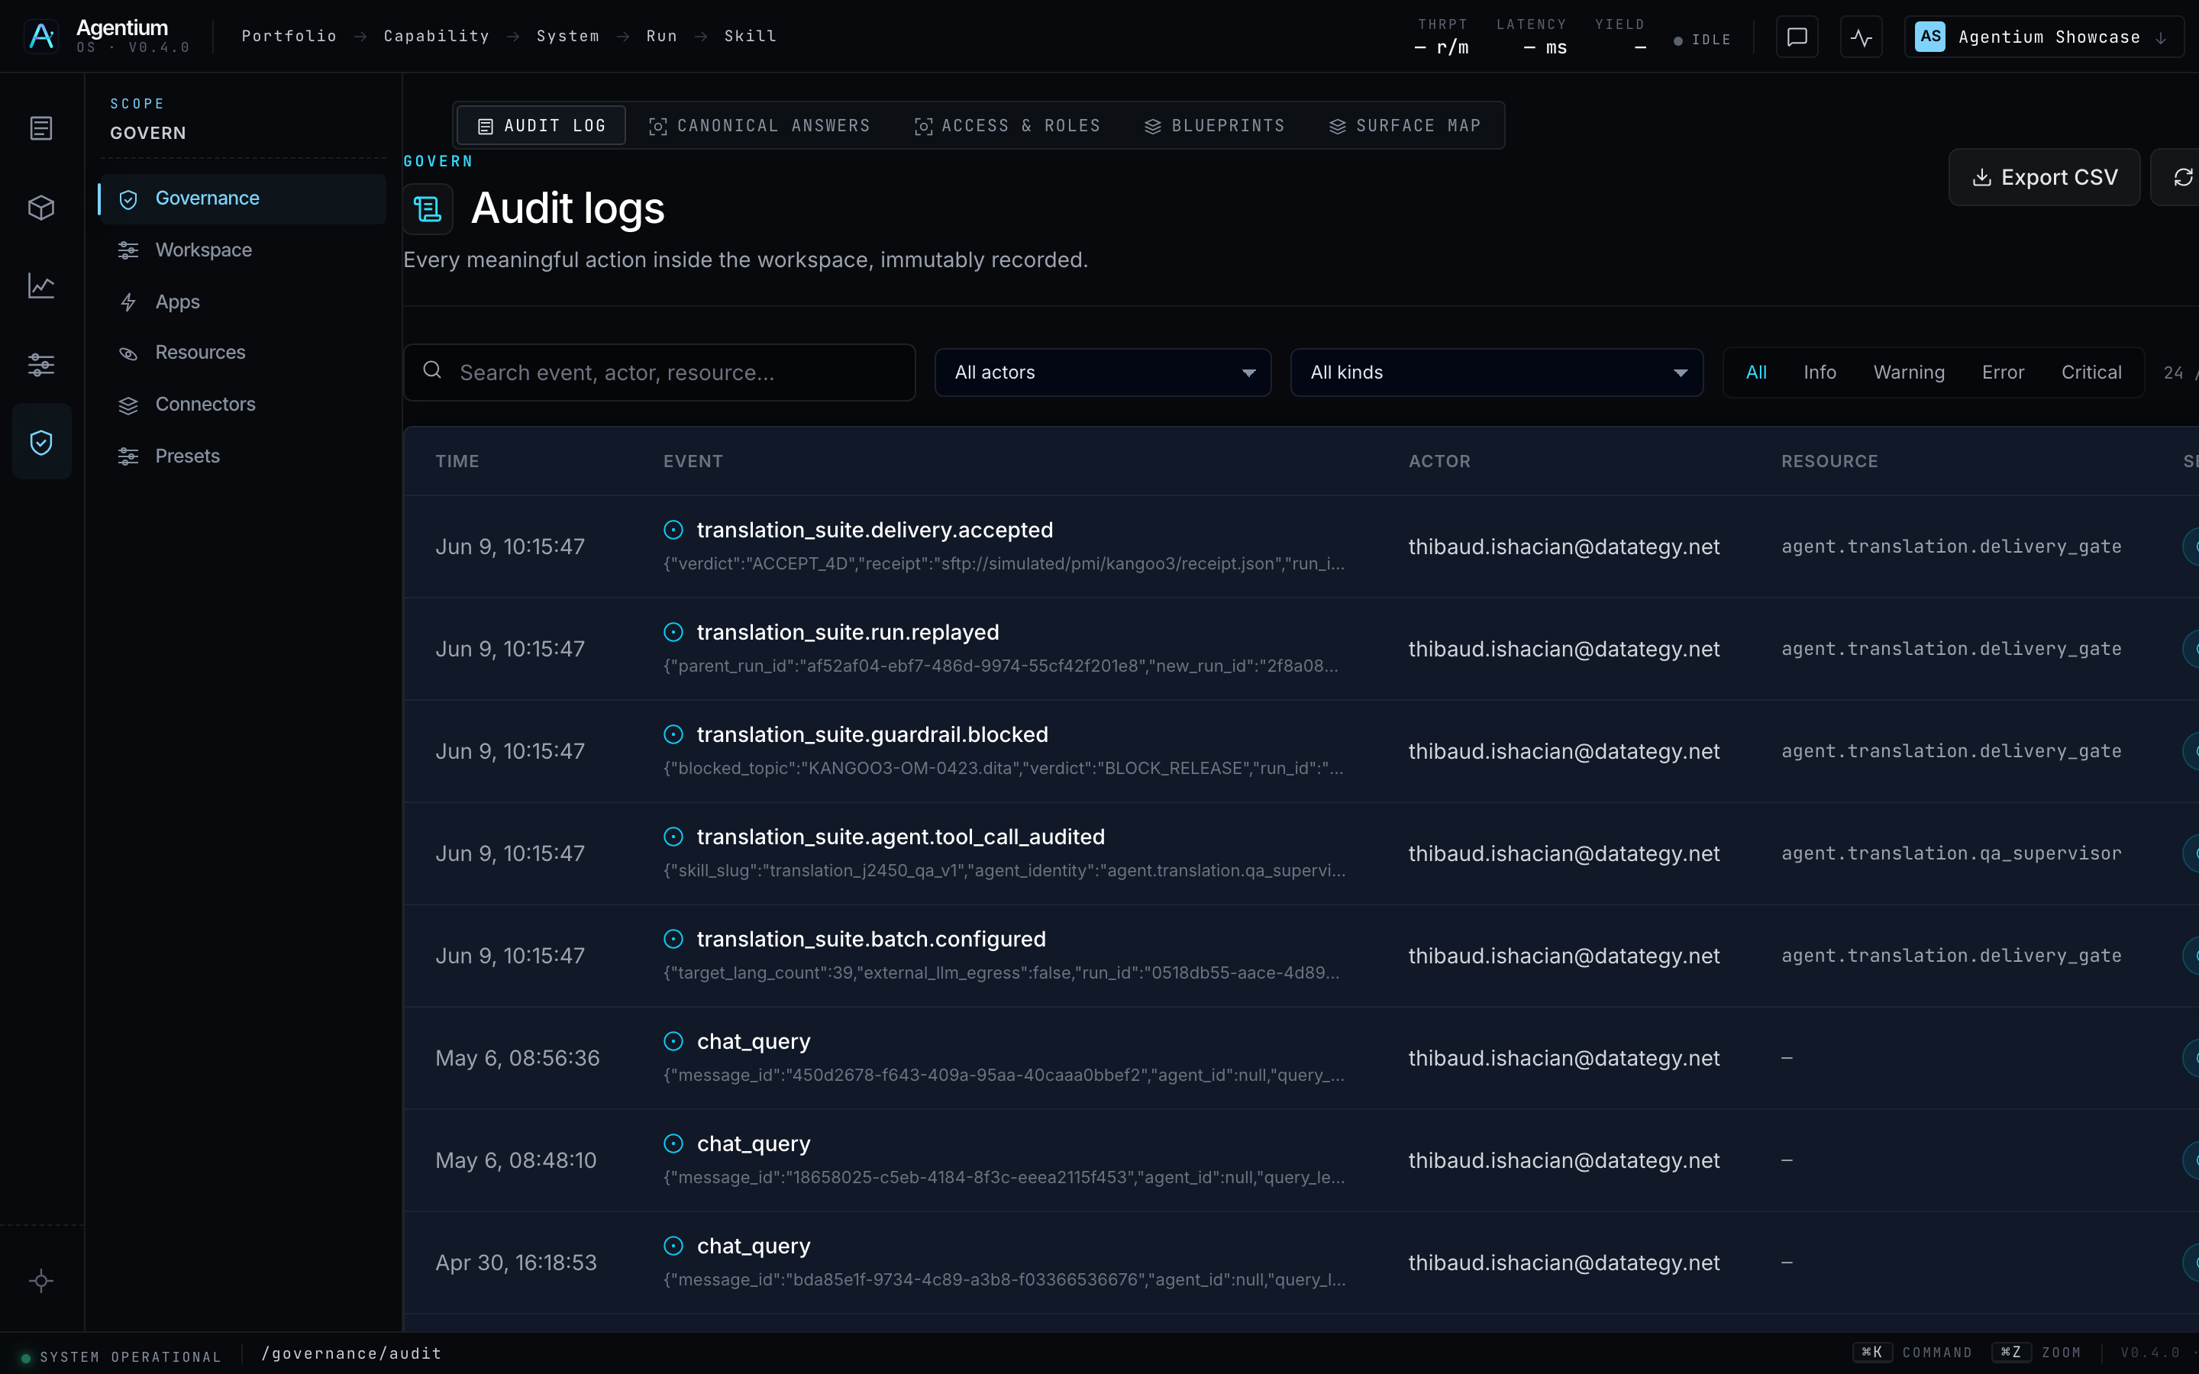
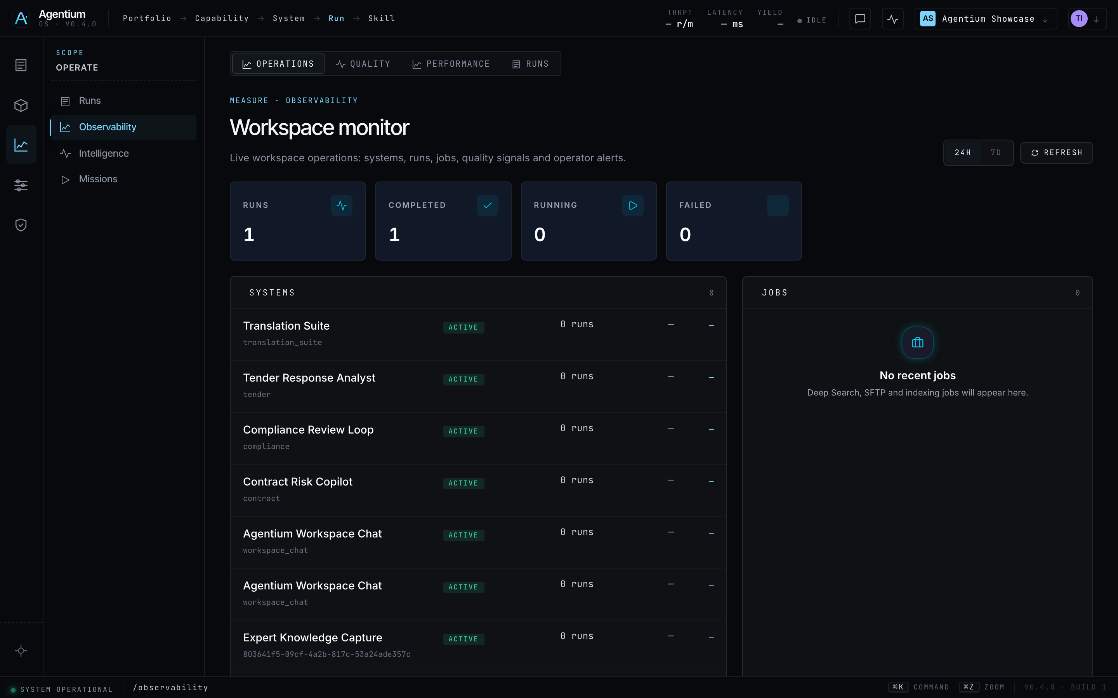
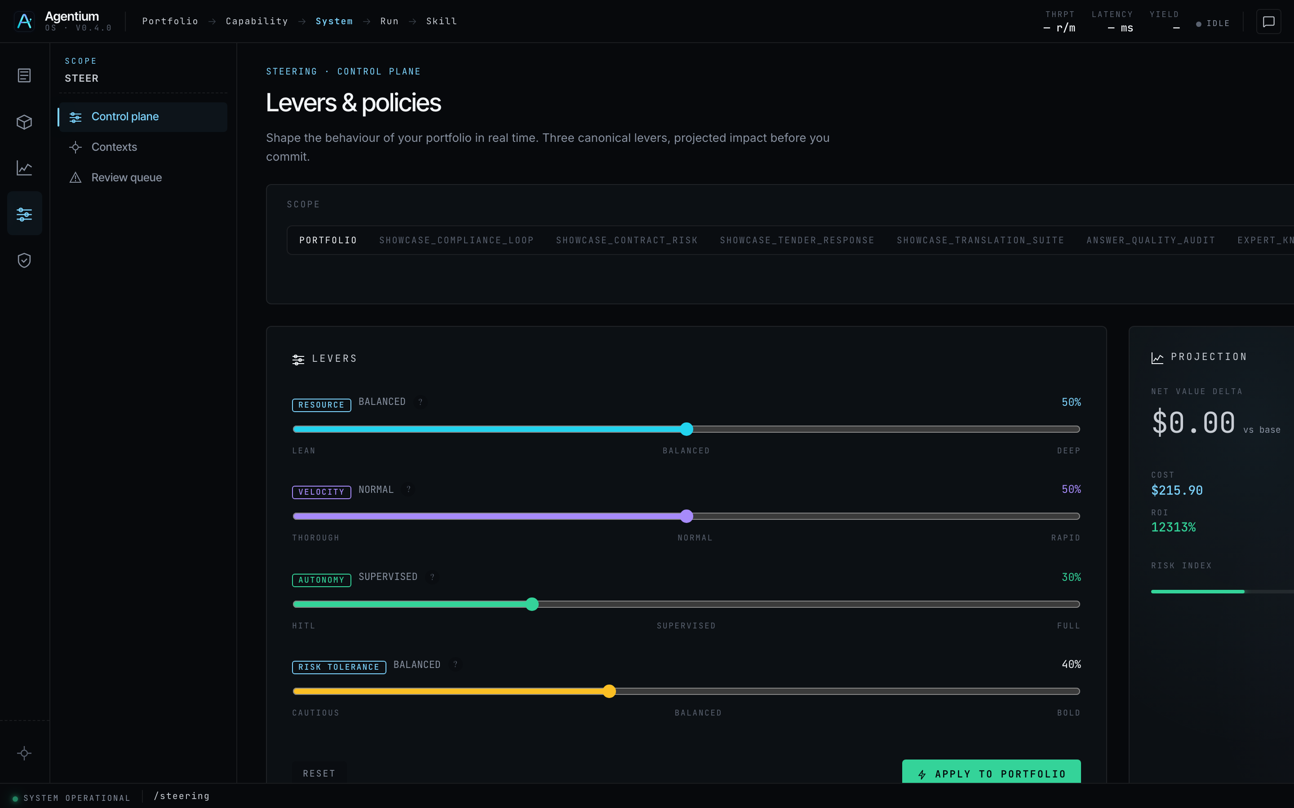
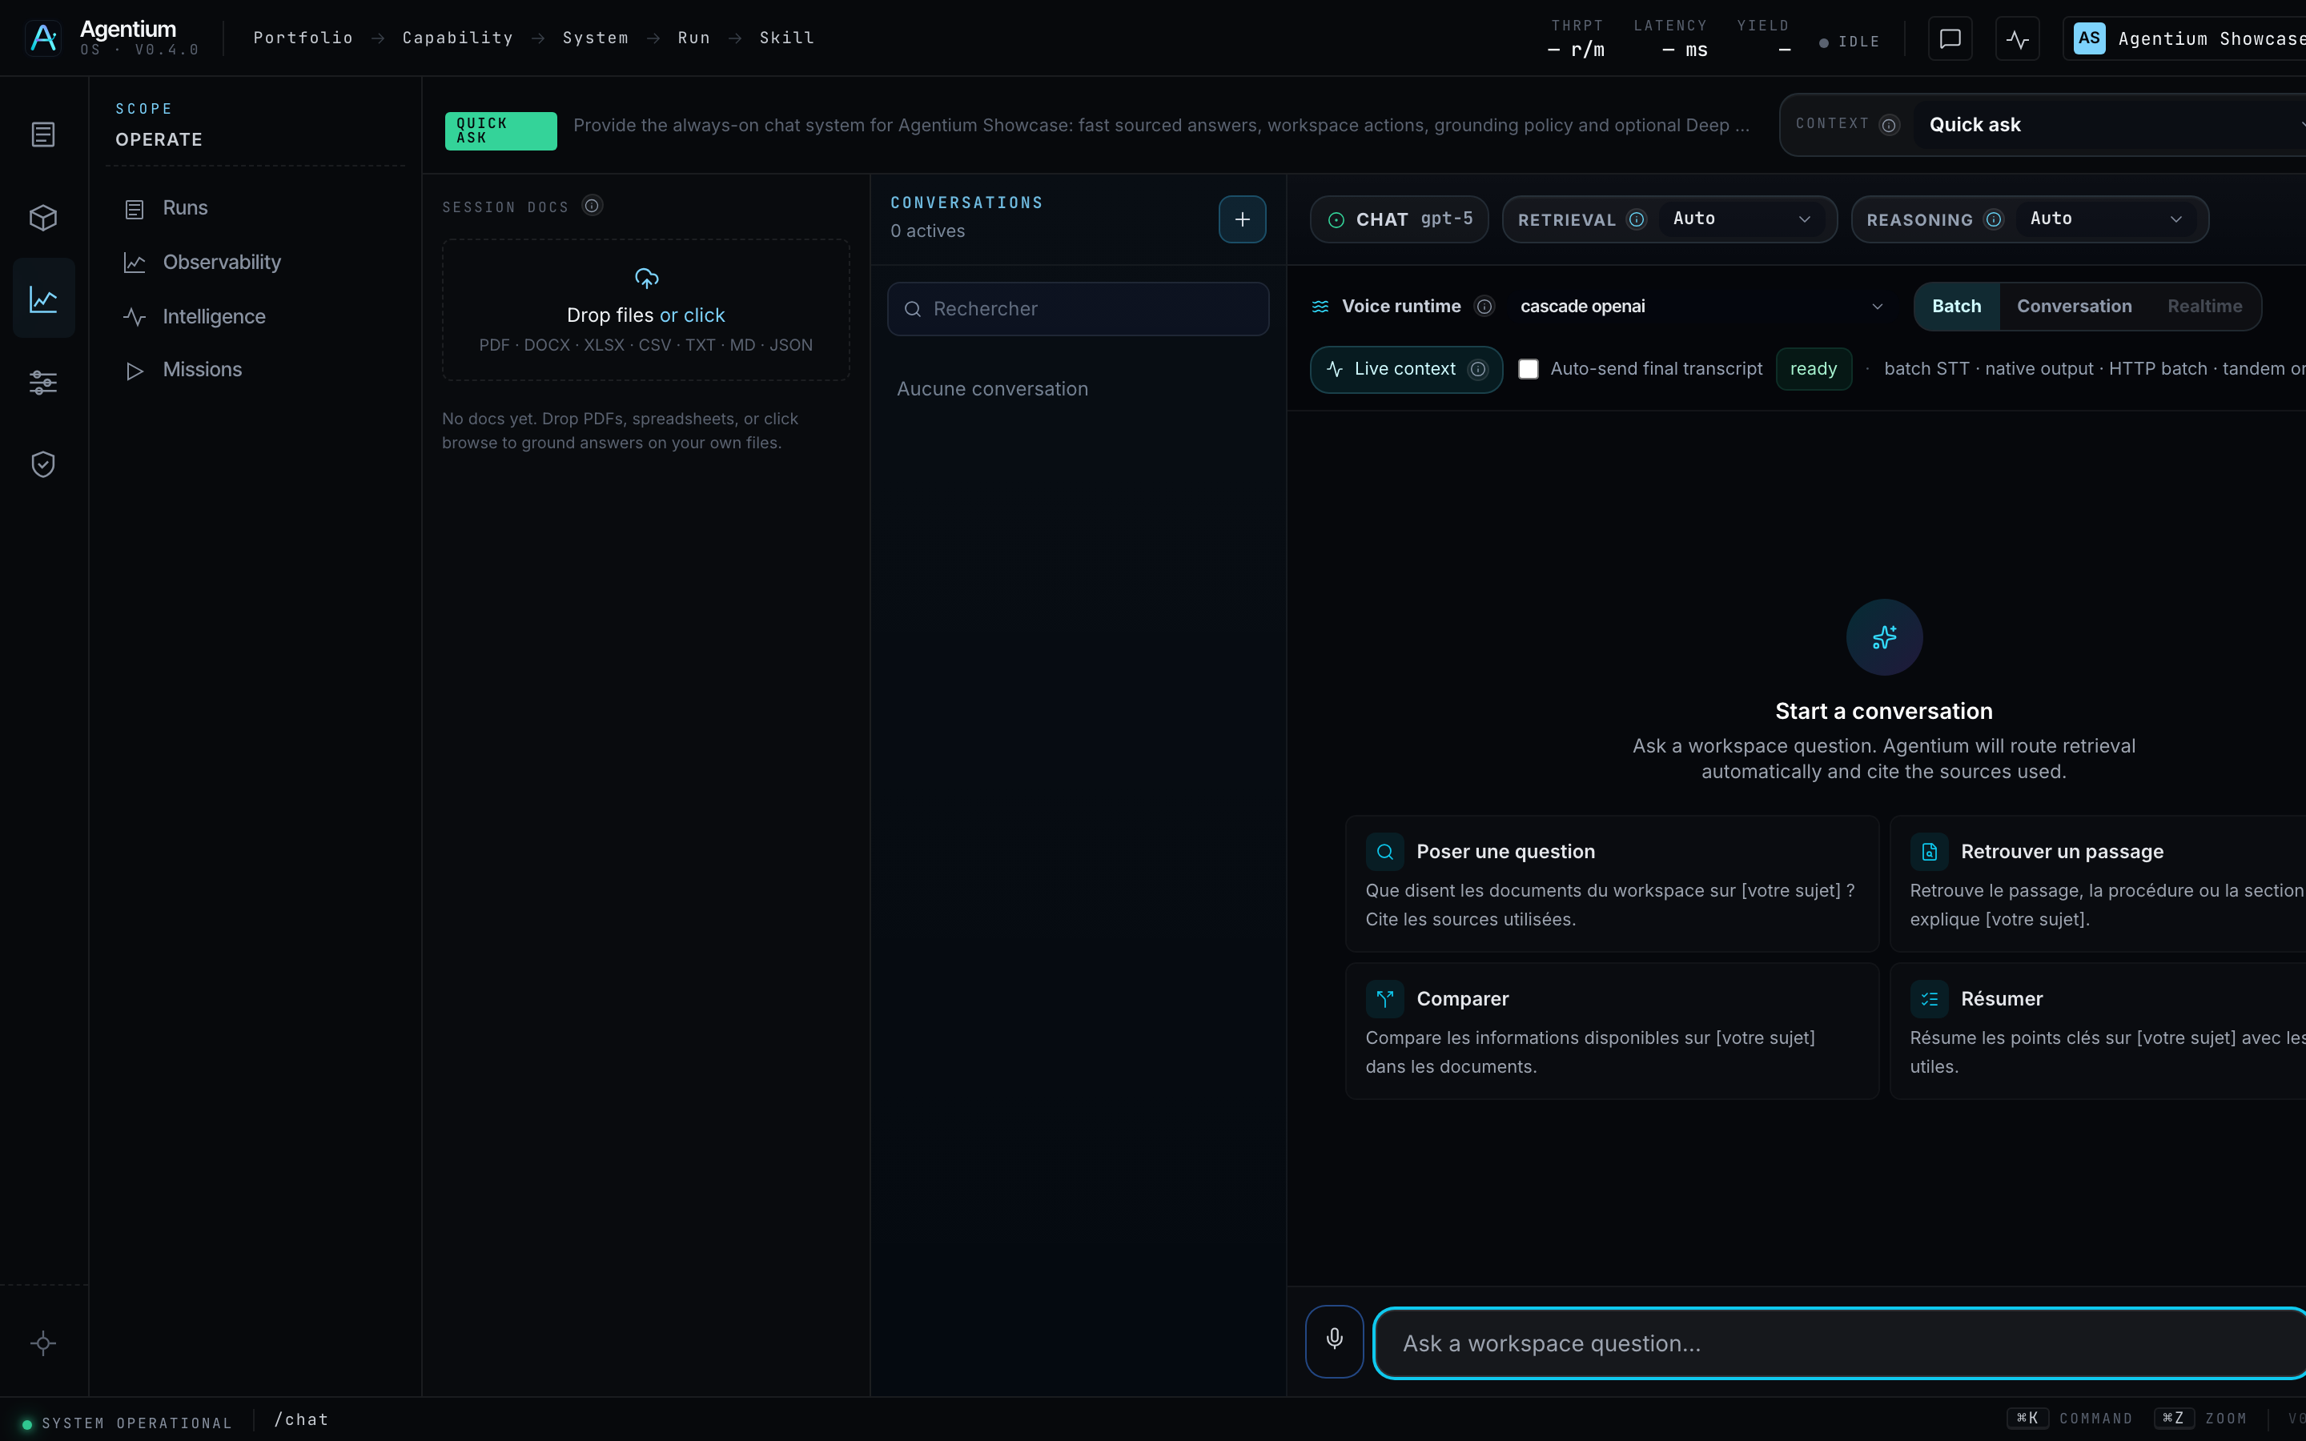
UI gallery
Agentium
Key surfaces — captured from agentium.papai.ai
Each screen maps to a PIH pillar in the following slides
Systems · (agent identity)
Run detail · (stateful execution)
Audit log · (governance)
Observability · (SLO metrics)
Control Plane · (model guardrails)
Chat + stream · (token orchestration)
Datategy — Agentium — PIH alignment intro
Page 7 / 15

Slide 8
Sovereignty
Agentium
Sovereignty — PIH alignment
Operate intelligent systems under customer control — on-prem, hybrid, or sovereign cloud.
How Agentium delivers
• Deploy fully on-prem: local LLM (Ollama / vLLM), Qdrant vectors, MinIO storage.
• Hybrid mode: keep data local while optionally routing to approved cloud models.
• Workspace isolation — multi-tenant boundaries tested in production paths.
• No mandatory external SaaS: every skill, run, and policy stays in your perimeter.
• Same architecture philosophy as papAI — convergence-ready enterprise stack.
Systems — distinct agent identity per workspace
Datategy — Agentium — PIH alignment intro
Page 8 / 15

Slide 9
Robustness
Agentium
Robustness — PIH alignment
Replay, resubmission, and stateful execution — autonomous agents must recover, not fail silently.
How Agentium delivers
• Every Run is a durable execution record with status, input_ref, outcome, lineage.
• POST /runs/{id}/replay — resubmit with overrides (model, prompt, RAG mode, tokens).
• parent_run_id + replay_overrides preserve full audit lineage.
• skill_invocations[] ledger = per-step checkpoint (cost, latency, I/O).
• DAG engine: retry with backoff, HITL pause/resume, parallel branches.
• Evaluation → Decision → replay closes the quality loop without manual re-entry.
Run detail — skill ledger, cost, latency, lineage
Datategy — Agentium — PIH alignment intro
Page 9 / 15

Slide 10
Security
Agentium
Security — PIH alignment
Model guardrails, distinct agent identity, and strict RBAC for autonomous agents.
How Agentium delivers
• ControlPolicy: allowed_models, max_cost, max_latency, mandatory HITL thresholds.
• claim_audit_v1 — faithfulness guardrails on generated outputs.
• Each System = distinct agent identity (objective, capability, flow, policies).
• Keycloak / OIDC authentication; workspace members with built-in roles.
• Context permissions JSON + audit log on every mutation (actor, target, diff).
• AdaptivePolicy gates autonomous actions — no silent policy bypass.
Audit log — actor, action, target, full traceability
Datategy — Agentium — PIH alignment intro
Page 10 / 15

Slide 11
Observability & Scalability
Agentium
Observability & Scalability — PIH alignment
Full auditability of agent tool-calling and enterprise-grade scaling.
How Agentium delivers
• Structured /audit stream — every mutation, upload, and policy change logged.
• skill_invocations persist full tool-call ledger: inputs, outputs, status, metrics.
• SSE /runs/{id}/stream — token_delta + structural node events in real time.
• /observability surfaces SLO: cost, latency, success rate, live telemetry.
• Async execution via background workers; Postgres-backed durable state.
• Horizontal scaling path: Celery runtime alignment for batch & event workloads.
Observability — SLO metrics and live telemetry
Datategy — Agentium — PIH alignment intro
Page 11 / 15

Slide 12
Token Performance
Agentium
Token Performance — PIH alignment
Efficient and deterministic sovereign model orchestration.
How Agentium delivers
• Control Plane routes to allowed_models only — no rogue model selection.
• Flow / DAG engine executes skills in declared order (sequential, parallel, gated).
• Per-skill cost_per_call + Run-level budget caps prevent token sprawl.
• token_delta SSE streaming — efficient UX without polling overhead.
• Deterministic paths: canonical answers bypass LLM when approved response exists.
• Impact preview (<300ms) before applying policy levers — predictable trade-offs.
Control Plane — allowed models, cost & latency guardrails
Honest boundary: Advanced custom RBAC roles and checkpoint resume tokens are on the roadmap; core governance, replay, and audit paths are shipped today.
Datategy — Agentium — PIH alignment intro
Page 12 / 15

Slide 13
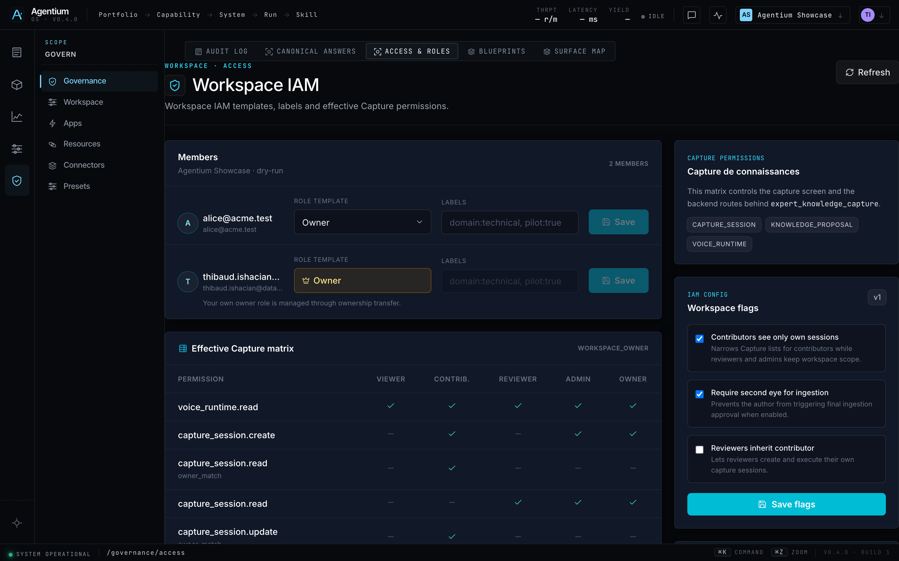
Security & execution
Agentium
RBAC perimeter + live agent execution
Access control before execution · token stream during run
Access & Roles — workspace RBAC (Keycloak / OIDC)
Chat — grounded answers with streaming token orchestration
Datategy — Agentium — PIH alignment intro
Page 13 / 15

Slide 14
Live demo
Agentium
From requirements to proof — demo flow
Five minutes to connect PIH pillars to what you will see on screen
1
2
3
4
5
Login & workspace
System & Control Plane
Run + stream
Skill ledger & audit
Evaluation → Replay
RBAC, sovereign perimeter
Agent identity + model guardrails
Stateful execution + token orchestration
Full tool-call traceability
Robustness loop in action
Key message: Agentium is not an agent playground — it is the control layer that makes autonomous systems sovereign, recoverable, secure, observable, and token-efficient.
Let's demo. Questions welcome throughout — we will map each screen back to the PIH pillars.
Datategy — Agentium — PIH alignment intro
Page 14 / 15

Slide 15
Ready for the live demo
Agentium — governed intelligent systems at enterprise scale
Sovereign · Robust · Secure · Observable · Token-efficient
Datategy — Confidential

