Slide 1
PicVerse A Social Media Photo Sharing Platform
Group ID :-14 202412026 Jain Tisha Navinkumar
202412032 Kaival Shah
202412066 Patel Dhruv Alkeshbhai

Slide 2
Description
PicVerse is a user-centric social media platform designed to let users seamlessly share moments through photo uploads, connect with friends, and engage through likes, comments, and direct messaging. Inspired by popular visual platforms, PicVerse offers essential features like user authentication, profile personalization, post interactions, explore/search functionality, and private chat – all wrapped in a simple and modern interface.
With robust backend support and user-friendly design, PicVerse aims to provide a secure, scalable, and interactive experience for users. The platform also includes admin capabilities such as banning users and monitoring server performance to ensure a healthy and safe environment. Built using agile Scrum methodology, this project demonstrates collaboration, planning, and real-world product development workflows.

Slide 3
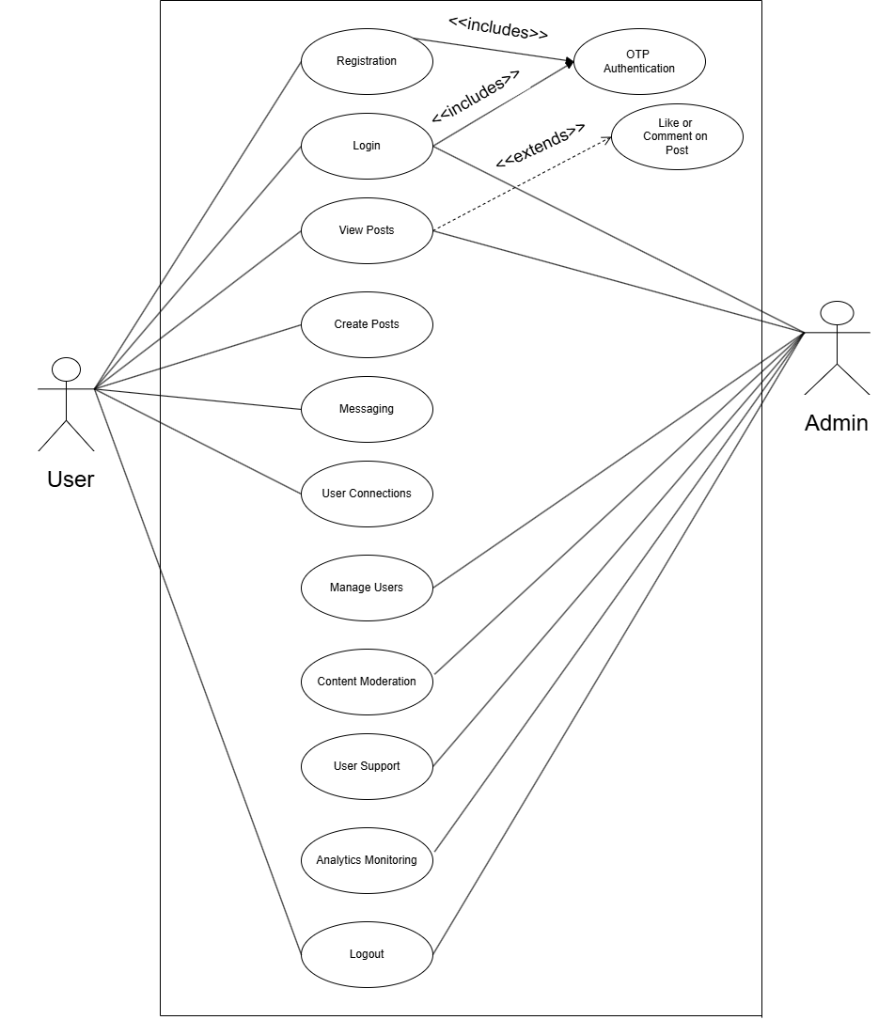
Use Case

Slide 4
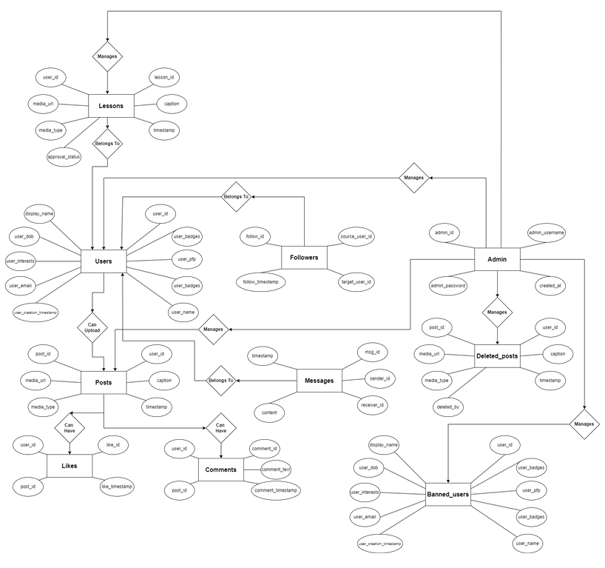
Entity-Relationship Diagram

Slide 5
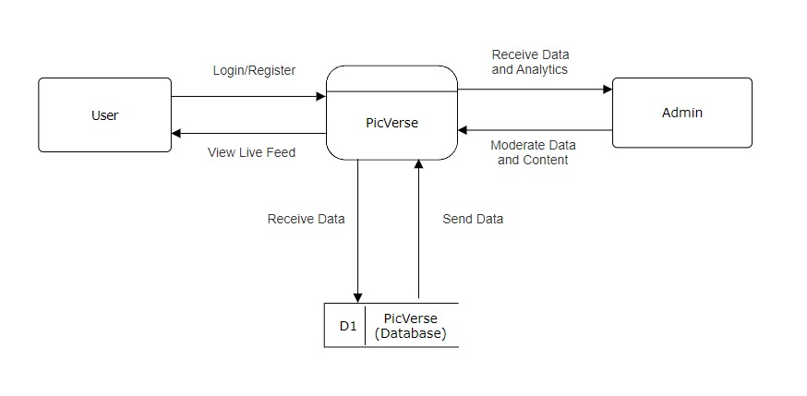
Level 0 DFD

Slide 6
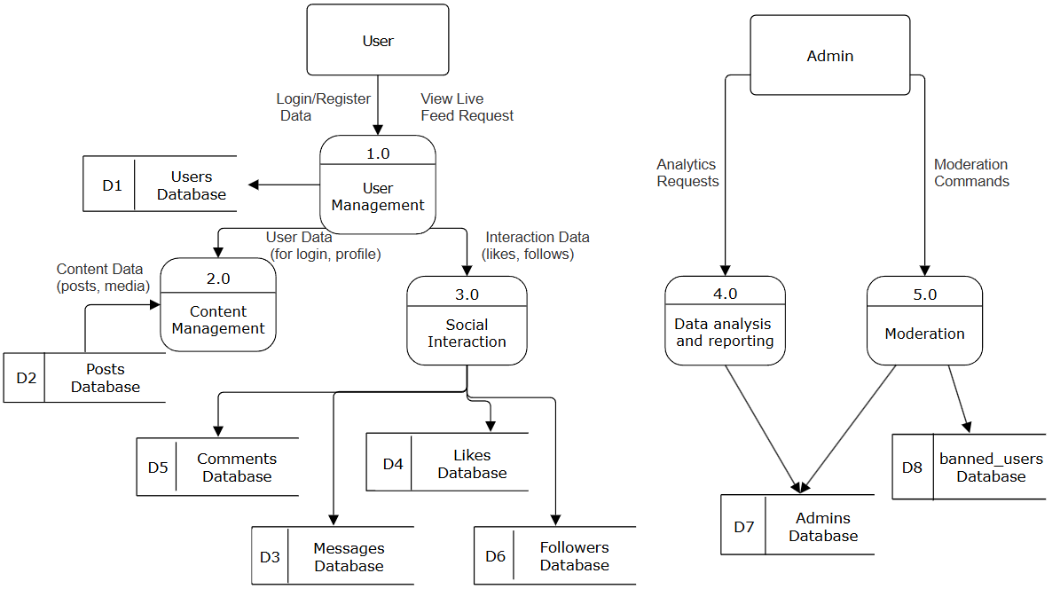
Level 1 DFD

Slide 7
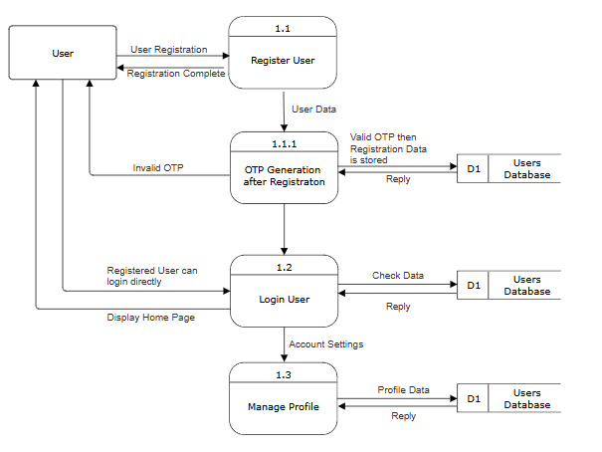
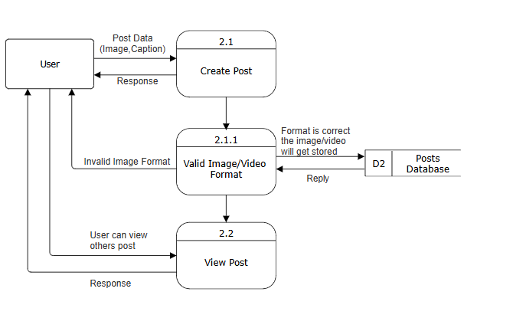
Level 2 DFD
1.0 User Management
2.0 Content Management

Slide 8
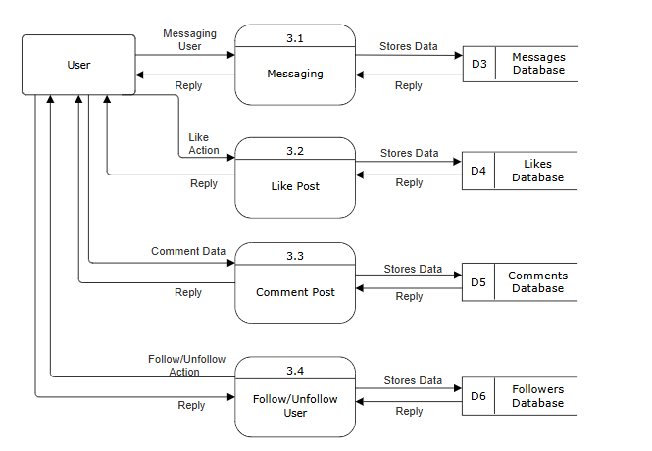
Level 2 DFD
3.0 Social Interaction

Slide 9
Level 2 DFD
4.0 Data Analysis and Reporting
5.0 Moderation

Slide 10
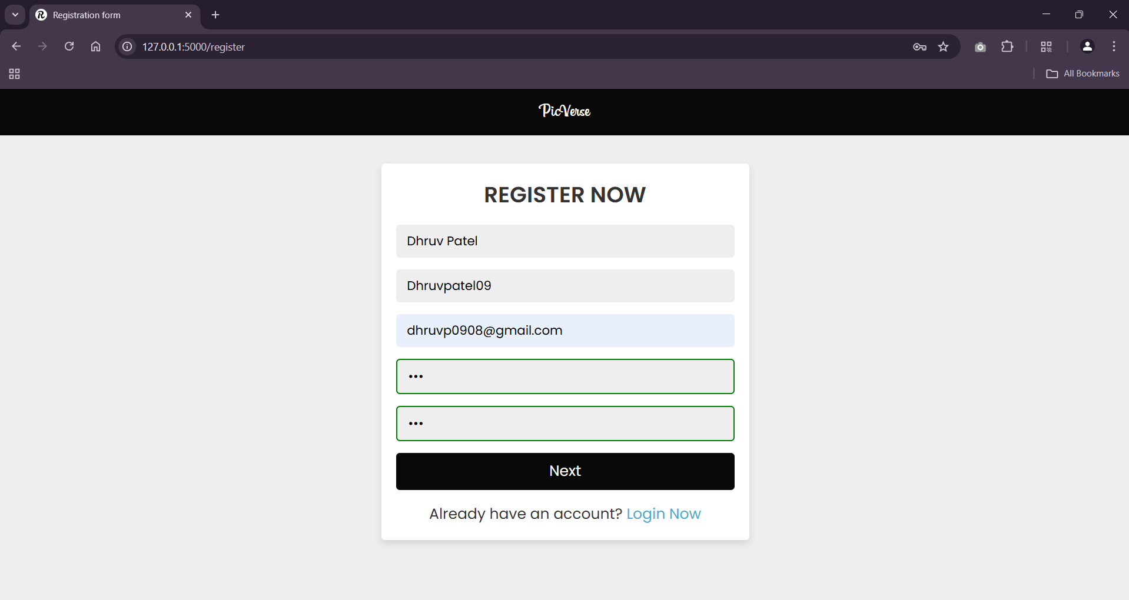
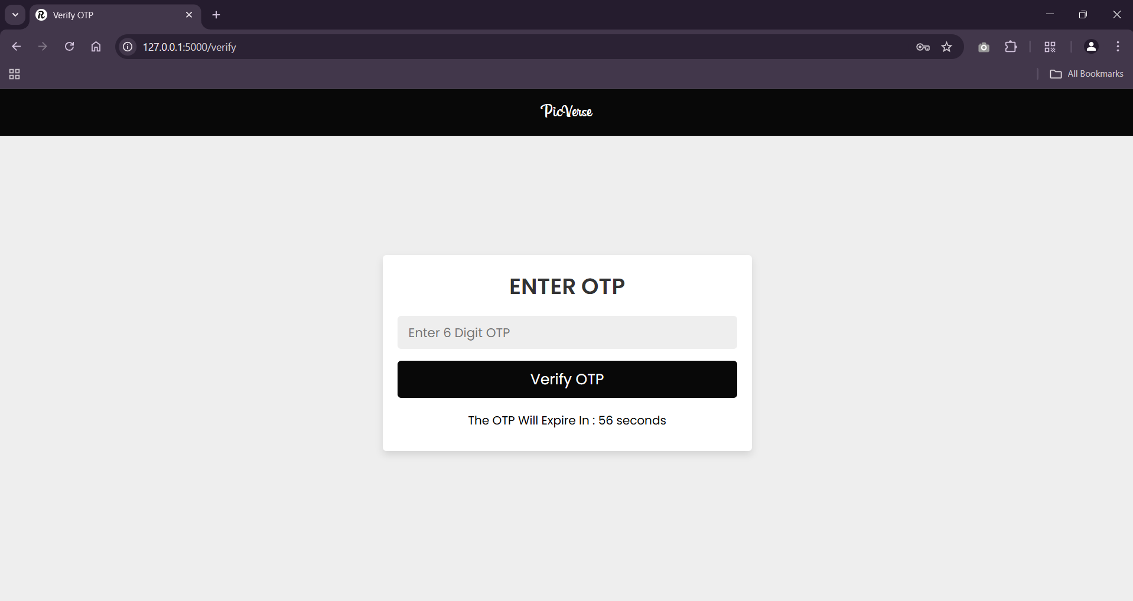
Screenshots
Registration
OTP Verification

Slide 11
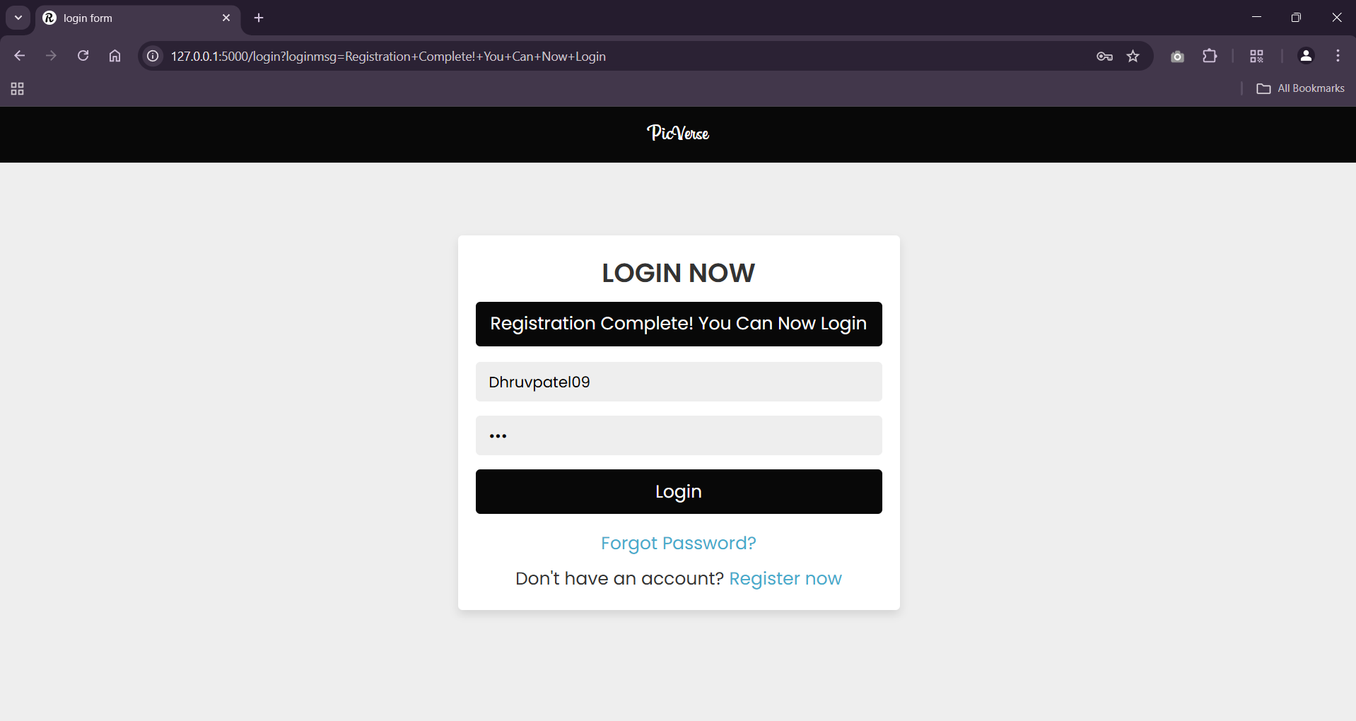
Login Page

Slide 12
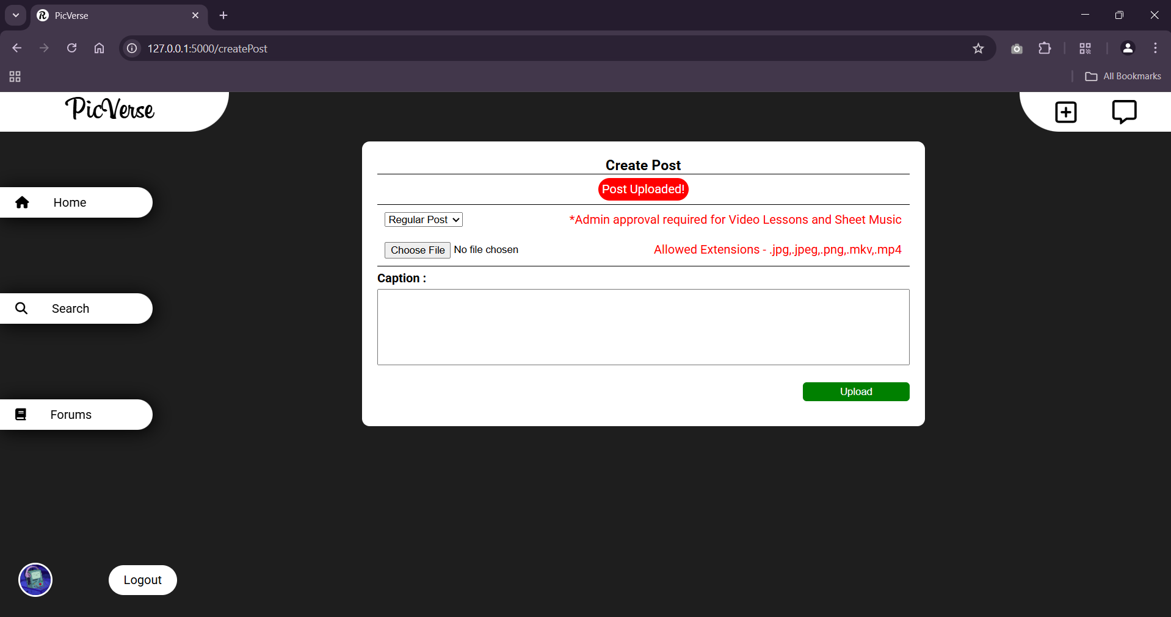
Create Posts

Slide 13
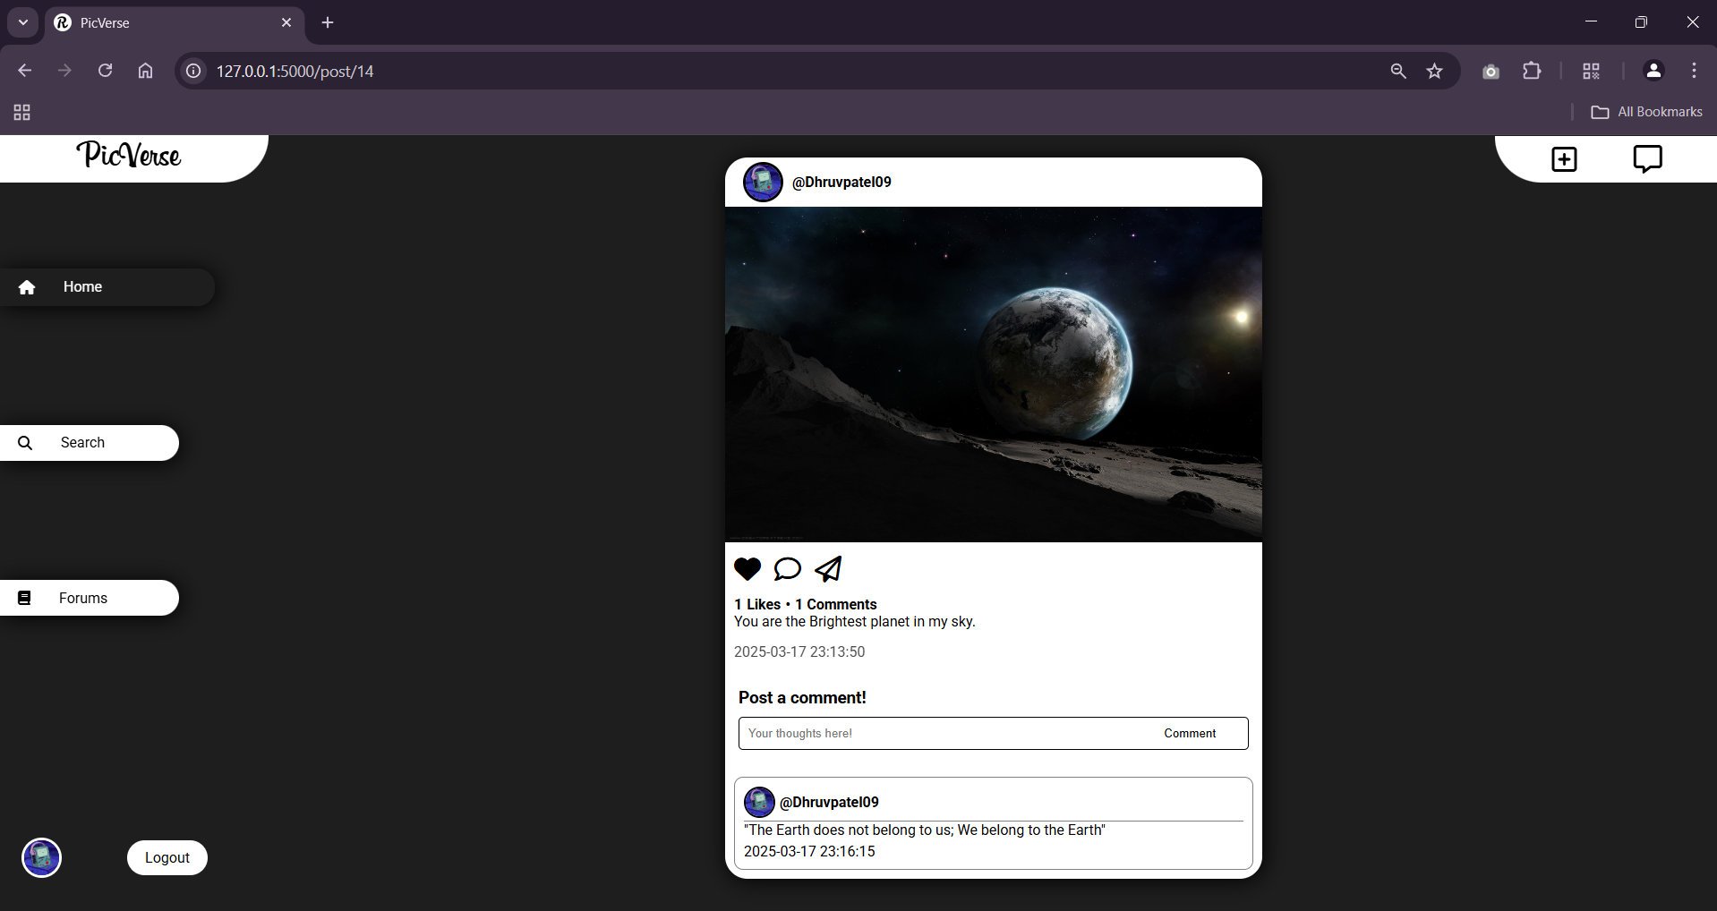
View Posts , Like and Comment.

Slide 14
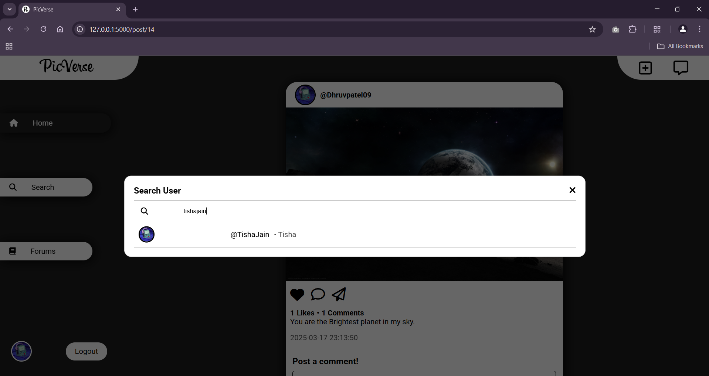
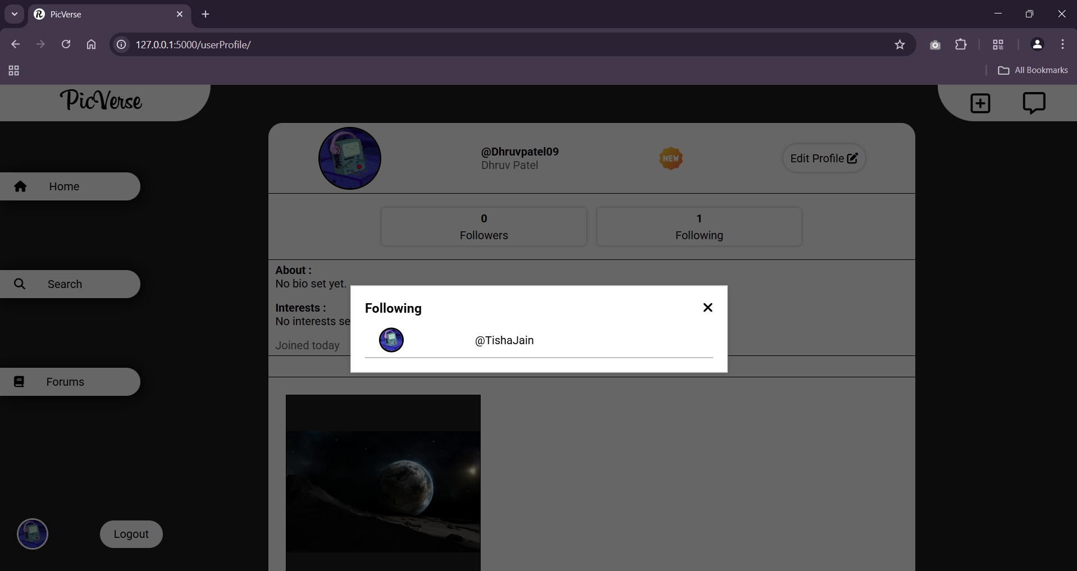
Search Users Following List

Slide 15
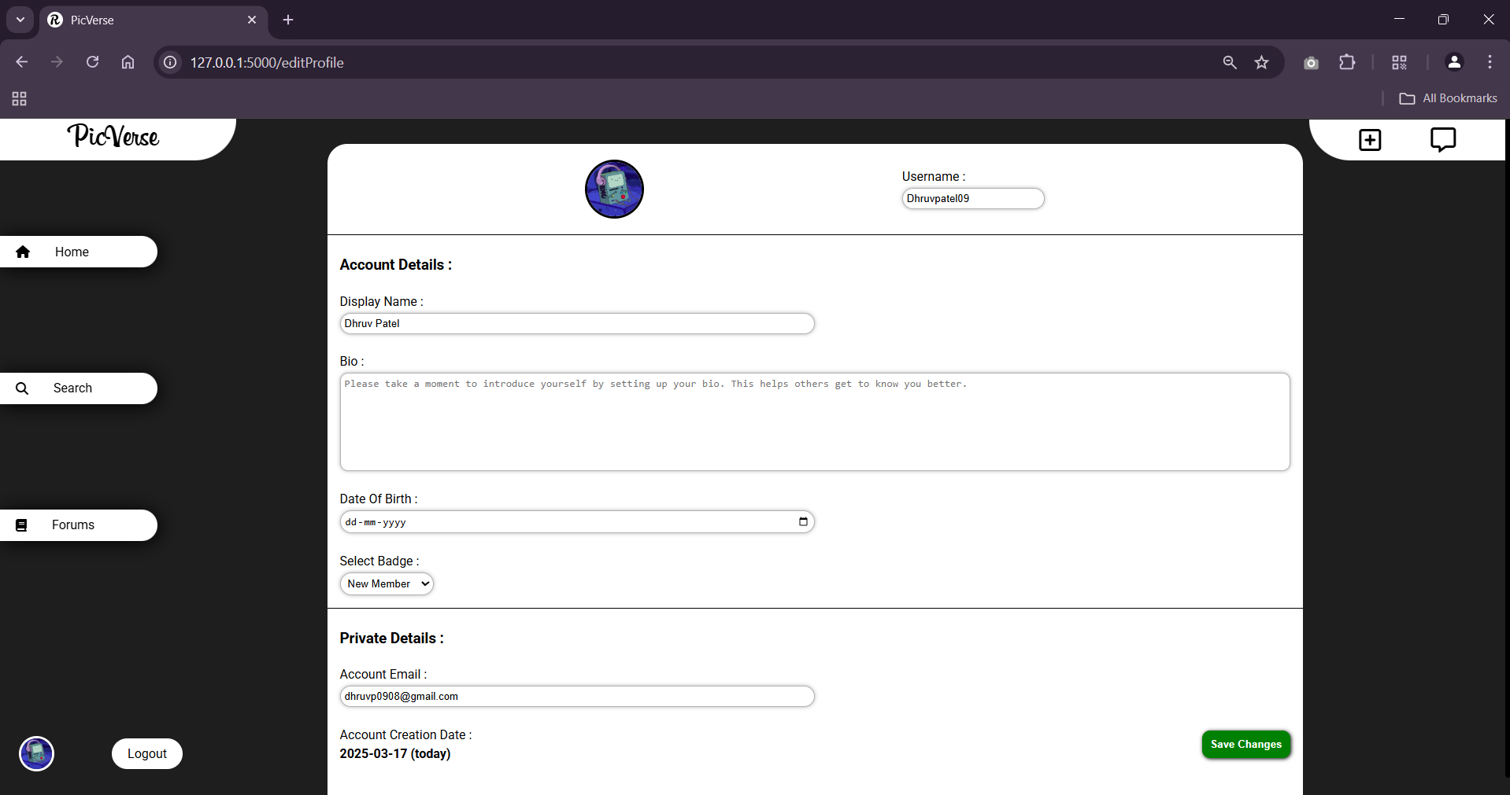
Edit Profile

Slide 16
Team Member Roles & Work Distribution
Kaival Shah :-
• Backend Development Lead – Authentication system, Messaging system, OTP integration, Server Monitoring.
• Completed: User authentication, OTP registration flow.
• Upcoming: Messaging backend logic, Admin features.
Jain Tisha Navinkumar :-
• UI/UX & Frontend Development – Profile page design, Photo upload interface, Follow/Unfollow UI, Messaging UI.
• Completed: Profile customization, Upload interface, Follow/Unfollow frontend , Explore/Search page UI.
• Upcoming: Messaging UI integration, Testing and visual polish.
Patel Dhruv Alkeshbhai :-
• Database & Integration – Schema design, DB connectivity, Feature testing.
• Completed: DB schema for users, posts, likes/comments.
• Upcoming: API integration, analytics dashboard, final testing and deployment support.

