Slide 1
Spark Vs MapReduce
229327C
Harischandra R.M.T.C.S.

Slide 2
AWS EMR - Amazon Elastic MapReduce
Leverages Apache Hadoop, Apache Spark, HBase, Presto, Hive, and others
cost-effective
flexible pricing option
Scalable

Slide 3
What is Spark
Open Source
Developed by Apache
Unified framework for Big Data Processing
In-memory caching and optimized query execution
supports SQL queries, streaming data, machine learning and graph processing
runs on Hadoop, Apache Mesos, Kubernetes, standalone, or in the cloud
can access diverse data sources including HDFS, Cassandra, HBase, and S3

Slide 4
What is Map Reduce
programming model for processing and generating large datasets with a parallel, distributed algorithm on a cluster
simplifies the processing of vast amounts of data by splitting the work into independent tasks
easily distributable across a cluster of machines

Slide 5
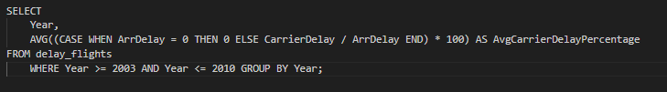
HiveQL and Map Reduce
HiveQL is a SQL-like abstraction to the Map Reduce
Removes code boilerplate by simply converting complex java implementation into a SQL query

Slide 6
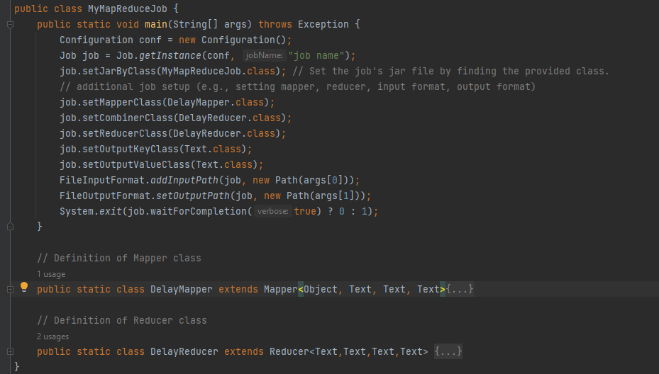
Equivalent Map Reduce

Slide 7
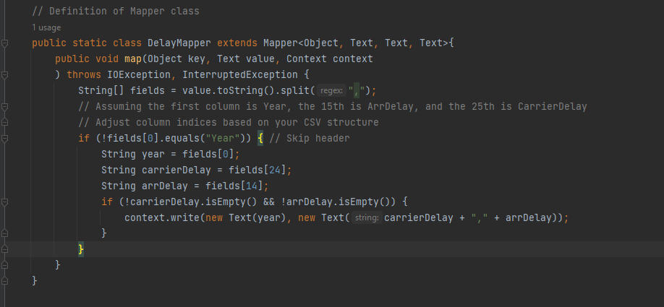

Slide 8
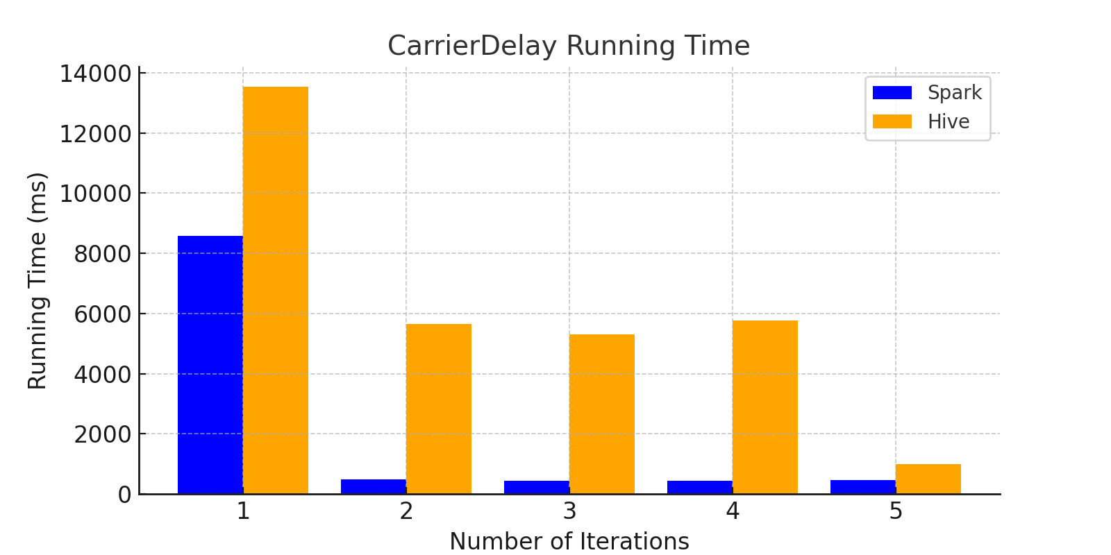
CarrierDelay Running Time

Slide 9
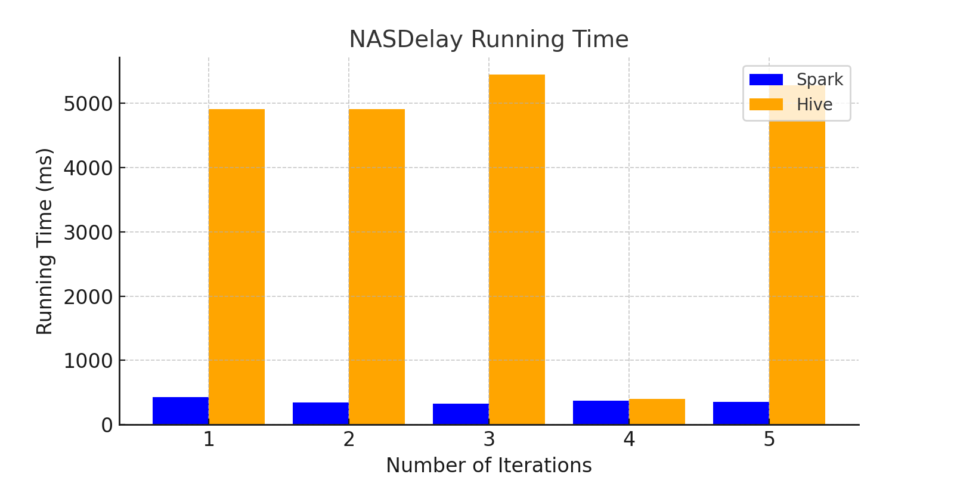
NASDelay Running Time

Slide 10
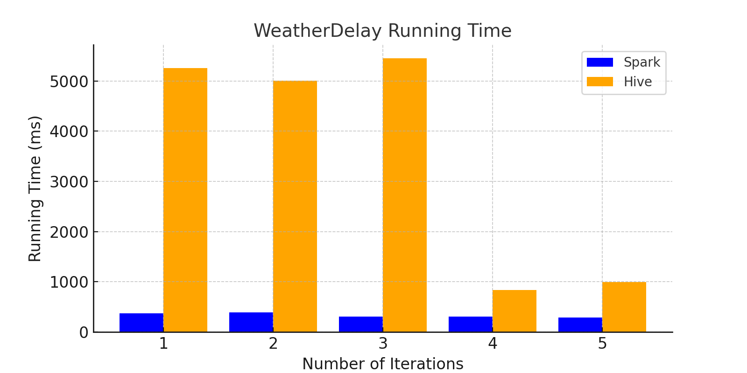
WeatherDelay Running Time

Slide 11
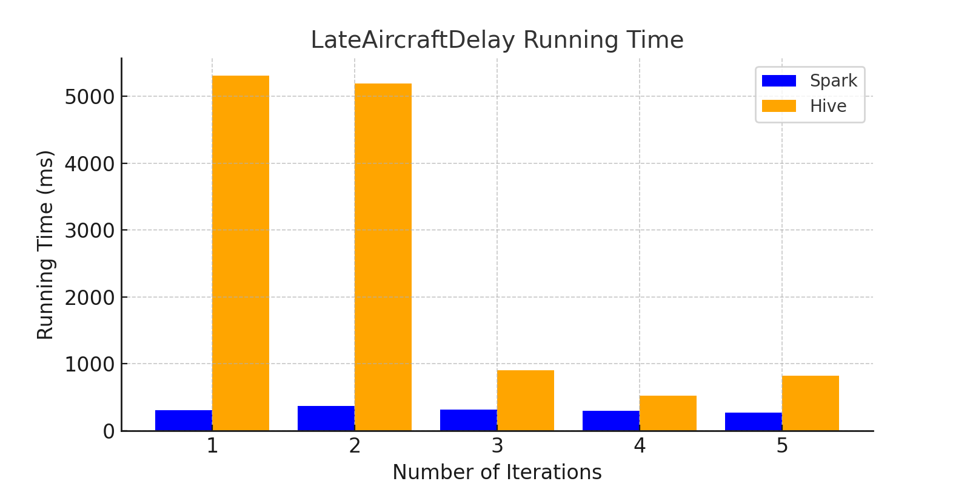
LateAircraftDelay Running Time

Slide 12
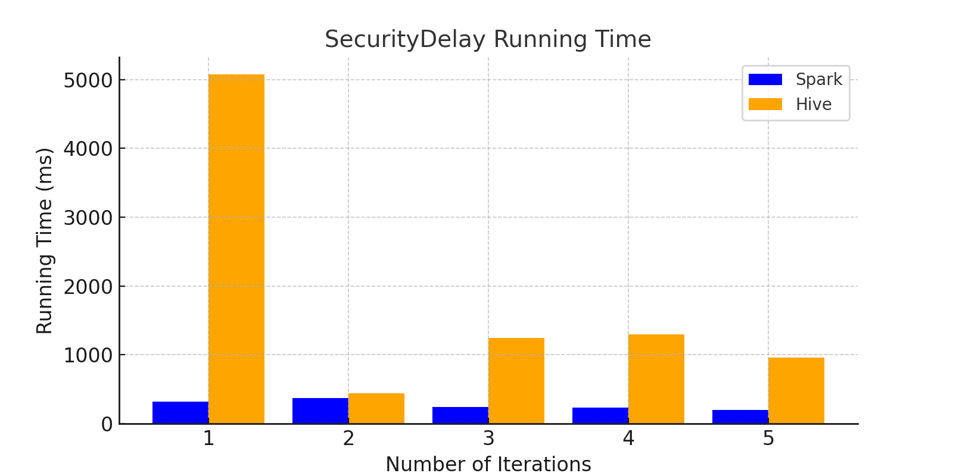
SecurityDelay Running Time

Slide 13
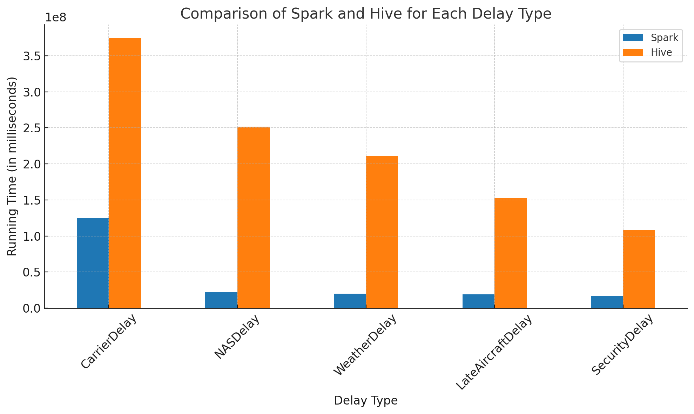
Average Running Times

Slide 14
Conclusion
Spark exhibits lower running times across all delay categories, indicating faster performance.
Spark's architecture allows for better scalability due to its in-memory processing capabilities.
The choice between Spark and HiveQL should be based on the specific use case requirements.

