Slide 1
INFO 4602/5602 Information Visualization
Individual Project Presentation
(My Dashboard Report)
Student Name:
Shruti Wakchoure

Slide 2
Table of Contents
Context
Motivation for dashboard
3 key research questions that my dashboard seeks to answer
(Real-world) data source and discussion
Presentation and discussion
Answers to 3 key research questions
URL/ web link for online hosted dashboard

Slide 3
Context/environment for dashboard design and development
Designed to uncover trends in Airbnb listings, pricing, and availability across NYC neighborhoods for the year 2019
Built with end-users in mind, including hosts, travelers, and city planners for data-driven decisions.
Developed using Tableau for interactive visualization.

Slide 4
Motivation for dashboard
Help potential guests make informed booking decisions based on neighborhood prices and availability.
Enables hosts to benchmark their listings and optimize pricing strategies.
Assists city officials and planners in understanding Airbnb’s impact on housing and tourism trends.

Slide 5
3 key research questions that my dashboard seeks to answer
Which neighbourhood group has the highest number of total listings?
Which host has the most total reviews? How do bookings vary by month?
What is the average price across neighborhoods in Brooklyn?

Slide 6
Data source and discussion
Tableau Sample Data – Supplementary demo datasets for visualization
Inside Airbnb – Real-time listing data across NYC neighborhoods
Enables analysis of booking trends, pricing, and host activity.
Supports decision-making for travelers, hosts, using real-world, up-to-date data.

Slide 7
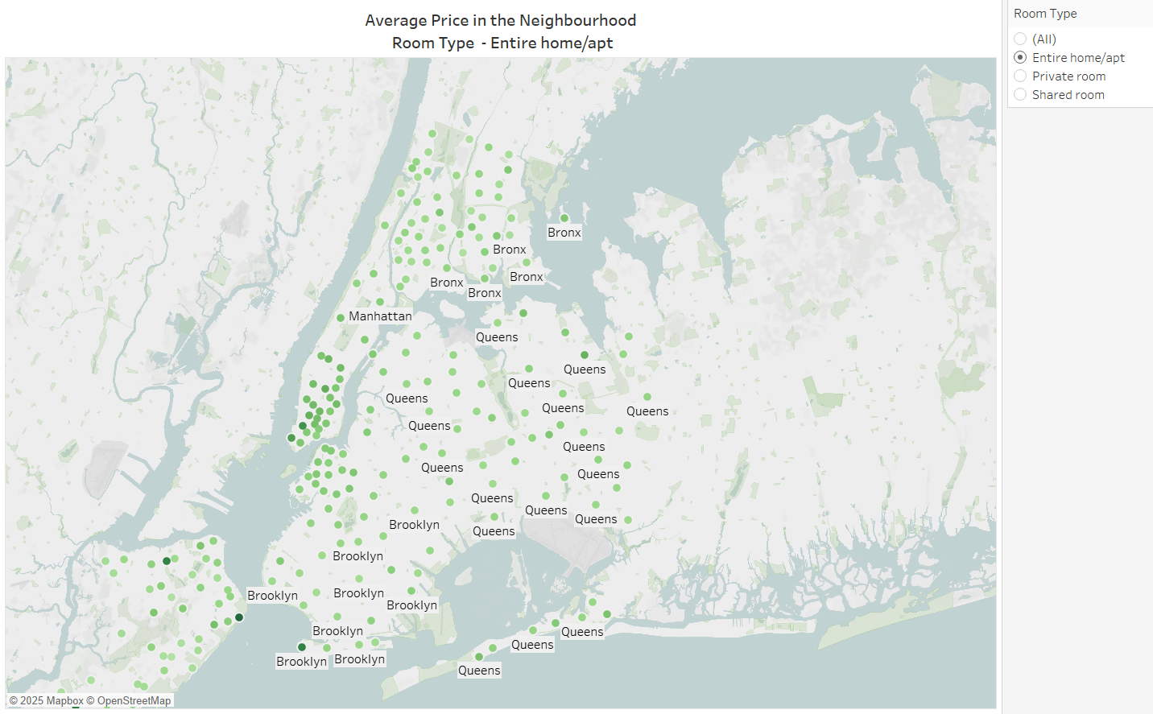

Slide 8
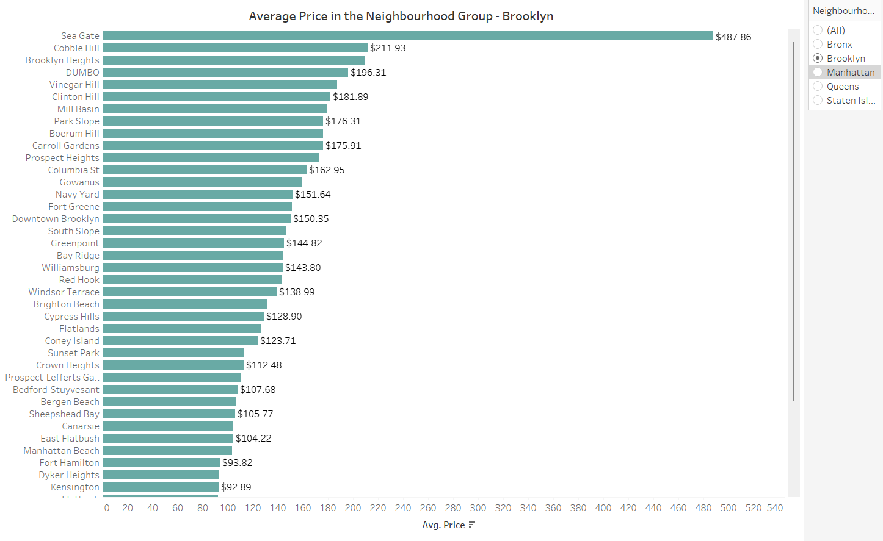

Slide 9
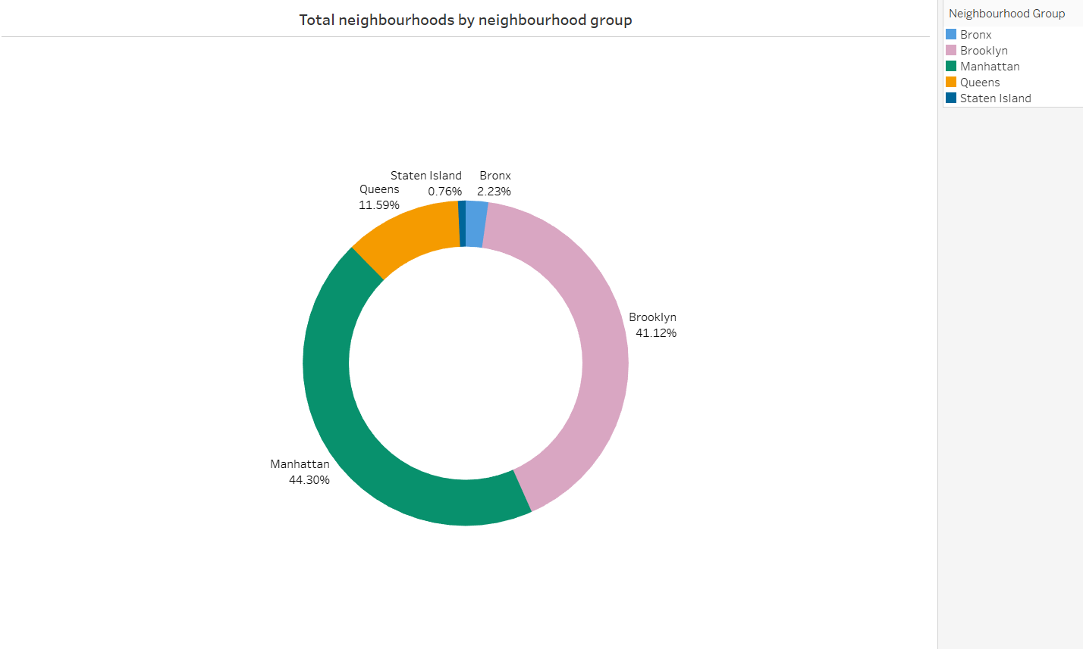

Slide 10
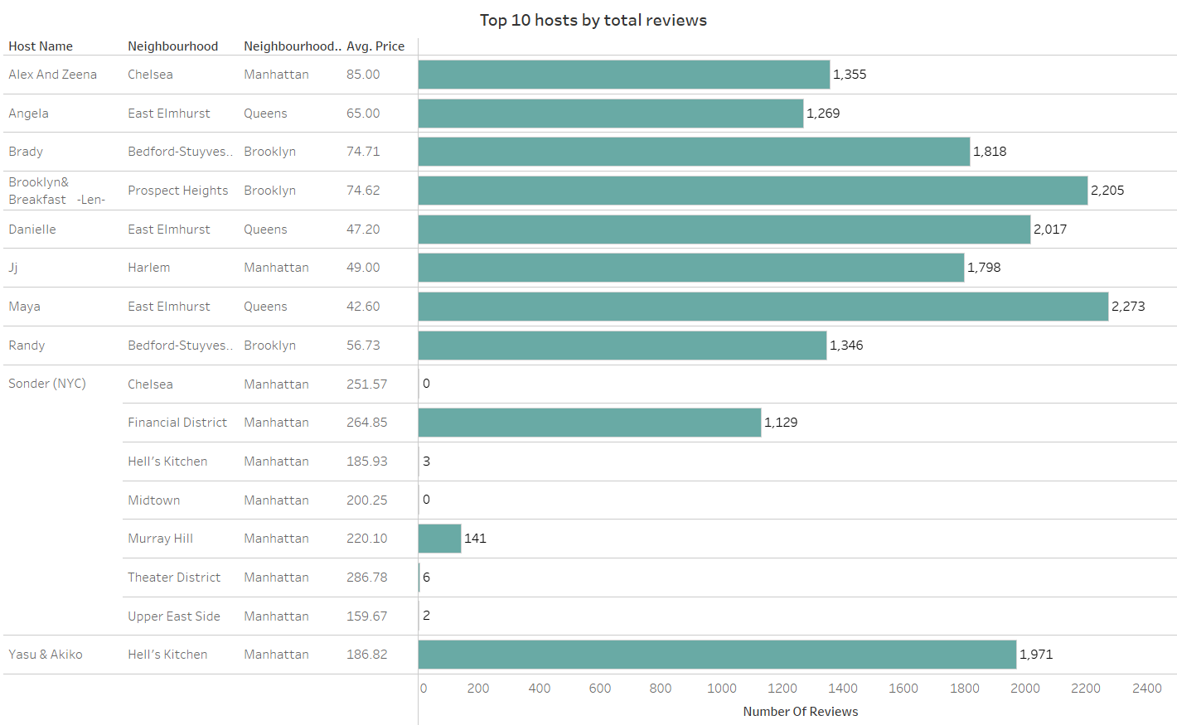

Slide 11
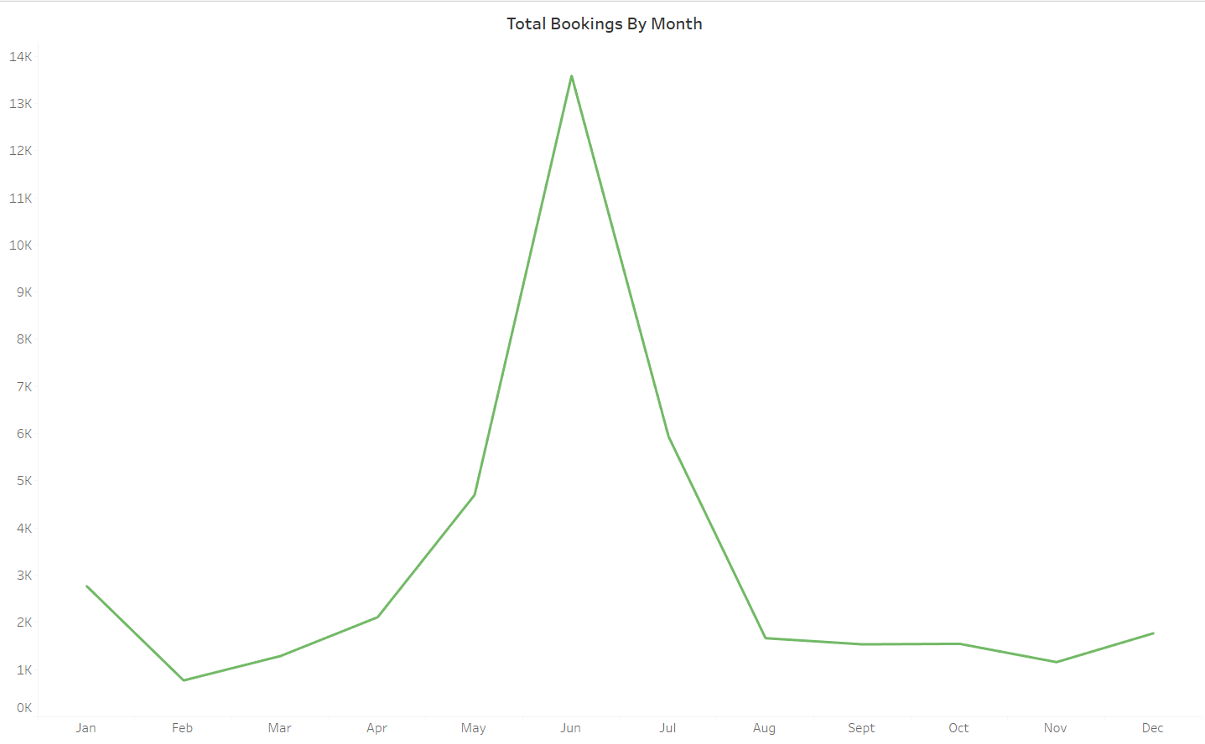

Slide 12
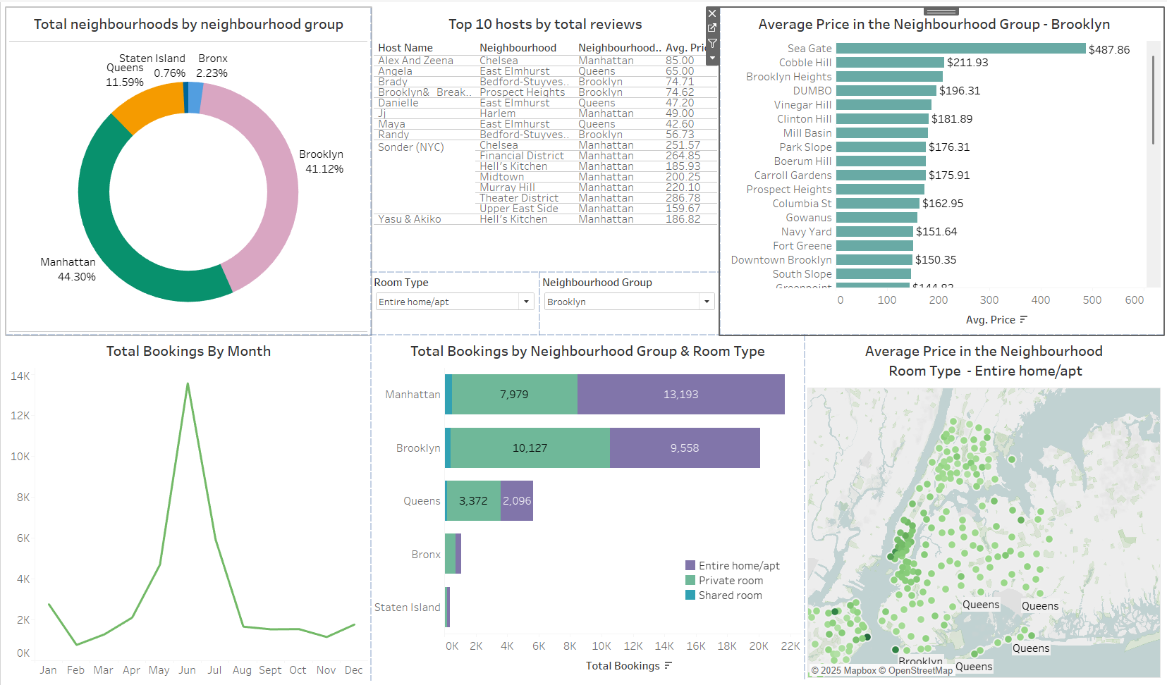

Slide 13
Answers to 3 key research questions and any recommendations
Which neighbourhood group has the highest number of total listings? Manhattan leads with 44.30% of total listings, followed closely by Brooklyn at 41.12%.
What is the average price across neighborhoods in Brooklyn? Sea Gate has the highest average price at $487.86
Cobble Hill and Brooklyn Heights also have high prices ($211.93 and $204.00+).
How do bookings vary by month? Bookings peak in June, with a sharp increase from May and a decline starting in July.

Slide 14
Link to the dashboard -
https://public.tableau.com/views/AirbnbDashboard_17448773248560/Dashboard1?:language=en-US&:sid=&:redirect=auth&:display_count=n&:origin=viz_share_link

