Slide 1

A Comprehensive Statistical Analysis of Various Conditions on a Car Crash in the United States - 2021
Pranit Katwe Anuj Hundia Shruti Wakchoure

Slide 2

Table of Contents
Introduction
Research Questions
Data sources
Outcome Visualization
Application of proper statistical methods
Results and conclusions
References

Slide 3
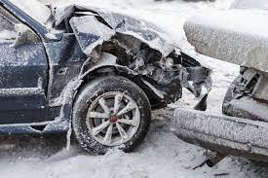
Introduction
Understanding the role of various conditions in car crashes.
Utilizing the statistical data obtained from the National Highway Traffic Safety Administration to examine the influence of seasons, weather patterns, type of area and type of crash on several vehicles and persons being involved.
Identifying various factors affecting crash statistics across all fifty states.
Employing hypothesis testing to measure the influence of different conditions such as lighting, type of crash, number of vehicles involved, and pedestrians involved in accidents quantitatively.

Slide 4

Research questions
How does the seasonal variation influence the total number of fatalities in car crashes across states?
What are the specific weather patterns that significantly impact the proportion of severe crashes in different regions?

Slide 5

Data Source
National Highway Traffic Safety Administration (NHTSA’s) National Center for Statistics and Analysis
It is responsible for providing a wide range of analytical and statistical support to the highway safety community.
Fatality Analysis Reporting System (FARS) is a nationwide census providing yearly data regarding fatal injuries suffered in motor vehicle traffic crashes.
Data from the 2021 Fatality Analysis Reporting System (FARS) includes all police-reported crashes, capturing both fatalities and injuries.

Slide 6
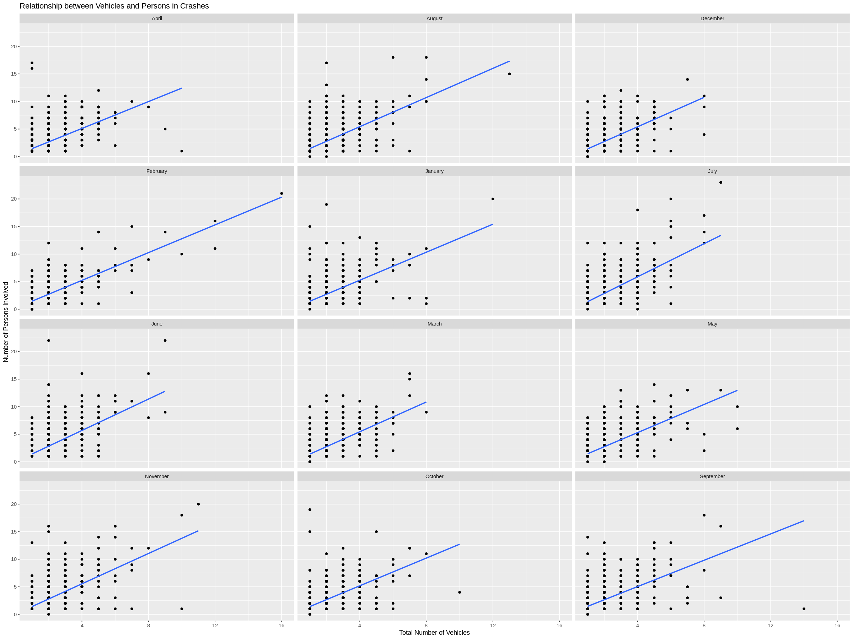
Scatter Plot of Vehicles vs. People in Crashes

Slide 7
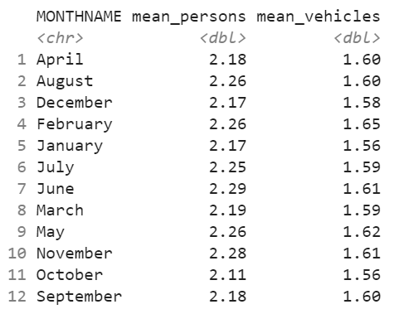
Summary of Scatter Plot of Vehicles vs. People in Crashes

Slide 8
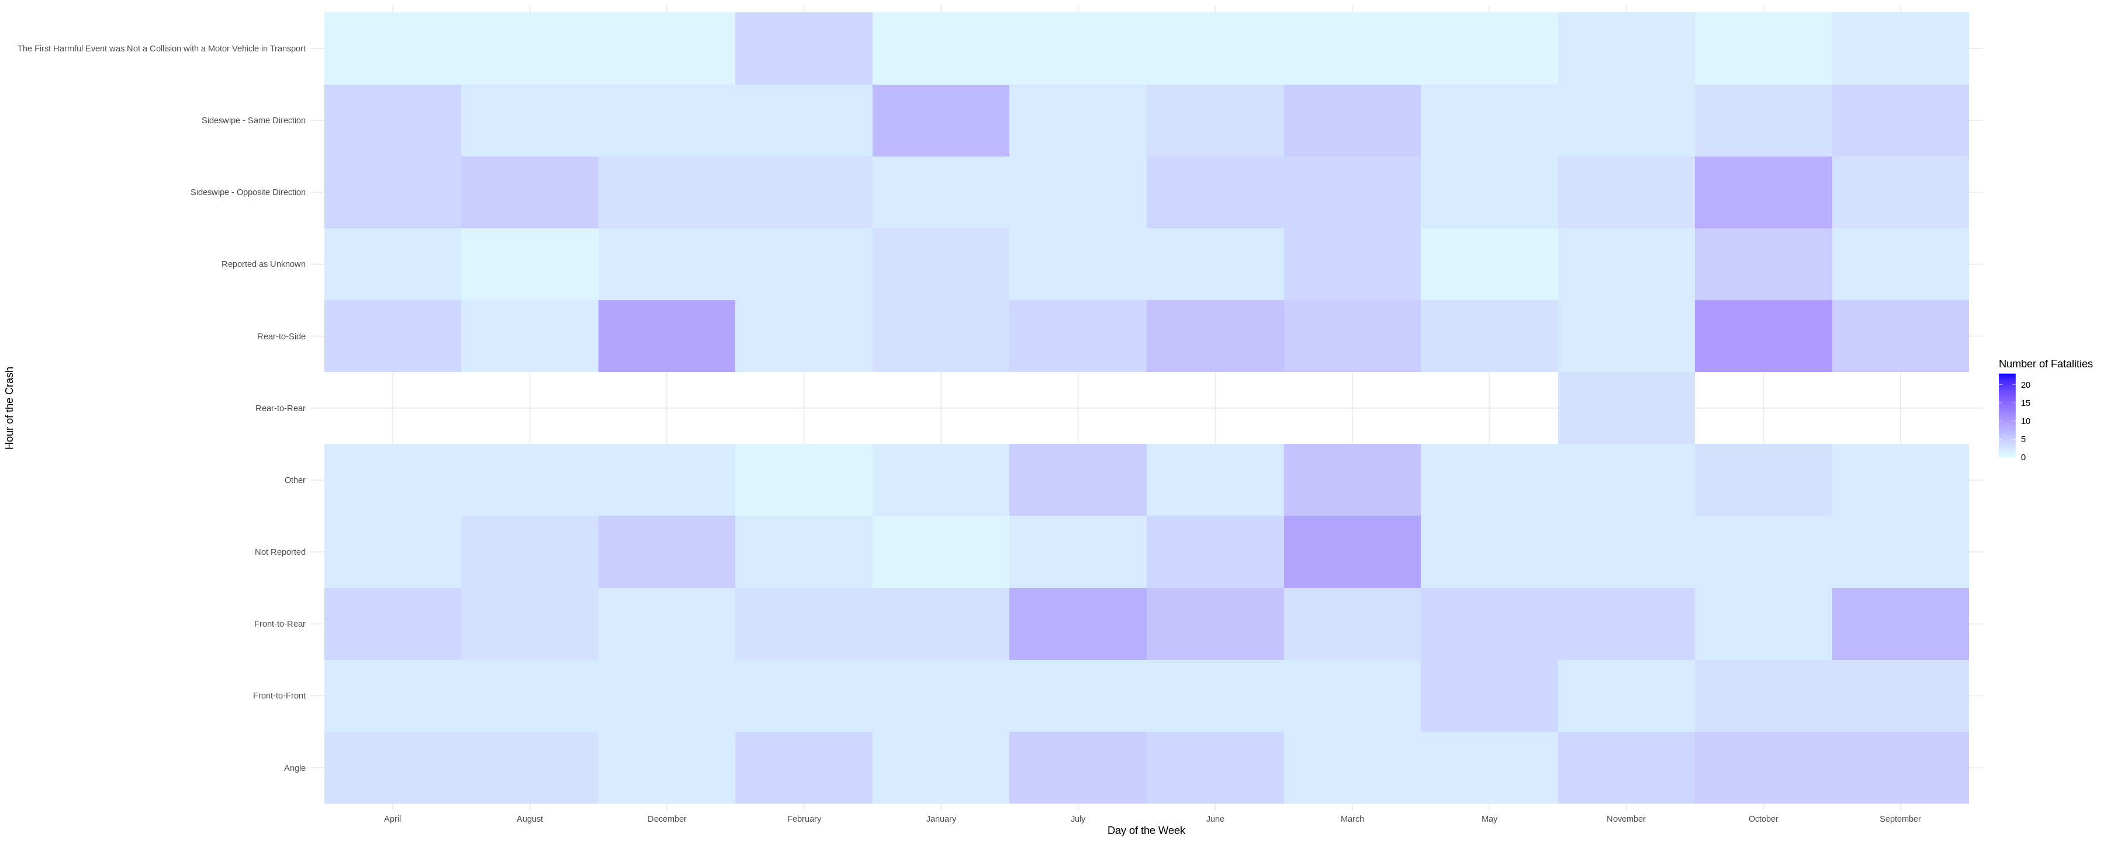
Heat Map of Type of Crashes per Month

Slide 9
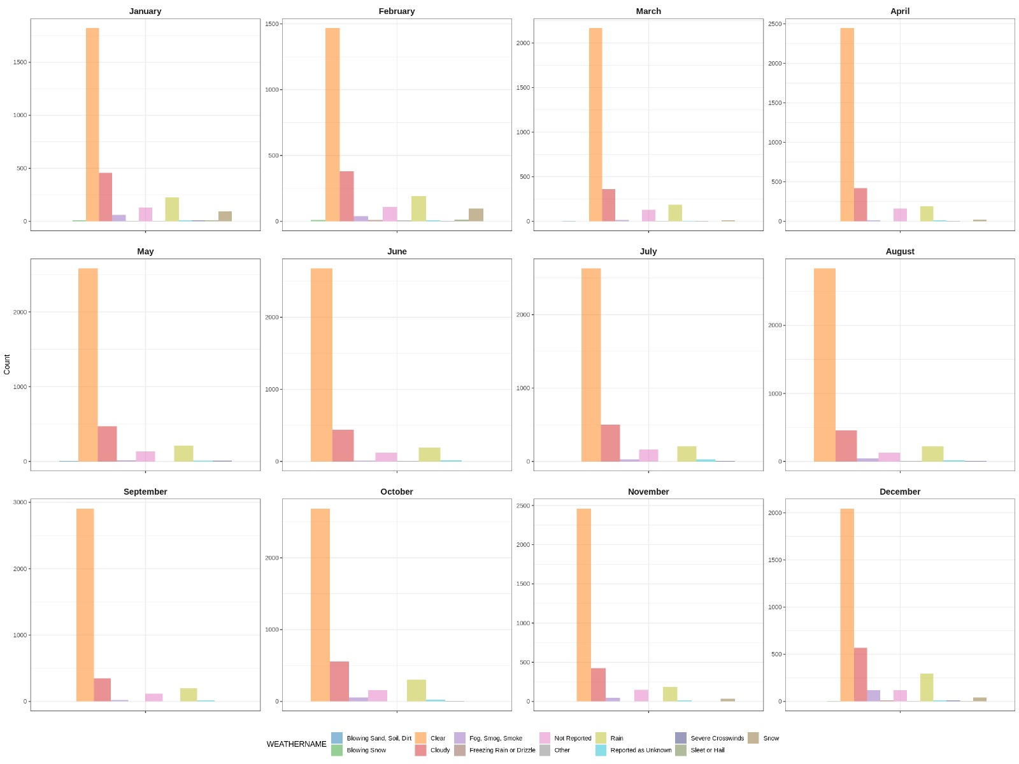
Count of Accidents Based on Weather Conditions

Slide 10
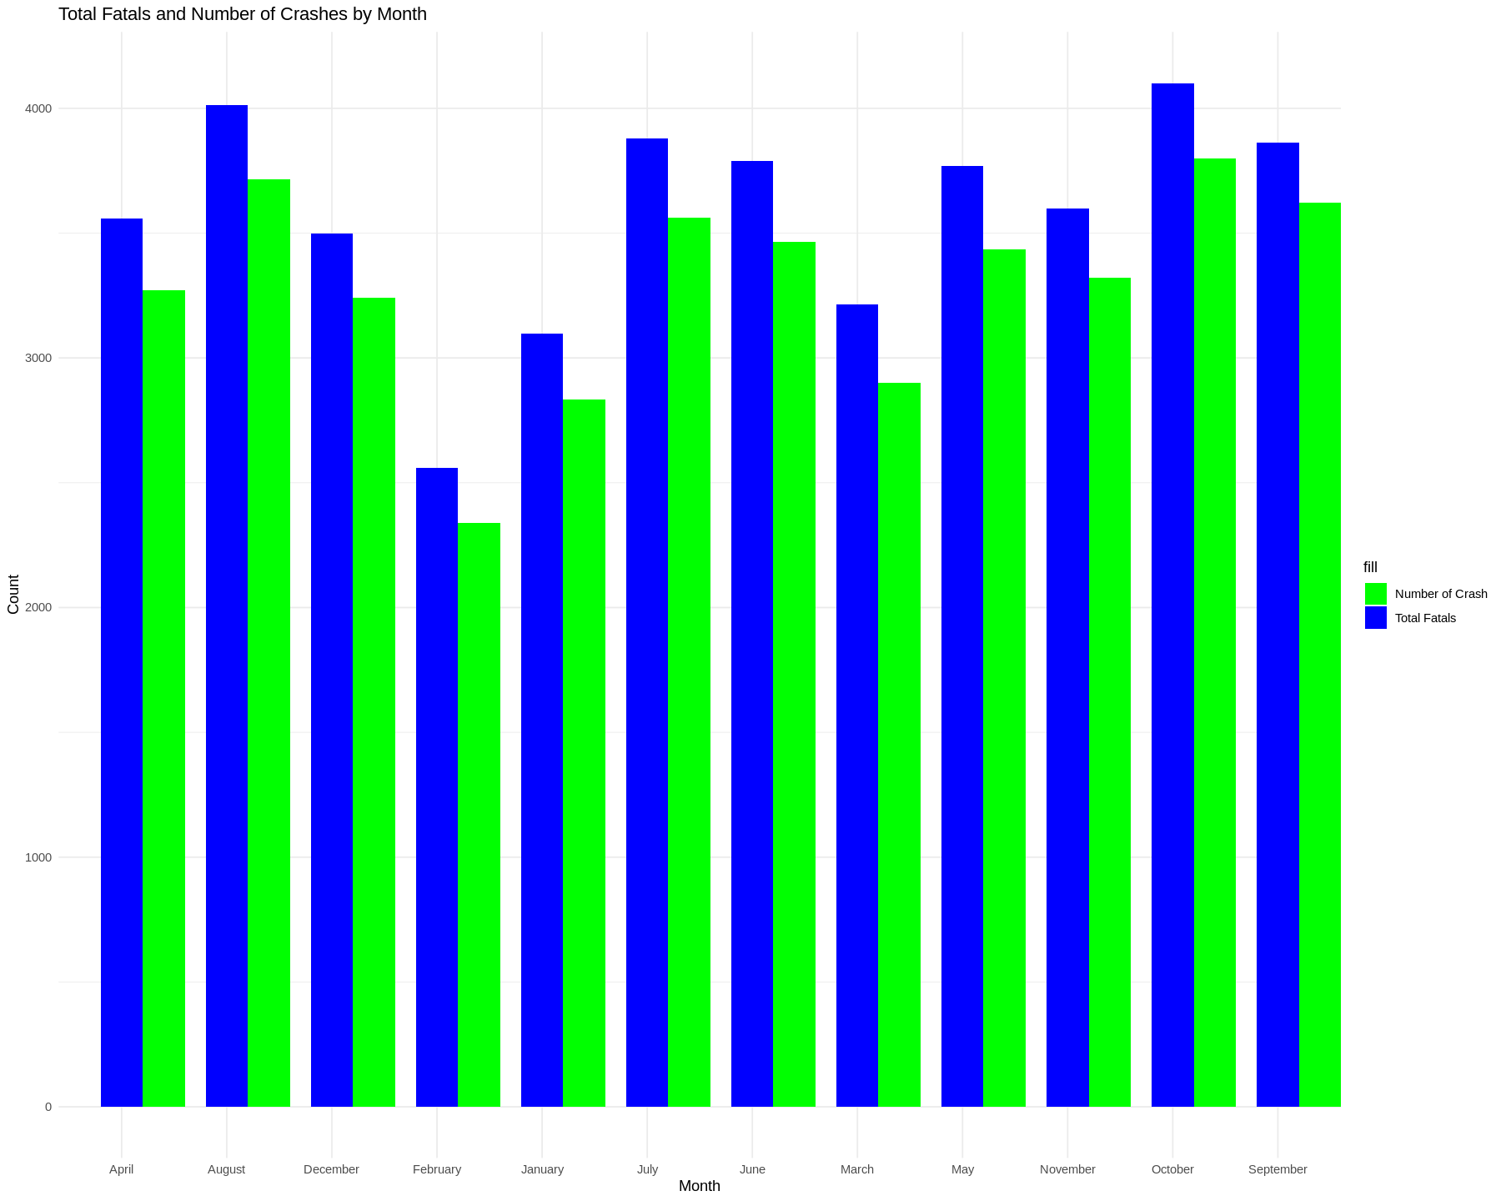
Number of traffic crashes and fatalities throughout the year

Slide 11
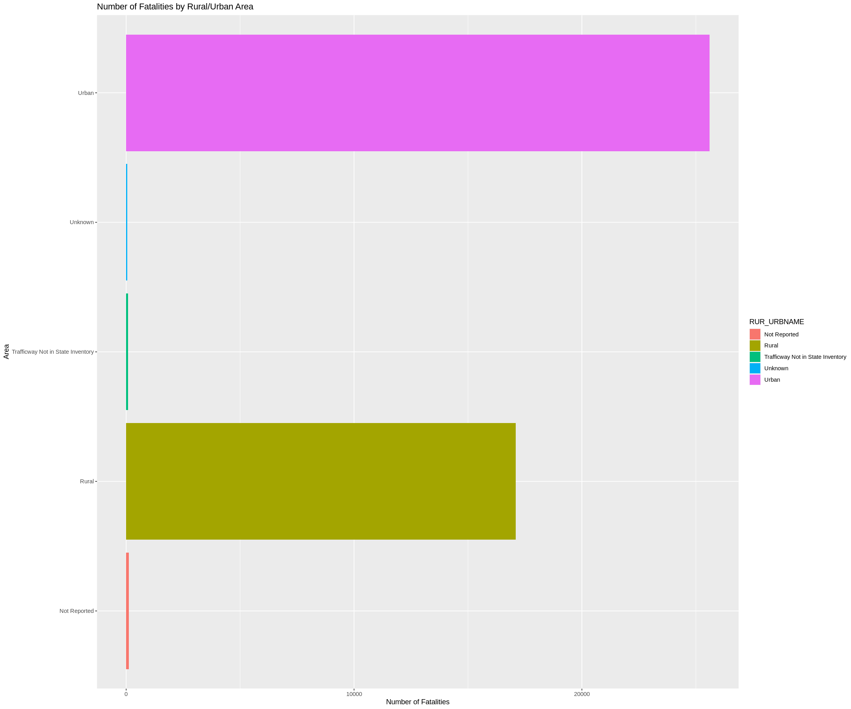
Number of Fatalities in Urban and Rural Area

Slide 12
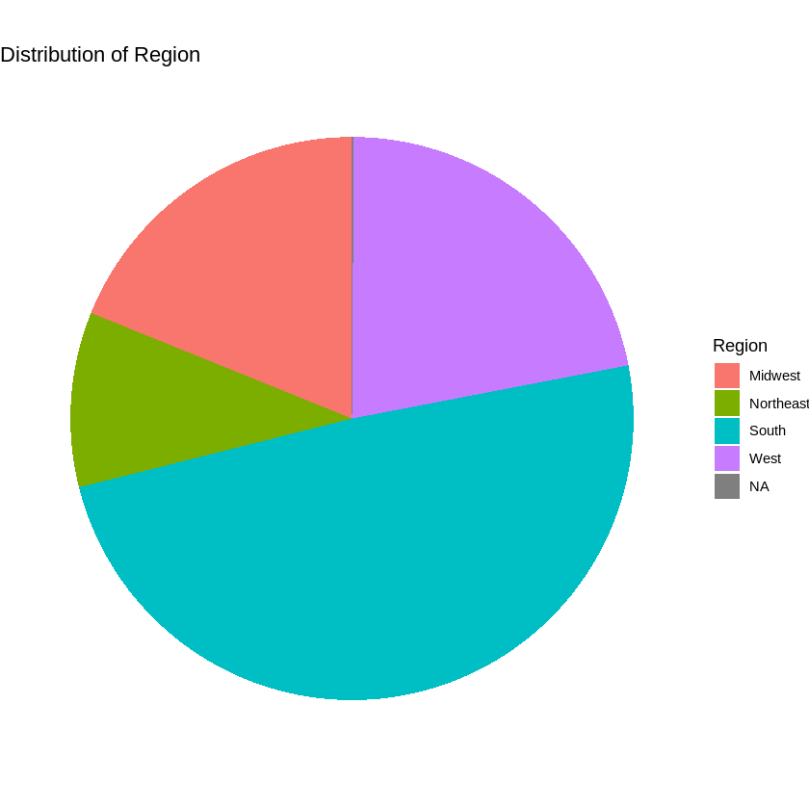
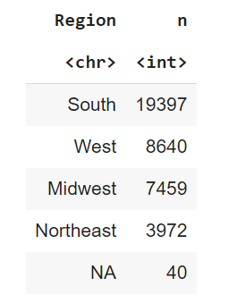
Number of accidents per region

Slide 13
Statistical Methods
Descriptive Statistics: To summarize and describe the characteristics of the dataset, such as calculating measures of central tendency (mean, median) and measures of dispersion (standard deviation, range).
Hypothesis Testing: To determine if there is a statistically significant association between specific conditions and car crashes.
Time Series Analysis: To explore the temporal patterns and trends in car crashes under different conditions of crashes.

Slide 14
Results and conclusions
Hypothesis 1:
Null Hypothesis – The number of total fatalities in summer months is greater than the number of total fatalities in winter months.
Alternative Hypothesis – The number of total fatalities in summer months is less than the number of total fatalities in winter months.

Slide 15
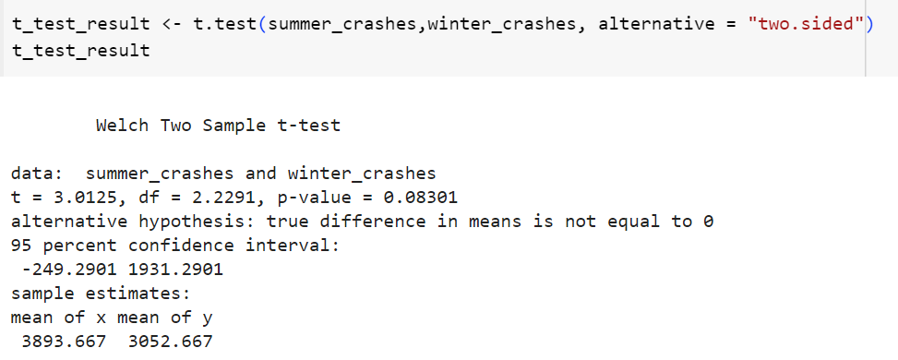

Slide 16
Results and conclusions
Hypothesis 2:
Null Hypothesis –There is no difference in the proportions of severe crashes (defined as involving 2 or more people) between "Clear" and "Cloudy" weather conditions.
Alternative Hypothesis – There is a significant difference in the proportions of severe crashes between "Clear" and "Cloudy" weather conditions.

Slide 17
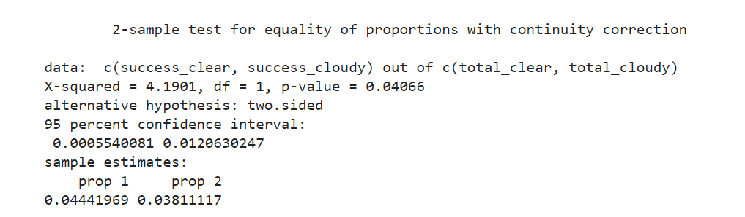

Slide 18
Conclusion
Based on the hypothesis performed seasonal patterns might play a role in car crashes across different regions.
Considering severe crashes, the proportion of accidents under different conditions changes.
The weak evidence against the null hypothesis in some cases indicates that further studies with more robust methodologies and controlled environments are necessary to establish a stronger causal relationship.

Slide 19
References
[1] Sheykhfard, A., Haghighi, F., Papadimitriou, E., & Van Gelder, P. (2021). Review and assessment of different perspectives of vehicle-pedestrian conflicts and crashes: Passive and active analysis approaches. Journal of Traffic and Transportation Engineering (English Edition), 8(5), 681–702. https://doi.org/10.1016/j.jtte.2021.08.001
[2] Blum, J. J., Scullion, P., Morgan, R. M., Digges, K., Kan, C.-D., Park, S., & Bae, H. (2008). Vehicle Related Factors that Influence Injury Outcome in Head-On Collisions. Annals of Advances in Automotive Medicine / Annual Scientific Conference, 52, 131–140. https://www.ncbi.nlm.nih.gov/pmc/articles/PMC3256768/Vehicle-Related
[3] Reddy, S. S., Chao, Y. L., Kotikalapudi, L. P., & Ceesay, E. (2022, June 1). Accident analysis and severity prediction of road accidents in United States using machine learning algorithms. IEEE Xplore. https://doi.org/10.1109/IEMTRONICS55184.2022.9795852

