Slide 1


XMLVM: A Smartphone
Cross-Compilation Framework
Arno Puder
San Francisco State University
arno@sfsu.edu

Slide 2

XMLVM: A SmartphoneCross-Compilation Framework
Sascha Häberling
XMLVM.org
saschah@gmail.com
Wolfgang Korn
blueCarat AG, Cologne
wolfgang.korn@bluecarat.de

Slide 3
XMLVM: A SmartphoneCross-Compilation Framework
Wolfgang Korn
blueCarat AG, Cologne
wolfgang@xmlvm.org

Slide 4
The Team
Core team:
  Arno Puder, SFSU
  Sascha Haeberling, Google Inc
  Wolfgang Korn, blueCarat AG
Committers:
  Oren Antebi, Panayotis Katsaloulis, Markus Neubrand, Paul Poley
Contributors:
  Kevin Glass, Gergely Kis, Jessica Lee, Joshua Melcon, Alexander Seewald
Sponsors:
  blueCarat AG, Cologne
  SAP Labs, Palo Alto
  Microsoft Research, Redmond

Slide 5

blueCarat AG
Company located in Cologne, offices in Hamburg,
Frankfurt and Stuttgart
Founded in 2001
One of the top 100 mid-sized German employers
Approx. 100 employees
Consulting in various areas
  Enterprise architectures
  ITSM and IT/Computing center outsourcing
  Business intelligence
  B2B communication
  Identity and access management
Software development and services
  Offered as an alternative to offshoring

Slide 6
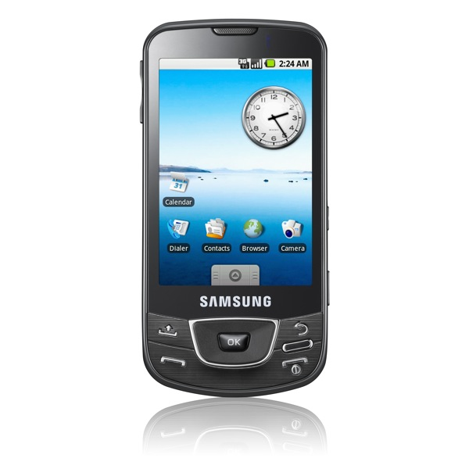
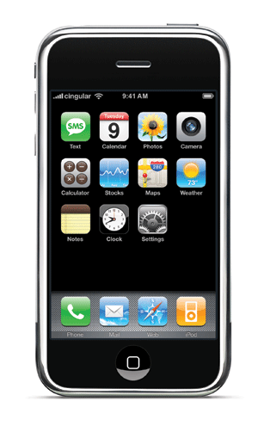
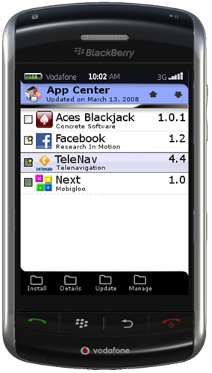
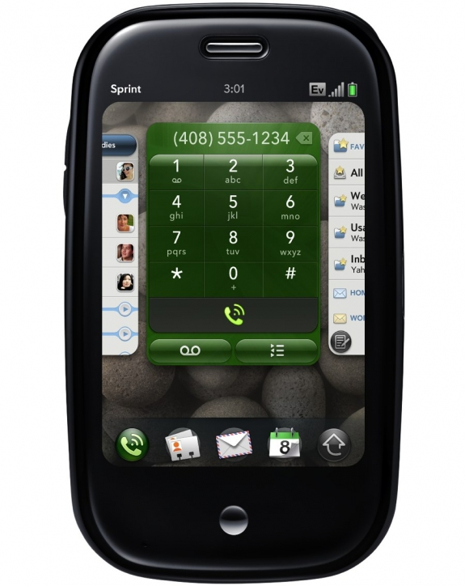
Motivation
Smart phones have entered the mainstream.
Most phones have similar capabilities.
Common subset useful for certain class of applications
(e.g. games).
Developers are interested to push their applications to different platforms.
Problem: Porting an application to different phones requires significant effort.

Slide 7
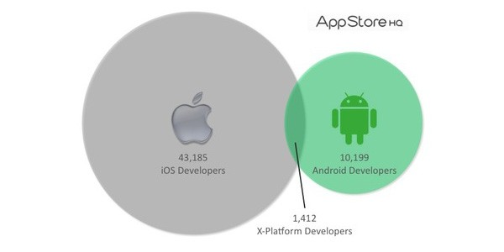
Smartphone Developers
July 2010
Source: http://blog.appstorehq.com/post/760323632/ios-vs-android-over-1-000-developers-including-some

Slide 8
Android vs. iOS vs. Windows Phone 7
 | Nexus S | iPhone 4 | WP7
OS | Linux | iOS | Windows CE
CPU | Hummingbird S5PC110, 1 GHz | Apple A4, 1 GHz | ARM v7, 1 GHz
RAM | 512 MB | 512 MB | 256 MB
Sensors | Accelerometer, GPS, proximity, ambient light, compass. | Accelerometer, GPS, proximity, ambient light, compass. | Accelerometer, GPS, proximity, ambient light, compass.
IDE | Eclipse | Xcode | VisualStudio
Dev-Language | Java | Objective-C | Visual Basic, C#
GUI | Android | Cocoa Touch | WP7
Virtual Machines | Allowed | Not allowed | Only .NET
License | Open Source | Proprietary | Proprietary

Slide 9
Android vs. iOS vs. Palm Pre
 | Nexus S | iPhone 4 | Palm Pre
OS | Linux | Mac OS | Linux
CPU | Hummingbird S5PC110, 1 GHz | Apple A4, 1 GHz | TI-OMAP, 600 MHz
RAM | 512 MB | 512 MB | 256 MB
Sensors | Accelerometer, GPS, proximity, ambient light, compass. | Accelerometer, GPS, proximity, ambient light, compass. | Accelerometer, GPS, proximity, ambient light.
IDE | Eclipse | Xcode | Eclipse
Dev-Language | Java | Objective-C | JavaScript
GUI | Android | Cocoa Touch | webOS
Virtual Machines | Allowed | Not allowed | Allowed
License | Open Source | Proprietary | Proprietary

Slide 10
Proposed Solution
Android is used as development platform:
  Developer only needs to know Android SDK.
    Make use of well-documented SDK.
    Powerful tools (debugging).
    Support for arbitrary screen resolutions using layout managers
    (Nexus S, iPhone, iPad, Netbooks).
  Android application is cross-compiled to target platform.
  Does not require a JVM on the target platform!
General approach:
  Cross-compile Java to target language (e.g., Objective-C, C#).
  Create Java API for target platform (e.g., Cocoa Touch, WinForms).
  Write Android compatibility library on top of Java API.
  Use native SDK (e.g., Xcode, VisualStudio) to create executable.

Slide 11
@interface
#import <Foundation/NSObject.h>
@interface Fraction: NSObject {
int numerator;
int denominator;
}
-(void) print;
-(void) setNumerator: (int) d;
-(void) setDenominator: (int) d;
-(int) numerator;
-(int) denominator;
@end

Slide 12
@implementation
#import "Fraction.h“
#import <stdio.h>
@implementation Fraction
-(void) print
{ printf("%i/%i", numerator,
denominator); }
-(void) setNumerator: (int) n
{ numerator = n; }
-(void) setDenominator: (int) d
{ denominator = d; }
-(int) denominator
{ return denominator; }
-(int) numerator
{ return numerator; }
@end

Slide 13
Creating and Using Objects
int main(int argc, const char *argv[])
{
// create a new instance Fraction
Fraction *frac = [[Fraction alloc] init];
// set the values
[frac setNumerator: 1];
[frac setDenominator: 3];
// print it
printf("The fraction is: ");
[frac print];
printf("\n");
// free memory
[frac release];
return 0;
}

Slide 14
Multiple Parameters
@interface
...
-(void) setNumerator: (int) n andDenominator: (int) d;
...
@implementation
...
-(void) setNumerator: (int) n andDenominator: (int) d
{
numerator = n; denominator = d;
}
...
Invocation
Fraction *frac = [[Fraction alloc] init];
[frac setNumerator: 1 andDenominator: 5];
setNumerator:andDenominator: is called a selector.

Slide 15
Categories
@implementation Fraction (FractionCategory)
-(void) multiplyWith: (Fraction*) f
{
numerator *= f->numerator;
denominator *= f->denominator;
}
@end
Categories allow to add methods to an existing class.
Access to source code of that class not necessary!
Cannot add new instance variables.

Slide 16
Reference Counting
Classes inheriting from NSObject have reference counting.
Fraction *frac = [[Fraction alloc] init];
printf(“Retain count: %i\n", [frac retainCount]);
[frac retain]; // 2
[frac retain]; // 3
printf(“Retain count: %i\n", [frac retainCount]);
[frac release]; // 2
printf(“Retain count: %i\n", [frac retainCount]);
[frac release]; // 1
[frac release]; // 0. Object will be deleted

Slide 17
Autorelease Pool
Sending message autorelease will add object to autorelease pool.
Releasing the pool will decrement reference counter of all managed object by 1.
If reference count drops to 0, object will be deleted.
Autorelease pools can be nested.
Cocoa automatically adds objects to autorelease pool.
NSAutoreleasePool *pool =
[[NSAutoreleasePool alloc] init];
Fraction *frac =
[[[Fraction alloc] init] autorelease];
[pool release]; // ‘frac’ will be deleted

Slide 18
Dynamic Invocations
Method invocations are bound at runtime:
id obj = …;
[obj someMethod];
id is a generic object type (similar to java.lang.Object)
obj may or may not implement someMethod. If not, a runtime error occurs.
Dynamic invocations are heavily used in the delegate pattern (e.g., UITableView)

Slide 19
iOS “Hello World” in Objective-C
@interface HelloWorld <UIApplicationDelegate>
(void) applicationDidFinishLaunching: (NSNotification*) n;
@end
@implementation HelloWorld
(void) applicationDidFinishLaunching: (NSNotification*) n
{
UIScreen* screen = [UIScreen mainScreen];
CGRect rect = [screen applicationFrame];
UIWindow* window = [[UIWindow alloc] initWithFrame: rect];
rect.origin.x = rect.origin.y = 0;
UIView* mainView = [[UIView alloc] initWithFrame: rect];
[window addSubview: mainView];
UILabel *title = [[UILabel alloc] initWithFrame: rect];
[title setText: @"Hello World!"];
[title setTextAlignment: UITextAlignmentCenter];
[mainView addSubview: title];
[window makeKeyAndVisible];
}
@end

Slide 20
iOS “Hello World” in Java
public class HelloWorld extends UIApplicationDelegate
{
@Override
public void applicationDidFinishLaunching(NSNotification n)
{
UIScreen screen = UIScreen.mainScreen();
CGRect rect = screen.applicationFrame();
UIWindow window = new UIWindow(rect);
rect.origin.x = rect.origin.y = 0;
UIView mainView = new UIView(rect);
window.addSubview(mainView);
UILabel title = new UILabel(rect);
title.setText("Hello World!");
title.setTextAlignment(
UITextAlignment.UITextAlignmentCenter);
mainView.addSubview(title);
window.makeKeyAndVisible();
}
}

Slide 21
Windows Phone 7 “Hello World” in C#
public class SayHello : Application {
public SayHello() {
this.Startup += new StartupEventHandler(startup);
}
public void startup(object sender, StartupEventArgs args) {
TextBlock label = new TextBlock();
label.Foreground = new SolidColorBrush(Colors.White);
label.Text = "Hello World!";
this.RootVisual = label;
}
}

Slide 22
Windows Phone 7 “Hello World” in Java
public class SayHello extends Application {
public SayHello() {
this.Startup.__add(new StartupEventHandler(this, "startup"));
}
public void startup(Object sender, StartupEventArgs args) {
TextBlock label = new TextBlock();
label.setForeground(new SolidColorBrush(Colors.White));
label.setText("Hello World!");
this.setRootVisual(label);
}
}

Slide 23
Tool Chain Overview
“Hello World”
Java app.
Java Compatibility
Library
Desktop application
(⇨ Java-based Device emulator)
Cross-Compilation
“Hello World”
Objective-C/C#
Runtime Library
Native iOS/WP7 application

Slide 24
Java API for Cocoa Touch
Design goals:
  If possible, Java API mimics 1:1 the Objective-C API.
  Use same class and method names.
  Use “Java-isms”:
    Constructors instead of alloc/init.
    Strongly typed interfaces for delegates.
    Use J2SE API where appropriate (e.g. data structures).
Cocoa Touch challenges:
  Makes use of C-functions (e.g., CGColorCreate)
  Uses value types (e.g., CGRect)
  Uses pointers for output parameters (e.g., NSURLConnection)
  Makes heavy use of delegation (e.g., data source for UITableView)

Slide 25
C Backend
Motivation:
  Both C++ and Objective-C are super-sets of C.
  Facilitates portability to other platforms.
  Allows efficient implementation of Java object model.
Approach:
  XMLVM is cross-compiled to portable C code.
  Dependency graphs determines which Java classes to consider.
  Efficient mapping via vtables and selector coloring for interface methods.
  Integrate the Boehm Garbage Collector.
Features:
  Cross-compile Apache Harmony for J2SE support.
  Wrapper option to create Cocoa Touch skeletons.

Slide 26
Generating XMLVM
// Java
package org.xmlvm;
class Calc {
static int add(int x, int y) {
return x + y;
}
}
Calc.java
Calc.class
javac
XMLVM
Calc.xmlvm

Slide 27
Creating XMLVM
// Java
package org.xmlvm;
class Calc {
static int add(int x, int y) {
return x + y;
}
}
Calc.java
javac
Calc.class
XMLVM
Calc.dex
Calc.xml

Slide 28
XMLVM of Class Calc
<xmlvm xmlns:dex="http://xmlvm.org/dex">
<class name="Calc" package="org.xmlvm">
<method name="add" isStatic="true">
<signature>
<parameter type="int" />
<parameter type="int" />
<return type="int" />
</signature>
<dex:code register-size="3">
<dex:add-int vx="0" vy="1" vz="2" />
<dex:return vx="0" vx-type="int" />
</dex:code>
</method>
</class>
</xmlvm>

Slide 29
Cross-Compiling XMLVM to C
Simply map DEX registers to variables of the target language!
These translations are done using XSLT.
Mappings exist for different languages.
The XSLT excerpt below demonstrates the translation of <dex:add-int/> (Integer add) to C.
// C
typedef union {
void* o;
int i;
float f;
double d;
} XMLVMElem;
<!– XSL template -->
<xsl:template match="dex:add-int">
<xsl:text>_r</xsl:text>
<xsl:value-of select="@vx"/>
<xsl:text>.i = _r</xsl:text>
<xsl:value-of select="@vy"/>
<xsl:text>.i + _r</xsl:text>
<xsl:value-of select="@vz"/>
<xsl:text>.i;</xsl:text>
</xsl:template>
_r0.i = _r1.i + _r2.i;

Slide 30
Class Calc in C
// C generated via stylesheet
int org_xmlvm_Calc_add___int_int(int n1, int n2)
{
XMLVMElem _r0;
XMLVMElem _r1;
XMLVMElem _r2;
_r1.i = n1;
_r2.i = n2;
_r0.i = _r1.i + _r2.i;
return _r0.i;
}

Slide 31
C Backend: Original Java Class
// Java
package org.xmlvm;
public class CBackendDemo {
int i;
@Override
public boolean equals(Object o) {
return super.equals(o);
}
public void foo() {
CBackendDemo o = new CBackendDemo();
o.bar();
System.out.println(i);
}
public void bar() {}
}

Slide 32
C Backend: Internal Data Structures
Object 1
Object 1
__TIB_Account
__TIB_java_lang_Object
TIB
balance: 100
overdraftProtection: true
Initialized: true
Base TIB
Fields
Methods
vtable
itable
Fields
int | balance
boolean | overdraftProtection
Object 2
TIB
balance: 250
overdraftProtection: false
Method Dispatcher
void method_dispatcher(JAVA_OBJECT target,
int slot, ...) {
// ...
switch (slot) {
case 0:
Account_deposit___int(target, ...);
break;
// ...
}
}

Slide 33
C Backend: Declarations
// C
__TIB_DEFINITION_org_xmlvm_CBackendDemo
__TIB_org_xmlvm_CBackendDemo = {
0, // classInitialized
"org.xmlvm.CBackendDemo", // className
&__TIB_java_lang_Object // extends
};
typedef struct org_xmlvm_CBackendDemo {
__TIB_DEFINITION_org_xmlvm_CBackendDemo* tib;
struct {
__INSTANCE_MEMBERS_java_lang_Object;
struct {
JAVA_INT i;
} org_xmlvm_CBackendDemo;
} fields;
} org_xmlvm_CBackendDemo;
Two basic data structures are created for each Java class:
  A struct that represents the TIB (Type Information Block) containing class name, base class, implemented interfaces, vtable, etc.
  A struct that contains the instance members of the Java class.
  Static members are mapped to global variables.

Slide 34
C Backend: Class Initialization
// C
void __INIT_org_xmlvm_CBackendDemo()
{
__TIB_org_xmlvm_CBackendDemo.classInitialized = 1;
// Initialize base class if necessary
if (!__TIB_java_lang_Object.classInitialized) __INIT_java_lang_Object();
// Copy vtable from base class
XMLVM_MEMCPY(__TIB_org_xmlvm_CBackendDemo.vtable,
__TIB_java_lang_Object.vtable,
sizeof(__TIB_java_lang_Object.vtable));
// Initialize vtable for this class
__TIB_org_xmlvm_CBackendDemo.vtable[7] =
(VTABLE_PTR) &org_xmlvm_CBackendDemo_equals___java_lang_Object;
__TIB_org_xmlvm_CBackendDemo.vtable[11] =
(VTABLE_PTR) &org_xmlvm_CBackendDemo_foo__;
__TIB_org_xmlvm_CBackendDemo.vtable[12] =
(VTABLE_PTR) &org_xmlvm_CBackendDemo_bar__;
}
Class initialization happens exactly once before the first use of a class.
First the base class is initialized if necessary.
Vtable from base class is copied into this class' vtable.
Vtable for this class is patched with the appropriate function pointers.
Java-specific class initializer <clinit> is called if present.

Slide 35
C Backend: Object Instantiation
// C
JAVA_OBJECT __NEW_org_xmlvm_CBackendDemo()
{
if (!__TIB_org_xmlvm_CBackendDemo.classInitialized)
__INIT_org_xmlvm_CBackendDemo();
org_xmlvm_CBackendDemo* me = XMLVM_MALLOC(sizeof(org_xmlvm_CBackendDemo));
me->tib = &__TIB_org_xmlvm_CBackendDemo;
me->fields.org_xmlvm_CBackendDemo.i = 0;
return me;
}
First, enough memory is malloc'ed for the new object.
Member tib points to the TIB (Type Information Block) of this object.
Member fields allows access to all fields of this object. Fields must be accessed via their name mangled version of the full qualified class name where the field is declared.

Slide 36
C Backend: Using an Object
void org_xmlvm_CBackendDemo_foo__(JAVA_OBJECT me)
{
XMLVMElem _r0;
XMLVMElem _r1;
XMLVMElem _r2;
_r2.o = me;
_r0.o = __NEW_org_xmlvm_CBackendDemo();
org_xmlvm_CBackendDemo___INIT___(_r0.o);
//org_xmlvm_CBackendDemo_bar__[12]
(*(void (*)(JAVA_OBJECT)) ((org_xmlvm_CBackendDemo*) _r0.o)->
tib->vtable[12])(_r0.o);
_r0.o = java_lang_System_GET_out();
_r1.i = ((org_xmlvm_CBackendDemo*) _r2.o)->fields.org_xmlvm_CBackendDemo.i;
//java_io_PrintStream_println___int[19]
(*(void (*)(JAVA_OBJECT, JAVA_INT)) ((java_io_PrintStream*) _r0.o)->
tib->vtable[19])(_r0.o, _r1.i);
return;
}
Calls to public/protected virtual methods are done via the vtable.
The function pointer contained in the vtable is cast to the correct type and then invoked.
Special comments help to related vtable index to method name.

Slide 37
C Backend: Ant target 'gen-c-wrappers'
void org_xmlvm_iphone_UILabel_setText___java_lang_String(JAVA_OBJECT me,
JAVA_OBJECT str)
{
//XMLVM_BEGIN[org_xmlvm_iphone_UILabel_setText___java_lang_String]
NSString* s = javaString2NSString(str);
UILabel* label = ((org_xmlvm_iphone_UILabel*) me)->
fields.org_xmlvm_iphone_UILabel.widget;
[label setText:s];
//XMLVM_END
}
ant gen-c-wrappers generates C-wrapper functions with the correct name mangling and class initialization functions.
Wrapper only contains public members and methods.
Special comments mark the location where developer can inject custom code that will be automatically copied to newly generated wrappers.
Injected code can be written in Objective-C!
See xmlvm/src/xmlvm2c/compat-lib/iphone/org_xmlvm_iphone_UIView.m for further details.

Slide 38
C Backend: Memory Management
C Object
Objective-C Object
C Reference
Objective-C Reference
Objective-C objects are wrapped by C objects.
Garbage Collector manages C objects.
C objects manage wrapped Objective-C objects via retain/release (release is done in the finalizer registered with the GC).
Important: Associations between Objective-C objects need to be reflected between C objects.

Slide 39
J2SE Library (1)
With the new C backend, J2SE classes such as java.lang.System are automatically cross-compiled from the Apache Harmony project.
XMLVM contains a version of Harmony in
xmlvm/lib/harmony6-build.jar
C backend will automatically pull in all dependent J2SE classes that are referenced directly or indirectly by the application.
Problem: Harmony contains many classes that are not needed for smartphones (e.g., AWT, Swing, CORBA, etc):
  Green classes: classes that an application can use (e.g., java,util.*).
  Red classes: classes that the application may not use (e.g., CORBA)
List of red classes can be found in xmlvm/lib/redlist.txt
Should a green class reference a red class, the offending byte code instruction in the green class is automatically replaced by a runtime assertion.

Slide 40
J2SE Library (2)
Some green classes contain native methods that need to be implemented in the target language.
Skeletons for the native methods can be found in xmlvm/src/xmlvm2c/lib/native/
Same rules for injected code apply as described on a previous slide.
Sometimes it becomes necessary to make manual changes to J2SE classes. This is called a proxy class.
Proxy classes can be found in xmlvm/src/xmlvm2c/lib/proxies
A proxy class has precedent over the stock Harmony class.
A proxy class can be a red class. In this case, the proxy is added to the cross-compiled classes and no runtime assertions are generated.

Slide 41
Reference Counting
// Java
public class RefCount {
public Object field;
public void set(Object arg) {
field = arg;
}
}
Memory management via reference counting.
Break cycle with java.lang.ref.WeakReference.
Pseudo instructions:
  <vm:reg-retain> (register retain)
  <vm:i-release> (instance release)
<!-- ... -->
<dex:code num-registers="2">
<vm:reg-retain reg="1"/>
<vm:i-release class-type="RefCount" member-name="field" vy="0"/>
<dex:iput-object class-type="RefCount" member-name="field" vx="1" vy="0"/>
<dex:return-void/>
</dex:code>

Slide 42
Android Compatibility Library
Application
Application
Application
Android API
Android
Android
Compat-Lib
Android
Compat-Lib
Common Layer API
Cocoa Touch
Layer
WP7
Layer
Device API
iOS
WP7
Android Compatibility Library:
  Offers Android API.
  Device-independent portions of Android.
  Builds upon a Common Layer API.
  Written in Java and cross-compiled to native language of target device.

Slide 43
Example 1: Button to UIButton Mapping
package android.widget;
public class Button extends View {
protected UIButton button;
// ...
public void setOnClickListener(OnClickListener listener) {
final OnClickListener theListener = listener;
button.addTarget(new UIControlDelegate() {
@Override
public void raiseEvent() {
theListener.onClick(Button.this);
}
}, UIControl.UIControlEventTouchUpInside);
}
}

Slide 44
Example 2: R-class
// Generated by Android
public final class R {
public static final class drawable {
public static final int ball=0x7f020001;
// ...
}
Resources in Android are referenced through R-class:
ImageView image = …;
image.setImageResource(R.drawable.ball);
Problem: map integer (0x7f020001) to file name (ball.png)
Solution: use Java reflection at runtime for the reverse mapping.

Slide 45
Example 2: R-class
// Generated by Android
public final class R {
public static final class drawable {
public static final int ball=0x7f020001;
// ...
}
Resources in Android are referenced through R-class:
ImageView image = …;
image.setImageResource(R.drawable.ball);
Problem: map integer (0x7f020001) to file name (ball.png)
Solution: use Java reflection at runtime for the reverse mapping.
String rClassName = "R$drawable";
Class<?> rClass = Class.forName(rClassName);
Field[] fields = rClass.getDeclaredFields();
for (int i = 0; i < fields.length; i++) {
String fieldName = fields[i].getName();
int id = fields[i].getInt(rClass);
// ...
}

Slide 46
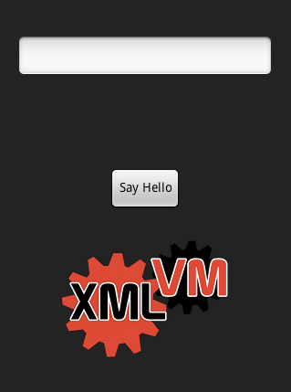
Example 3: Layout Manager
Android uses declarative UI descriptions.
UI descriptions are saved in XML files.
XMLVM cross-compiles Android’s implementation of the layout managers.
Option 1:
  Layout files are copied to iOS device.
  At runtime, XML files are parsed and UI is built on the iOS device.
<LinearLayout orientation="vertical”
layout_width="fill_parent"
layout_height="fill_parent">
<EditText ... />
<TextView ... />
<Button layout_width="wrap_content"
layout_height="wrap_content”
id="@+id/sayHello"
text="Say Hello" ... />
<LinearLayout background="@drawable/xmlvm_logo" ... />
</LinearLayout>

Slide 47
Example 3: Layout Manager
Option 2: Cross-compile layout files.
Layout File
<Button text="Say Hello" ... />
Stylesheet
<xsl:template match="@text">
<dex:const-string vx="1" value="@text" />
<dex:invoke-virtual class-type="android.widget.TextView"
method="setText" register="0">
<dex:parameters>
<dex:parameter type="java.lang.String" register="1" />
<dex:return type="void" />
</dex:parameters>
</dex:invoke-virtual>
</xsl:template>
XMLVM

Slide 48
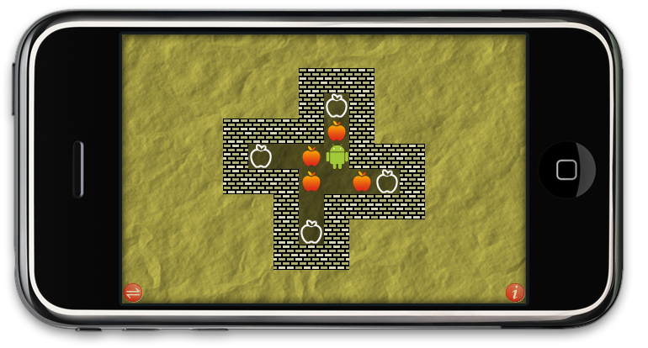
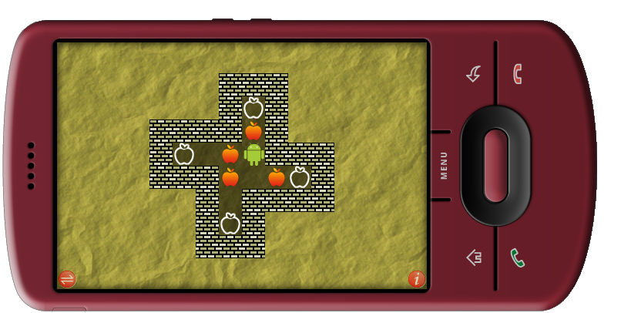
Xokoban
Sokoban version developed for Android and cross-compiled to iOS.
Available in the Android Market and iOS AppStore.
Features:
  2D animation.
  Dialog boxes.
  Accelerometer and swipe interface.
  Landscape full-screen mode.
  Saving of settings.

Slide 49
Xokoban
Sokoban version developed for Android and cross-compiled to iOS.
Available in the Android Market and iOS AppStore.
Features:
  2D animation.
  Dialog boxes.
  Accelerometer and swipe interface.
  Landscape full-screen mode.
  Saving of settings.

Slide 50


Legions
Implementation of the Stratego board game.
Developed for Android.
AI engine implemented by
Vincent De Boer (three-time Stratego world champion).
Android version of Legions uses:
  Activity lifecycle.
  Sound.
  Animation.
  Custom dialogs/toasts.
  Declarative layouts using different layout managers.
  File I/O.

Slide 51
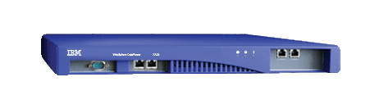
DataPower Logger
IBM's Websphere DataPower SOA Appliance.
Supports management through a well-defined SOAP based interface:
  Read real-time data like CPU usage, transaction rates, etc.
  Carry out administration tasks like reboot and user management.
  Modify the appliance's configuration.
Android-based monitoring application by blueCarat:
  Login screen using Basic Authentication over HTTPS.
  Retrieves data periodically and displays a graph in realtime.
  Automatically adapts to different screen resolutions.

Slide 52
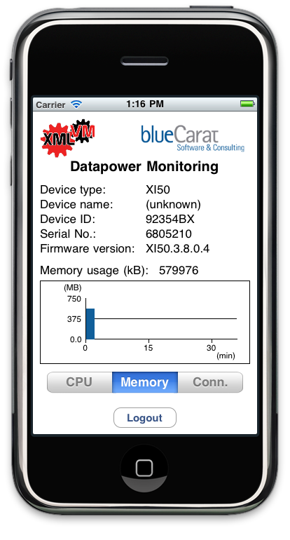
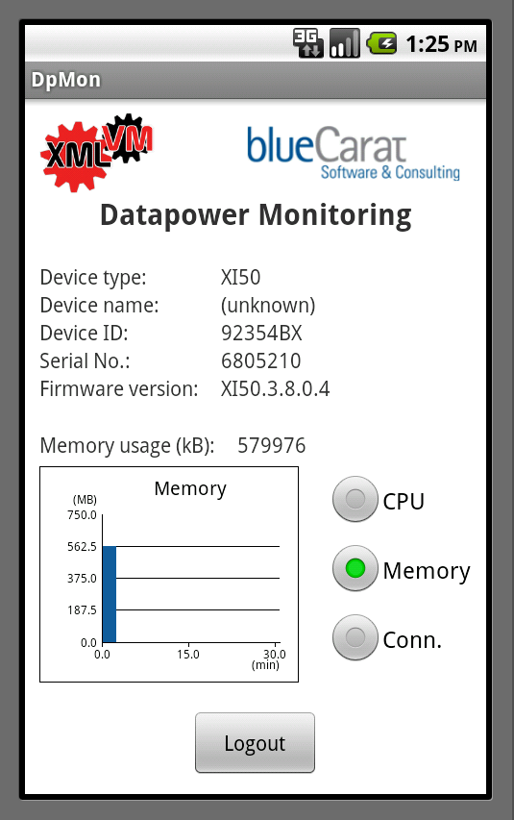
DataPower Logger

Slide 53
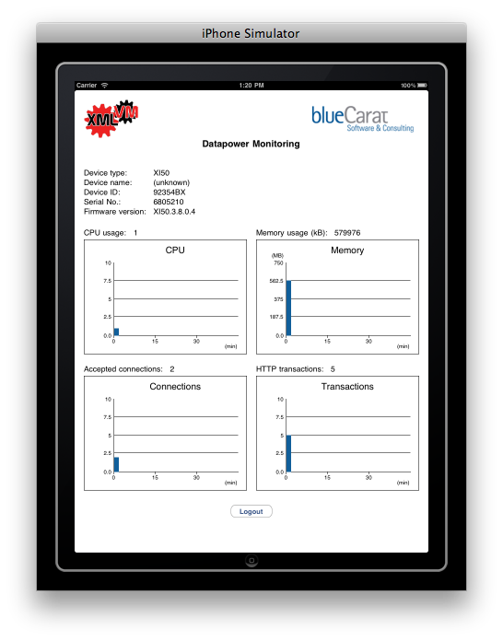
DataPower Logger

Slide 54
Remote Debugging
On-device debugging often necessary
Debugging cross-compiled applications is challenging
  Native (C/Objective-C) development environment has to be used
  Generated code is not human-readable
XMLVM remote debugging allows using a familiar Java development environment for
  On-device debugging
  On-simulator debugging
Debug meta-information is used by XMLVM during code generation
Debugging facility is based on JPDA (Java Platform Debugging Architecture)
Building on JPDA supports using any JPDA-compatible debugger (Eclipse, Netbeans, ...)

Slide 55
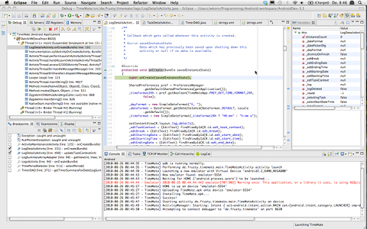

Remote Debugging Architecture

Slide 56
Remote Debugging Architecture
Frontend
Application
JVM TI
JDI
Runtime
JDWP
Backend
JDI: Java Debug Interface
JVM TI: Java VM Tool Interface
JDWP: Java Debug Wire Protocol

Slide 57
Scope
Android API offers good support for different screen resolutions.
Cross-compilation of games is feasible.
Problem: widget-driven applications.
Solution: partial cross-compilation.
Benefits:
  Code-reuse of Model/Controller.
  Custom View for native look-and-feel.
  Custom View can still be implemented in Java.
Idea: use iOS/WP7 widgets in conjunction with Android layout managers.

Slide 58
Other Use Cases
XMLVM supports CLR and YARV as input.
Cross-Compiling between virtual machines.
Generating of other high-level languages:
  JavaScript: cross-compiling Java/C# to AJAX apps.
  C++: cross-compiling JUnit to CPPUnit.
Abstract Virtual Machine:
  Heterogeneous mix of byte code instructions.
  Cross-platform aspect weaving.

Slide 59
XMLVM Tool Chain
.NET .exe
Java Class File
Ruby YARV
MBEL
BCEL
Ruby
XMLVM_{CLR}
XSL
XMLVM_{CLR-DFA}
XSL
XMLVM_{JVM}
DX
BCEL
XSL
XMLVM_{DEX}
Java Class File
XMLVM_{CLR}
XSL
XSL
XSL
XSL
MBEL
C#
C
JavaScript
Python
.NET .exe

Slide 60
XMLVM Tool Chain
.NET .exe
Java Class File
Ruby YARV
MBEL
BCEL
Ruby
XMLVM_{CLR}
XSL
XMLVM_{CLR-DFA}
XSL
XMLVM_{JVM}
DX
BCEL
XSL
XMLVM_{DEX}
Java Class File
XMLVM_{CLR}
XSL
XSL
XSL
XSL
MBEL
C#
C
JavaScript
Python
.NET .exe

Slide 61
XMLVM Tool Chain
.NET .exe
Java Class File
Ruby YARV
MBEL
BCEL
Ruby
XMLVM_{CLR}
XSL
XMLVM_{CLR-DFA}
XSL
XMLVM_{JVM}
DX
BCEL
XSL
XMLVM_{DEX}
Java Class File
XMLVM_{CLR}
XSL
XSL
XSL
XSL
MBEL
C#
C
JavaScript
Python
.NET .exe

Slide 62
XMLVM Tool Chain
.NET .exe
Java Class File
Ruby YARV
MBEL
BCEL
Ruby
XMLVM_{CLR}
XSL
XMLVM_{CLR-DFA}
XSL
XMLVM_{JVM}
DX
BCEL
XSL
XMLVM_{DEX}
Java Class File
XMLVM_{CLR}
XSL
XSL
XSL
XSL
MBEL
C#
C
JavaScript
Python
.NET .exe

Slide 63
XMLVM Tool Chain
.NET .exe
Java Class File
Ruby YARV
MBEL
BCEL
Ruby
XMLVM_{CLR}
XSL
XMLVM_{CLR-DFA}
XSL
XMLVM_{JVM}
DX
BCEL
XSL
XMLVM_{DEX}
Java Class File
XMLVM_{CLR}
XSL
XSL
XSL
XSL
MBEL
C#
C
JavaScript
Python
.NET .exe

Slide 64
Using XMLVM: Setting up the environment
Development and cross-compilation can be performed on any platform
To compile a native iPhone application MacOS is required
Install prerequisite software
  Java 1.6.0
  Eclipse
  Android SDK
  Apache ant
  Xcode
Get the latest XMLVM version from SVN at http://xmlvm.svn.sourceforge.net/svnroot/xmlvm/trunk/xmlvm
Run ant to build XMLVM ($XMLVM_HOME/dist/xmlvm.jar)
Test your environment by running the provided demo applications

Slide 65
Using XMLVM: Running XMLVM
Command line
  java -jar $XMLVM_HOME/dist/xmlvm.jar [--help] shows help
  Setting an alias “xmlvm” is a good practice to easily call XMLVM
  Example
    java –jar xmlvm.jar –-in=<inDir> --out=<outDir> --resource=<resDir> --target=android-on-iphone
    –-app-name=SayHello
Ant
<java jar="${xmlvm.dist}/xmlvm.jar" fork="true">
<arg value="--out=${xmlvm.demo}/android/sayhello/iphone" />
<arg value="--target=android-on-iphone" />
<arg value="--app-name=SayHello" />
<arg value="--in=${xmlvm.sayhello}/" />
<arg value="--resource=demo/android/sayhello/res/layout"/>
<arg value="--resource=demo/android/sayhello/res/drawable"/>
<arg value="--resource=demo/android/sayhello/AndroidManifest.xml"/>
</java>

Slide 66
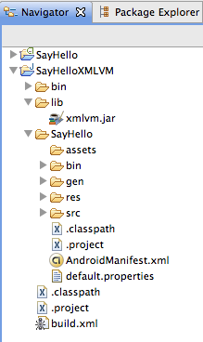
Using XMLVM: Setup the Project
Create empty Java project
Create/import nested Android project
Adjust Java project
  Adjust classpath
    Remove default src folder
    Add src folder from Android project
    Add gen folder from Android project
    Add xmlvm.jar as library
  Create run configuration
    Specify main class:
    android.internal.AndroidAppLauncher
    Extend classpath
      Add resource directories
      (layout, drawable, values ...)
      Add Android project's root
Android project
Java project

Slide 67
Using XMLVM: Estimate the Gap
XMLVM's API coverage is not complete
Java project linked against XMLVM's Android compatibility library shows missing pieces
  Create empty implementations for missing classes
  Create empty implementations for missing methods
Determine possible changes to simplify the application
Estimate required effort based on
  The number of missing Android classes and methods
  The complexity of the missing functionality
  The number of missing iPhone classes needed to implement the missing Android and JRE classes
→ Missing Android classes and methods indicate what has to be done in XMLVM to port a given application to the iPhone

Slide 68
Outlook
Debugging:
  Problem: generated code can only be debugged with native debugger.
  No more association with original Java program.
  Solution: cross-compile Java-based implementation of the JDWP (Java Debug Wire Protocol).
  Benefit: cross-platform debugging of Java applications.
Testing:
  Problem: cross-platform testing.
  Language cross-compilation: easy.
  UI testing: difficult.
  Solution: ???

Slide 69
Conclusions
Summary:
  Java support for iOS/WP7 devices.
  Android Compatibility Classes.
Benefits:
  Leverage existing Android/Java skills.
  Only knowledge of a single platform is required.
  Reduces development costs.
  Shortens time-to-market.
Outlook:
  Target other smartphones.
  Remote debugging.
  Testing framework.

Slide 70
Conclusions
Summary:
  Java for iOS/WP7 devices.
  Android Compatibility Classes.
Benefits:
  Leverage existing Android/Java skills.
  Only knowledge of a single platform is required.
  Reduces development costs.
  Shortens time-to-market.
Commercial support at http://xmlvm.org/support/
What we offer:
  Provide a broad range of porting services across source-target combinations.
  Build a range of services on the preferred platform of development.
  Provide software and services for the mobile infrastructure and application development industries.

Slide 71
Looking for sponsors!
arno@sfsu.edu

