Slide 1
What Is JavaScript?
JavaScript is a high level programming language used to create interactive effects within web browsers
Case-sensitive language
JavaScript is the programming language of HTML and the Web. It makes web page dynamic. It is an interpreted programming language with object-oriented capabilities.
It is client side scripting Language to interact with the user and make dynamic pages.
Can be used on the server
1995 by Brendan Eich (NetScape)

Slide 2
Server
User
www.facebook.com
HTML
CSS
JavaScript

Slide 3
Advantage of JavaScript
Client Side Execution
Immediate feedback to the visitors
Validation on Browser
Easy Language to learn

Slide 4
Disadvantage of JavaScript
Less Secure
No Hardware Access
JavaScript Enable Browsers

Slide 5
The JavaScript Language
Scripting Language
Interpreted
Untyped
Multi-Paradigm – Object-Oriented, Functional

Slide 6
What is ECMAScript?
ECMAScript (European Computer Manufacturers Association)is a trademarked scripting-language specification and standard
Provide standard to Javascript for different Browsers.
Also used with NodeJs
It is not framework or Library
It comes in 1997

Slide 7
Versions
ES5 - Standardized in 2009 implemented fairly completely in all browsers
ES6 / ES2015 – Partially implemented in most modern browsers

Slide 8
JavaScript Output/Display
console.log(‘some value’) – Prints to console in browser or terminal and also check error in js code
window.alert() – Displays in an alert box in the browser
document.write() – Display within <script> tags in the html
innerHTML – Access an html element using document.getElementById() and output to it

Slide 9
Comments
Single Line Comment
// This is a single line comment
Multi Line Comment
/*
This is a
multi-line comment
*/

Slide 10

Data Type:
In JavaScript we do not need to specify type of the variable because it is dynamically used by JavaScript engine.
We can use var data type. It can hold any type of data like String, Number, Boolean, etc.
Two Types:-
1)Primitive Data Type
2)Non-Primitive Data type
String
Number
Boolean
Undefined
Null
Object
Array
RegExp

Slide 11
Variable in JavaScript
Variables are used to store values
It is temporary memory location which hold value of any type of data type like string, number, null etc..
JavaScript uses the “var” keyword (optional) to declare variables and an equal sign to assign values
Syntax:- variablename =value; Rules:
var x;//declaration
x = 100;//initialization
Same as
var x = 100;
Variables can contain letters, numbers, underscores (_) and dollar signs ($) that means [a-z,A-Z,0-9,_,$]
Can not start with number that means Variables MUST begin with a letter, underscore(_) or dollar sign ($)
Can not contain space in between variable name.
Can not use reserve keyword.

Slide 12
JavaScript Operators:
Operators are used to perform operation on variable and value.
Arithmetic Operators
Comparison (Relational) Operators
Logical Operators
String Operators(+)For concatenation
Assignment Operators
Ternary Operator

Slide 13
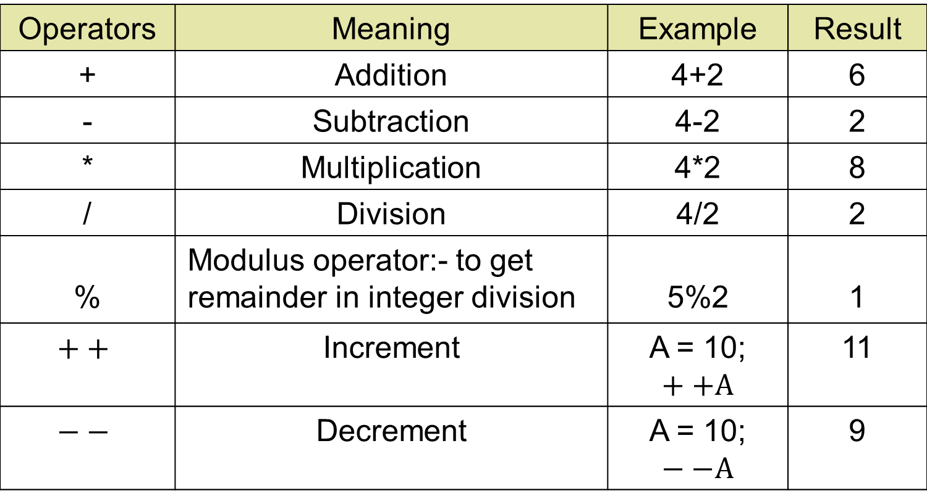
Arithmetic Operators
Operators | Meaning | Example | Result
+ | Addition | 4+2 | 6
- | Subtraction | 4-2 | 2
* | Multiplication | 4*2 | 8
/ | Division | 4/2 | 2
% | Modulus operator:- to get remainder in integer division | 5%2 | 1
$$++$$ | Increment | A = 10; $$++A$$ | 11
$$−−$$ | Decrement | A = 10; $−−A$ | 9

Slide 14
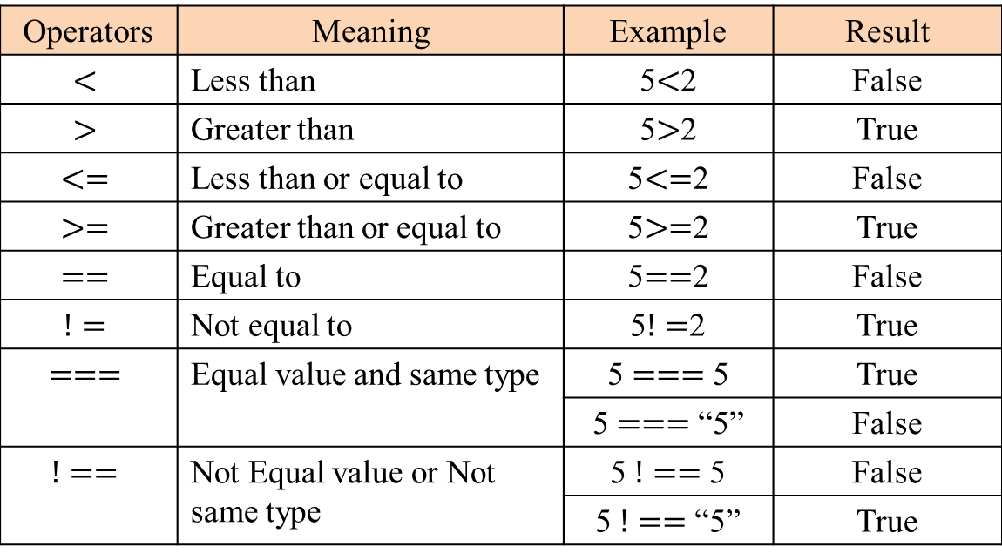
Relational Operators
Operators | Meaning | Example | Result
 | Less than |  | False
 | Greater than |  | True
 | Less than or equal to |  | False
 | Greater than or equal to |  | True
 | Equal to value check but not data type check |  | False
 | Not equal to |  | True
 | Equal value and same data type(Identical operator) |  | True
 |  |  | False
 | Not Equal value or Not same data type |  | False
 |  |  | True

Slide 15
Logical Operators
Operator | Meaning | Example | Result
&& | Logical and | (5<2)&&(5>3) | False
|| | Logical or | (5<2)||(5>3) | True
! | Logical not | !(5<2) | True

Slide 16
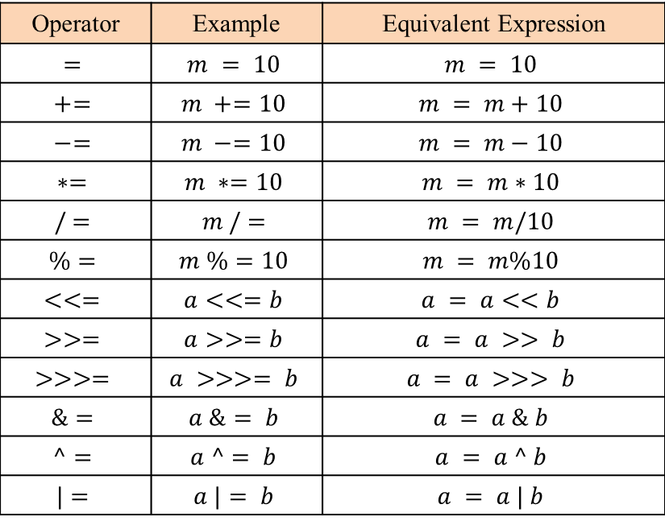
Assignment Operators
Operator | Example | Equivalent Expression

Slide 17
Ternary Operator
The conditional (ternary) operator that takes three operands
Syntax:-
(condition)? true : false
Eg.
var age = 18;
document.write((age >= 18) ? "you can vote" : "you can't vote");

Slide 18
Conditionals Statement
Runs a block of code if something is true
if else
if -else if- else
Nested if

Slide 19
Switch
Selects one of many blocks of code to execute. Often used as an alternative for an if –else statement
-processing fast
-multi-decision making
Syntax:-
switch(variablename)
{
case ‘val1’:
//code
break;
case ‘val2’:
//code
break;
--------
--------
default:
document.write("not matches any cases…");
}

Slide 20
Loops
Execute a block of code as long as a condition is true and repeat
For Loop:
for(initialization; condition; inc/dec){
//stmt
}
While Loop:
Initialization;
while(condition){
//stmt
inc/dec
}
Do While Loop:
Initialization;
do{
//stmt
inc/dec
}while(condition);

Slide 21
Why Function?
Why Functions?
You can reuse code: Define the code once, and use it many times.
You can use the same code many times with different arguments, to produce different results.

Slide 22
Function
-Block of code designed to run a task. Can be created and then invoked later or earlier on
-reusability
Syntax-
function function_name()
{
//stmt of code
}
Call:- function_name();
Function have two types:-
1-predefined(Javascript own function)
2-user defined
A-with argument
B-without argument

Slide 23
Return Keyword
When JavaScript reaches a return statement, the function will stop executing.
Functions often compute a return value.
The return value is "returned" back to the "caller”

Slide 24
Function Expression
Function expressions simply means Create a function and put it into the variable
function sum(a,b){
return total = a+b;
}
var funExp = sum(5,6);
console.log('the sum of two no is ' + funExp );

Slide 25
Anonymous Function
A function expression is similar to and has the same syntax as a function declaration One can define "named"
function expressions (where the name of the expression might be used in the call stack for example) or "anonymous" function expressions.

Slide 26
Arrow Function
Syntax: (para1, para2) => expression;
Ex:
(a, b) => a+b;
Above code is equivalent to:
function add(a, b) {
return a + b;
}
Syntax: (para1, para2) => {expression}; // it won’t work
Ex: (a, b) => {a+b};
Syntax: (para1, para2) => {return expression};
Ex: (a, b) => {return a+b};

Slide 27
Immediately Invoked Function Expression (IIFE)
IIFE (Immediately Invoked Function Expression) is a JavaScript function that runs as soon as it is defined.
It is a design pattern which is also known as Self-Executing Anonymous Function and contains two major parts. The first is the anonymous function with lexical scope enclosed within the Grouping Operator (). This prevents accessing variables within the IIFE idiom as well as polluting the global scope.
The second part is creating the immediately executing function expression (), through which the JavaScript engine will directly interpret the function.
Ex: -
(function( ) { document.write(“Javascript”);})( );
(function(a, b) { document.write(a + “ ” + b);})(10, 20);

Slide 28
Template literals (Template strings)
Template Literal :- string interpolation (concatenation)
we use backricks symbol(``)
eg:
let a=10;
let b=20;
let sum=a+b;
//old es5
console.log("The sum of "+a+" and "+b+" is "+sum);
//es6 template Literal
console.log(`The sum of ${a} and ${b} is ${sum}`)

Slide 29
Arrays
JavaScript arrays allow us to store multiple values in a single variable and value of any data type
Array’s index always start from 0
Syntax-
arrayname=['val1','val2',.......];//array literal
arrayname=new Array('val1','val2',.......);// Array constructor
To Get the length of an Array
arrayname.length // length start from 1

Slide 30
Modifying or new add Array Elements
Syntax:-
arrname[index_numer] = value;

Slide 31
Removing Array Elements
Array elements can be removed using delete operator. This operator sets the array element it is invoked on to undefined but does not change the array’s length.
Syantx :- delete Array_name[index];
Ex:- delete arr[0];

Slide 32
forEach Loop
The forEach calls a provided function once for each element in an array, in order.
Syntax: - arrayname.forEach(function (v, i) {
});
Where,
v – It is the current value of array index.
i – Array’s index number

Slide 33
for of Loop
The for...of statement creates a loop iterating over iterable objects.
Syntax: -
for (var variable_name of arrayname) {
}
Ex: -
for (var a of arr){
}

Slide 34
Multidimensional Array
Multidimensional array is Arrays of Arrays.
Multidimensional array can be 2D, 3D, 4D etc.
Syntax: - 2D - var name=[ [ ], [ ] ];
Ex-
let multi=
[
[1,2,3],
[4,5,6],
[7,8,9]
];
//document.write(multi[0][1]);
for(let i=0;i<multi.length;i++)
{//outer loop for row
for(let j=0;j<multi[i].length;j++)
{//inner loop for column
document.write(multi[i][j]);
}
document.write("<br>");
}

Slide 35
Objects
Almost everything in JS can be considered an “object”.
Objects have properties and methods (functions)
Syntax: - var object_name = {key1:value1, key2:value2, ..........key_n:value_n};
Ex:-
// Assign Properties
var person = {name:”Mike”, age:33, getSal:()=>{return 50000}}
// Access Property
document.write(person.name); // Mike
// Accessing Method
person.getSal()

Slide 36
Declaration and initialization of Object
Using Object Literal
Syntax: - var object_name = {key1:value1, key2:value2, ..........key_n:value_n};
Ex: - var fees ={Rahul: 100, Sumit: 200, Rohan: 300};
var fees ={
Rahul: 100,
Sumit: 200,
Rohan: 300
“Super Man”: 400
};
var fees ={Rahul: 100, Sumit: 200, Rohan:300, “Super Man”: 400};

Slide 37
Declaration and initialization of Object
Using Object Constructor
Syntax: - var object_name = new Object( );
Ex: - var fees = new Object ( );
fees['Rahul'] = 100;
fees['Sumit'] = 200;
fees['Rohan'] = 300;
var fees = { };
fees.Rahul = 100;
fees.Sumit = 200;
fees.Rohan = 300;

Slide 38
Adding Properties/Methods
Syntax:-
Object_name.Property_name = value;
Object_name[‘Property_name’] = value;
Ex: -
fees.Sonam = 600;
fees[‘Sonam’] = 600;

Slide 39
Deleting Properties
Delete operator is used to delete instance properties.
Syntax:- delete object_name.property_name
delete object_name[“property_name”]
Ex: - delete fees.Rahul;
delete fees[“Rahul”]
After removal with delete operator, the property has the undefined value.

Slide 40
For in loop
The for...in loop is used to loop through an object's properties not method.
Syntax: -
for (var variable_name in object_name){
block of statement
}
Ex: -
for (var specs in samsung) {
document.write(specs);//key return
document.write(samsung[specs]);//value return and don’t access samsung.specs
}

Slide 41
Exception
An exception is a generalization of the concept of an error to include any unexpected condition encountered during execution.
Exception Handling-
try:- Inside the try block we write those codes which can cause execption
catch:- Inside the catch block we write codes which can handle the exception thrown by try block
finally:-Inside the finally block we write code which must be executed for normal termination of application or a specific program
throw :- using throw u can define your message on browser according your error message without going try catch block

Slide 42
Ex:-
try {
add();// It will throw an execption
document.write("Skipped Code"); // if exception generate it would not get executed
}
catch (e) {
// document.write("Message" + e.message + "<br>");
// document.write("Name" + e.name + "<br>");
// document.write("Stack" + e.stack + "<br>");
document.write("add is not defined by u<br>"); // Handling Code for the exception
}
finally {
document.write("Get executed whether there is exception or not");
}

Slide 43
Ex:
function getArea(w,h)
{
if(isNaN(w) || isNaN(h)) {
throw "function parameter should be numberic value!";
}
console.log("Area:"+w*h);
}
try
{
getArea(5, "14djd");
}
catch (e) {
document.write(e);
}
From – Sudhir Kumar
Group - D

