Slide 1
Introduction Principles of Programming Language
S.Venkatesan
Reference: Robert W. Sebesta, Concepts of Programming Languages, 10th Edition, Pearson

Slide 2
Why?
Increased Capacity to express Ideas.
Improved Background for choosing appropriate languages.
Increased ability to learn new languages.
Better understanding of the significance of implementation.
Better use of languages that are already known.
Overall advancement of computing.

Slide 3
Programming Domains
Scientific Applications
Business Applications
Artificial Intelligence
System Programming
Web Software

Slide 4
Evaluation Criteria & Characteristic
Criteria
Readability
Writability
Reliability
Characteristic
Simplicity
Orthogonality
Data types
Syntax Design
Support for abstraction
Expressivity
Type Checking
Exception Handling
Restricted aliasing

Slide 5
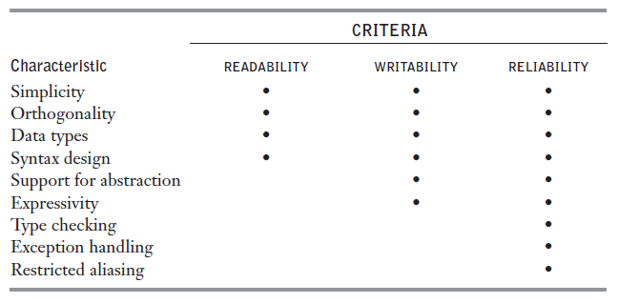
Language evaluation criteria and the characteristics

Slide 6
Readability
Programs that can be read and understood.
Earlier that is before 1970, efficiency was the only point of view.
After 1970, the coding was relegated to a much smaller role and maintenance become a major role. (according to the software life cycle concept by Grady Booch, 1987).
Readability must be considered in the context of the problem domain.

Slide 7
Simplicity
Simplicity affects the readability
Like feature multiplicity
count = count + 1
count += 1
count++
++ count
Operator Overloading

Slide 8
Orthogonality
Independent of the context.

Slide 9
Data Type
Adequate facilities for defining data types and data structures in a language is required.
For example, a numeric type is used for boolean
timeout = 1
However, for language having boolean type we can write
timeout = true

Slide 10
Syntax Design
Special Words
Confusion if reserved words allowed for user defined variable names. For example, fortran – Do and End can be variable.
Compound statements with brace is confusing compare to end if and end loop
Form and Meaning
Semantics or meaning, should follow directly from syntax or form.
Problematic – grep in UNIX

Slide 11
Writability
It is a measure of how easily a language can be used to create programs for a chosen problem domain.

Slide 12
Simplicity and Orthogonality
Large number of constructs might not be familiar with all of them.
Too much orthogonality can be a detriment to writability.
Errors in program can go undetected when nearly any combination of primitives is legal.

Slide 13
Support for Abstraction
Process Abstraction
Use of a subprogram. For example, inserting the sort algorithm in all places as per need.
Otherwise program will be longer or cluttered if we repeat writing it.
Data Abstraction
For example writing a binary tree that stores integer data in its node.
The complexity of writing such program in non-pointer supported languages.

Slide 14
Expressivity
Powerful operations can be accomplished with a complex statements
count++
count = count + 1

Slide 15
Reliability
Type Checking – Compile or Run time
Exception Handling
Aliasing – two or more distinct names that can be used to access the same memory cell.
Readability and Writability - Maintenance

Slide 16
Cost
Training Programmers.
Cost of writing programs.
Cost of Compiling programs – Optimization
Expensive Hardware – can run on it.
Poor reliability – cost of failure in critical system.
Maintenance.
In general – development, maintenance and reliability. Also portability

Slide 17
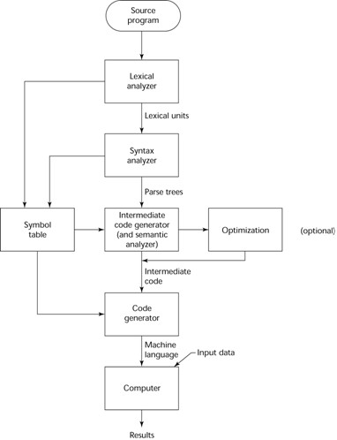
Compiler

Slide 18
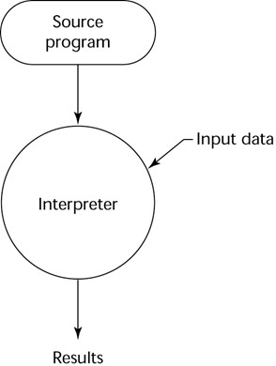
Pure Interpreter

Slide 19
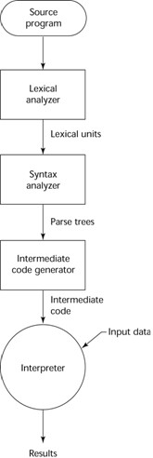
Hybrid Implementation

Slide 20
End of Preliminaries

