Slide 1
Correlation and Inter-market Analysis of Bitcoin, Ethereum, and Cardano on Binance
Data Analytics Graduate Capstone
Author: Joshua Bonie
Program: Masters of Data Analytics
Date: 03/12/2025

Slide 2
Introduction
Bachelors in Computer Science
Data analytics for 4 years
Understanding the correlation between Bitcoin, Ethereium, and Cardano
Understanding what to do with that knowledge

Slide 3
Problem Statement/Hypothesis
Problem:
  The volatile cryptocurrency market requires a deeper understanding of how major assets interact to optimize trading strategies.
Research Question:
  What is the nature of the relationship between Bitcoin (BTC/USDT), Ethereum (ETH/USDT), and Cardano (ADA/USDT) on Binance, and can these correlations be leveraged to optimize trading strategies?
Hypotheses:
  Null (H₀): No statistically significant correlation exists among these assets.
  Alternate (H₁): Statistically significant correlations exist, with evidence that one asset's movements may predict those of another.

Slide 4
Data Collection/Methodology
Data Source:
  Binance API via a custom Python client (ccxt library).
Assets:
  BTC/USDT, ETH/USDT, ADA/USDT.
Timeframe:
  Two years of 1-minute OHLCV data (ending at yesterday’s midnight).
Method:
  Round-robin data extraction with incremental CSV saving.
Advantages:
  High-frequency, granular data.
  Continuous saving allows for early troubleshooting.
Disadvantages:
  API rate limits and occasional missing intervals.
  Gaps in data require careful cleaning.

Slide 5
Data Extraction & Preparation
Raw CSV data was extracted using custom Python scripts.
Timestamps were converted to datetime format and set as the DataFrame index.
A full 1-minute interval was generated to reindex the data.
Missing rows were identified (e.g., ADA/USDT: 1,048,160 expected rows with 408,660 missing) and rows that were completely empty were dropped.

Slide 6
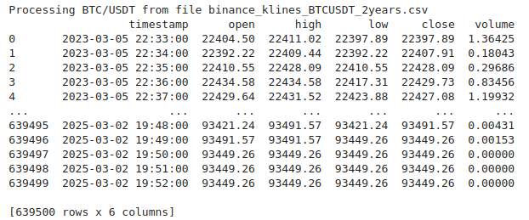
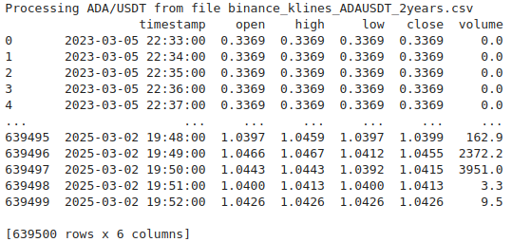
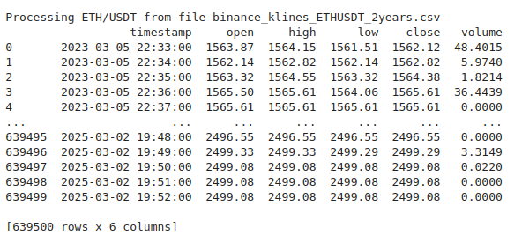
Raw Data

Slide 7
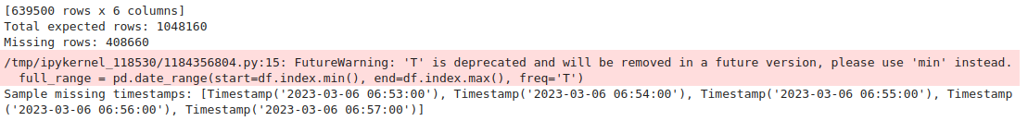
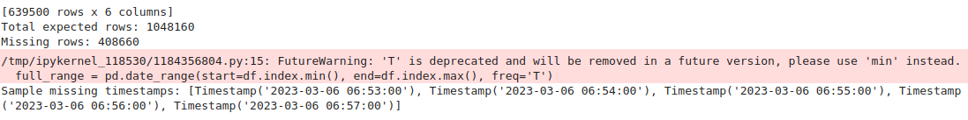
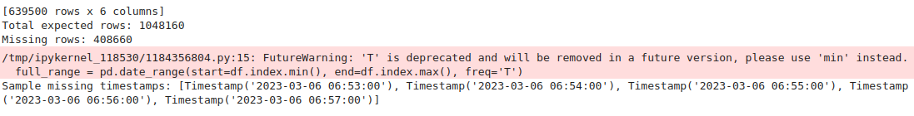
Missing Rows
BTC:
ETH:
ADA:

Slide 8
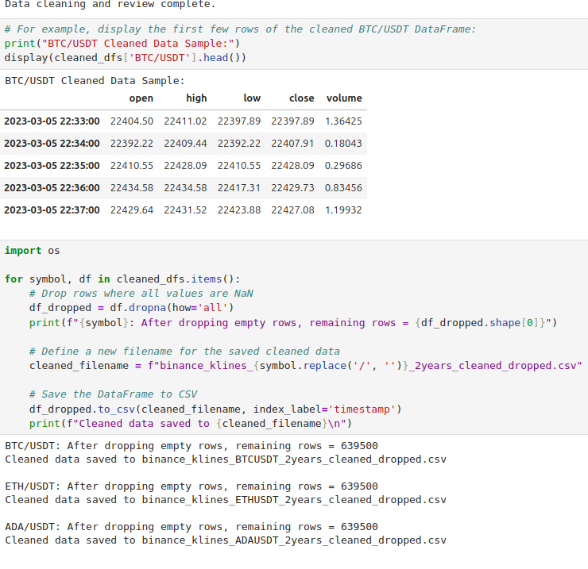
Cleaned Data

Slide 9
Data Analysis Process
Computed 'pct_change': Percentage change in closing price from one minute to the next.
Calculated 'movement': Categorized changes as 'up', 'down', or 'flat'.
Performed Time Series Analysis with line plots of closing prices and percentage changes.
Conducted Correlation Analysis by merging data on timestamps (e.g., BTC vs. ETH ~0.84).
Calculated Rolling Volatility using a 60-minute rolling standard deviation.
Utilized technical analysis tools (mplfinance) to generate candlestick charts, Bollinger Bands overlays, Renko charts, and RSI subplots.

Slide 10
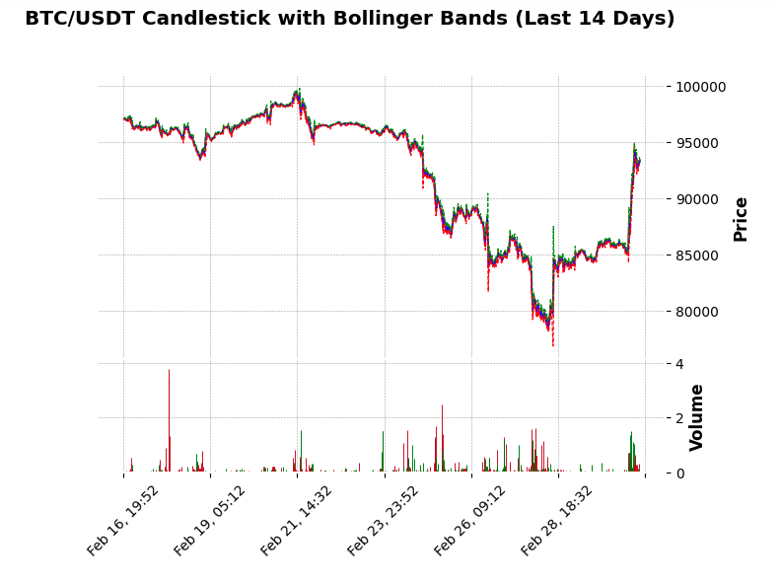
Candlestick Bollinger Bands

Slide 11
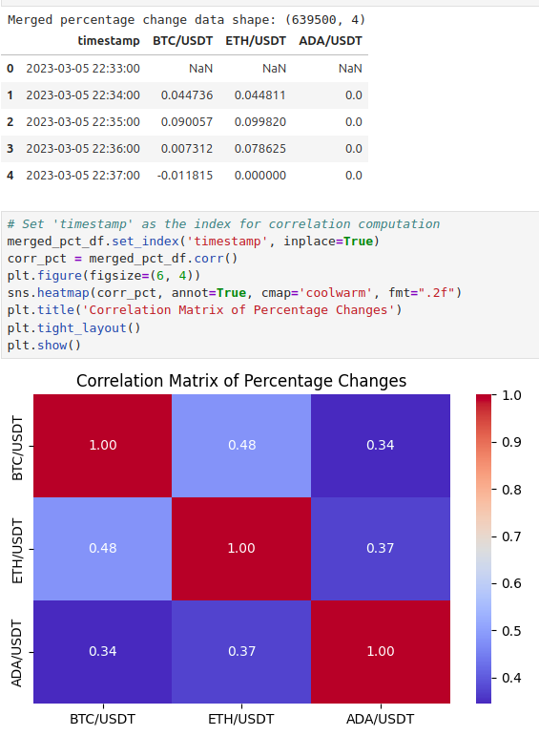
Correlation Matrix

Slide 12
Key Findings
BTC and ETH exhibit a high correlation (≈0.84).
ADA shows moderate correlations with BTC (≈0.80) and ETH (≈0.68).
Normalized percentage changes allow for effective cross-comparison.
Rolling volatility analysis identifies periods of increased market risk.
Implications:
  BTC may serve as a leading indicator for market movements.
  These insights can inform improved risk management and trading strategy adjustments.

Slide 13
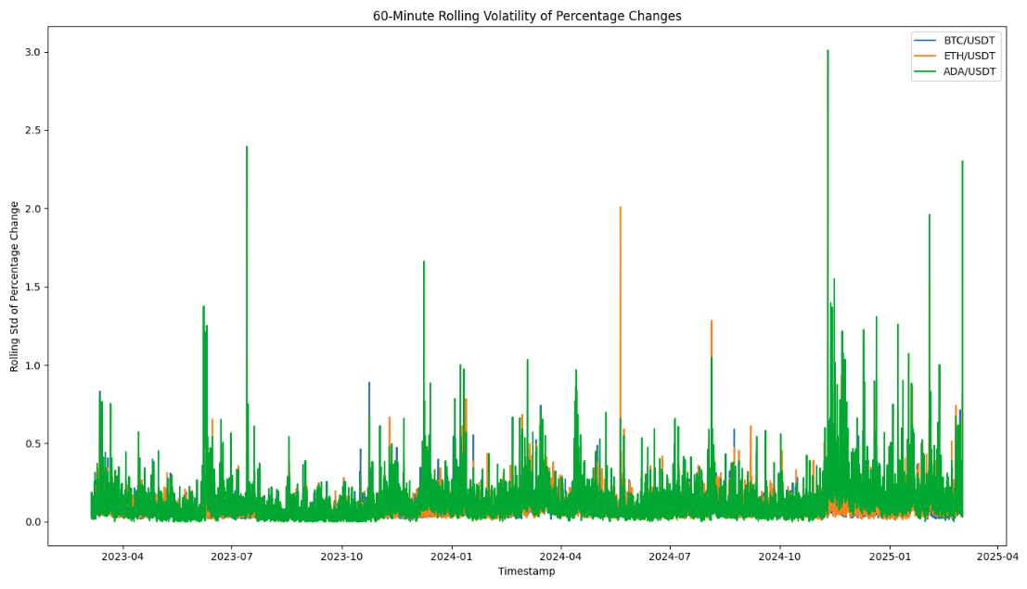
Rolling Volatility Plot

Slide 14
Limitations & Proposed Actions
Limitations:
  Missing data: Dropped rows may exclude low-volume periods.
  Assumptions in statistical methods (e.g., stationarity) may impact predictive accuracy.
Proposed Actions:
  Monitor BTC as a leading indicator to adjust ETH and ADA trading positions.
  Expand the asset universe to include more cryptocurrencies.
  Apply machine learning models (e.g., LSTM networks) for improved predictions.

Slide 15
Expected Benefits
Enhanced risk management through more accurate trading signals.
Improved portfolio diversification strategies.
Potential quantitative improvements: a 5–10% increase in risk-adjusted returns.
Data-driven insights enable better decision-making in volatile markets.

Slide 16
Conclusion & Summary
Our analysis shows strong correlations among BTC, ETH, and ADA.
BTC’s movements, in particular, may serve as a leading indicator.
Key insights: normalized percentage changes and rolling volatility patterns inform risk management.
Recommended actions include monitoring BTC, expanding the asset analysis, and exploring advanced predictive models.
These findings offer actionable insights for optimizing trading strategies.

Slide 17
References
Binance API Documentation. (Year). Retrieved from [URL].
ccxt Library Documentation. (Year). Retrieved from [URL].
mplfinance Documentation and Tutorials. (Year). Retrieved from [URL].
Relevant Academic Literature on Financial Time Series Analysis. (Authors, Year, Title, Source).

