Slide 1

What are containers?

Slide 2
Basic concepts about containers
A container is a standard unit of software that packages up code and all its dependencies so the application runs quickly and reliably from one computing environment to another. That includes: files, environment variables, dependencies and libraries
A container image is a filesystem tree that will be presented to the applications running inside it.
They use cgroups and namespaces of Linux Kernel, to isolate groups of processes and resources
Solves the reproducibility problem (Recipes are the source)
Reduce software maintainability
Obsolete software stacks

Slide 3
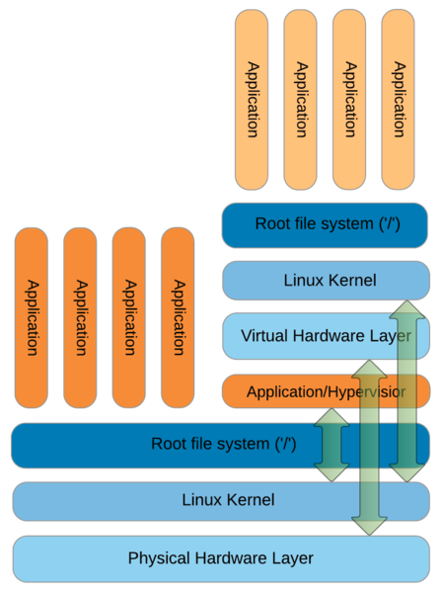
Virtual machines
Pros:
  Complete isolation between virtual machines
  Compatibility - same “virtual HW” on all physical machines
  Portability – run on any host OS
  Aggregation of resources
  Snapshots
Cons:
  No direct resource sharing
  Overhead
  Large VM images – contain whole OS
  Difficult to run on a cluster (kernel modules etc.)

Slide 4
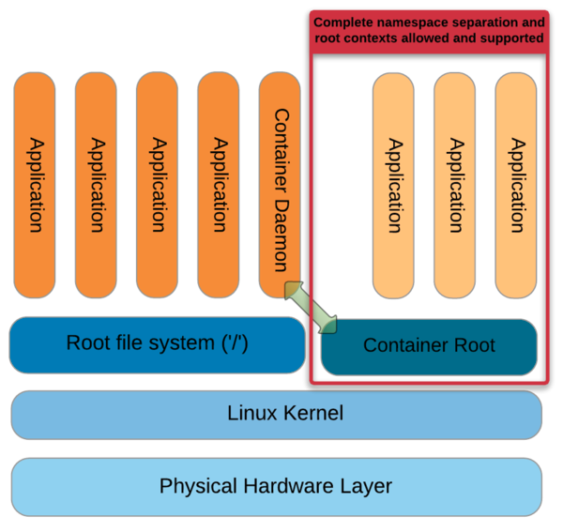
Containers
Pros:
  Speed - start, create, replicate or destroy quickly
  Portability – run on any host OS
  Allows access to host filesystems
  Image contain only necessary files
  Aggregation of resources
  Small overhead
Cons:
  Shares kernel of host OS
  Weaker isolation

Slide 5
Container usage
Process data – computation i.e. scientific pipelines
CI/CD, brand new environment for every build
It might be used to run a service (Apache, MySQL, Rstudio, Jupyter)

Slide 6
Docker vs Singularity
Docker has a persistent daemon running with root privileges and many container operations require root as well. In practice, a user who can run docker containers can get root access
The user IDs inside and outside the docker containers are not easily mapped.
Privilege elevation inside a Singularity container is impossible (in theory ;): to be root inside, you have to be root outside
Singularity automatically maps the user IDs

Slide 7
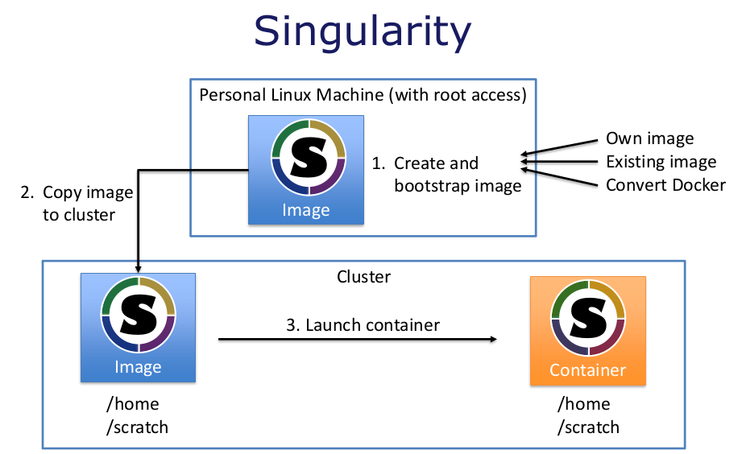
Singularity Workflow

Slide 8
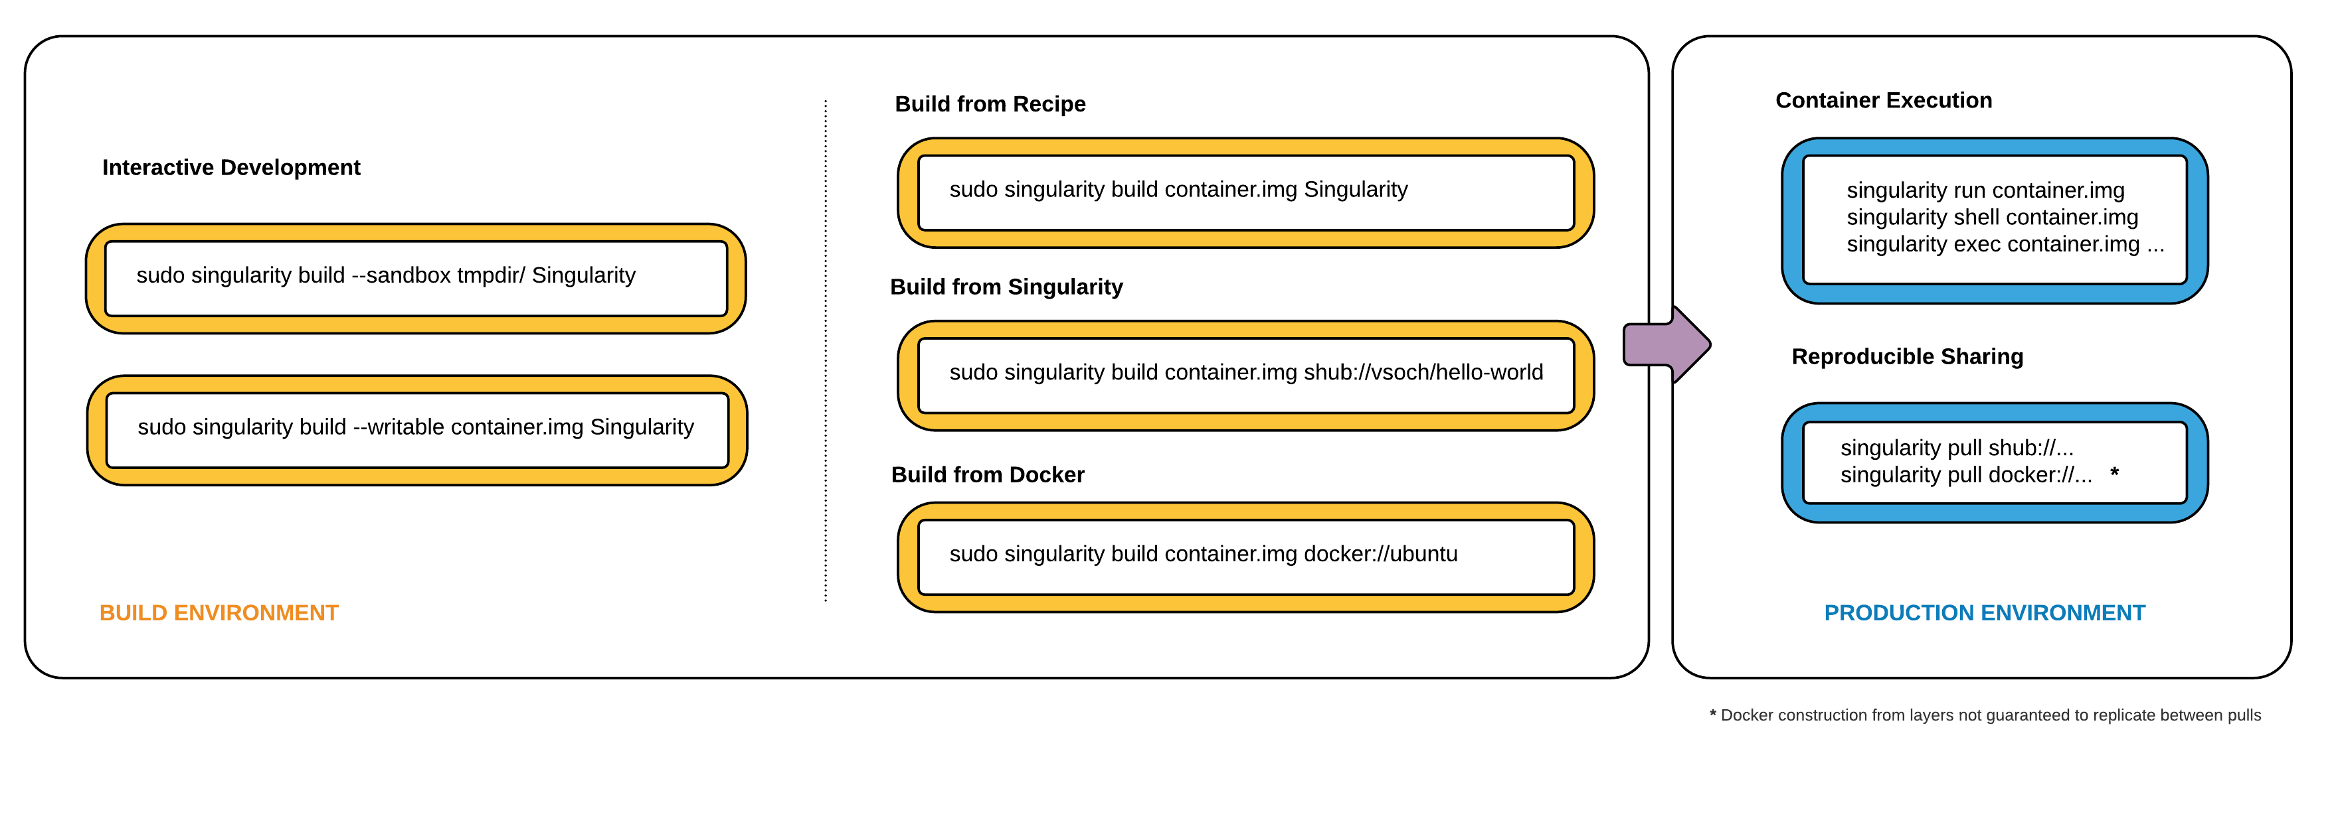
Singularity Workflow
The general idea: prepare container on a local machine with full control, then you can move it to the cluster to run it without root. You can use scp or upload it to a containers registry.
If you upload the container image to a registry like docker hub , singularity hub or a private registry you can directly download the container to the cluster as a regular user.

Slide 9
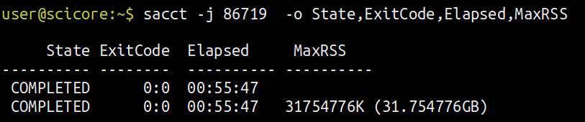
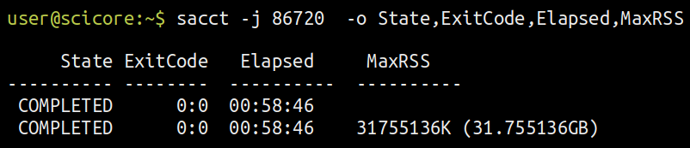
Performance benchmark - Native vs singularity
NGS pipeline without container
NGS pipeline using Singularity

Slide 10
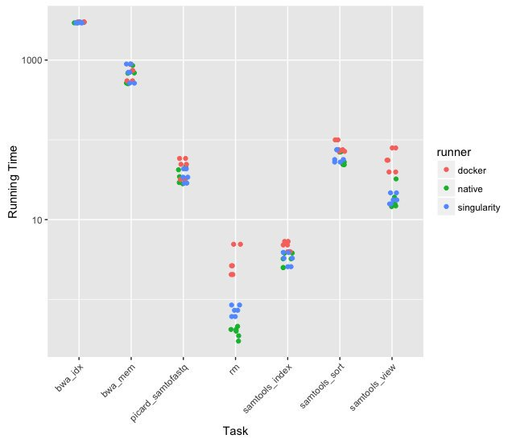
Performance benchmark

Slide 11
FAQ
OpenMPI
GPU
X11 forwarding
Kernel-dependent? No, never. But sometimes yes.
Glibc forward compatibility, CentOS 7 container won’t run in a CentOS 5 host.

Slide 12
ACK
Pablo Escobar Unibas
https://scicore-unibas-ch.github.io/singularity-slides/
Josef Hrabal (IT4Innovations) Prace
http://prace.it4i.cz/sites/prace.it4i.cz/files/files/perftools-hrabal-singularity.pdf
https://twitter.com/ljdursi/status/827186459975286787

Slide 13
Join the community
https://www.opencontainers.org/
you can join the google group without a google account by sending email to:
singularity+subscribe@lbl.gov
Issues on https://github.com/sylabs/singularity/issues
Slack https://singularity-container.slack.com/

