Slide 1



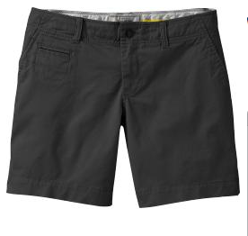
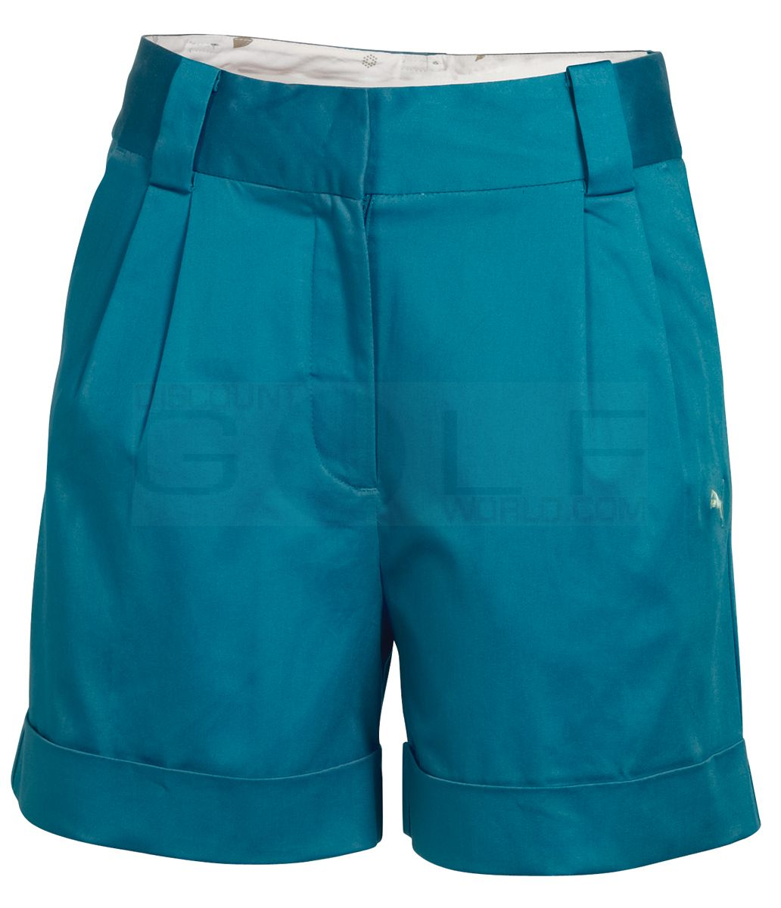
Harte Hanks 2015 Fundraising Kick-Off Helping Hand Home for Children Be cool and contribute!
Wear shorts to work for just $1 a day!
Support a great cause and be cool doing it!
This offer won’t last long – passes available through the end of September. Buy your tickets from your Supervisor – stay cool!

