Slide 1
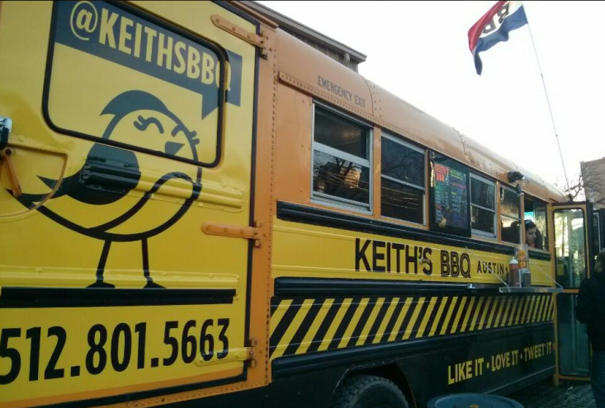
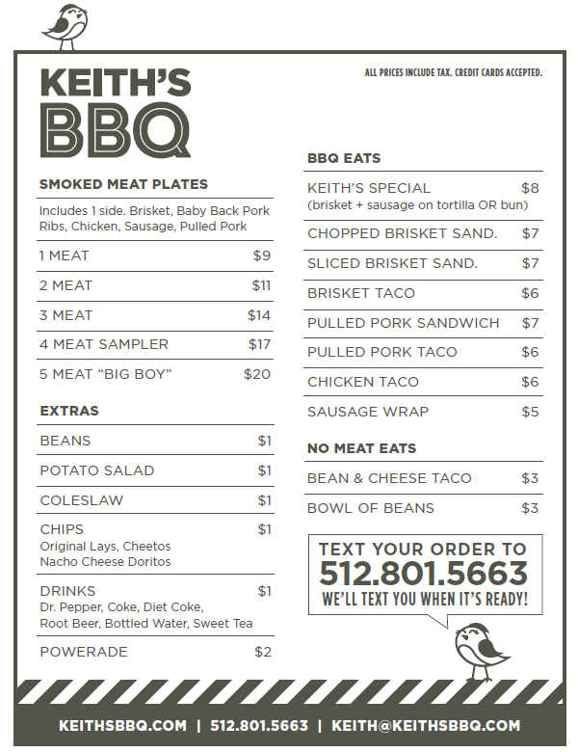
KEITH’S BBQ
TODAY!!
11:00AM – 1:30PM
FREE COUPONS at Receptionist Desks
TODAY ONLY!

