Slide 1

Lending Club
Case Study
September , 2023
Titas Biswas

Slide 2

Approach
Problem Statement
This company is the largest online loan marketplace, facilitating personal loans, business loans, and financing of medical procedures. Borrowers can easily access lower interest rate loans through a fast online interface.
In order to felicitate that, one aspect, is to understand the driving factors (or driver variables) behind loan defaults.
Data Cleaning
Data Understanding
Univariate Analysis
Segmented Univariate analysis
Bivariate Analysis
Recommendations

Slide 3
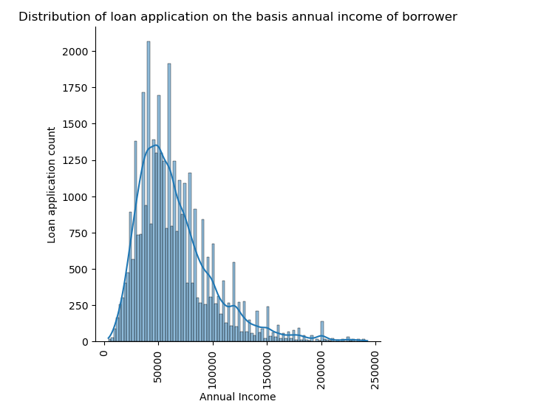
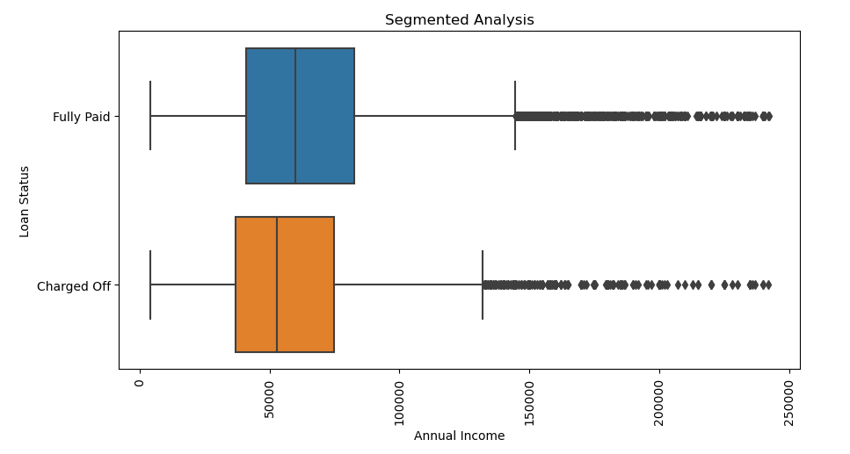
Annual Income
Borrowers with higher annual income contributed to lower number of defaulters

Slide 4
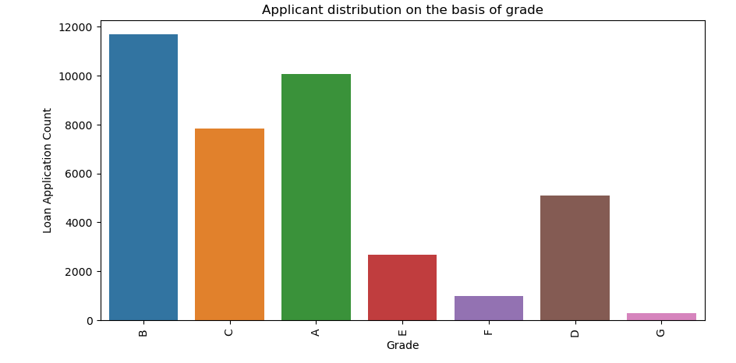
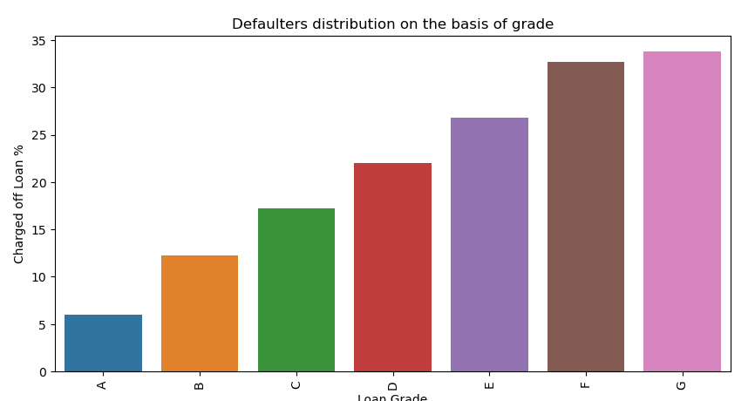
Grade
The riskier the grade the higher the number of faulting in a consistent trend

Slide 5
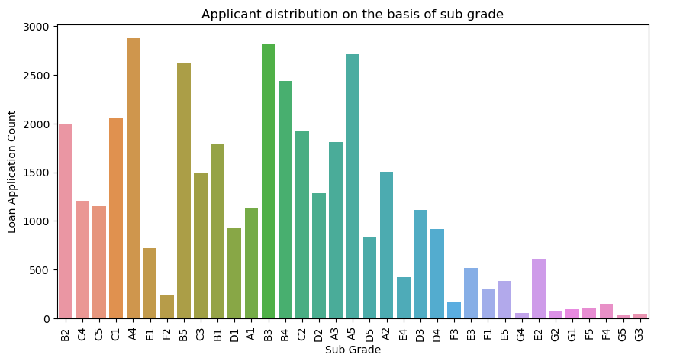
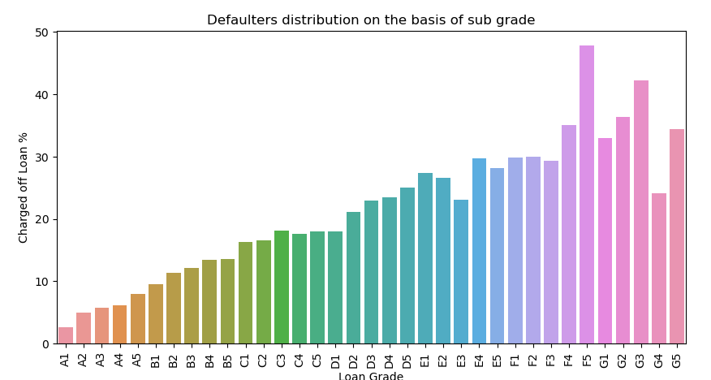
Grade
The same trend as grade is further confirmed with F5 and G3 contributes to highest defaulters

Slide 6
Sub Grade
The same trend as grade is further confirmed with F5 and G3 contributes to highest defaulters

Slide 7
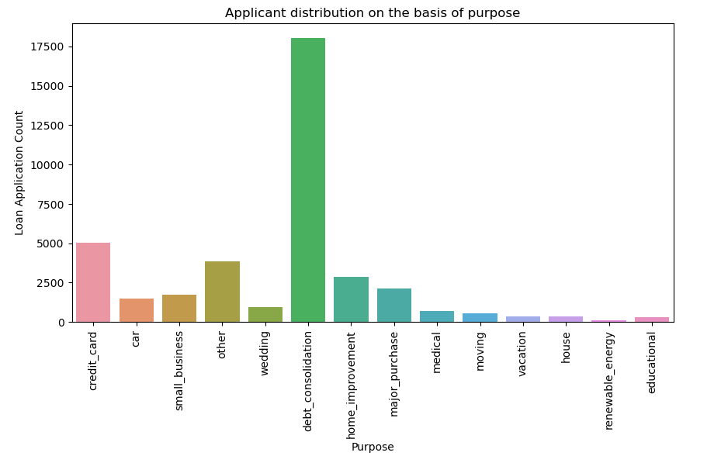
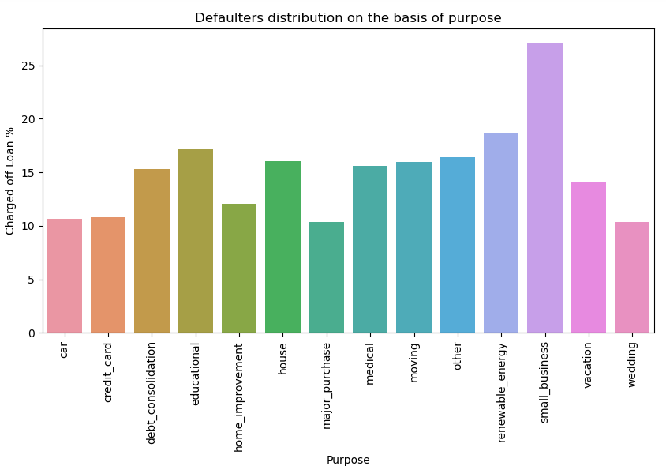
Purpose
- Number of applicants for debt consolidation is the highest and significantly higher than the next highest credit card
- Number of defaulters is significantly higher for small business (27%) even if it is compared with next highest renewal energy (18%)

Slide 8
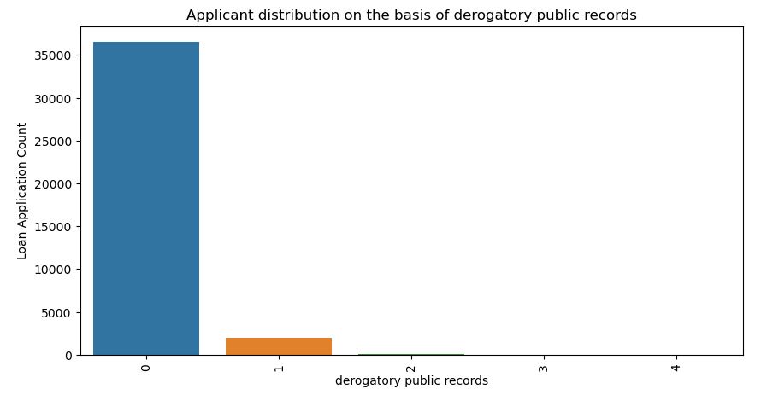
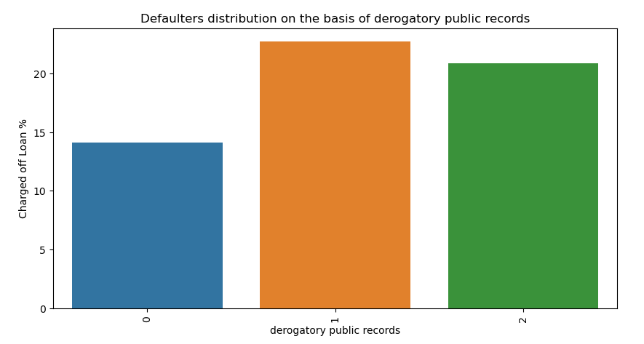
Derogatory public records
Chance of defaulting is higher with the borrowers having derogatory public records than who don't have

Slide 9
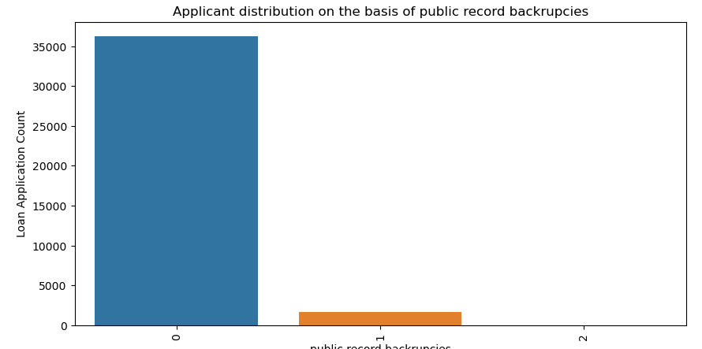
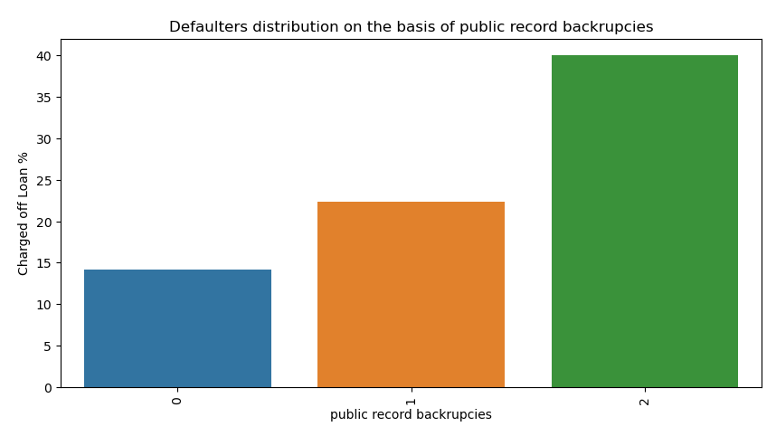
Public record bankruptcies
With increase of public record bankruptcies the number of defaulters increases

Slide 10
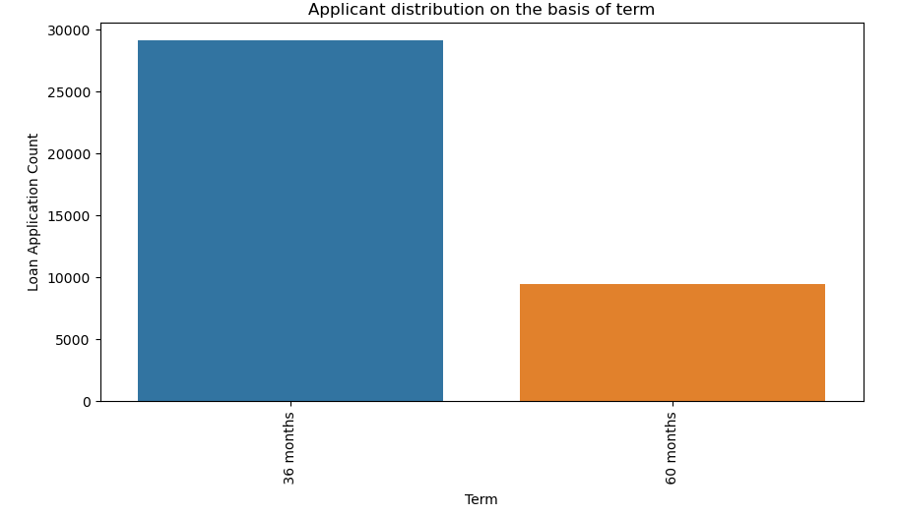
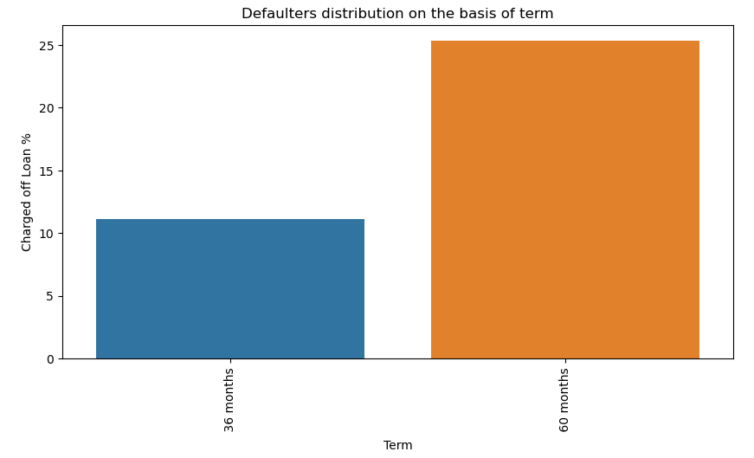
Loan terms
Loans with terms of 60 months attracts more risk of defaulting

Slide 11
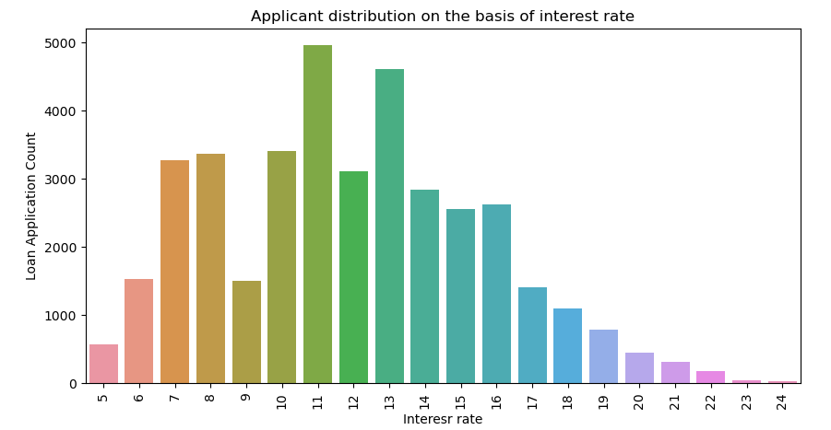
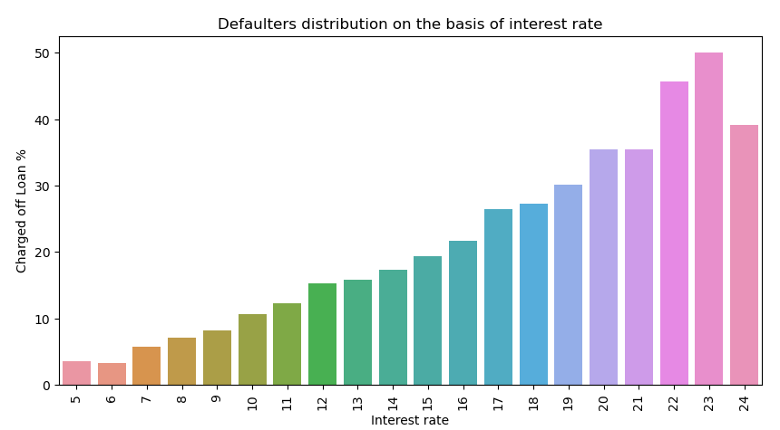
Interest rate
With increase of interest rate, the risk of defaulting increases

Slide 12
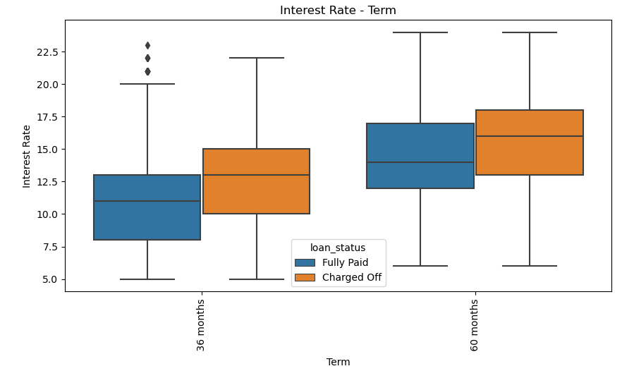
Terms- Interest rate
Analysis:
Interest rate increases with loan terms
Irrespective of terms, risk of defaulting increase with increment of interest rate

Slide 13
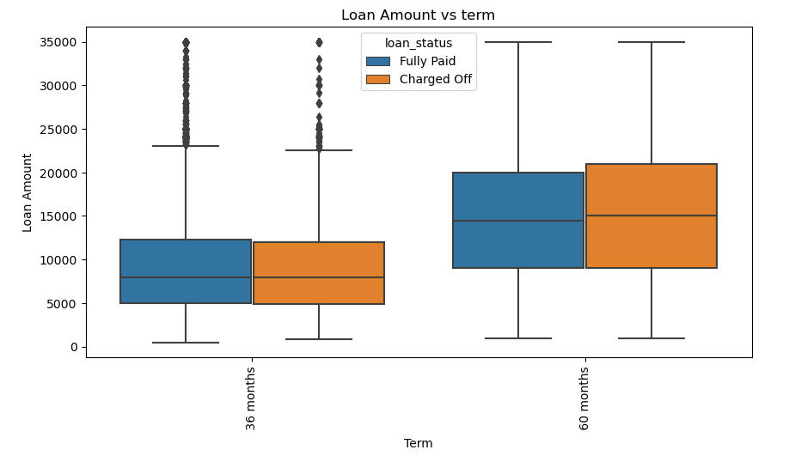
Terms- Interest rate
Analysis:
Loan amount increases with loan terms
A relation with risk of defaulting can't be determined for the same

Slide 14

Conclusion
- Higher loan grade(G) will have more chances of charging out. Lesser risk grade loans(A) have less chances of charging out.
- "Small Business" loan purpose has higher chances of charging out.
- Higher interest rate of loan will have higher chances of charging out.
- Company should focus on giving loan for shorter term (36 months than 60 months).
- Company should not give loans to borrowers with derogatory public records.
- Company should not give loans to borrowers with bankruptcy records.
- Company should not give loans to borrowers with more than 2 inquiries in last 6 months.
- Higher income groups have less chances of charging out.

