Slide 1
CBETA Visit 16th – 27th April 2018
James Jones
STFC Daresbury Laboratory, UK

Slide 2
Aims
Begin collaboration between the UK and Cornell/BNL on CBETA
Investigate potential areas of future collaboration
Take part in commissioning shifts to further understanding of CBETA
Provide commissioning support in several areas:
Beam dynamics
High-level software

Slide 3
Beam Dynamics
Phase Cavities with first dipole to determine phasing resolution
Determine how and to what accuracy emittance can be measured using a quad scan in S1.
Devise a method for measuring dispersion in S1
Develop user knobs (linear combinations of magnet strengths) that will be useful for matching the orbit at the end of S1 into the permanent magnet arc (PMA).

Slide 4
High-level Software
Open-ended!
Use of python and (probably) Qt bindings for high-level software development
Investigate potential areas of future collaboration

Slide 5
Part 1: This week I have been mostly working on…

Slide 6
Outcomes
Generated several high-level software GUIs for use on CBETA
Provided demonstration python scripts for use in future applications
Scripts:
Generic EPICS PV based classes for use in python scripting
PyQt based tuning knob application with several example potential tuning knobs
PyQt based multiKnob application for “ganging” epics PVs together
PyQt based response matrix generation application
PyQt based application for recording data

Slide 7
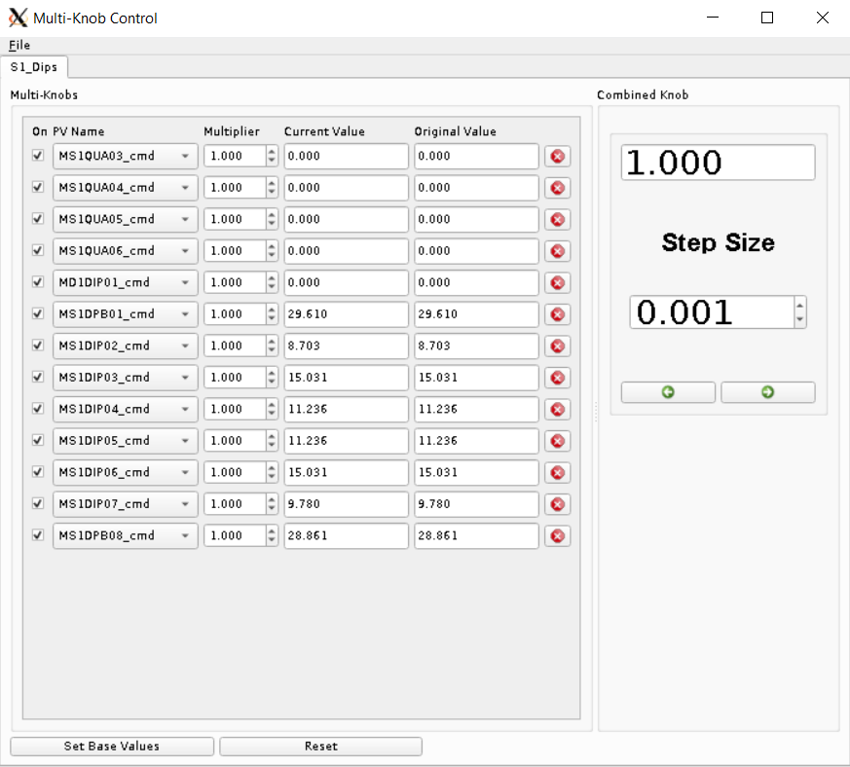
Multi-Knob Control application

Slide 8
Multi-Knob Control application
Global Ratio
Original value
Current read-back
Global Step-size
Individual magnet control
Global Controls
Actuator

Slide 9
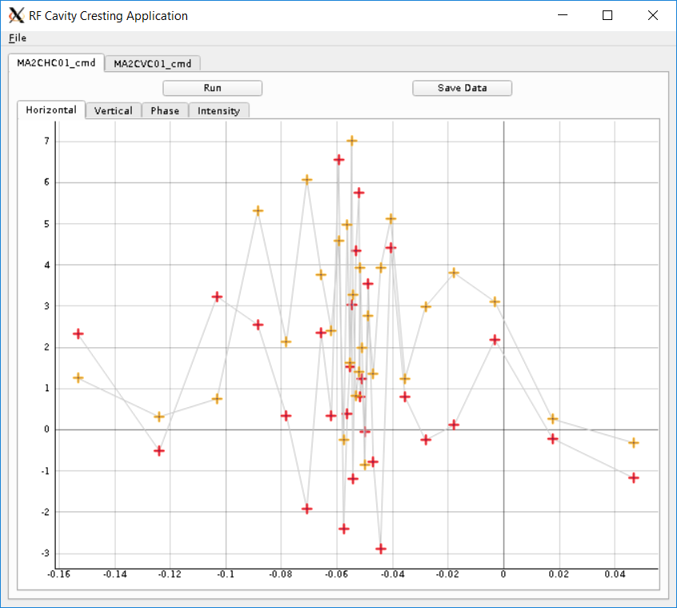
Response Matrix Application

Slide 10
Response Matrix Application
Save data to HDF5 format
Actuators
Response on all Monitors

Slide 11
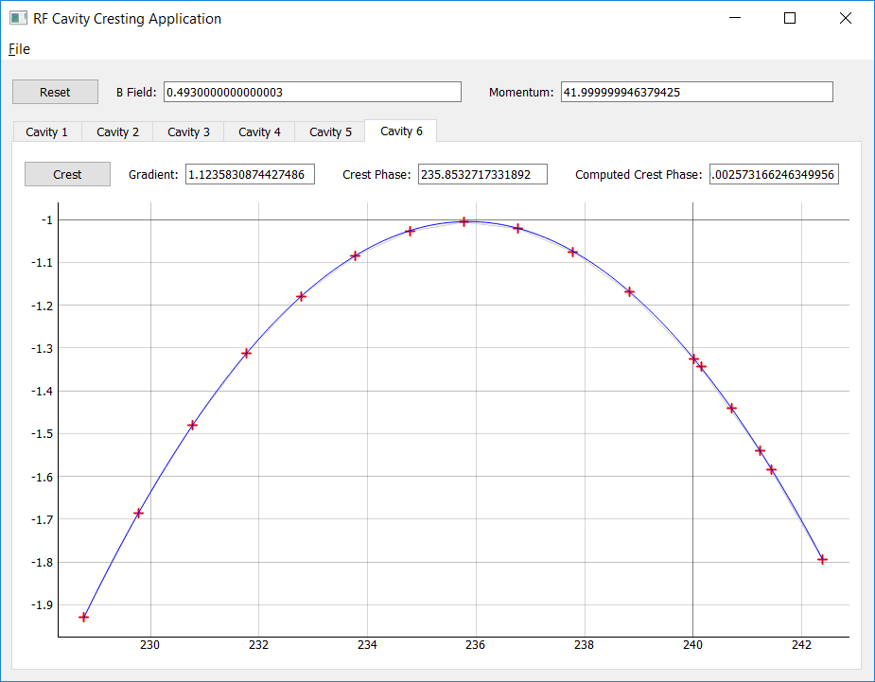
MLC Cresting Application (Untested!)

Slide 12
MLC Cresting Application (Untested!)
B-Field
(Un-calibrated)
Calculated Energy (Un-calibrated)
Screen/BPM position read-back
Cavity Control

Slide 13
Model Independent Analysis
Plan to take data for MIA analysis (Friday)
Record BPMs in steady-state conditions, under several scenarios:
On crest on all cavities
At ±20° on each cavity
Other scenarios??
Using SVD:
Reconstruct dominant Eigen-modes of the system
Differentiate between:
laser jitter + other jitter (on-crest)
RF + laser jitter + other (off-crest)
Analysis done after IPAC

Slide 14
Conclusions
Very productive 2 weeks
Some applications have been created that I hope will be useful to the CBETA team
There is a general cross-facility benefit to this type of high-level software work:
Nearly everything is facility independent!
All applications will be useful on my home facility
Everything on GitHub
Many thanks to the whole team for helping me and providing a friendly environment to work in!

Slide 15
Part 2: How we do things wrong at Daresbury
From an AP/Operations perspective

Slide 16
The Daresbury Way…
At DL we have commissioned (in the last 10-15 years):
A SC ERL (ALICE)
A ns-FFAG (EMMA)
A linear accelerator for industrial applications (VELA)
An FEL test-facility (CLARA) – ongoing!
We have made many mistakes…
But, we are trying to learn from them:
Changes to operating procedures
Changes to reporting procedures
Changes to documentation procedures
…

Slide 17
The Daresbury Way…
Lessons from ALICE and EMMA:
Too few people could “run” the machine well
We did not have consistent procedures
Beam quality dependent on shift operator
No documentation
Lessons from VELA and CLARA:
People were too “silo”-ed
Technical groups were not well integrated with Operations
Users…
…not enough time to actually commission the machine

Slide 18
The Daresbury Way…
Most staff should be available for shifts
Not all are “first”/”lead” commissioners, but heading that way
Each shift must/should include 1 AP, 1 RF, 1 Laser
Others (diagnostics, controls etc.) when available
For experiments we have Principle Investigators (PIs)
Define and run experiments during commissioning
Are not (in general) operators
For continuity we have Beam Operations Coordinators:
One week “in charge” of machine (not experiments)
Provide continuity from day-to-day
Lead commissioners with broad knowledge
Generally AP, but could be RF/Laser/Other

Slide 19
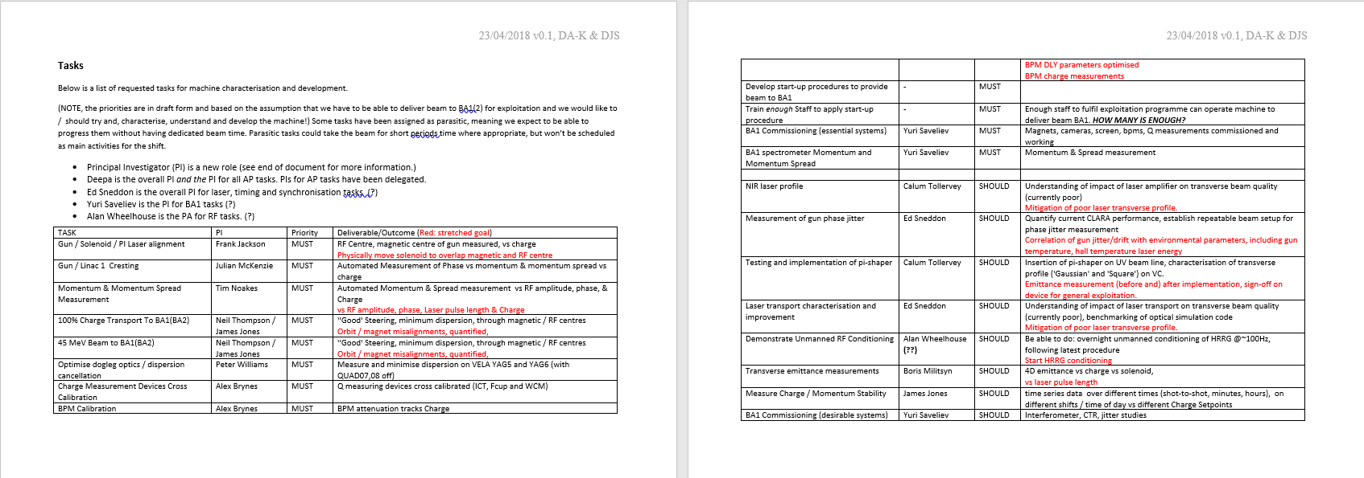
The Daresbury Way…
Everybody ^{more or less} is responsible for (at least) one high-level “application”:

Slide 20
The Daresbury Way…
High-level software can be written in anything
Very strong preference for Python+PyQt or C++
Legacy software in Mathematica/Matlab/Labview
Algorithms/procedures developed in Python
Once prototyped and useful:
Pushed onto controls group to be implemented in lower layers (i.e. EPICS)
Every application must be useable by “anyone”
Pushes people towards GUI development
Individuals are “responsible” for application – implies lots of complaints if software unusable…

Slide 21
The Daresbury Way…
Conclusions:
We are moving away from a single “super” operator
Make everyone/as many people as possible to be lead operators
Encouraged through responsibility to some high-level aspect of the machine
Documentation:
By forcing people to be responsible for “applications” we encourage documentation
This also encourages “good” programming practices
Final aim is to engender “buy-in”/”Ownership” of everyone towards a common goal

