Slide 1
COMPREHENSIVE CRICKET TEAM ANALYSIS
-Titiksha Kumari

Slide 2
Objective
To build a data-driven cricket team model that consistently scores 180 runs on average and has the ability to defend at least 150 runs. Players are classified into specific roles (Openers, Anchors, Finishers, All-Rounders, Fast Bowlers) using clear performance-based criteria. This ensures fair, transparent, and strategic selection of the final playing XI.

Slide 3
OPENERS
Parameter | Description | Criteria
Batting Average | Average runs scored in an innings | > 30
Strike Rate | Runs scored per 100 balls | > 140
Innings Batted | Total innings batted | 23
Boundary % | % of runs scored in boundaries | > 50
Batting Position | Order in which the batter played | < 4

Slide 4
ANCHORS / MIDDLE ORDER
Parameter | Description | Criteria
Batting Average | Average runs scored in an innings | > 40
Strike Rate | Runs scored per 100 balls | > 125
Innings Batted | Total innings batted | > 3
Average Balls Faced | Average balls faced in an innings | > 20
Batting Position | Order in which the batter played | > 2

Slide 5
FINISHERS / LOWER ORDER ANCHOR
Parameter | Description | Criteria
Batting Average | Average runs scored in an innings | -
Strike Rate | Runs scored per 100 balls | -
Innings Batted | Total innings batted | -
Average Balls Faced | Average balls faced in an innings | -
Batting Position | Order in which the batter played | -
Innings Bowled | Total innings bowled | > 1

Slide 6
ALL-ROUNDERS / LOWER ORDER
Parameter | Description | Criteria
Batting Average | Average runs scored in an innings | > 15
Strike Rate | Runs scored per 100 balls | > 140
Innings Batted | Total innings batted | > 2
Batting Position | Order in which the batter played | > 4
Innings Bowled | Total innings bowled | > 2
Bowling Economy | Average runs allowed per over | < 7
Bowling Strike Rate | Average balls required to take a wicket | < -

Slide 7
SPECIALIST FAST BOWLERS
Parameter | Description | Criteria
Innings Bowled | Total innings bowled | > 4
Bowling Economy | Average runs allowed per over | < 7
Bowling Strike Rate | Balls required to take a wicket | < 16
Bowling Style | Bowling style of the player | = "%Fast%"
Bowling Average | Runs allowed per wicket | < 20
Dot Ball % | % of dot balls bowled | > 40

Slide 8
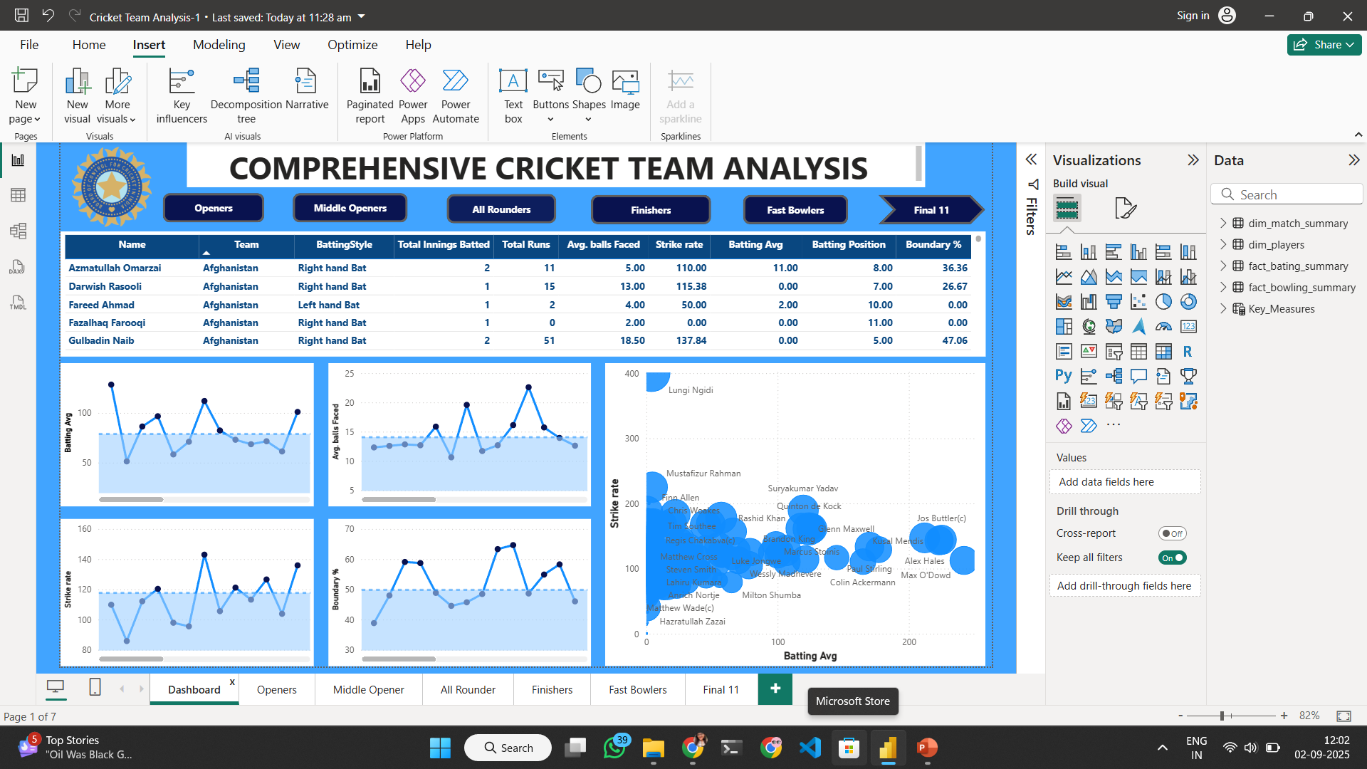

Slide 9
