Slide 1
Worditionary

Slide 2
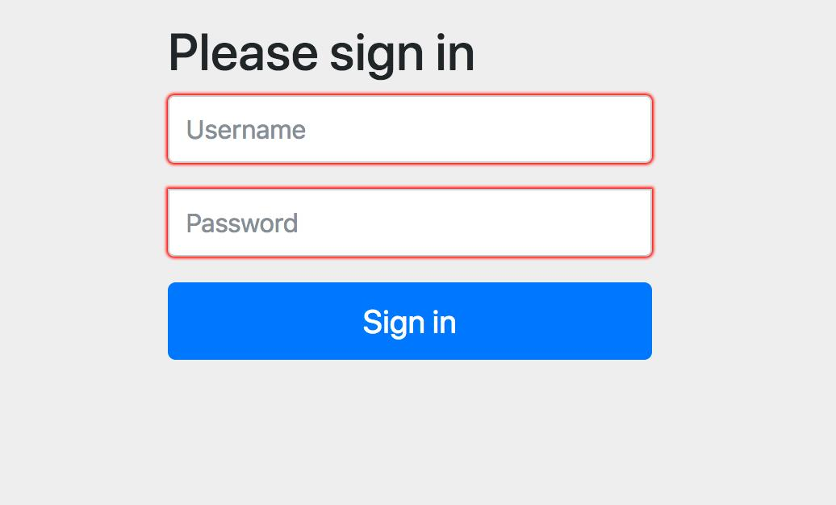
Spring Security

Slide 3
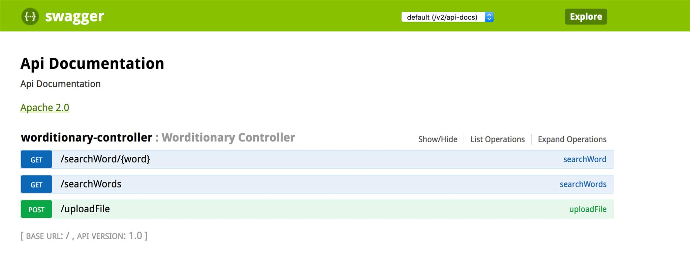
Swagger documentation
http://localhost:9001/swagger-ui.html

Slide 4
End points
post /uploadFile - uploads the file in .txt format and retrieves the words from this file and puts it in dictionary.json
get /searchWord/{word} – searches for the word mentioned in the path variable in the dictionary.json
get /searchWords – searches for words mentioned in the query param from the dictionary.json

Slide 5
Running the application
Import project as Maven project
Under “Run configurations”, go to maven and add goal as “spring-boot:run” and run the configuration
To change the port number, change the server.port property in application.properties file. Note – the default port number is 9001

Slide 6
Thank you

