Slide 1

IETF Hackathon: Measurements that Lead/Follow Stds: Three Projects
IETF 103
3-4 November, 2018
Bangkok

Slide 2
QUIC Delay Sample
Subject: Measuring accurate RTT over QUIC protocol (with visibility from an intermediate observer).
Reference: draft-trammell-quic-spin-03
Goal: to reduce from 3 to 2 bits the header space used for delay measurements (VEC proposal)
Job: implementing the Delay Sample (DS): Spin Bit+DS bit
Experimentation: Comparison between Delay Sample and Valid Edge Counter (VEC):
Pros 1 bit saving
Better measurements in case of out of order
Cons less measurements in case of «traffic holes» and losses (1 empty period more)
Observer implementation (needs a timer to clean edges)
Web site: http://5.135.192.128/

Slide 3



Benchmarking & IP Access Measurement Cross-over
Access Capacity
(xxxx Mbps)
Access moving to Gbps & Low Latency
Benchmark Methods: UDP & new Robust Search alg.
Today’s Access Test Methods: N x TCP conn.
Test using Calibrated DUT
Results: UDP found Cap Limits! Best perf using MTU
Need to get iPerf working, etc.
or
vSwitch
Netem Traffic Control on Egress, multiple shaper traffic filters
Physical
port
Physical
port
Multiple SW-based Traffic Generators and Measurement systems
Test Device
(Send&Rcv)

Slide 4
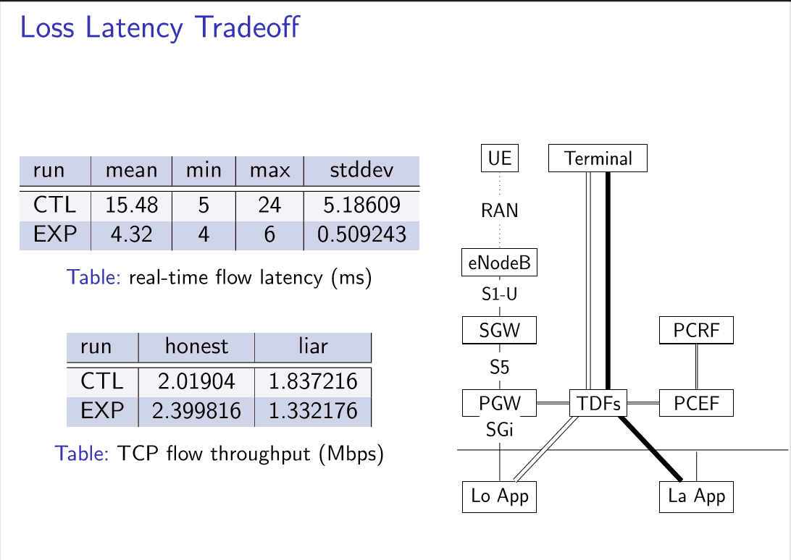

Slide 5
Wrap Up
Team members:
Mauro Cociglio*, Fabio Bulgarella*
Thomas Fossati
Al Morton
* First timers @ IETF/Hackathon
Web site: http://5.135.192.128/
https://github.com/thomas-fossati/llt
See OPNFV Wiki
https://wiki.opnfv.org/display/vsperf

