Slide 1
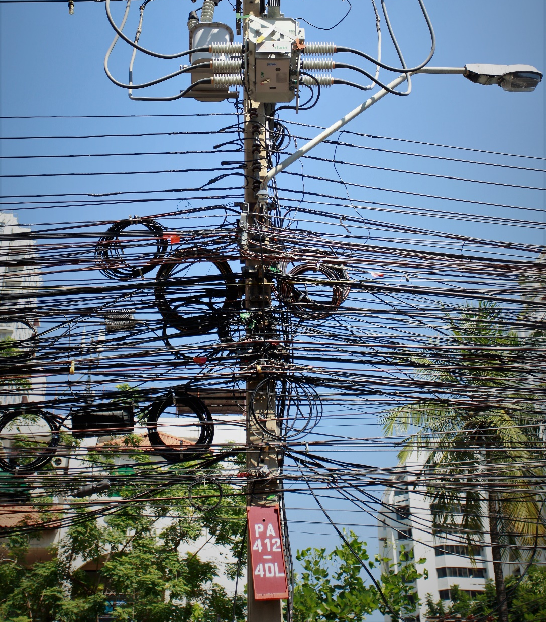
IETF Hackathon:
Software Updates for IoT (SUIT)
IETF 102
3-4 Nov, 2018
Bangkok

Slide 2
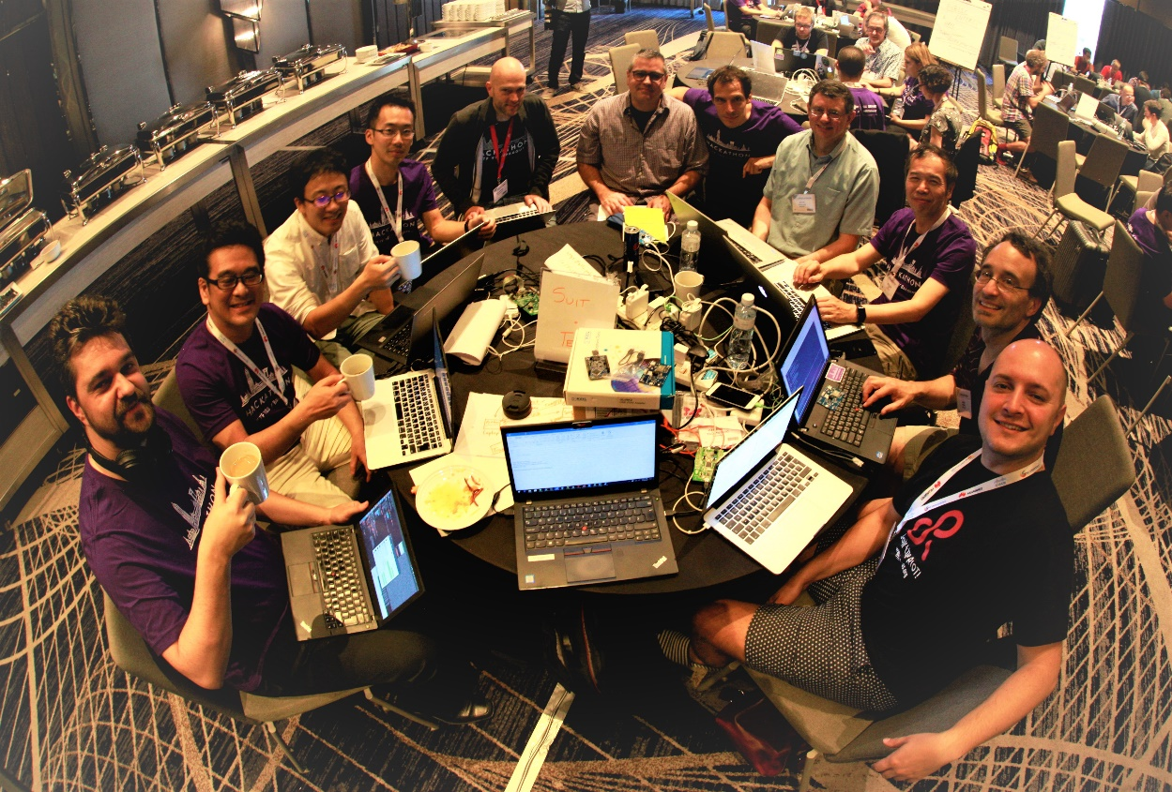
The Group
Team:
Hannes Tschofenig
Jaime Jiménez
Tadahiko Ito
Yohei Kaieda
Yuichi Takita
Dan Petrie
Emmanuel Baccelli
Henk Birkholz
Chris Inacio
Laurence Lundblade
1st time IETF
1st time SUIT Hackathon

Slide 3
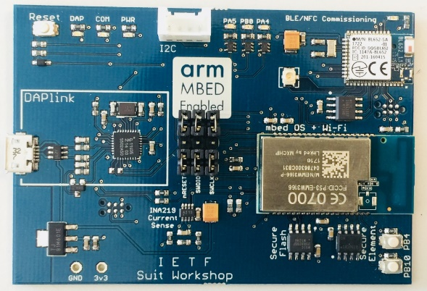
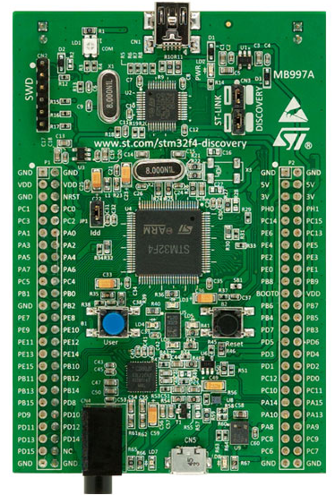
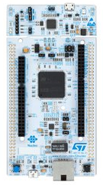
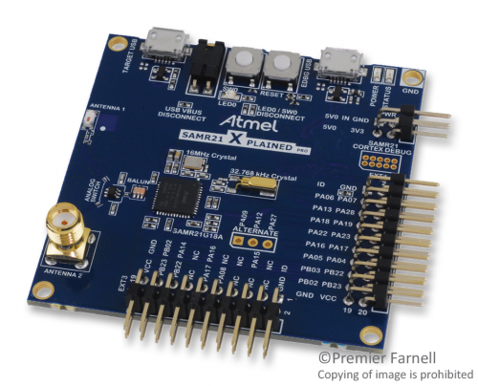
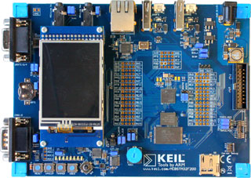
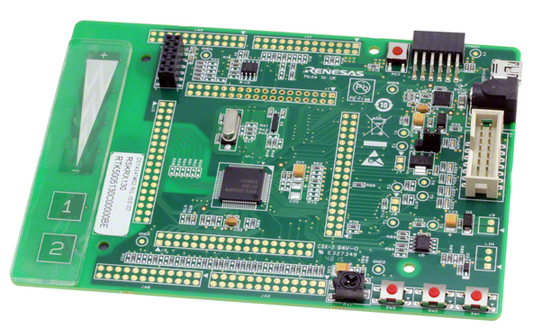
Lots of Hardware
STM32F4-DISCOVERY
NUCLEO-F207ZG
SAMR21 xpro
Renesas Starter Kit for RX231
MCBSTM32F400
Custom SUIT Hackathon Board

Slide 4
Laptop
1
Create
Firmware & Manifest
Renesas
USB
2
Transport
Firmware & Manifest
JLINK
STM
0
CoAP
Dockerized development environments
(Mbed OS & RIOT)
SAMR21 xpro

Slide 5
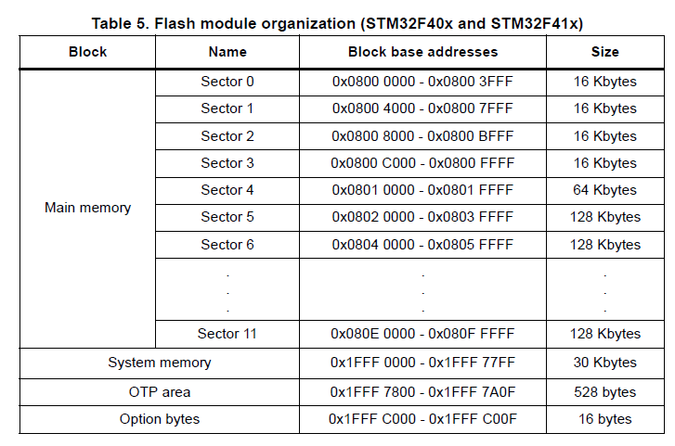
Verifying and booting
3
Bootloader
Application
Firmware
Staging Area

Slide 6
What we learned
First day of a Hackathon is always pain
Power adapter killed → Shop visit
Missing Serial-to-USB cable → Shop visit
Help is nearby
CDDL is hell → Ask Carsten
COSE is hell too → Ask Jim
SUIT manifest draft needs an update (CDDL and examples)
1
No development boards have been killed this time!

Slide 7
What got done
Development environments installed (for new folks)
MCUs configured
Manifest generator updated to latest draft
Manifest and firmware verified on device
Wrote basic bootloader and simple embedded application

Slide 8
More Info
IETF SUIT Working Group: https://datatracker.ietf.org/wg/suit/about/
Manifest draft used: https://tools.ietf.org/html/draft-moran-suit-manifest-03
Poster:
http://jaimejim.github.io/docs/suit_poster.pdf
Detailed write-up available at https://git.io/fxh6D

