Slide 1

IETF Hackathon: Work on Semantic/Hypermedia Interoperability (WISHI)
IETF 103
3-4 November, 2018
Bangkok

Slide 2

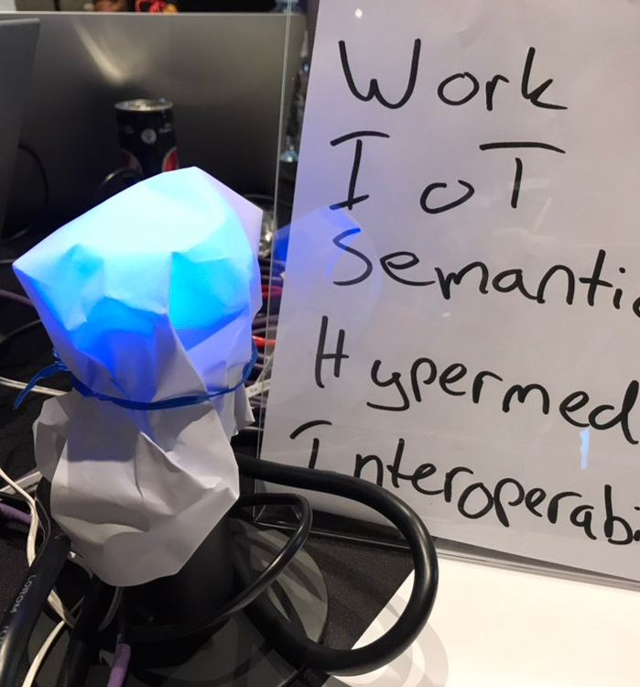
Hackathon Plan
Semantic and Hypermedia interoperability for IoT
Lots of web and IoT RFCs/drafts and W3C Web of Things specs involved
Connecting things from different ecosystems automagically
Solved using web technologies and shared semantics

Slide 3
What got done
Key achievements
Turned a lamp on (and off) – hands off
Semantic interop for data and actions between LwM2M clients, Philips Hue lights, CoMI Toaster (kind of)
New Tiny Thing Directory implementation
Improved RD implementation
Good discussions
Adding semantics to binary data
Hypermedia safety for IoT
Semantics and engineering principles; semantic uncertainty and usable semantics

Slide 4
What we learned
Semantics is hard(er than you think)
Setting up and testing stuff even more beforehand helps a lot – but we're getting better
Bunch of new potential research topics for T2TRG

Slide 5
Wrap Up
Team members (alphabetically):
Ari Keränen
Carsten Bormann
Christer Holmberg
Ivaylo Petrov
Klaus Hartke (remotely)
Matthias Kovatsch
Michael Koster (remotely)
Niklas Widell
https://github.com/t2trg/wishi/wiki/IETF-103-Hackathon

