Slide 1

IETF Hackathon: LPWAN Open-SCHC
IETF 103
3-4 November, 2018
Bangkok

Slide 2
Hackathon Plan
Implementation of Header Compression and Fragmentation for LPWANs (Low Power Wide Area Networks)
draft-ietf-lpwan-ipv6-static-context-hc -17
New clean micropython open source project
Implement ACK-on-Error fragmentation mode (new in -17)
Define code architecture, interfaces, modules
Setup GitHub project, tools

Slide 3
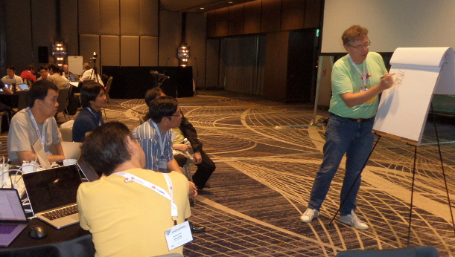
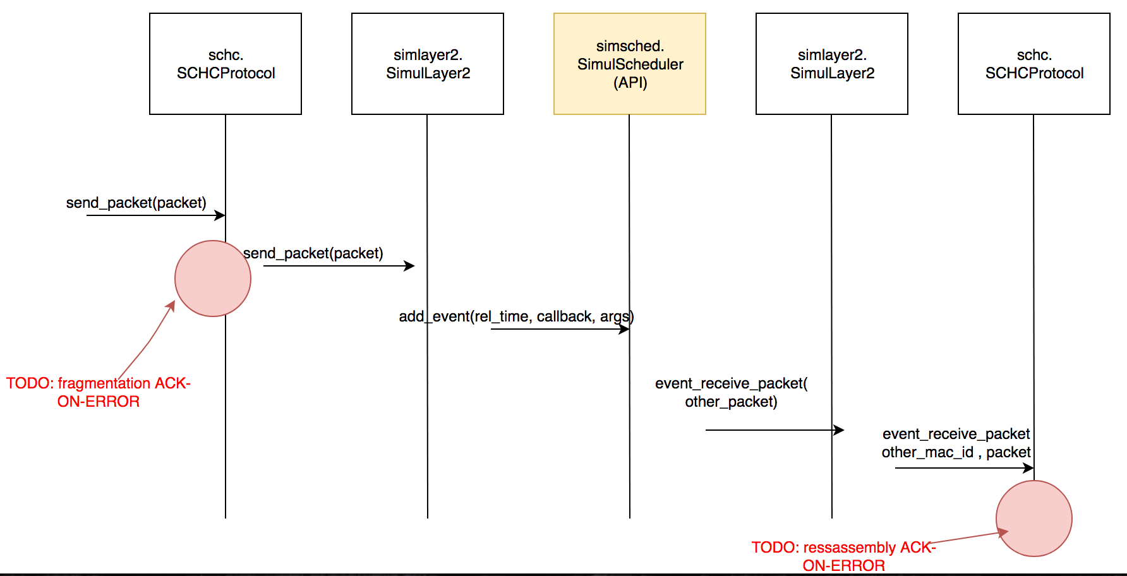
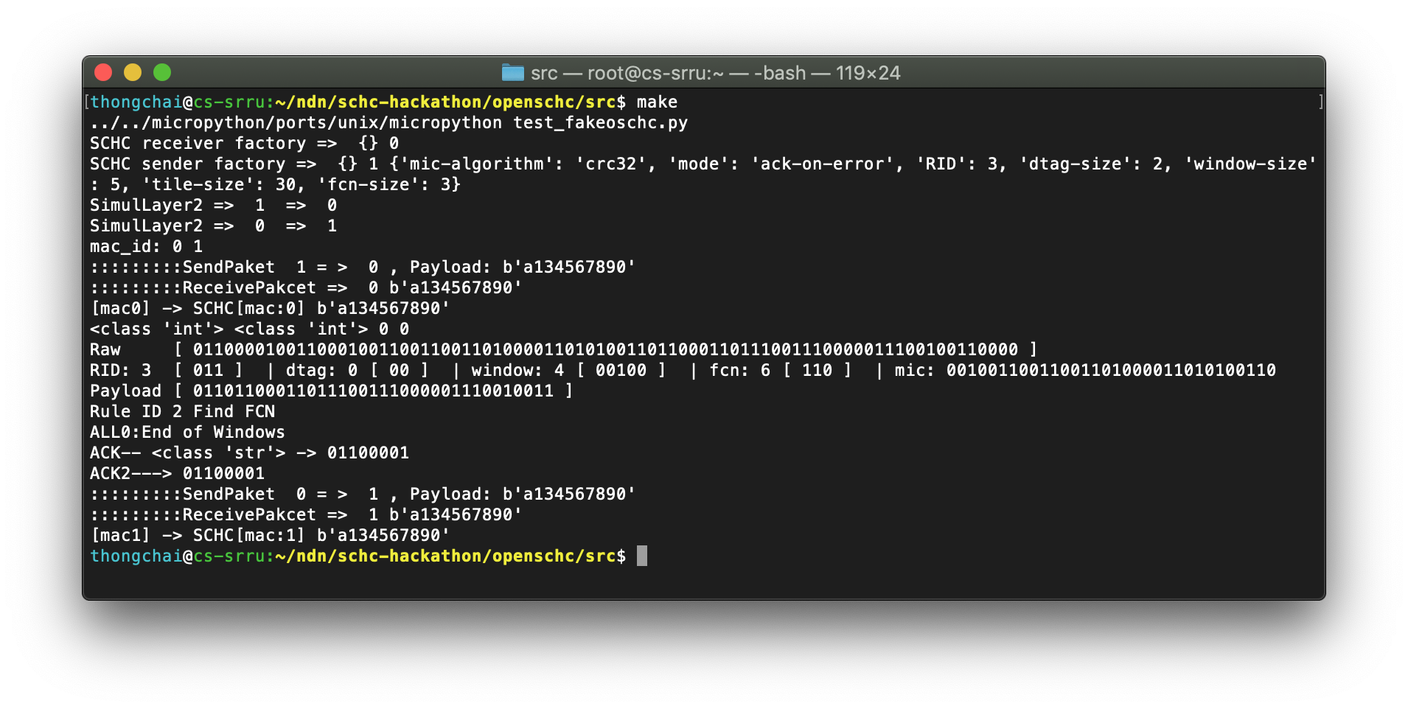
What got done
Educating newcomers to SCHC
Educating on new ACK-on-Error frag.
New code
Repo https://github.com/openschc
Architecture (first version)
JSON Profile definition, parser code
ACK-on-Error mode of F/R
Fragmentation code
Part of Reassembly code
Initial ACK-on-Error F/R testing

Slide 4
What we learned
Thorough reading of draft-ietf-lpwan-ipv6-static-context-hc-17 resulted in
Better common understanding of protocol
Several editorial comments
Spotted one missing MUST statement
Discussed various possible fragmentation implementation strategies, picked one
Increased confidence in ACK-on-Error fragmentation mode
to be presented at LoRa Alliance after IETF meeting
Outlined new pieces of work for WG new charter (discussed at this IETF meeting).

Slide 5
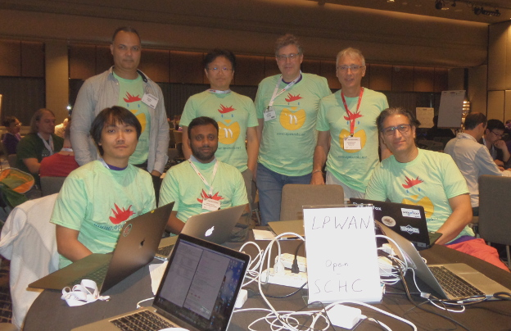
Wrap Up
10 team members:
Cédric Adjih
Sandoche Balakrichenan
Dominique Barthel
Thongchai Chuachan*
Arunprabhu Kandasamy⁺
Soichi Sakane
Laurent Toutain
Apinun Tunpan*
Nunthaphat Weshsuwannarugs*
Juan Carlos Zuniga
* First timer @ IETF/Hackathon
+ Remote
<Other links, contacts or notes>
https://github.com/openschc

