Slide 1
Building Floodgates: Cutting-Edge Denial of Service Mitigation
Yuri Gushin & Alex Behar

Slide 2
Agenda
Introduction
DoS Attacks – overview & evolution
DoS Protection Technology
Operational mode
Detection
Mitigation
Performance
Wikileaks (LOIC) attack tool analysis
Roboo release & live demonstration
Summary

Slide 3


Introduction - who we are
labs

Slide 4
Introduction - what we do
Newton’s Third Law (of Denial of Service) For every action, there is an equal and opposite reaction.
Research and mitigate DoS attacks
Core founders of the Radware ERT
In charge of Radware’s strategic security customers around EMEA and the Americas

Slide 5
DoS Attacks - Overview & Evolution

Slide 6

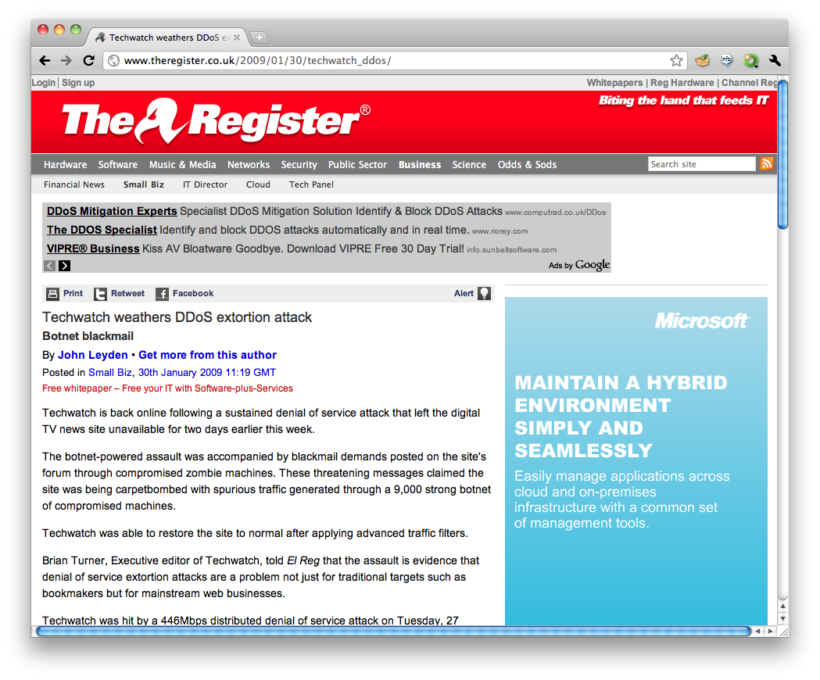
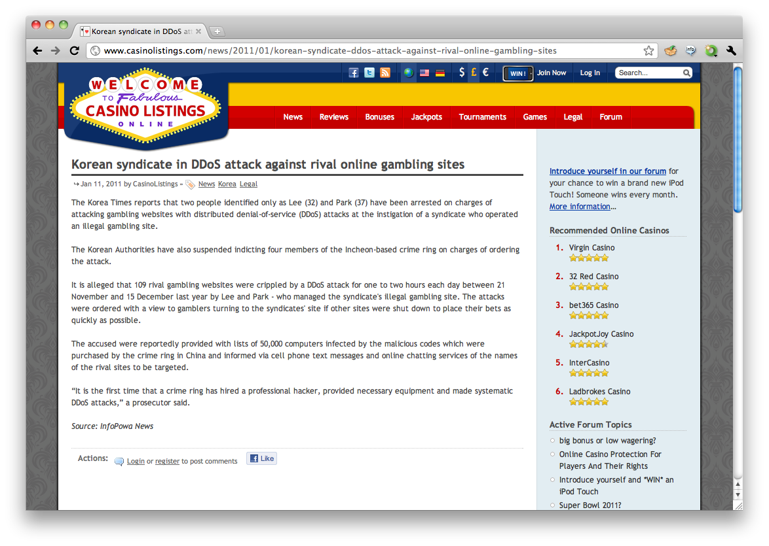
DoS Attacks - Overview
Goal – exhaust target resources to a point where service is interrupted
Common motives
Hacktivism
Extortion
Rivalry
Most big attacks succeed!

Slide 7



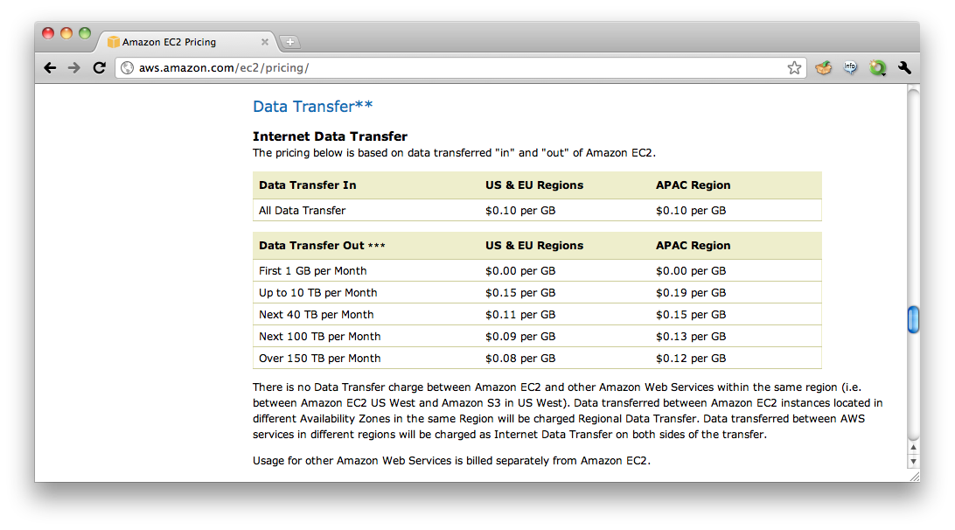
DoS Attacks - Overview
Scoping the threat – main targets at risk
On-line businesses, converting uptime to revenue
Cloud subscribers, paying per-use for bandwidth utilization

Slide 8
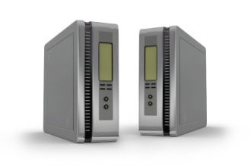


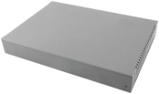
DoS Attacks - Evolution
Layer 3 - muscle-based attacks
Flood of TCP/UDP/ICMP/IGMP packets, overloading infrastructure due to high rate processing/discarding of packets and filling up the packet queues, or saturating pipes
Introduce a packet workload most gear isn't designed for
Example - UDP flood to non-listening port
I’m hit!
CPU overloaded
I’m hit!
CPU overloaded
I’m hit!
CPU overloaded
UDP to port 80
Internet
Access Router
Firewall
IPS
Switch
DMZ

Slide 9
DoS Attacks - Evolution
Layer 4 – slightly more sophisticated
DoS attacks consuming extra memory, CPU cycles, and triggering responses
TCP SYN flood
TCP new connections flood
TCP concurrent connections exhaustion
TCP/UDP garbage data flood to listening services (ala LOIC)
Example – SYN flood
I’m hit!
SYN queue is full, dropping new connections
SYN
Internet
Access Router
Firewall
IPS
Switch
DMZ
SYN+ACK

Slide 10
DoS Attacks - Evolution
Layer 7 – the culmination of evil!
DoS attacks abusing application-server memory and performance limitations – masquerading as legitimate transactions
HTTP page flood
HTTP bandwidth consumption
DNS query flood
SIP INVITE flood
Low rate, high impact attacks - e.g. Slowloris, HTTP POST DoS
I’m hit!
HTTP requests/second at the maximum
HTTP: GET /
Internet
Access Router
Firewall
IPS
Switch
DMZ
HTTP: 503 Service Unavailable
HTTP: 200 OK

Slide 11
DoS Protection Technology

Slide 12
DoS Protection Technology
Operational modes
Detection
Mitigation

Slide 13
DoS Protection Technology
Operational mode

Slide 14
DoS Protection Technology
Operational mode
The operational mode is defined during the configuration of an Anti-DoS system.
There are two typical operational modes:
Static – static rate-based thresholds are set for detection (e.g. SYNs/second, HTTP requests/second)
Adaptive – the system learns and adapts dynamic thresholds continuously, according to the network characteristics

Slide 15
DoS Protection Technology
Static thresholds
Put the user in control
Requires constant tuning and maintenance – decreasing accuracy and increasing operational expenses
Restricts detection phase to a single-dimension (rate)
Adaptive thresholds
Adapts to the real traffic characteristics, improving accuracy
Automatic – no need to tune every time before Christmas!
Anything can be learned – allowing the detection phase for behavioral multi-dimensional decision-making (rate & ratio)

Slide 16
DoS Protection Technology
Detection

Slide 17
DoS Protection Technology
Detection
Reliant on the data from the previous phase – the detection phase can be one of the following:
Rate-based (single-dimensional) – the detection engine will detect anything breaching the threshold as an attack
Behavioral (multi-dimensional) – the detection engine will correlate the dynamic thresholds and real-time traffic of several dimensions (e.g. rate & ratio) to detect an attack

Slide 18
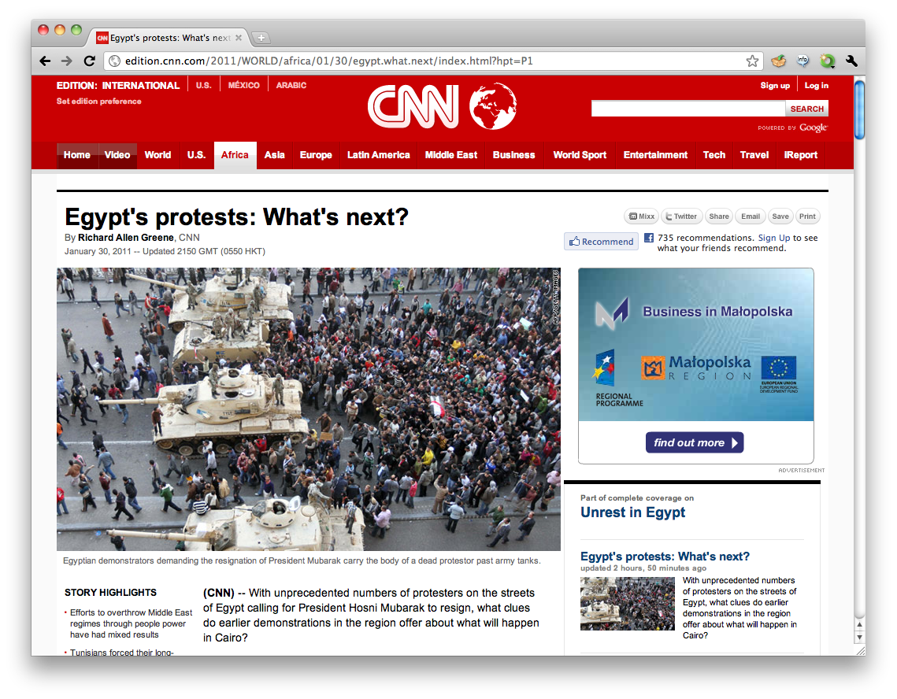
Rate-based Detection
Rate-based (single-dimensional)
Prone to false-positives (legitimate traffic identified as attack)
Prone to false-negatives (attack traffic below the radar)
Examples:
SYNs / second
HTTP requests / second
HTTP requests / second / source IP
No attacks
Attack Detected
Current rate
Threshold
Current rate
HTTP requests /second

Slide 19
Behavioral Detection
Behavioral (multi-dimensional)
Highly accurate due to correlation of multiple dimensions
Rate dimension consists of the throughput and rate of packets/requests/messages (depending on the protected layer)
E.g. PPS, BPS, HTTP requests per second, SIP messages per second, DNS queries per second
Ratio dimension consists of the ratio, per protocol, of message/packet/request/data types
E.g. L4 Protocol %, TCP flag %, HTTP content-type %, DNS query type %
Logic – both dimensions must identify “anomalies” to decide an attack is ongoing

Slide 20
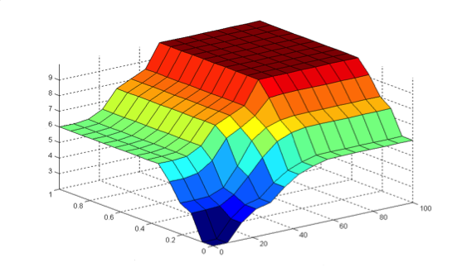
Behavioral Detection – L3 floods
Example: L3 flood
Decision = Attack!
Z-axis
Attack area
Attack Degree axis
Suspicious area
X-axis
Y-axis
Normal area
Abnormal protocol distribution [%]
Ratio dimension
Rate dimension
Abnormal rate of packets,…

Slide 21
Behavioral Detection – L4 floods
Example: L4 flood
Decision = Attack!
Z-axis
Attack area
Attack Degree axis
Suspicious area
X-axis
Y-axis
Normal area
Abnormal TCP flag distribution [%]
Ratio dimension
Rate dimension
Abnormal rate of SYN packets

Slide 22
Behavioral Detection – L7 floods
Example: L7 flood
Decision = Attack!
Z-axis
Attack area
Attack Degree axis
Suspicious area
X-axis
Y-axis
Normal area
Abnormal content-type distribution [%]
Ratio dimension
Rate dimension
Abnormal rate of HTTP requests

Slide 23
Behavioral Detection – flash crowd
Example: Flash Crowd scenario
Z-axis
Attack area
Attack Degree axis
Suspicious area
Decision = not an attack!
X-axis
Y-axis
Normal area
Ratio dimension
Rate dimension
Abnormal rate of SYN packets
Normal TCP flag distribution [%]

Slide 24
DoS Protection Technology
Mitigation

Slide 25
DoS Protection Technology
Mitigation
An attack has been detected, now we need to analyze it and start mitigating!
Mitigation flow
Analysis
Active & passive mitigation

Slide 26
DoS Mitigation - Analysis
Analysis – generate a real-time signature of the ongoing DoS attack, by using the highest repeating anomaly values from L3-L7 headers
Exactly what you do manually when under attack, sifting through Wireshark looking for patterns ☺

Slide 27
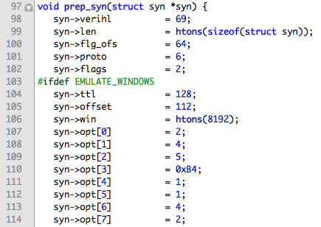
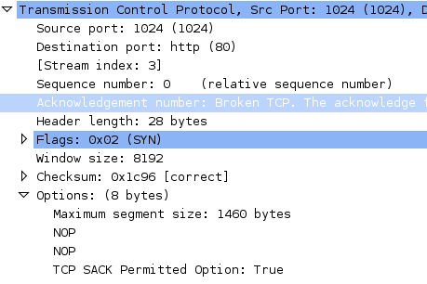

DoS Mitigation - Analysis
Juno2.c – Popular SYN Flooder
Very good performance (up to 700K PPS per box)
Creates a fairly static header
Each attack has its own “fixed” characteristics [src.port + dst.port + win.size + ip.ttl + tcp.ack != 0]

Slide 28
DoS Mitigation Techniques
Passive mitigation techniques
Rate-limit packets according to the threshold (skipping analysis)
Drop matches to the real-time signature created during analysis
Active mitigation techniques
Challenge/Response – issue challenges for various protocols to clean out clients/flooders without a real protocol stack
Session Disruption (effective with stateful attacks) – drop malicious packets while resetting the session with the server, occupying the flooders’ TCP/IP stack sockets and forcing retransmits
Tarpit (effective with stateful attacks) – actively stall malicious TCP sessions (e.g. TCP window size = 0)

Slide 29
DoS Mitigation - Passive
Passive mitigation techniques
Rate-limit packets according to the threshold (skipping analysis)
Attack Detected
Dropped
Current rate
Threshold
HTTP requests /second

Slide 30

DoS Mitigation - Passive
Passive mitigation techniques
Drop matches to the real-time signature created during analysis
Example – Juno2.c
Drop matches to:
[src.port = 1238 && dst.port = 80 && win.size = 8192 && tcp.ack != 0]
SYN
Internet
Access Router
Anti-DoS
Firewall
IPS
Switch
DMZ

Slide 31
DoS Mitigation - Active
Active mitigation techniques
Challenge/Response – issue challenges for various protocols to clean out clients/flooders without a real protocol stack
Example – HTTP Javascript stack verification
HTML + Javascript instructing the browser to set a cookie and reload
HTTP: GET /
Internet
HTTP: 200 OK
Access Router
Anti-DoS
Firewall
IPS
Switch
DMZ

Slide 32
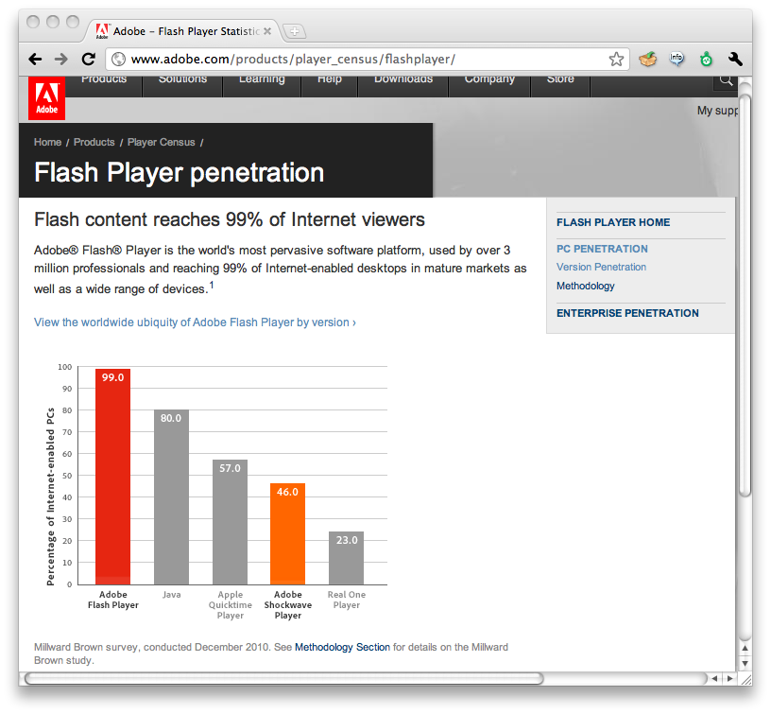
DoS Mitigation - Active
Active mitigation techniques
Challenge/Response – issue challenges for various protocols to clean out clients/flooders without a real protocol stack
Example – HTTP Flash Player verification
SWF including Javascript code to set a cookie and reload
HTTP: GET /
Internet
HTTP: 200 OK
Access Router
Anti-DoS
Firewall
IPS
Switch
DMZ

Slide 33

DoS Mitigation - Active
Active mitigation techniques
Session Disruption - drop carefully selected packets in connections, while resetting the session with the server, occupying the flooders’ sockets and forcing retransmits
GET request packet is silently dropped
Backend connection is reset, or avoided completely
HTTP: GET /
RETRANSMIT
TCP RESET
Internet
RETRANSMIT
Access Router
Anti-DoS
Firewall
IPS
Switch
DMZ
RETRANSMIT

Slide 34
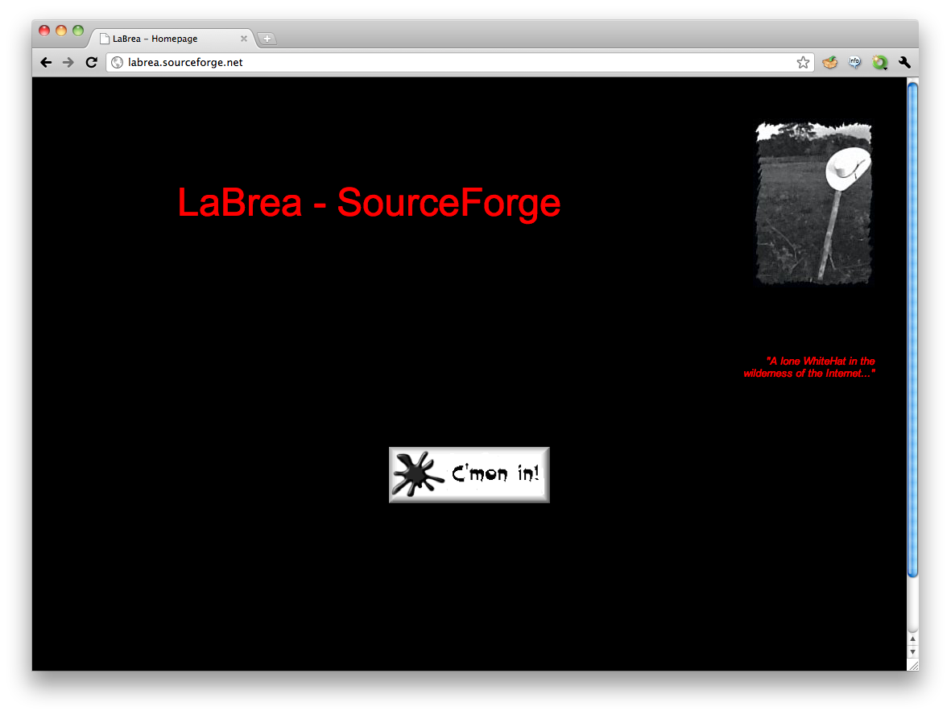
DoS Mitigation - Active
Active mitigation techniques
Tarpit (effective with stateful attacks) – actively stall malicious TCP sessions (e.g. TCP window size = 0)
Window size = 5
SYN
Attacker’s TCP stack enters “persist” state, periodically sending window probes
SYN+ACK
ACK / Data
ACK window size=0
Internet
Window probe
Access Router
Anti-DoS
Firewall
IPS
Switch
ACK window size=0
DMZ

Slide 35
DoS Protection Technology
Mitigation Performance

Slide 36
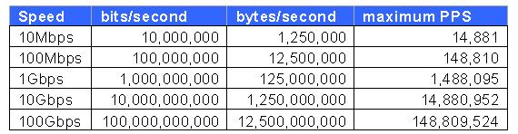
DoS Mitigation Performance
Link capacity breakdown (for 84-byte untagged frames)
Most off-the-shelf x86 hardware deals poorly with such workloads
Maintaining connection states for the good guys is a must while blocking the bad guys – even more performance intensive
Resilient mitigation of high-rate attacks is currently only possible with ASIC-based architectures
Table source: Juniper Networks KB14737

Slide 37
LOIC attack tool analysis

Slide 38
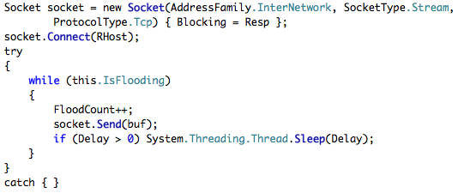
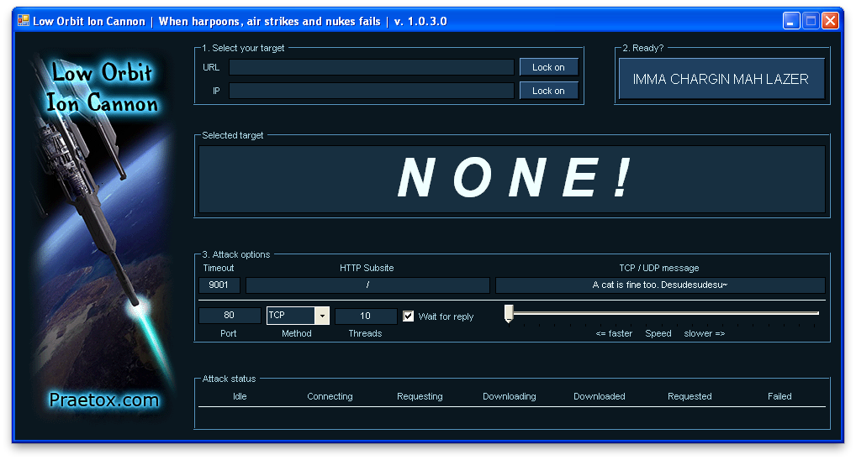
LOIC – IMMA CHARGIN MAH LAZER
Used in December 2010’s Operation Payback attacks
Flood attack vectors: UDP and TCP data, HTTP requests
Uses windows sockets to send data – stateful
Generates malformed HTTP requests
Terrible thread and IO management

Slide 39
Roboo Open Source HTTP Robot Mitigator

Slide 40
Roboo – HTTP Robot Mitigator
Uses advanced non-interactive HTTP challenge/response mechanisms to detect & mitigate HTTP Robots
Weeds out the larger percentage of HTTP robots which do not use real browsers or implement full browser stacks, resulting in the mitigation of various web threats:
HTTP Denial of Service tools - e.g. Low Orbit Ion Cannon
Vulnerability Scanning - e.g. Acunetix Web Vulnerability Scanner, Metasploit Pro, Nessus
Web exploits
Automatic comment posters/comment spam as a replacement of conventional CAPTCHA methods
Spiders, Crawlers and other robotic evil

Slide 41
Roboo – HTTP Robot Mitigator
Will respond to each GET or POST request from an unverified source with a challenge:
Challenge can be Javascript or Flash based, optionally Gzip compressed
A real browser with full HTTP, HTML, Javascript and Flash player stacks will re-issue the original request after setting a special HTTP cookie that marks the host as “verified”
Marks verified sources using an HTTP Cookie
Uses a positive security model - all allowed robotic activity must be whitelisted

Slide 42
Roboo – HTTP Robot Mitigator
Verification cookie is calculated as follows:
SHA1(client_IP, timebased_rand, secret) – 160bits
Timebased_rand changes every X seconds (cookie validity window)
Secret is a 512 bit randomly-generated value that initializes when Roboo starts
Integrates with Nginx web server and reverse proxy as an embedded Perl module
Available at https://github.com/yuri-gushin/Roboo/

Slide 43
Demo
Roboo vs. LOIC & MSF

Slide 44
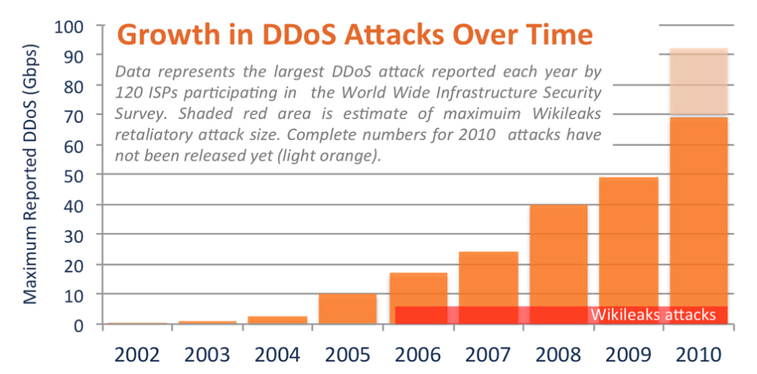
Summary
DoS business is literally booming
Attack power is growing (source: Arbor Networks, December 2010)
Cloud-subscribers become new targets
Anti-DoS technologies have greatly evolved
Goodbye rate-limits
Hello adaptive, behavioral detection, real-time signatures, active mitigation and dedicated Anti-DoS architectures

Slide 45
Q&A

Slide 46
Thanks!

