Slide 1

Agentic RAG-VLM
Affordance-Aware Retrieval-Augmented Generation
with Self-Reflective Planning for Robotic Grasping
Tao Chen¹, Lizheng Liu¹, Jiaxu Wang¹, Ziyue Jiang¹,
Ruiqi Tian², JiGuang Huo¹, Zhongxue Gan¹
¹ Fudan University ² Kean University
IROS 2026 / Lightning Talk / Paper 1772
Notes:
0–18 seconds (planned)
Hello, I’m Tao Chen from Fudan University. Grasp planning needs experience that fits the object and feedback when actions fail. We present Agentic RAG-VLM, combining affordance-aware retrieval, scene constraints, and self-reflective planning.
中文：大家好，我是复旦大学的陈涛。抓取规划需要适合当前物体的经验，也需要在动作失败后利用反馈。我们提出 Agentic RAG-VLM，结合可供性感知检索、场景约束与自反思规划。
提示：看镜头开场，不朗读全部作者和长标题。
Source: /home/admin1/ct/CARVE-VLA/paper/Agentic-RAG-VLM/main_final.tex.

Slide 2
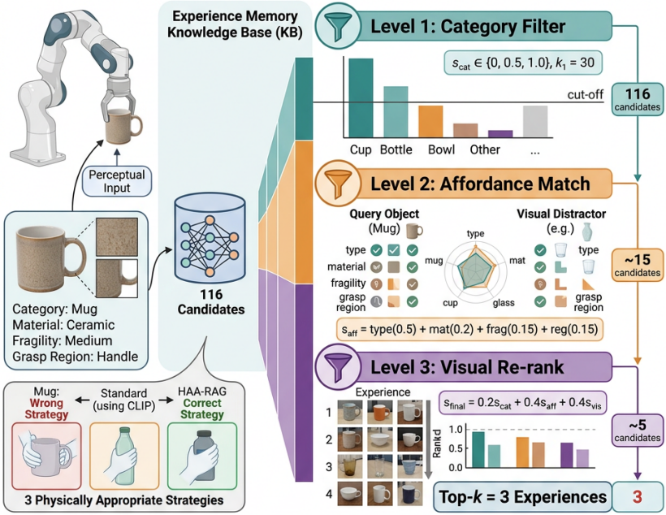
HAA-RAG: affordance-aware experience retrieval
1 Category matching
Select experience from the same
or a related object category.
2 Affordance compatibility
Compare type, material, fragility
and graspable region.
3 Visual re-ranking
Combine compatibility and visual
similarity to return the top 3.
IROS 2026 / Paper 1772
02
Notes:
18–42 seconds (planned)
Similar-looking objects may require different grasps. HAA-RAG first matches object categories, then checks compatibility using affordance type, material, fragility, and graspable region. It combines this compatibility with visual similarity to rank candidates and retrieve the top three experiences. The figure illustrates how these stages select relevant grasp strategies.
中文：外观相近的物体可能需要不同的抓法。HAA-RAG 首先匹配物体类别，再通过可供性类型、材质、脆弱性和可抓区域检查兼容性，最后结合视觉相似度重排候选，检索前三条经验。图中展示这三个阶段如何筛选相关抓取策略。
提示：对应论文原图 fig.2.png。沿右图三个彩色筛选层级从上向下讲解，左侧文字用于概括。原图包含细节数字，不逐个朗读。
Source: /home/admin1/ct/CARVE-VLA/paper/Agentic-RAG-VLM/main_final.tex.

Slide 3
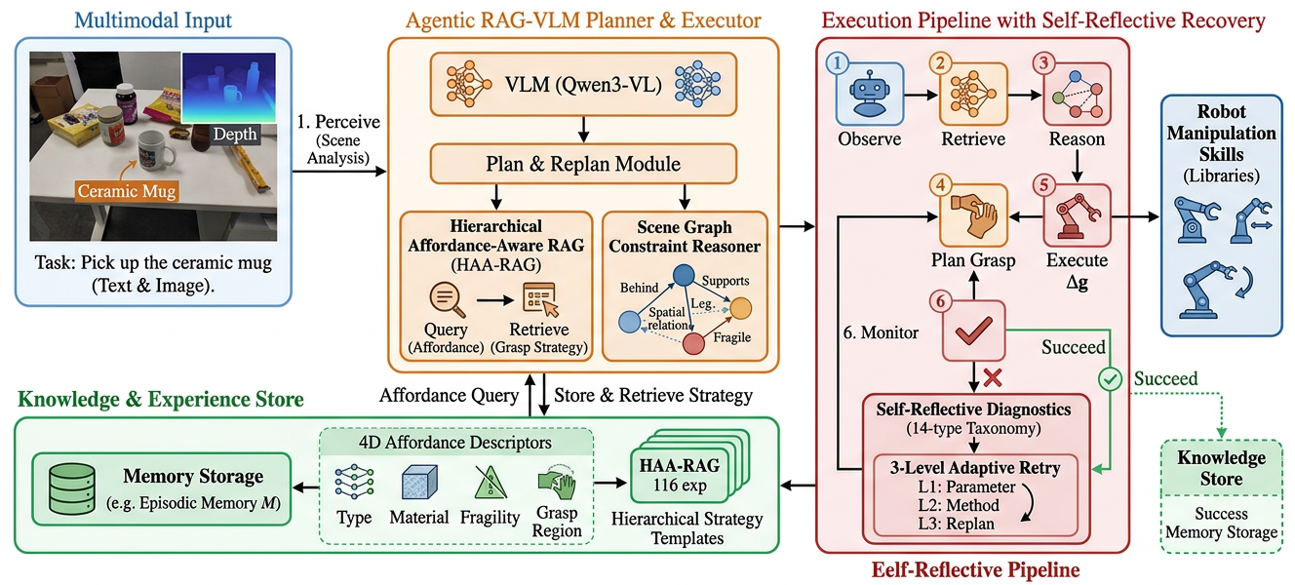
Agentic RAG-VLM framework
Self-Reflective Pipeline
HAA-RAG + memory
Scene graph reasoning
Self-reflective recovery
Retrieve and retain grasp experience.
Apply spatial constraints to the plan.
Tune parameters, switch method, replan.
IROS 2026 / Paper 1772
03
Notes:
42–75 seconds (planned)
The full framework connects perception, planning, and execution. Retrieved experience guides grasp selection. Scene-graph reasoning adds constraints for collisions, container contents, support, and occlusion. Robot skills execute the plan, while the agent monitors outcomes. When an action fails, self-reflection selects parameter tuning, a different grasp method, or replanning within a retry budget. Successful grasps enter episodic memory for reuse in later tasks.
中文：完整框架连接感知、规划与执行。检索经验指导抓法选择，场景图推理补充碰撞、容器内容物、支撑和遮挡约束。机器人技能执行计划，智能体监测结果。动作失败后，自反思模块在重试预算内选择调整参数、更换抓法或重新规划。成功抓取进入情景记忆，供后续任务复用。
提示：对应论文原图 fig.1.png。先指左侧输入，再指中央检索与场景图模块，随后指右侧执行、失败诊断与三级重试，最后指下方记忆库。不逐项朗读全部小标签。原图中的 Qwen3-VL 是论文框架标注，P5 后续演示使用 Qwen3.5-4B 保存的规划收据，二者不混称同一次实验。此页介绍方法设计，不表示 P5 覆盖所有恢复层级。
Source: /home/admin1/ct/CARVE-VLA/paper/Agentic-RAG-VLM/main_final.tex.

Slide 4
Component comparisons reported in the paper
12 tasks, 360 trials per configuration. Success rate (%)
Retrieval / overall
78.3% Full vs. 25.0% no HAA-RAG
Recovery / overall
78.3% Full vs. 46.7% no recovery
Scene graph / interactive tasks
64.2% Full vs. 25.0% no scene graph
Heuristic scores higher than Full on single-grasp and long-horizon tasks.
Analytical simulation: quality-model-based outcomes.
Paper-reported values; original trial logs unavailable for reanalysis.
IROS 2026 / Paper 1772
04
Notes:
75–107 seconds (planned)
The paper evaluates twelve tasks using an analytical grasp-quality model. Overall success is seventy-eight point three percent for the full system, twenty-five without HAA-RAG, and forty-six point seven without recovery. On interactive tasks, removing the scene graph reduces the reported rate from sixty-four point two to twenty-five percent. These are comparisons within this evaluation setting. The heuristic baseline remains stronger on single-grasp and long-horizon tasks.
中文：论文用解析抓取质量模型评估十二项任务。总体成功率分别为：完整系统 78.3%，无 HAA-RAG 25.0%，无恢复机制 46.7%。交互任务中，去掉场景图后，报告成功率从 64.2% 降至 25.0%。这些是该评估设置下的比较；启发式在单抓和长程任务上仍更高。
提示：先指左图 Full，再依次指右侧三个模块比较。Overall 与 Interactive 的分母不同，不能混称总体结果。保留质量模型及原始日志状态页脚，不声称新实验复现了旧表。
Source: /home/admin1/ct/CARVE-VLA/paper/Agentic-RAG-VLM/main_final.tex.

Slide 5
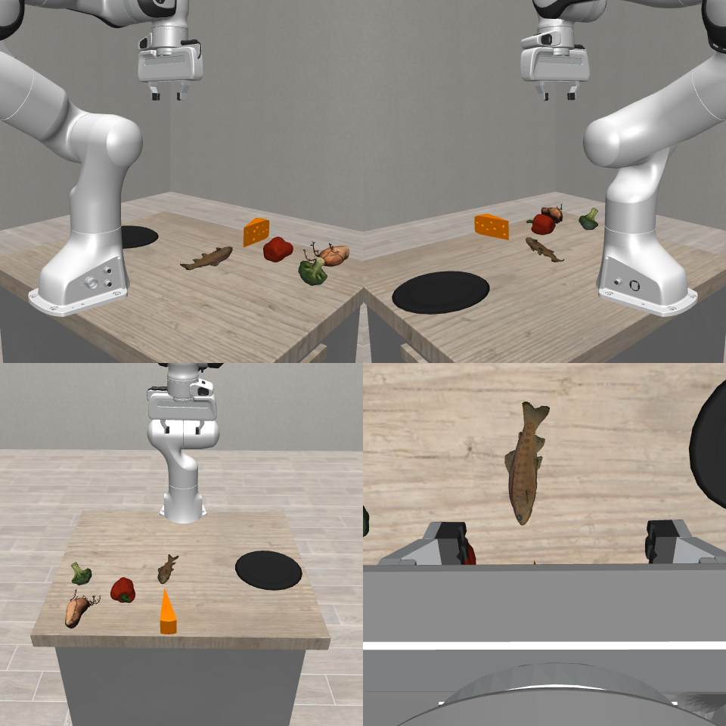
Recipe-guided ingredient preparation in VLABench
Task: prepare the ingredients for a broccoli and cheese bake on a plate.
Recipe knowledge: what to pick
VLM proposal: broccoli, cheese, fish.
Specified recipe: broccoli + cheese.
HAA-RAG: how to grasp
Retrieve ingredient-specific grasp cards.
Bind the top-approach pick-and-place skill.
Execution and final-state checks
Both ingredients released onto the plate.
Hand retracted, final positions stable.
VLABench simulation, seed 7. Stored Qwen3.5-4B plan.
Skill / IK execution with added release and settling checks.
IROS 2026 / Paper 1772
05
Notes:
107–152 seconds (planned)
This VLABench simulation separates two uses of retrieval. Recipe knowledge determines what to pick: the model proposes broccoli, cheese, and fish, while the specified recipe contains only broccoli and cheese. HAA-RAG retrieves grasp cards for the selected ingredients, which connect to a top-approach robot skill. The execution reuses the stored model plan. Both ingredients are released onto the plate, followed by hand retraction and settling checks. This case demonstrates knowledge-guided planning and execution, rather than failure recovery.
中文：这个 VLABench 案例区分检索的两种作用。菜谱知识决定拿什么：模型提出西兰花、芝士和鱼，而指定菜谱只包含西兰花与芝士。HAA-RAG 为选定食材检索抓取卡片，并对接从上方接近的机器人技能。本次执行复用保存的模型规划。两个食材释放到盘中后，机械手回撤，并检查稳定状态。案例展示知识引导的规划与执行，不展示失败恢复。
提示：切到 P5 立即点击新录像并同时讲解。先解释菜谱决定目标，再解释 HAA-RAG 提供抓取卡片，最后指出真实释放与回撤。右侧为同次执行的日志摘要，不是实时模型字幕。菜谱来自预设知识，规划复用原始 Qwen3.5-4B 收据。本例展示备料规划与执行，不展示烹饪、失败恢复或抓法的对照优势。
Source: /home/admin1/ct/CARVE-VLA/paper/Agentic-RAG-VLM/main_final.tex. Planning: /home/admin1/ct/CARVE-VLA/artifacts/vlabench/agentic_cook_dishes_20260901/seed_007/planner_receipt_v2.json. Execution: /home/admin1/ct/CARVE-VLA/artifacts/vlabench/presentation_cook_completion_20260915/seed007_v2/result.json. Embedded unmodified video: /home/admin1/ct/CARVE-VLA/artifacts/vlabench/presentation_cook_completion_20260915/seed007_v2/episode_success_True.mp4. Qwen3.5-4B planning receipt is reused by this execution run; no claim of a new model call at every action.

Slide 6
Knowledge and feedback for task-level planning
Agentic RAG-VLM guides the task plan.
Retrieved experience and scene constraints
provide context for decisions and revisions.
Robot skills handle motion execution.
Next: broader physical evaluation and real-robot transfer
Thank you
Paper 1772
IROS 2026 / Paper 1772
06
Notes:
152–172 seconds (planned)
Agentic RAG-VLM uses retrieved experience and scene constraints to guide task-level planning. Robot skills handle motion, while feedback supports plan revision. The recipe case illustrates this integration. Broader physical evaluation and real-robot transfer are our next steps. Thank you, and I welcome your questions.
中文：Agentic RAG-VLM 利用检索经验与场景约束引导任务级规划。机器人技能负责运动执行，反馈支持计划调整。菜谱案例展示了这一系统集成。下一步是更广泛的物理验证与实机迁移。感谢聆听，欢迎提问。
提示：看镜头收尾，不再重复数字或逐项解释框架。若整体超时可删去第三句，保留后续工作。
Source: /home/admin1/ct/CARVE-VLA/paper/Agentic-RAG-VLM/main_final.tex.

