Slide 1

Customer ratings AIRLINE REVIEW analysis
BY: TITO OSADEBEY
03/06/2024

Slide 2
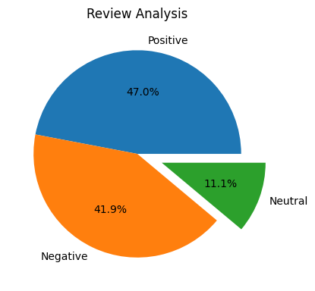
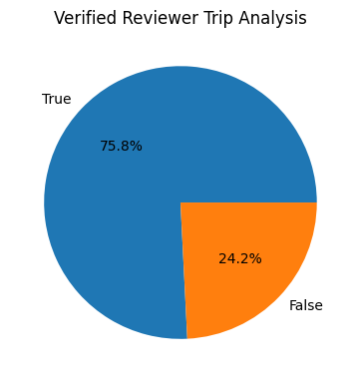
INSIGHTS FROM CUSTOMER REVIEW
Majority of reviews were polarised as either positive or negative.
The percentage of verified trips by reviewers:
1000
Total reviews
collected

