Slide 1
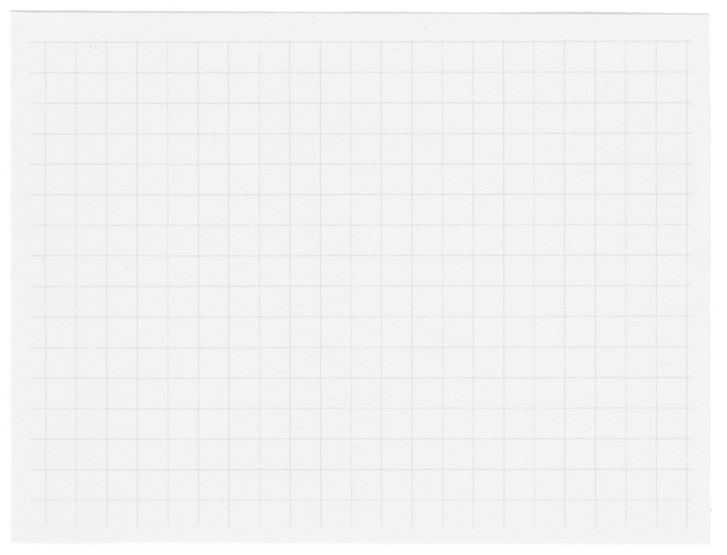













CRM
Analysis
Presented by Titto George

Slide 2

Index
EDA
Univariate Analysis
Bivariate Analysis
Multivariate Analysis
RCM Analysis
Feature Engineering
Recommendations
Conculsions
Questions
Thank you note

Slide 3
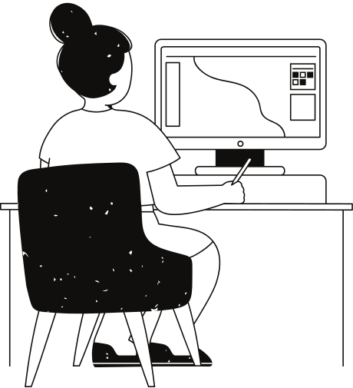
EDA
Mean vs. Median Analysis
Quantity and Unit Price distributions are right-skewed, suggesting presence of outliers.
Majority of transactions involve smaller quantities and lower-priced items.
Outlier Detection Overview
Quantity Column: 26646
UnitPrice Column: 35802
Return Analysis
Returns: 2.21% of Transactions
Sales: 97.79% of Transactions
Duplicate Values Overview
Exact Duplicates: 5225
Potential Duplicates: 0
Shape After Handling Duplicates: (Rows: 401604, Columns: 8)
Missing Values Overview
Description Column:1454
CustomerID Column:135080

Slide 4
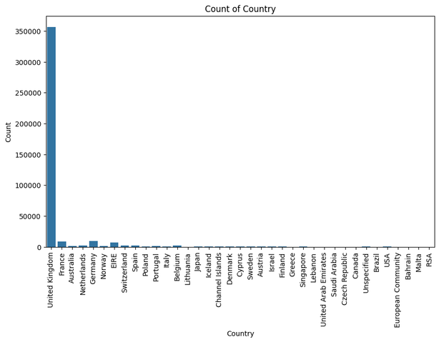
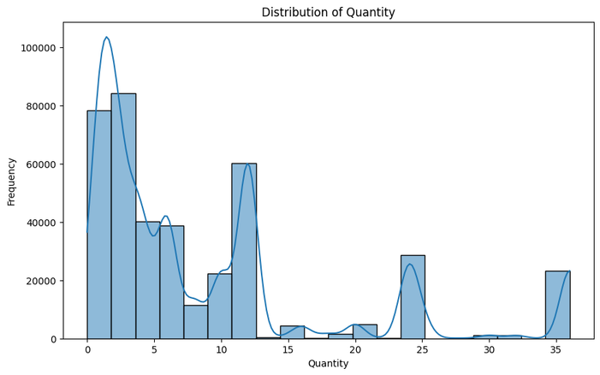
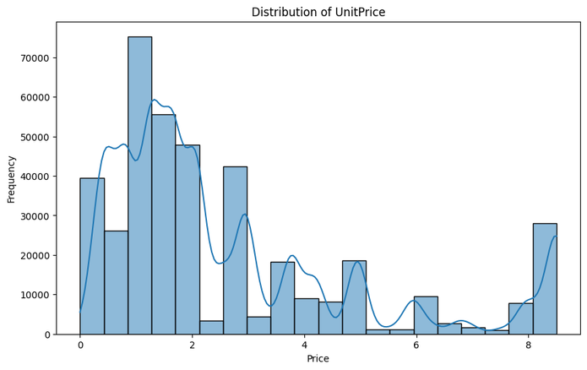
Univariate Analysis
01
02
03
Geographic Distribution of Orders
Quantity Distribution Overview
Most values in the dataset are relatively small or close to the minimum value.
Unit Price Distribution Overview
The dataset indicates that many products have low prices.
United Kingdom: Dominates with approximately 88.83% of Total Orders.

Slide 5
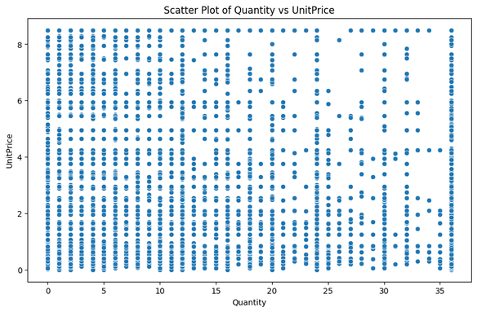
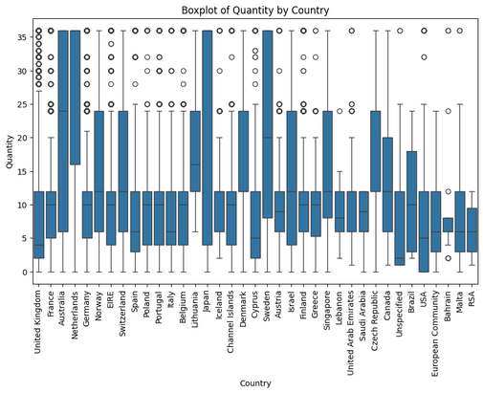
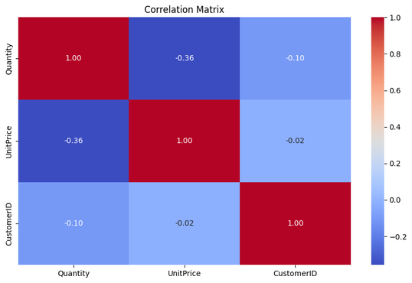
Bivariate and Multivariate Analysis
01
02
03
Quantity vs UnitPrice
customers prefer to purchase larger quantities of lower-priced items, potentially indicating price sensitivity or value-seeking behavior.
Quantity by Country
The presence of outliers in the United Kingdom suggests unique purchasing behavior or market dynamics compared to other countries.
Correlation Analysis: Quantity vs. Unit Price
Customers may exhibit price sensitivity, preferring lower unit prices for larger quantities.

Slide 6
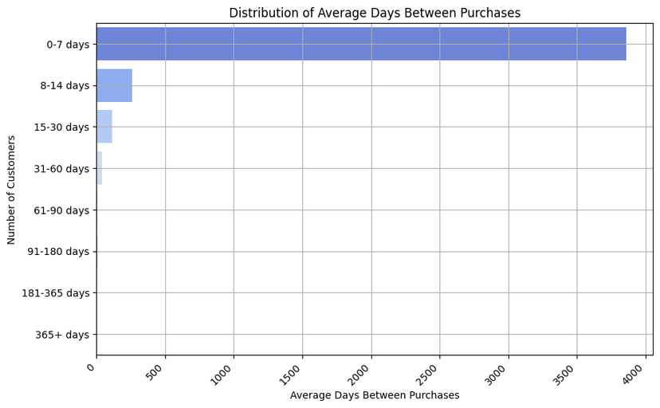
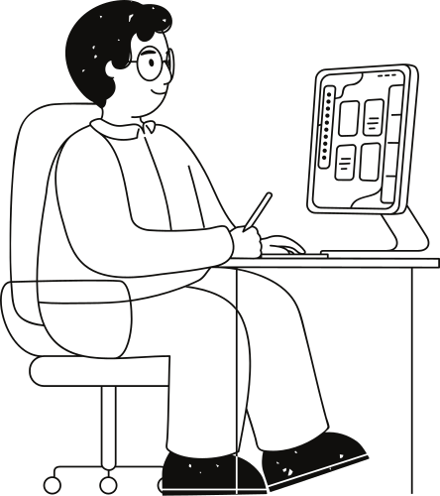
Feature Engineering
Distribution of Average Days Between Purchases
High Frequency Purchasers
(0-7 days)
Moderate Frequency Purchasers (8-14 days)
3863 customers on average.
Frequent buyers with high engagement.
Fewer customers than high frequency.
Maintain regular buying habits.
Low Frequency Purchasers
(15-30 days)
Infrequent Purchasers
(31-60 days)
Significant decrease in customer numbers.
Longer intervals between purchases.
Small number of customers.
Infrequent or sporadic purchases.
Recommendations
Focus on Retaining High-Frequency Purchasers:
Prioritize engagement with high-frequency purchasers.
Implement Tailored Strategies for Re-engagement:
Utilize tailored marketing, loyalty programs, and incentives to re-engage customers with longer purchase intervals.

Slide 7
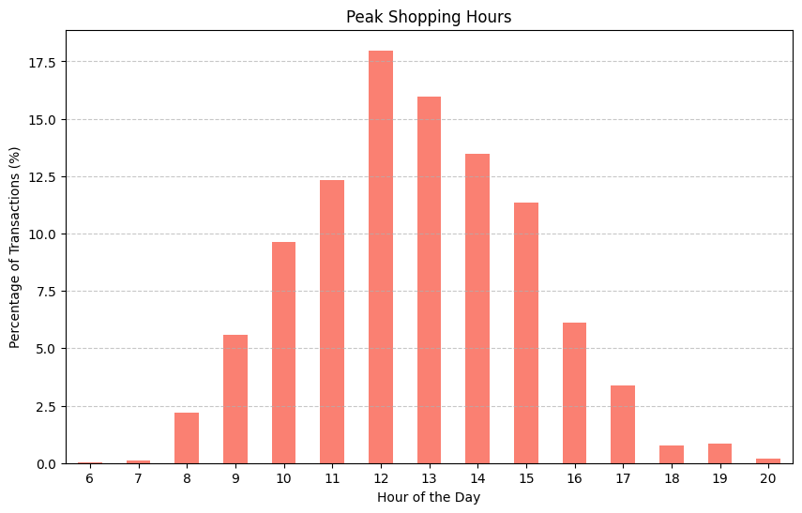
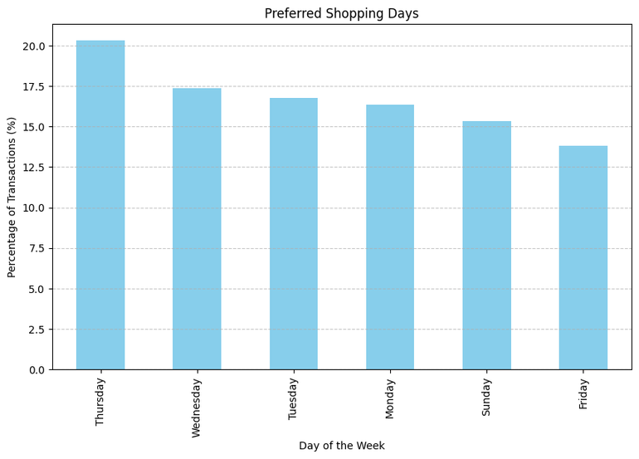
Feature Engineering
Peak Shopping Hours
Preferred Shopping Days
The peak shopping hours seem to be around midday, with 12:00 PM (noon) being the peak hour, accounting for approximately 17.98% of purchases.
Thursday appears to be the most preferred shopping day, with approximately 20.31% of purchases occurring on that day.
The hours from 11:00 AM to 3:00 PM (11:00 to 15:00) appear to be the busiest, with proportions ranging from 11.36% to 17.98%.
Sunday and Friday have slightly lower proportions of purchases, accounting for around 15.36% and 13.82% respectively.

Slide 8
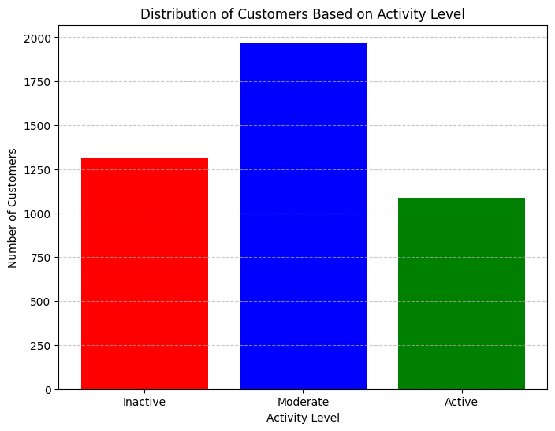
Feature Engineering
Distribution of Customers Based on Activity Level
These customers are highly engaged and make frequent purchases, contributing significantly to the business's revenue.
Active Customers
(1087)
This segment represents customers with moderate purchase frequency and engagement.
Moderate Customers
(1972)
z
These customers make the fewest purchases and have the lowest engagement with the business.
Inactive Customers
(1313)

Slide 9
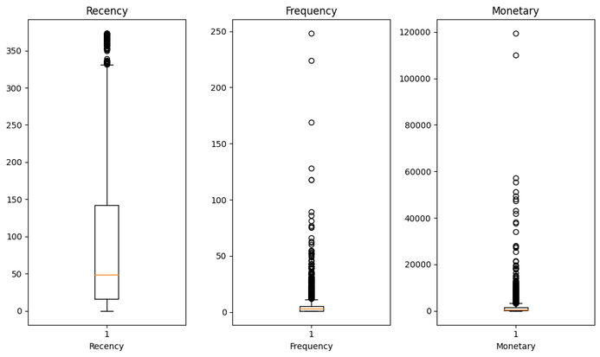
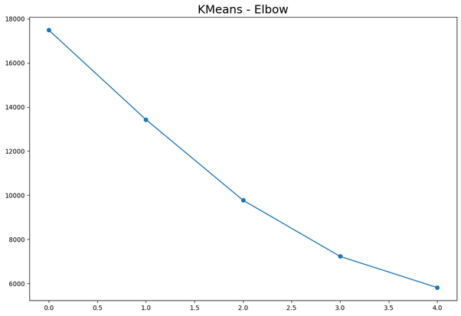
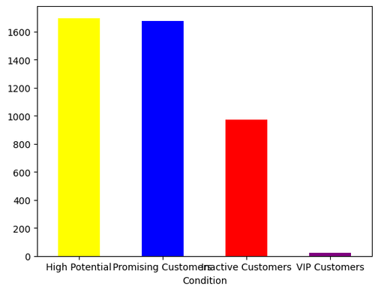
RCM Analysis
01
02
03
Recency, Frequency & Monetary
RFM analysis is a customer segmentation technique based on three key metrics: Recency, Frequency, and Monetary value.
K-Means Clustering
Performing KMeans clustering on the dataset using 4 numbers of clusters.
Customer Segementation:
Assigning a customer segment label based on the value of the 'Cluster_No' column in the row.

Slide 10
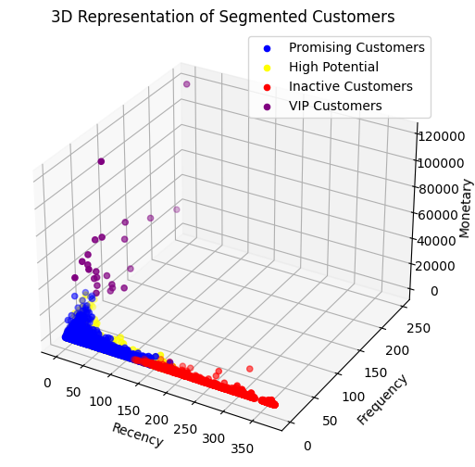
RCM Analysis
Cluster 1: Promising Customers
Cluster 2: VIP Customers
This cluster has moderate recency, indicating somewhat recent purchases.
Frequency and monetary values are also moderate, suggesting potential for higher engagement and spending in the future.
This cluster has very low recency, indicating very recent purchases.
Both frequency and monetary values are significantly higher compared to other clusters, suggesting high-value customers.
Cluster 3: Inactive Customers
Cluster 4: High Potential
This cluster has high recency, indicating less recent purchases.
Both frequency and monetary values are relatively low, suggesting inactive or low-engagement customers.
This cluster has relatively low recency, indicating recent purchases.
The frequency and monetary values are moderate, suggesting consistent but not high spending behavior.

Slide 11
Recommendations based on RCM Analysis
Promising Customers
VIP Customers
Segment these customers based on their preferences and purchase history to tailor marketing efforts.
Offer incentives such as loyalty programs, referral rewards, or exclusive deals to encourage repeat purchases.
Collect feedback to understand their needs and preferences better and adjust strategies accordingly.
Provide VIP customers with exclusive benefits, such as early access to new products, VIP-only events, or dedicated customer support.
Personalize communications and offerings based on their preferences and purchase history.
Regularly engage with VIP customers to show appreciation for their loyalty and ensure their continued satisfaction.
Inactive Customers
High Potential Customers
Re-engage inactive customers through personalized email campaigns, offering discounts or incentives to return.
Conduct surveys or reach out to understand the reasons for their inactivity and address any concerns or issues.
Implement strategies to reactivate dormant accounts, such as reminder emails for abandoned carts or exclusive offers for returning customers.
Implement targeted marketing campaigns to nurture and retain these customers. Offer personalized discounts or promotions to encourage repeat purchases and loyalty.
Provide excellent customer service to enhance their shopping experience and strengthen their relationship with the brand.

Slide 12

Final Recommendations
Targeted Marketing for High Potential Customers
Segmentation and Incentives for Promising Customers
Re-Engagement Strategies for Inactive Customers
Exclusive Benefits for VIP Customers
Targeted Marketing Based on Shopping Patterns

Slide 13
Thank you very much!

