Slide 1

Pantip Tagging Recommender
Wisaroot Lertthaweedech 6370267221
Patta Yovithaya 6370220721

Slide 2
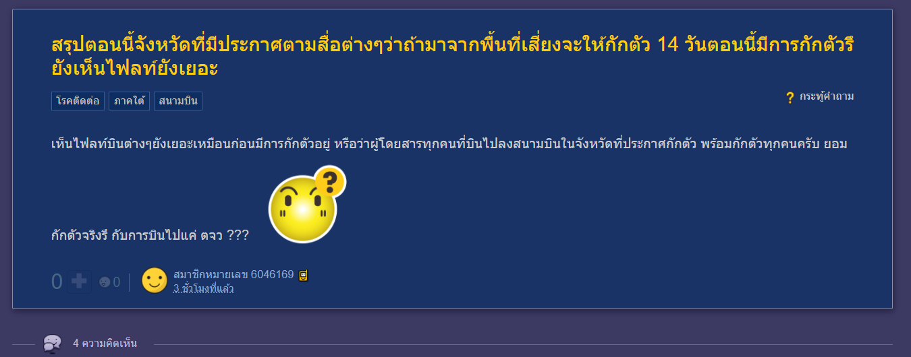
Introduction

Slide 3
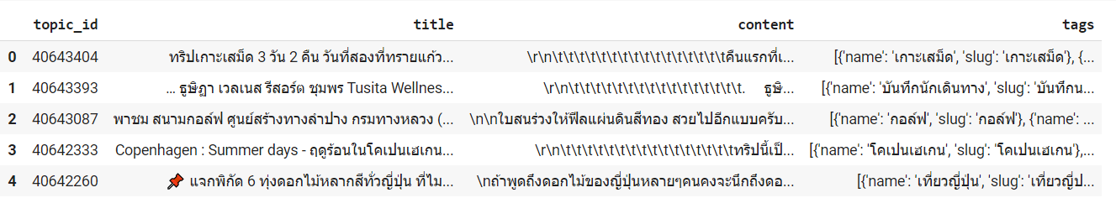
Progress
Scraped content for 10,000 topic from Blue Planet room (related to travelling)

Slide 4
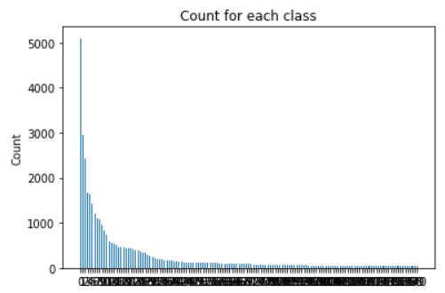
Progress
From 10,000 topic, we have 1,418 tag counts. So, we will focus only P10 of tag’s usage frequency. (141 tags ranged from 34 – 5,099 topics)

Slide 5
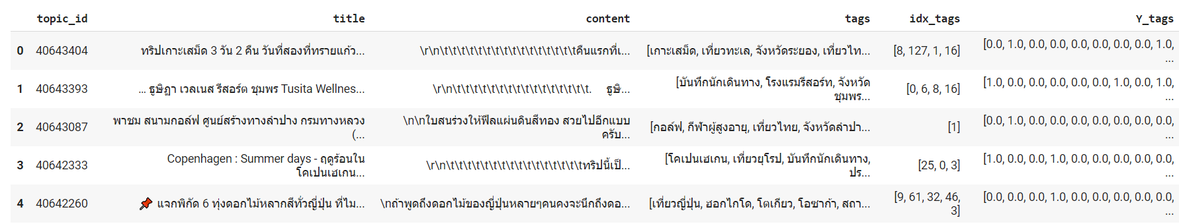
Progress
From 10,000 topic, we have 1,418 tag counts. So, we will focus only P10 of tag’s usage frequency. (141 tags ranged from 34 – 5,099 topics)

Slide 6
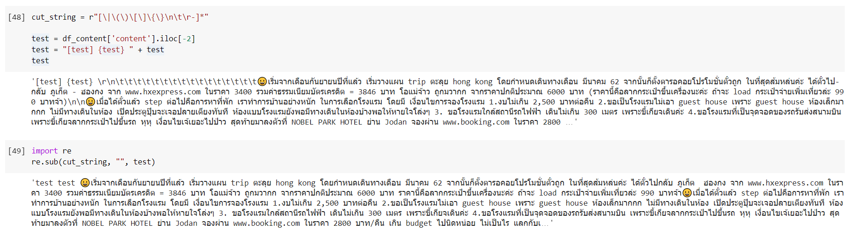
Progress
Cleaning Topic and Content

Slide 7
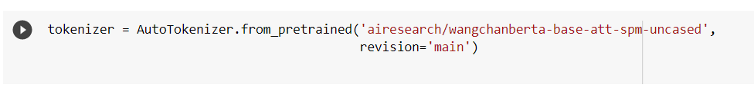
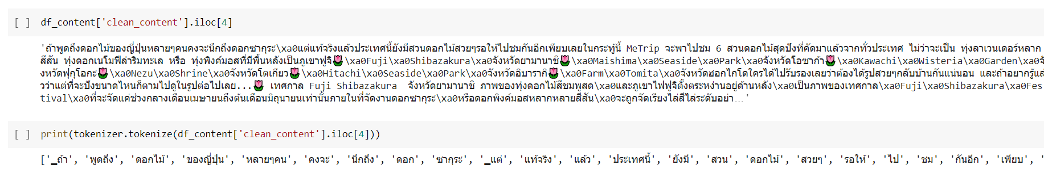
Progress
Wangchan BERT tokenizer

