Slide 1
Plot Group: (Group Code Name)

Slide 2
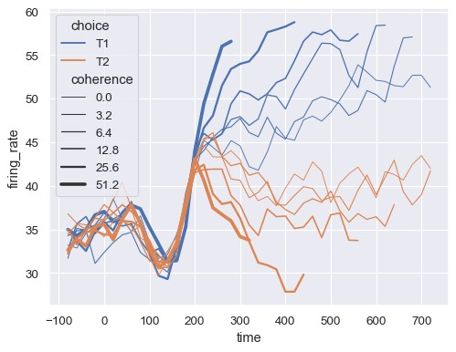
Plot Title: (Specific group code names)
Sample plot generated with Python program
List of Statistical Outliers:
Blue-line1: (codename)
Blue-line2: (codename)
Orange-line3: (codename)
…

