Slide 1
1.Cloud Technoligies.

Slide 2
Overview
Introduction to cloud computing
Introduction AWS
AWS core services

Slide 3
Introduction to cloud computing
Why cloud computing?
IT assets as programmatic resources to quickly set up and tear down resources
Access resources dynamically for agility and flexibility to meet customer needs
Pay-as-you-go to test and use the system without being fully commited

Slide 4
Introduction to cloud computing
On demand delivery!
A cloud provider has the resources you need, when you need them

Slide 5
Introduction to cloud computing
IT resources over the internet!
Servers, networks, storage, development tools, and applications.

Slide 6
Introduction to cloud computing
Pay-as-you-go pricing
Pay only for what you need when you use it.

Slide 7



Introduction to cloud computing

Slide 8
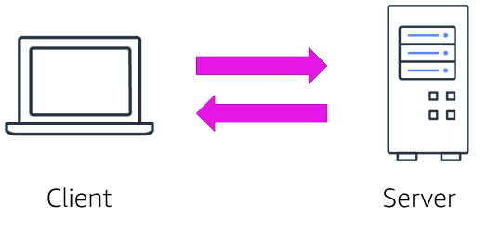
Introduction to cloud computing

Slide 9
Introduction to cloud computing
A client can be a web browser or desktop apps that a person interacts with to make requests to computer servers.

Slide 10
Introduction to cloud computing
Infrastructure as a service ( IaaS)-
Contains the basic building blocks for cloud IT. It typically provides access to network features, computers (virtuall or dedicated) and data storage. It offers the highest level of flexibility and management over IT resources

Slide 11
Introduction to cloud computing
Platform as a service ( PaaS)-
It removes the need for organizations to manage the underlying infrastructure. They can focus on the deployment and management of apps. These tools give devs the ability to be more efficient because they don’t need to worry about resources procurement, planning, maintenance and patching.

Slide 12
Introduction to cloud computing
Software as a service ( SaaS)-
It is a completed software product that the service provider runs and manages. You do not have to think about how the service is maintained or how underlying infrastructure is managed. You only must think about how you will use the software.

Slide 13
Introduction to cloud computing
Deployment models
Cloud
Hybrid
On-premises

Slide 14
Introduction to cloud computing
Cloud based
Migrate existing apps to the cloud
Create a new one

Slide 15
Introduction to cloud computing
Hybrid
Cloud resources connected to on-premises infrastructure.
Legacy applications.

Slide 16
Introduction to cloud computing
On-premises
- Deploying on premises using virtualization and resource management tools

Slide 17
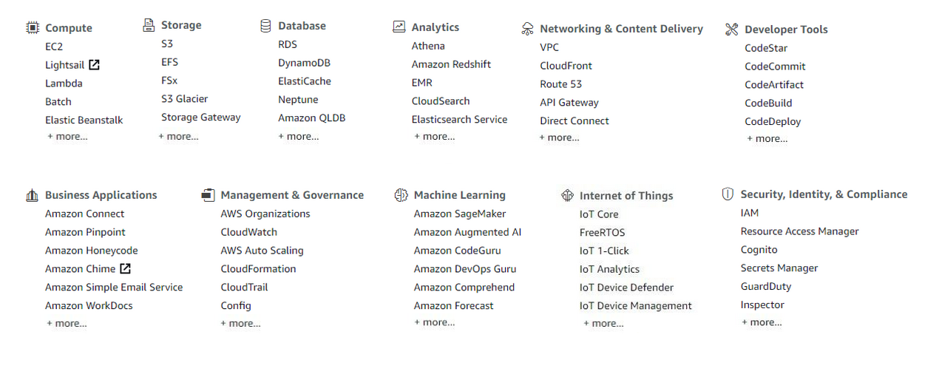
Introduction AWS

Slide 18
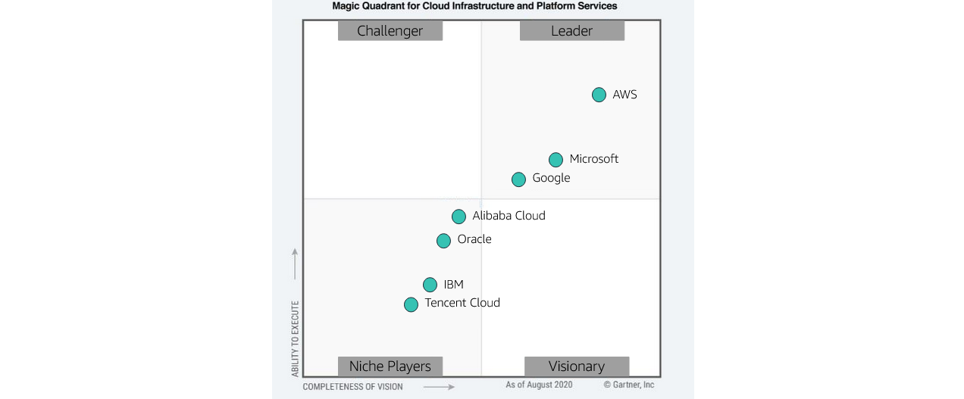
Introduction AWS

Slide 19
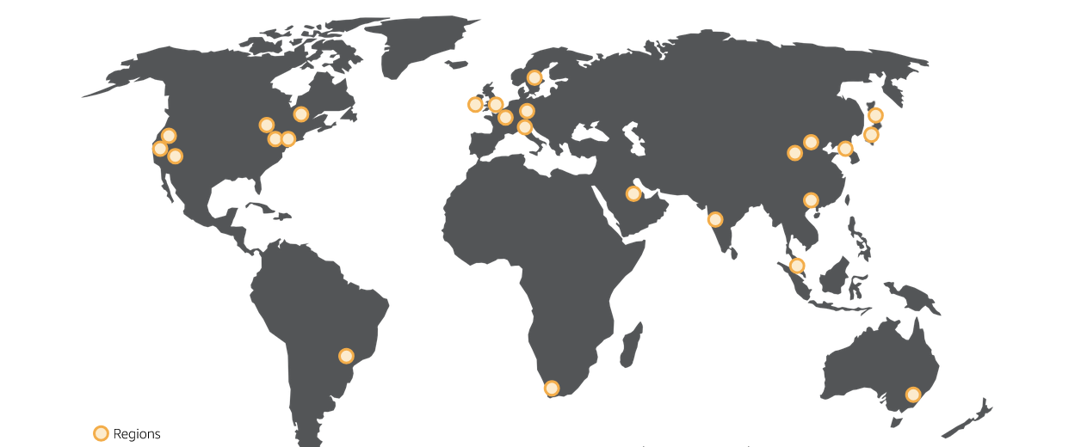
Introduction AWS

Slide 20
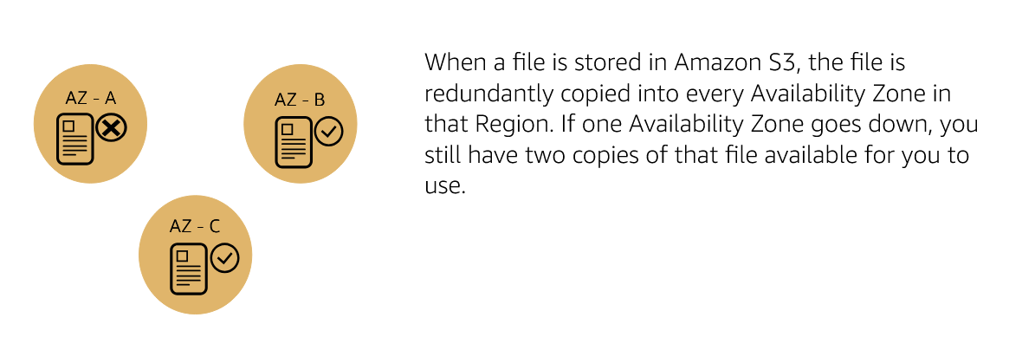
Introduction AWS
Storage

Slide 21
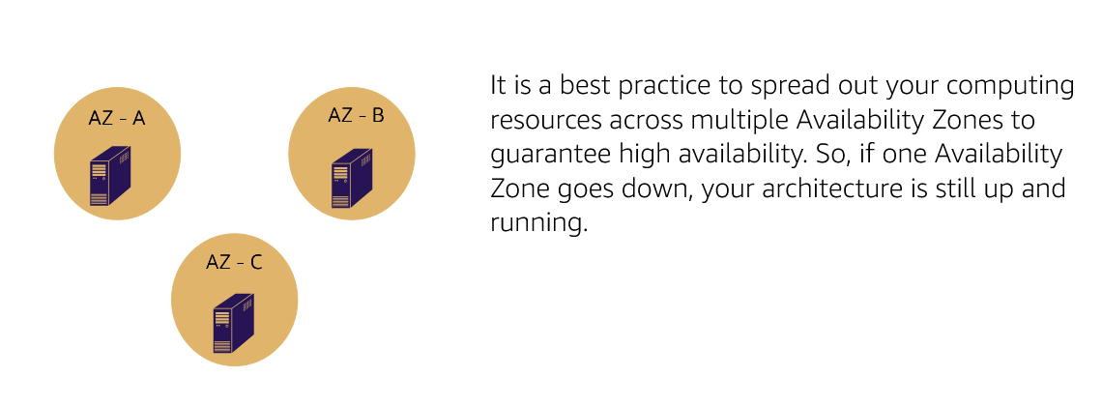
Introduction AWS
Compute

Slide 22
Introduction AWS
Operational Excellence
Security
Reliability
Performance Efficiency
Cost Optimization
Sustainability

Slide 23
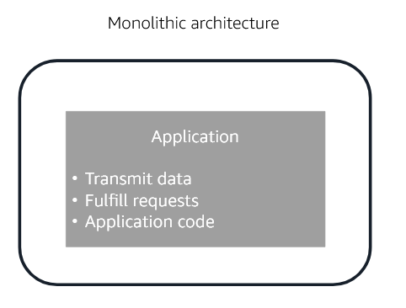
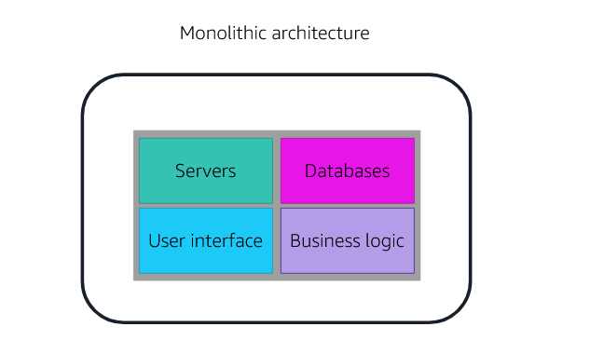
Introduction AWS

Slide 24
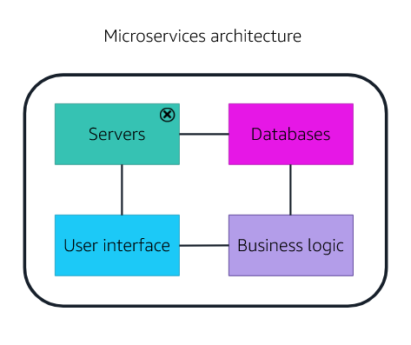
Introduction AWS

Slide 25
Introduction AWS
Managed services
Fully Managed services
Serverless services

Slide 27
DISKRET TUZILMALAR
ORALIQ | 30
YAKUNIY | 30
JAMI | 180

Slide 28
DISKRET TUZILMALAR
Oraliq
17-22 | 3
23-26 | 4
27-30 | 5
Yakuniy
17-22 | 3
23-26 | 4
27-30 | 5

Slide 29
DISKRET TUZILMALAR
Mavzular
RSA kriptografiyasini amalga oshirish.
Eng qisqa yo'lni aniqlash (Deykstra Algoritmi).
Mantiqiy zanjirlar simulyatori.
Permutatsiya va kombinatsiyalar dasturiy to'plami.
Ekvivalentlik munosabatini tekshiruvchi dastur.
Chekli avtomat (Finite-State Machine) simulyatori.

Slide 30
DISKRET TUZILMALAR
Oraliq
Ohirgi haftaning ohirgi darsida
Mustaqil ish topshirmaganlar
Yakuniy va oraliq faqat men beraman
- Baholar, fan muammolari

Slide 31
DISKRET TUZILMALAR
Dars
2ta kech qolish – osha darsga NB
Davomat 5 minut

Slide 32
DISKRET TUZILMALAR
Kerak bo’ladigan bilimlar:
Calculus 1,2
Dasturlash 1,2
Ma’lumotlar tuzilmasi va algoritmlar

Slide 33
DISKRET TUZILMALAR
“Diskret sozi nimani bildiradi?”
Sanoqlik
Alohida alohida hisoblanishi mumkun
Uzluksizlik aksi

Slide 34
DISKRET TUZILMALAR
Sinfdagi talabalarni sanashni tasavvur qiling - sizda 25 yoki 26 talaba bo'lishi mumkin, lekin hech qachon 25,5 talaba bo'lmaydi. Bu diskretlik. Aksincha, o'sha sinfning haroratini o'lchash sizga uzluksiz qiymatlar beradi - u 72,3 daraja, 72,35 daraja yoki oraligidagi istalgan qiymat bo'lishi mumkin.

Slide 35
DISKRET TUZILMALAR
Asosiy Mavzular va Tushunchalar:
Mantiq va Isbotlash Usullari
To'plamlar Nazariyasi va Kombinatorika
Graflar Nazariyasi
Munosabatlar va Funksiyalar
Sonlar Nazariyasi
Daraxtlar va Rekursiya

Slide 36
DISKRET TUZILMALAR
Amaliy Qo'llanmalar:
Kompyuter Tarmoqlari
Kriptografiya va Axborot Xavfsizligi
Ma'lumotlar Bazasi Dizayni va Optimallashtirish
Algoritm Tahlili
AI va ML
Logistika va ish protsessini optimallashtirish

