Slide 1
1. Mobil Dasturlash tillari va muhitlari.
Mobil ilovalar ishlab chiqishda qo’llaniladigan dasturlash tillari (Kotlin, Swift, Js/Typescipt) va dasturlash muhitlari (Android Studio, Xcode, VS Code)

Slide 2



Slide 3
Yillab rivojlanish
Yillab test va tekshiruvlar
Dasturchilar uchun qulay interface va funksiyalar
Hackathon va Startup larga investitsiya

Slide 4
Qurilma ishlab chiquvchilar bilan keng hamkorlik
Qualcomm
MediaTek
Apple (Bionic A chips)
Samsung
HiSilicon

Slide 5
Raqobatchilar hatolari
Windows Phone
Blackberry

Slide 6



Slide 7



Slide 8
Android SDK: dasturchilar uchun qulay intrumentlar va qurilmani boshqarish uchun kerakli interface.
AVD: dasturlangan code ni simulatsiya qilish

Slide 9



Slide 10
Java
public class User {
private String name;
private int age;
public User(String name, int age) {
this.name = name;
this.age = age;
}
public String getName() { return name; }
public void setName(String name) { this.name = name; }
public int getAge() { return age; }
public void setAge(int age) { this.age = age; }
}

Slide 11
Kotlin
data class User(val name: String, val age: Int)

Slide 12
XML
<LinearLayout android:layout_width="match_parent" android:layout_height="match_parent" android:orientation="vertical" android:padding="16dp">
<TextView android:id="@+id/titleText" android:layout_width="wrap_content" android:layout_height="wrap_content" android:text="Welcome to My App" android:textSize="24sp" android:textStyle="bold" />
<Button android:id="@+id/actionButton" android:layout_width="match_parent" android:layout_height="wrap_content" android:text="Click Me"
android:layout_marginTop="16dp" />
</LinearLayout>

Slide 13
@Composable
fun WelcomeScreen() {
Column( modifier = Modifier .fillMaxSize() .padding(16.dp) )
{
Text( text = "Welcome to My App", fontSize = 24.sp, fontWeight = FontWeight.Bold )
Spacer(modifier = Modifier.height(16.dp))
Button( onClick = { /* Handle button click */ }, modifier = Modifier.fillMaxWidth() )
{ Text("Click Me") } }
}

Slide 14
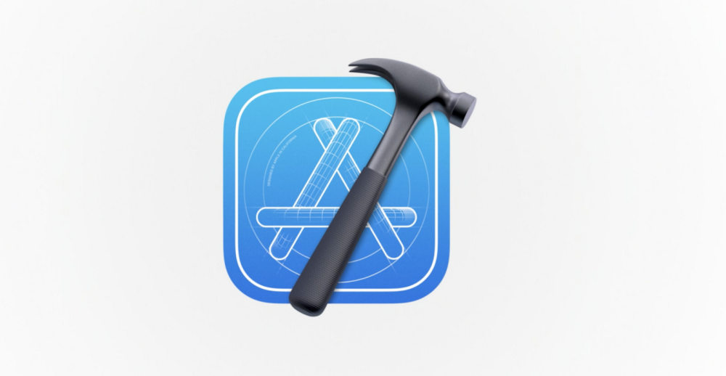

Slide 15
- iOS SDK dasturchilar uchun qulay intrumentlar va qurilmani boshqarish uchun kerakli interface.
iPhone, iPads
UIKit

Slide 16
Objective-C
@interface Person : NSObject
@property (nonatomic, strong) NSString *name;
@property (nonatomic, assign) NSInteger age;
(instancetype)initWithName:(NSString *)name age:(NSInteger)age;
(void)greet; @end
@implementation Person
- (instancetype)initWithName:(NSString *)name age:(NSInteger)age {
self = [super init];
if (self) { _name = name; _age = age; } return self; }
- (void)greet { NSLog(@"Hello, I'm %@", self.name); } @end

Slide 17
Swift
class Person {
let name: String
initialization var age: Int
init(name: String, age: Int)
{ self.name = name self.age = age }
func greet() {
print("Hello, I'm \(name)")}
}
let person = Person(name: "Alice", age: 25) person.greet()

Slide 18
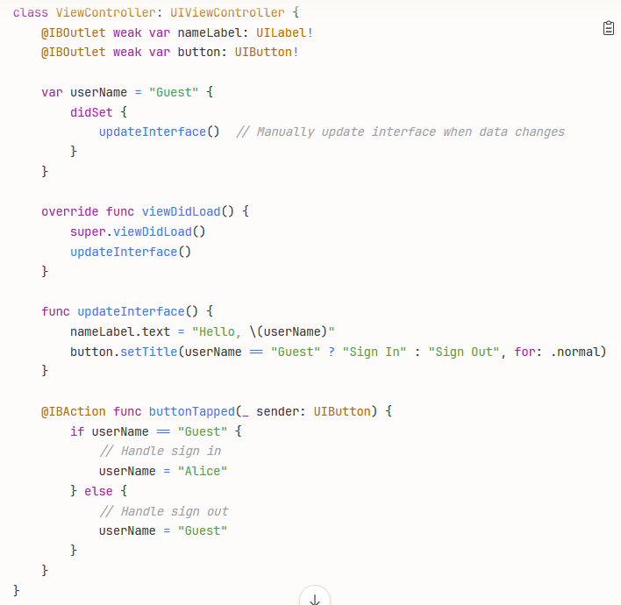

Slide 19
