Slide 1
1. Fizik saqlash tizimlari va arxitekturasi

Slide 2
AGENDA
Fizik saqlash turlari
Magnetik disklar va flash hotira
RAID
Tertiary Storage

Slide 3
Fizik saqlash turlari
Cache
RAM, Main memory
Flash memory
Magnetic Disk
Optical storage, CD, DVD, Blu-ray DVD

Slide 4
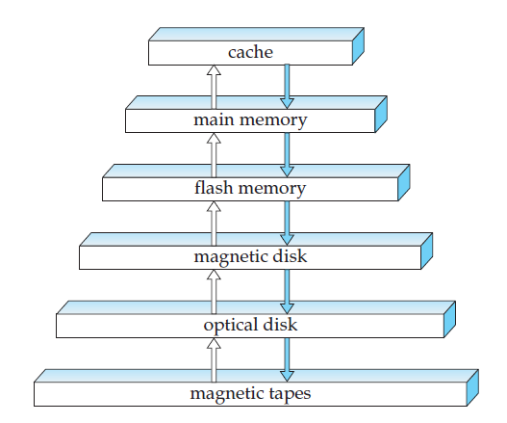
Fizik saqlash turlari

Slide 5
Magnetik disklar va flash hotira
Platter – dumaloq disk, kopincha metal yoki oynakdan yasalgan. Ma’lumotni 2ta tomonga yoziladi.
60, 90, 120, 250 RPM.
Track -> sectore: 512 byte, 50k-100k sector, 1-5 platter

Slide 6
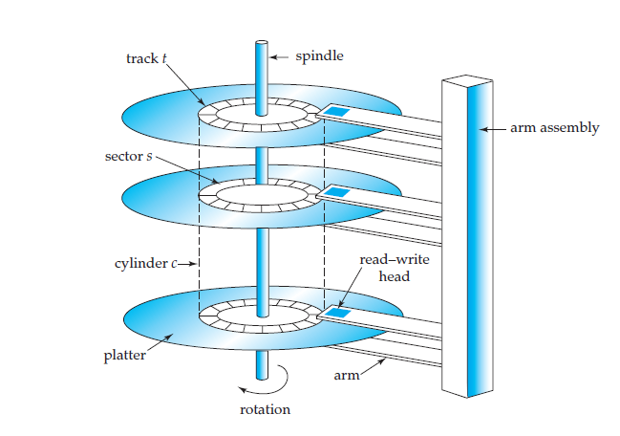
Magnetik disklar va flash hotira

Slide 7
Magnetik disklar va flash hotira
Checksum
SATA, SATA 2, PATA
Small computer system interconnected, SCSI (“scuzzy”)
SAS
Fiber channel interface

Slide 8
Magnetik disklar va flash hotira
Access time
Seek time, 2-30 mllsecs
Rotational latency, 4-11.1 mllsecs
Data-transfer rate, 25-100 Mgb
Access time = seek time + rotational latency

Slide 9
Magnetik disklar va flash hotira
Meant time to failure (MTTF)
500,000 – 1,200,000 = 57 – 136 years!

Slide 10
Magnetik disklar va flash hotira
Virtual memory manager -> block number
1 block = nechtadur yonma yon sectorlar, 512 byte – N kB

Slide 11
Magnetik disklar va flash hotira
Sequential access
Random access

Slide 12
Magnetik disklar va flash hotira
- Buffering
Read ahead
Scheduling, elevator method
File organization
fragmentation

Slide 13
Magnetik disklar va flash hotira
NVRAM
Log disk, journaling file systems.

Slide 14
Magnetik disklar va flash hotira
NOR va NAND
- Writes in parallel

Slide 15
RAID
Redundant array of independent disk.
- mirroring

Slide 16
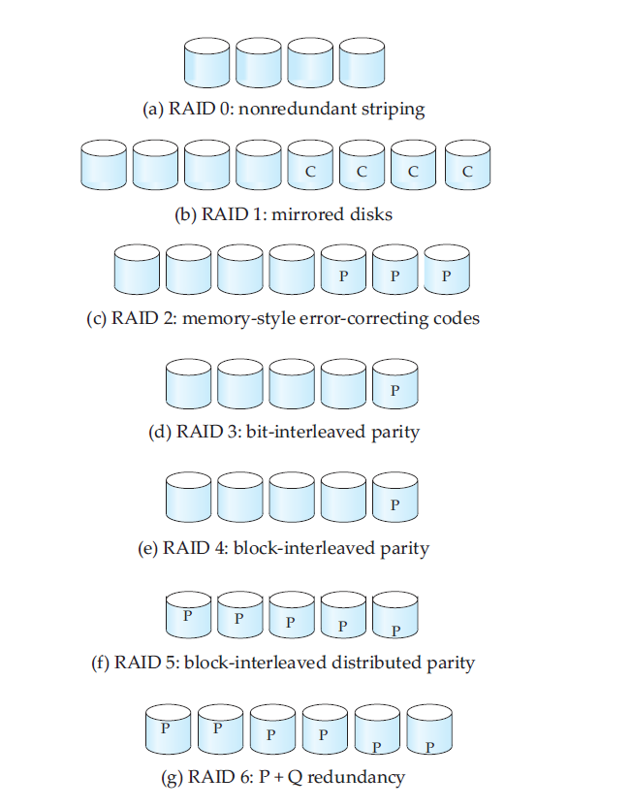
RAID

