Slide 1
Power Point

Slide 2
What we gonna have tdy
What is Power Point
How to give Presentation
Working with texts, images and animation

Slide 3




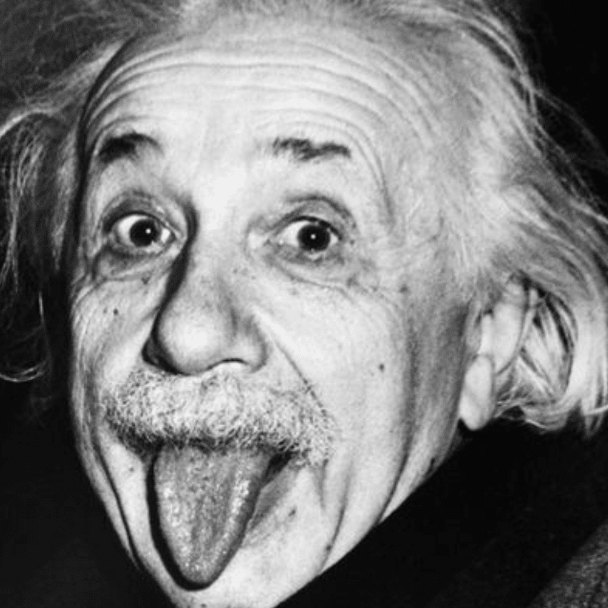

What is PowerPoint

Slide 4
What is the problem with Presentations
They are boring
They are too long

Slide 5

Poor people – students …
Mostly too long

Slide 6

Co workers –
Mostly too long, dull

Slide 7

Rich people – pitching, at most 15 minutes

Slide 8
Don’t have to many words

Slide 9
Economics
Economics focuses on the behaviour and interactions of economic agents and how economies work. Microeconomics analyses what is viewed as basic elements within economies, including individual agents and markets, their interactions, and the outcomes of interactions. Individual agents may include, for example, households, firms, buyers, and sellers. Macroeconomics analyses economies as systems where production, distribution, consumption, savings, and investment expenditure interact; and the factors of production affecting them, such as: labour, capital, land, and enterprise, inflation, economic growth, and public policies that impact these elements. It also seeks to analyse and describe the global economy.

Slide 10
Bullet points are dull
Economics focuses on the behaviour and interactions of economic agents and how economies work.
Microeconomics analyses what is viewed as basic elements within economies, including individual agents and markets, their interactions, and the outcomes of interactions.
Individual agents may include, for example, households, firms, buyers, and sellers.
Use only when necessary!

Slide 11
Better to have …

Slide 12
How to give good presentation
Try to use less words
More visual elements
Same design
One idea per slide
Large, readable text

Slide 13
More visual content rather than bullet points or text.
Large, readable texts.
One idea per slide
A lot words per page.
Badly designed text.
Too many ideas per page.

Slide 14

Is university degree path to career success ?

